Slide 1
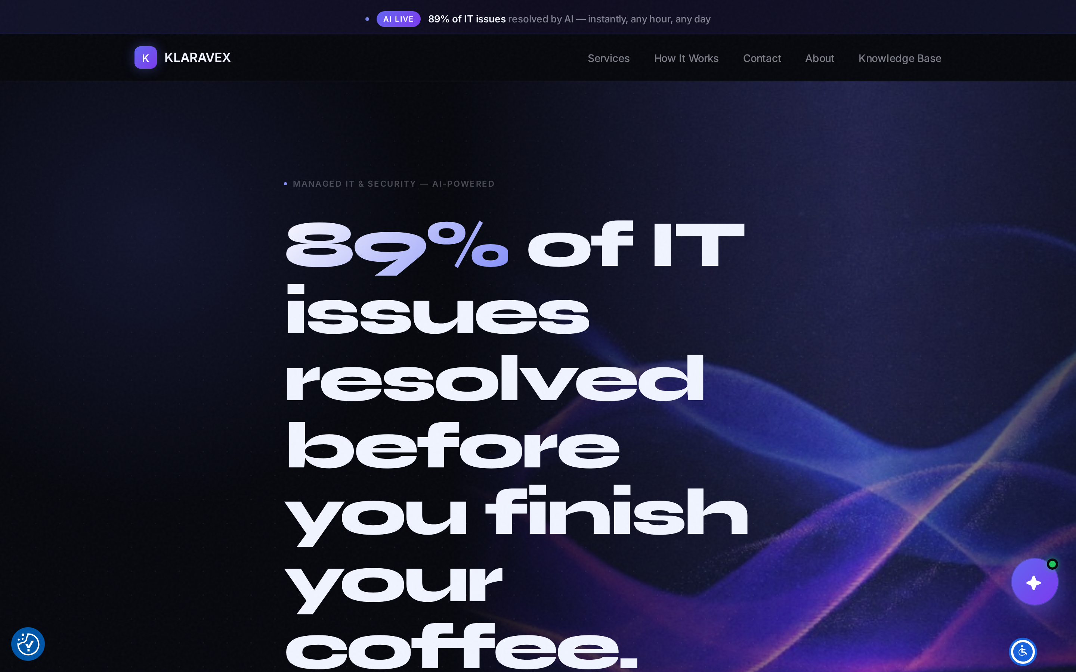
PRODUCT DECK
Klaravex
Managed IT, powered by Klara AI. Two sites. One operating console.
klaravex.com

Slide 2
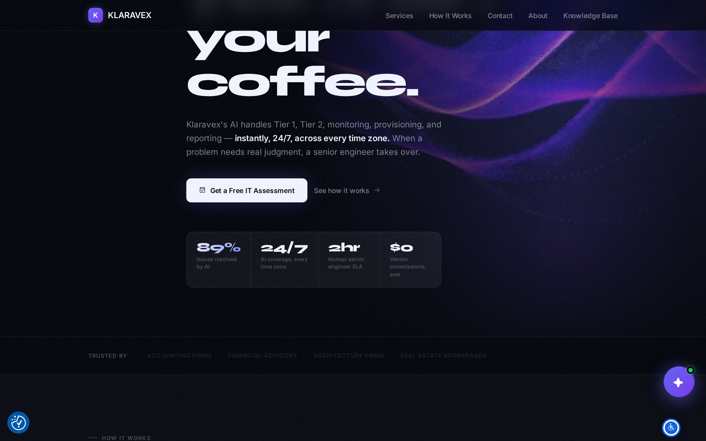
THE COMPANY
AI takes the first call. A senior engineer takes the hard ones.
Klaravex
2 / 8

Slide 3
KLARAVEX
The business site
klaravex.com
Klaravex
3 / 8

Slide 4
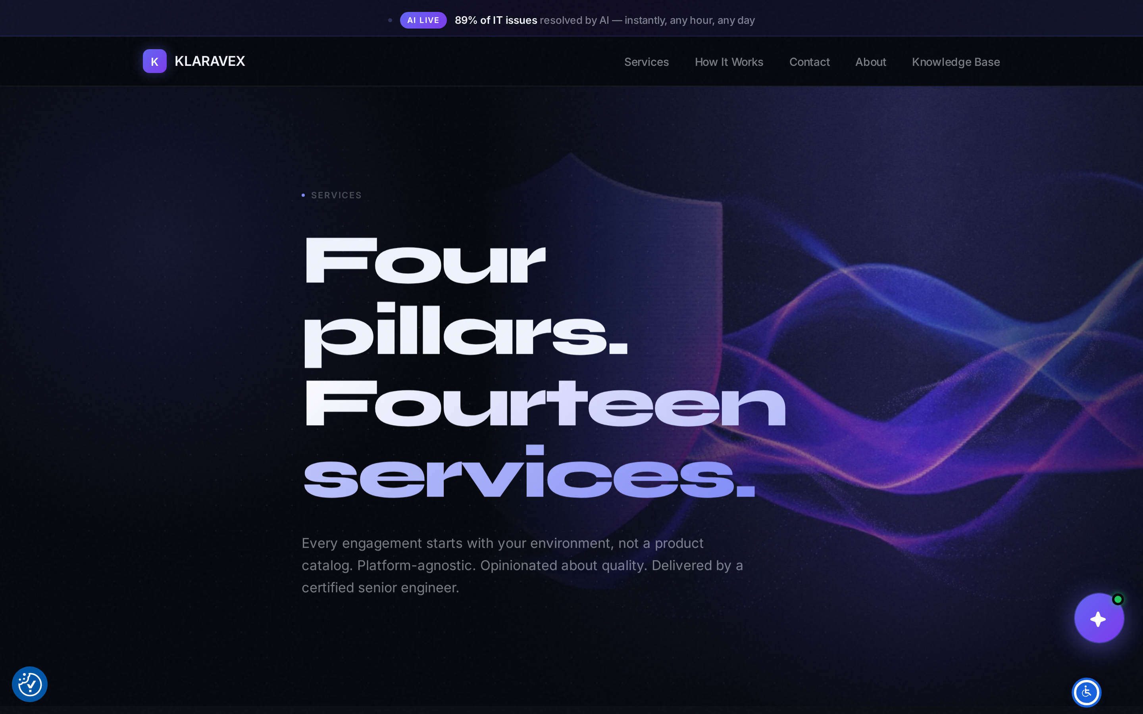
KLARAVEX
What we sell is on the site
Klaravex
4 / 8

Slide 5
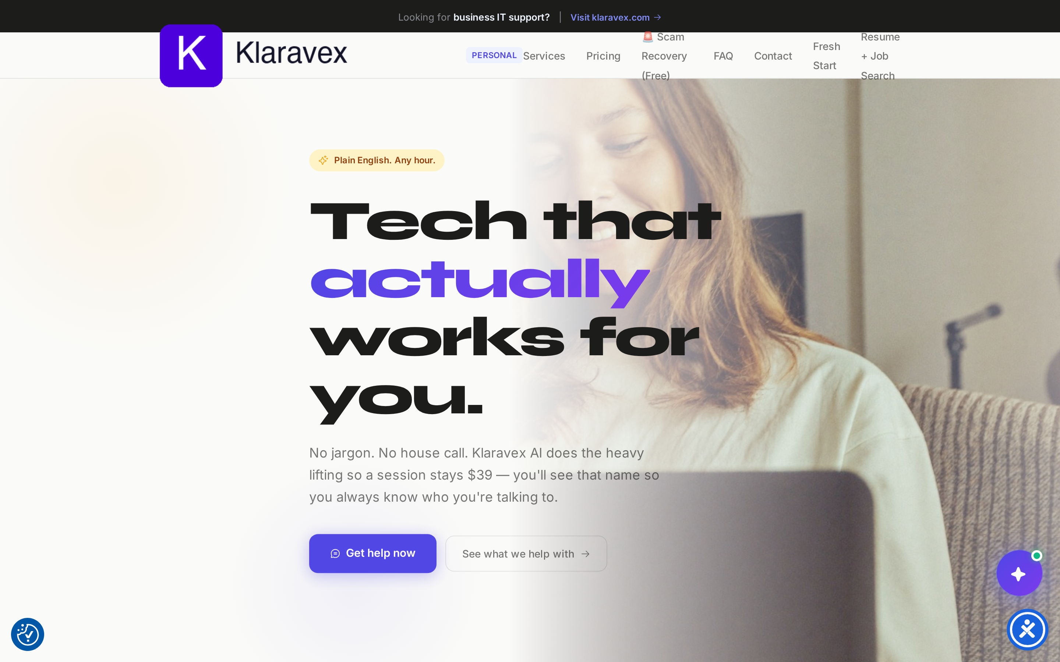
PERSONAL
Home and home-office support
personal.klaravex.com
Klaravex
5 / 8

Slide 6
KLARA AI
The AI on the site. Always labeled.
Klara AI handles everyday IT. A named senior engineer steps in when judgment is required. Clients always know which one they’re talking to.
Klaravex
6 / 8

Slide 7
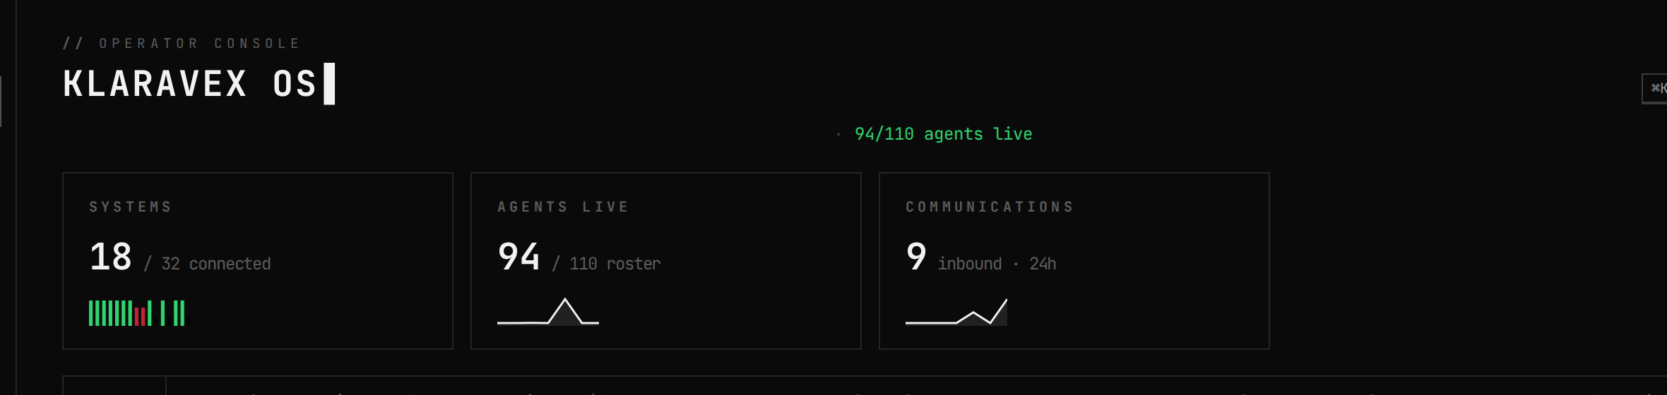
KLARAVEX OS
The operating console
One screen for the company: systems, agents, and communications.
Klaravex
7 / 8

Slide 8
KLARAVEX 2.0
Keeps the sites and the outreach moving.
Content, campaigns, and conversations that point back to the two websites. Not a second product — the growth layer behind this one.
Klaravex
8 / 8

