Slide 1
Concept
Identify stakeholders' needs
Explore concepts
Propose viable solutions
Development
Refine system requirements
Create solution description
Build system
Verify and validate system
Production
Produce systems
Inspect and test
Utilisation
Operate system to satisfy users' needs
Support
Provide sustained system capability
Retirement
Store, archive or dispose of system

Slide 2
Development
Concept
Production
Utilisation
Retirement
Support

Slide 3
Power / influence
Keep
satisfied
Manage closely
High
Monitor
Keep informed
Low
Interest /
importance
Low
High

Slide 4

push
fetch
deploy
deploy
Development
Test
Live
Project
├ Dir1
│ └ File1
├ File2
└ File3
Project
├ Dir1
│ └ File1
├ File2
└ File3
Project
├ Dir1
│ └ File1
├ File2
└ File3
Workstation / laptop
Server / cloud
Server / cloud

Slide 5
Analysis
Design
Implementation
Testing
Maintenance

Slide 6
1
Increment 1
2
3
4
5
1
Increment 2
2
3
4
5
1
Increment 3
2
3
4
5
Time

Slide 7
Analysis
Design
Implementation
Testing
Maintenance

Slide 8
Requirements
Acceptance testing
Analysis
System testing
High-level design
Integration testing
Low-level design
Unit testing
Coding

Slide 9
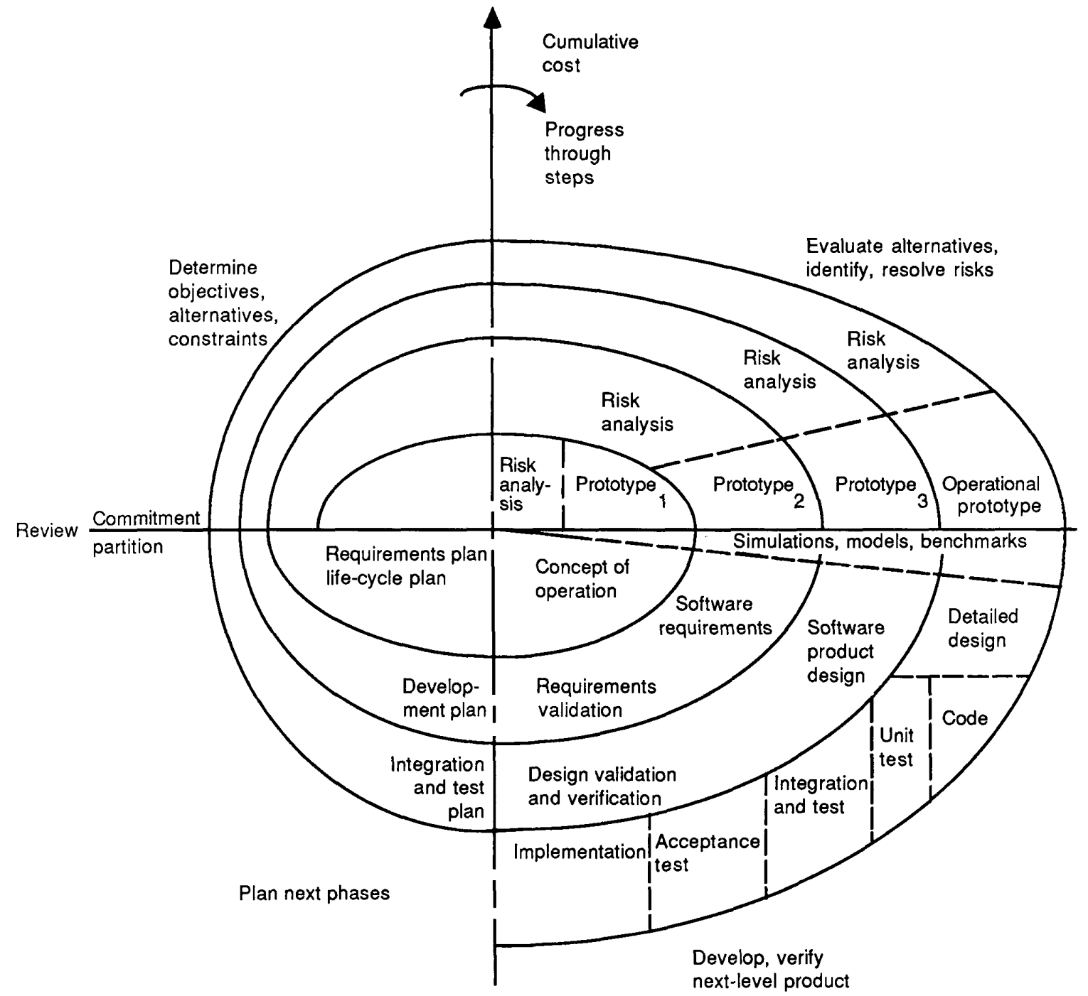

Slide 10
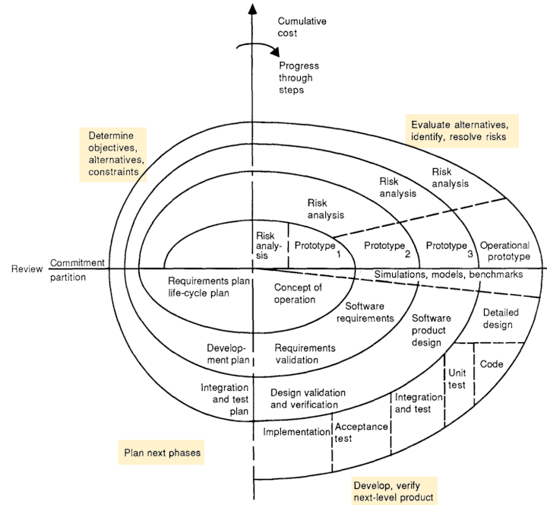
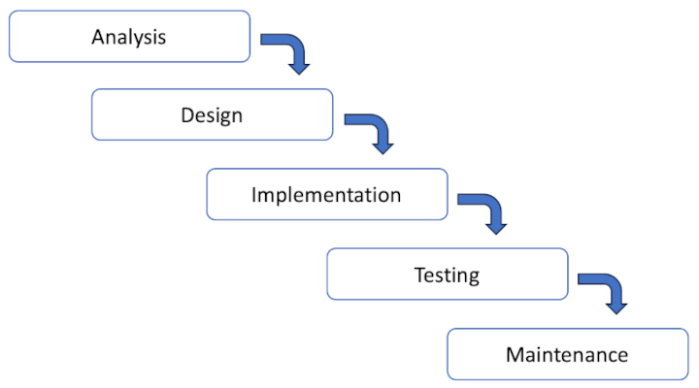
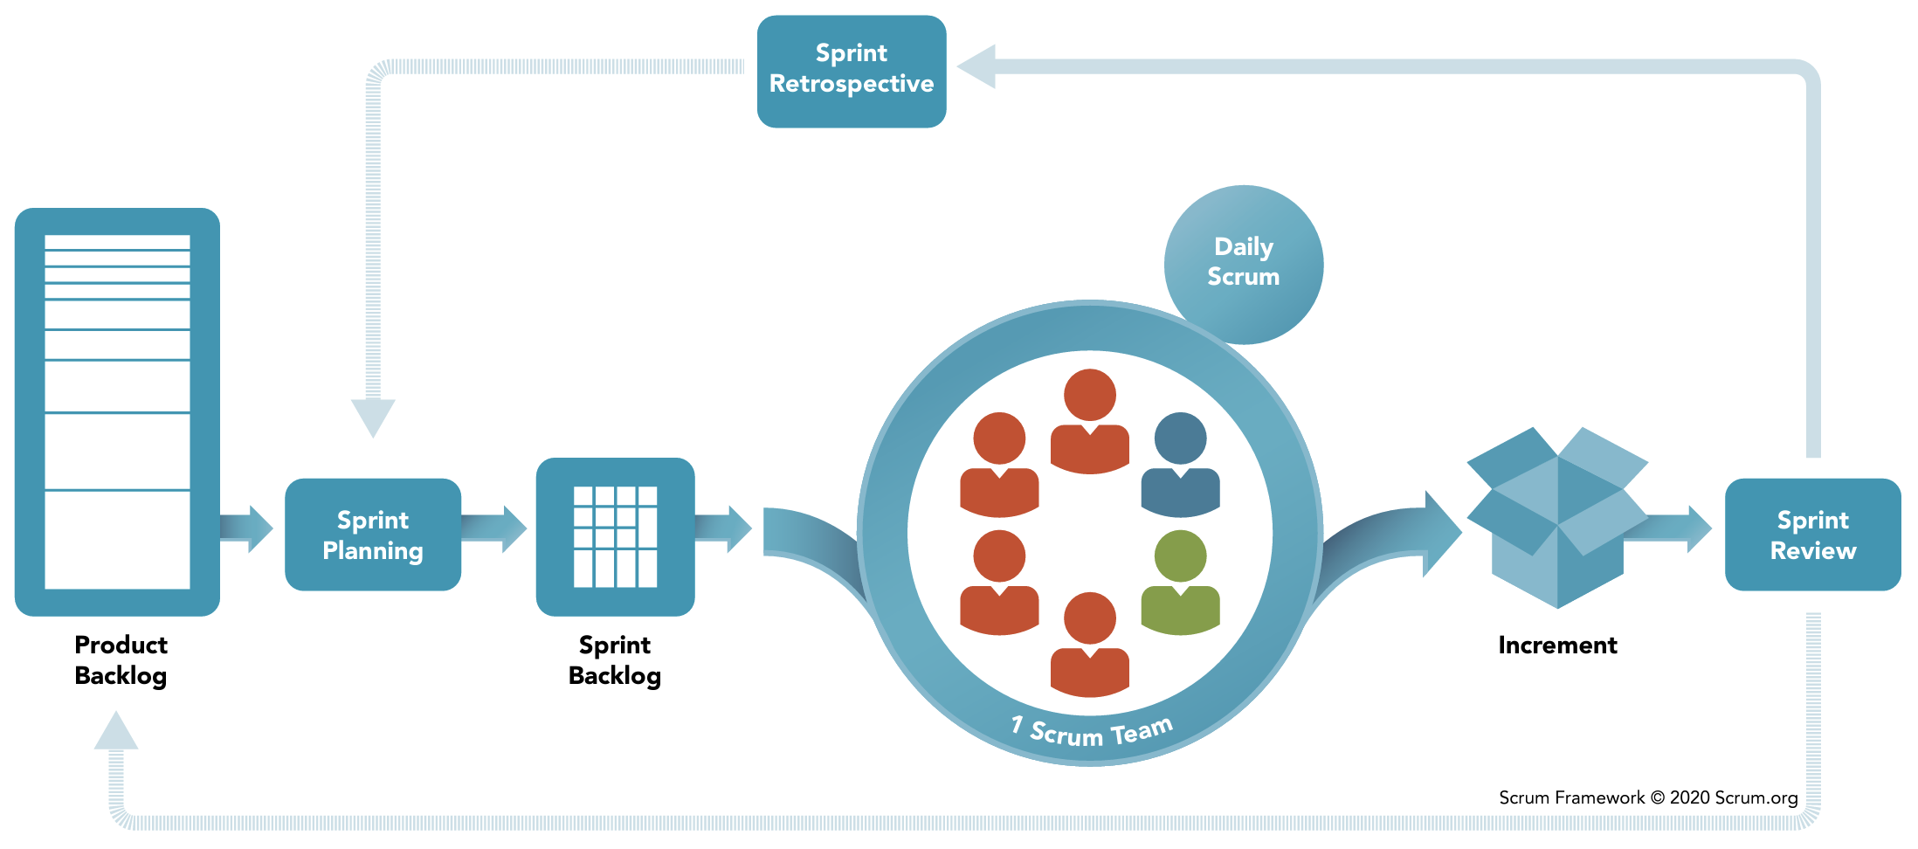
Environment
System
Inputs
Outputs
Feedback

