Slide 1
Concept
Identify stakeholders' needs
Explore concepts
Propose viable solutions
Development
Refine system requirements
Create solution description
Build system
Verify and validate system
Production
Produce systems
Inspect and test
Utilisation
Operate system to satisfy users' needs
Support
Provide sustained system capability
Retirement
Store, archive or dispose of system

Slide 2
Development
Concept
Production
Utilisation
Retirement
Support

Slide 3
Power / influence
Keep
satisfied
Manage closely
High
Monitor
Keep informed
Low
Interest /
importance
Low
High

Slide 4

push
fetch
deploy
deploy
Development
Test
Live
Project
├ Dir1
│ └ File1
├ File2
└ File3
Project
├ Dir1
│ └ File1
├ File2
└ File3
Project
├ Dir1
│ └ File1
├ File2
└ File3
Workstation / laptop
Server / cloud
Server / cloud

Slide 5
Analysis
Design
Implementation
Testing
Maintenance

Slide 6
1
Increment 1
2
3
4
5
1
Increment 2
2
3
4
5
1
Increment 3
2
3
4
5
Time

Slide 7
Analysis
Design
Implementation
Testing
Maintenance

Slide 8
Requirements
Acceptance testing
Analysis
System testing
High-level design
Integration testing
Low-level design
Unit testing
Coding

Slide 9
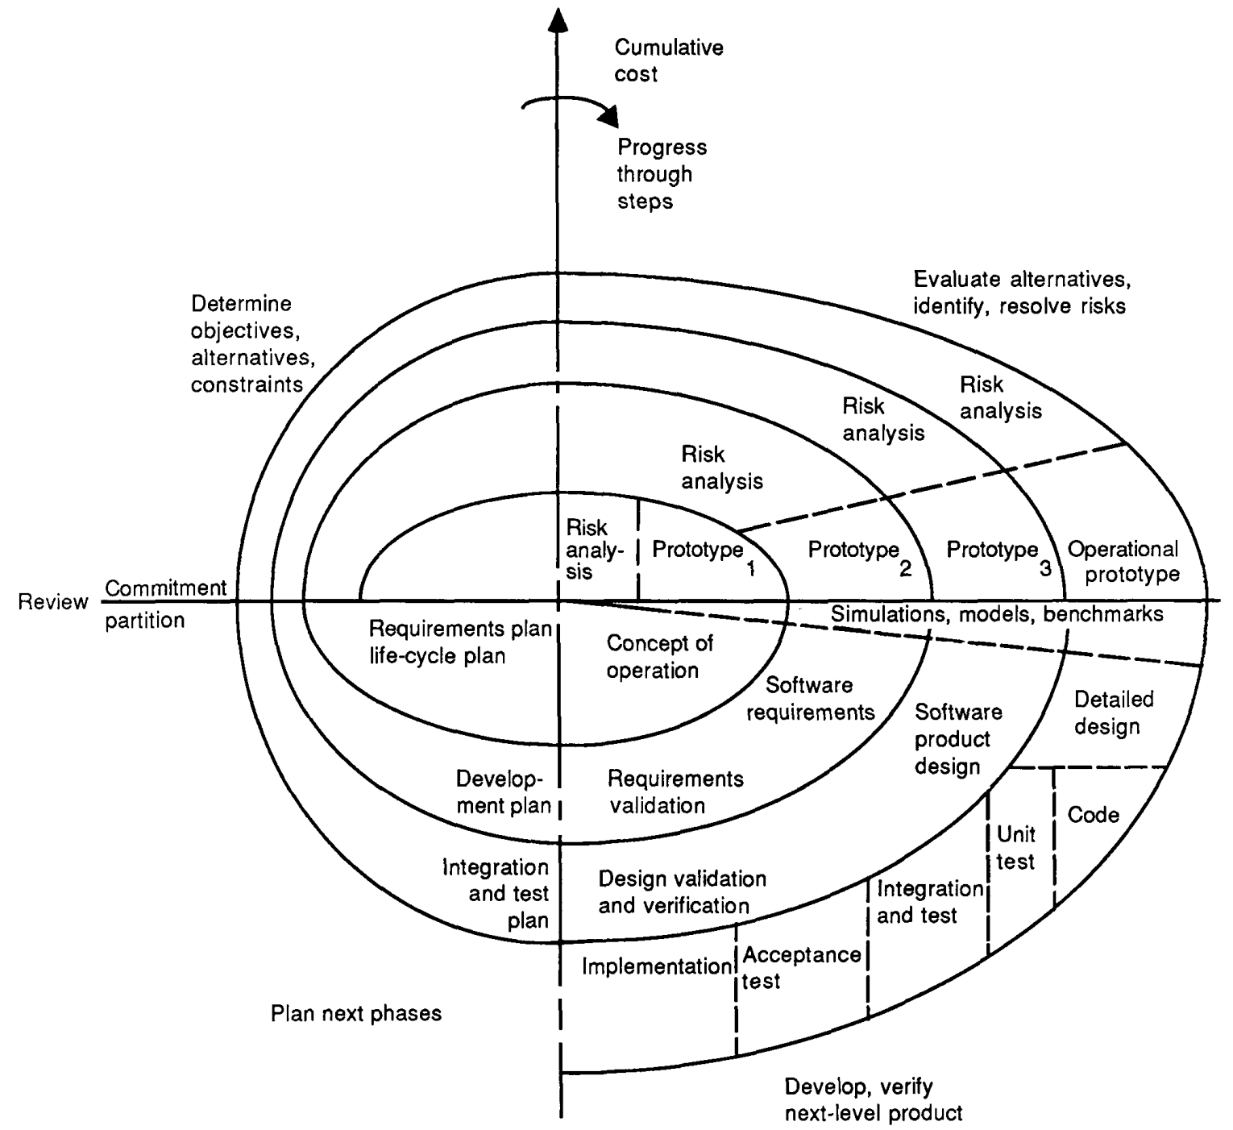

Slide 10
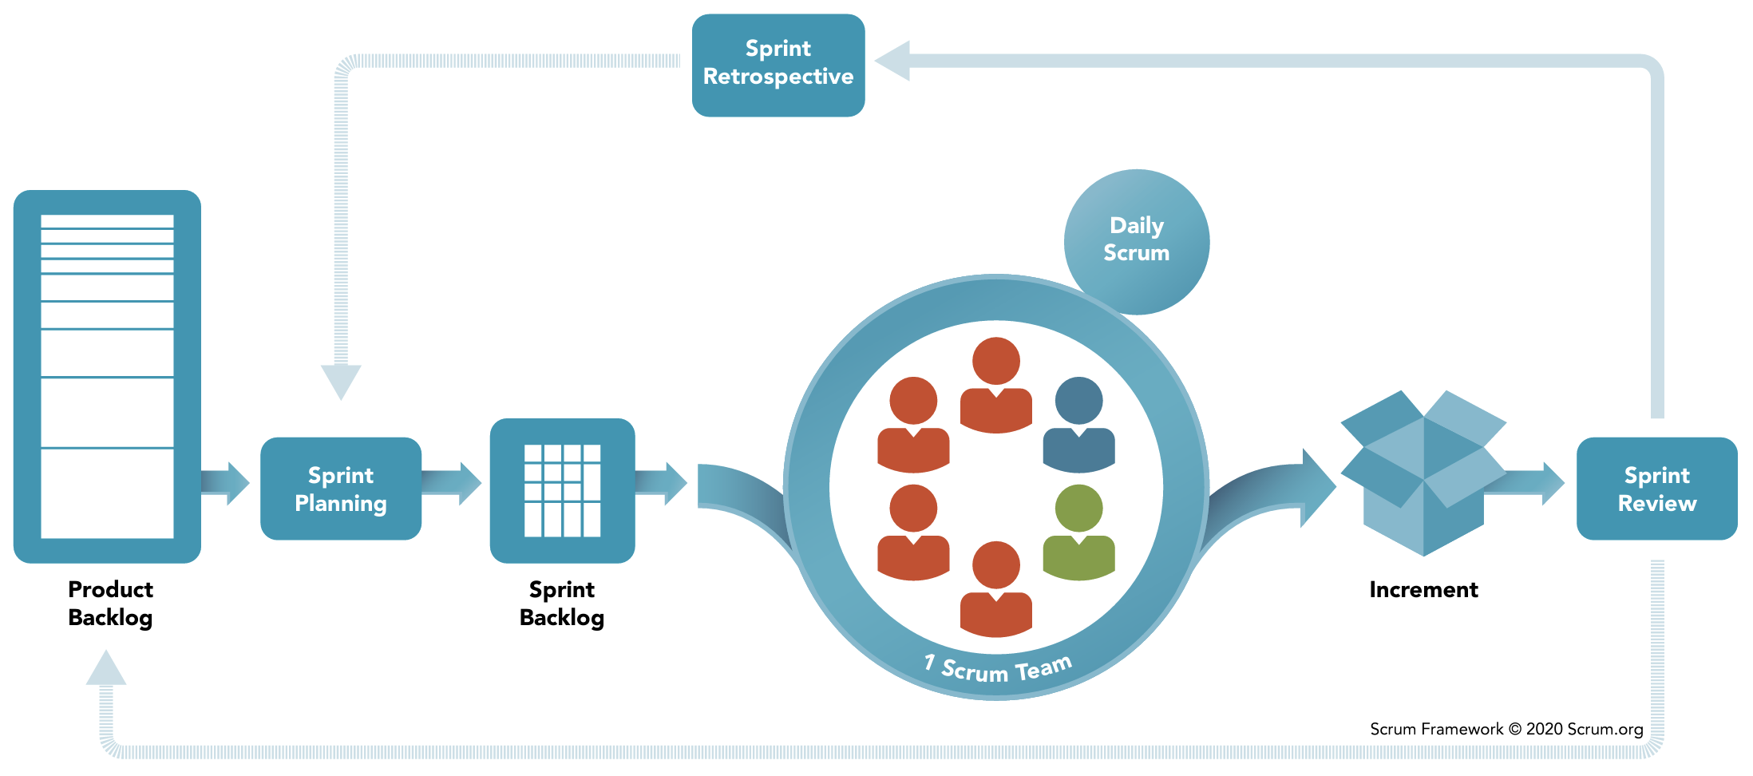
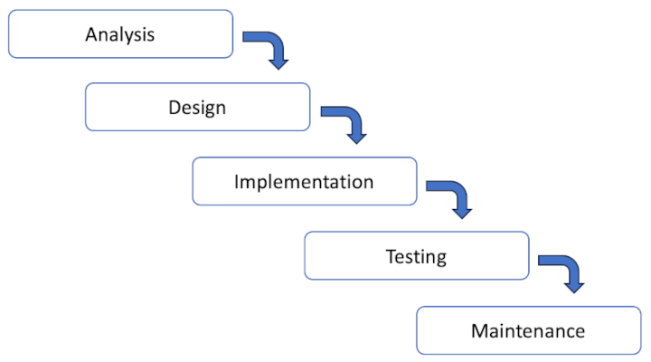
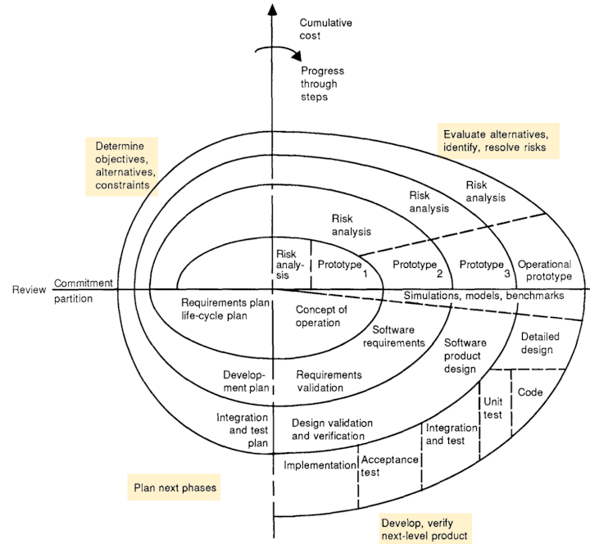
BS ISO/IEC 25000:2014
Environment
System
Inputs
Outputs
Feedback

Slide 11
Effect of
software product
Process
Software product
Influences
Influences
Influences
Quality in use
External properties
Quality in use
Process quality
Internal properties
Quality in use
Contexts of use
Depends on
Depends on
Depends on
Process
measures
Internal
measures
External
measures
Quality in use
measures

Slide 12
Class A
Object 1
id | column_a | column_b
1
2
Id
Property a: “….”
Property b: 999
Property c:
ORM
id | column_x | column_y | FK
100 |  |  | 1
101 |  |  | 1
102 |  |  | 1
103 |  |  | 1
104 |  |  | 2
105 |  |  | 2
Object 2
Id
Property a: “….”
Property b: 999
Property c:

Slide 13
Make changes to class definitions
Generate migration scripts
Apply changes to the database
The software engineer updates the code.
The ORM generates uprade and downgrade scripts. Scripts contain data definition statements such as ALTER TABLE.
The ORM applies the upgrade script to the database.

Slide 14
Initial project requirements
High level design
Low level design
Final product
Generate high level descriptions
Evaluate against requirements
Repeat
Generate module code
Apply standards, debug, test, integrate
Refactor
Repeat

Slide 15
Windows
Mac/Linux
C:\
│
├─ Program Files\
│ │
│ ├─ Application\
│ │ │
│ │ ├─┄
│ ╎ ╎
│
├─ Program Files (x86)\
│
├─ Windows\
│ │
│ ├─ System\
│ │ ╎
│ │
│ ├─ System32\
╎ ╎ ╎
/
├─ bin/
│
├─ etc/
│
├─ usr/
│ │
│ ├─ bin/
│ │
│ ├─ local/
│ │ │
│ │ ├─ bin/
│ ╎ ╎
│
├─ opt/
│
├─ home/
│ │
│ ├─ bin/
│ │ ╎

Slide 16
Database

