Slide 1
Wasserstein Distributionally Robust Adaptive Filtering (DRiFt)
26 JUN 2026

Slide 2
Jackal Experiments
Available information
RTK GPS (Ground Truth) – higher quality
Jackal GPS – lower quality
IMU
Wheel Odometry

Slide 3
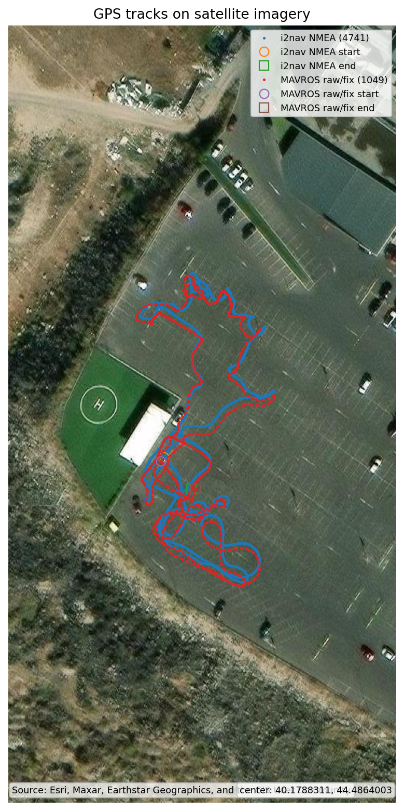
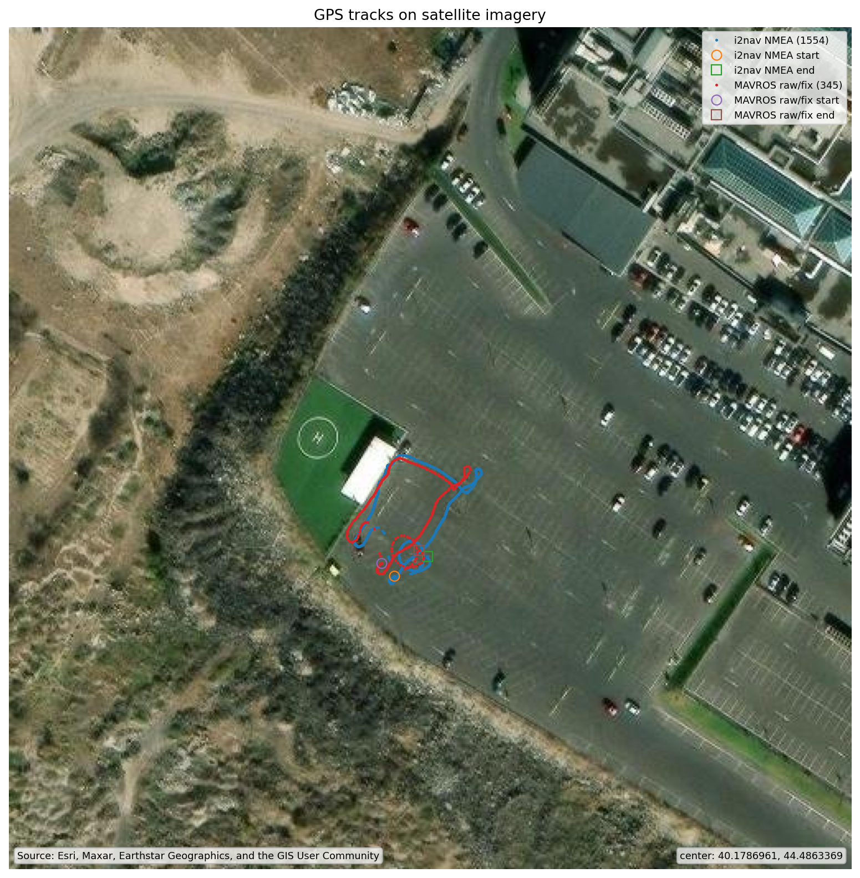
Jackal Experiments
Trajectory 1
Trajectory 2

Slide 4
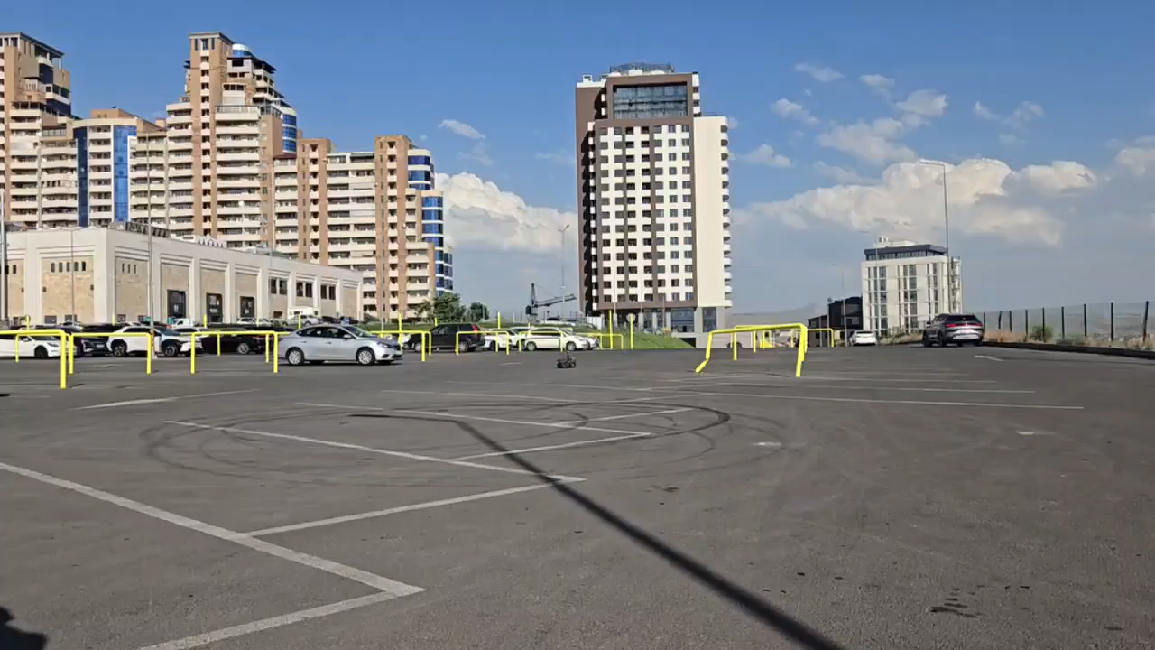
Jackal Experiments

Slide 5
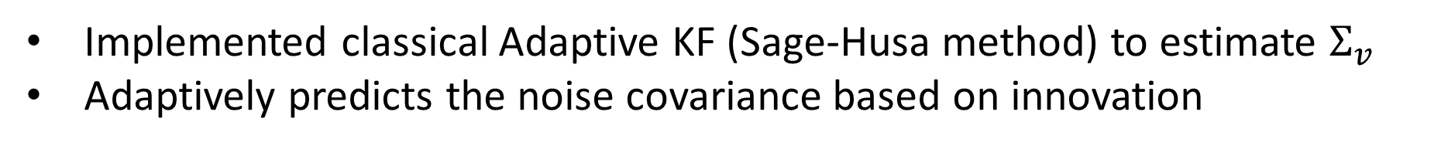
Jackal Experiments
Sage, Andrew P., and Gary W. Husa. "Adaptive filtering with unknown prior statistics." Joint Automatic Control Conference. No. 7. 1969.
Implemented classical Adaptive KF (Sage-Husa method) to estimate $Σ_{v}$
Adaptively predicts the noise covariance based on innovation

Slide 6
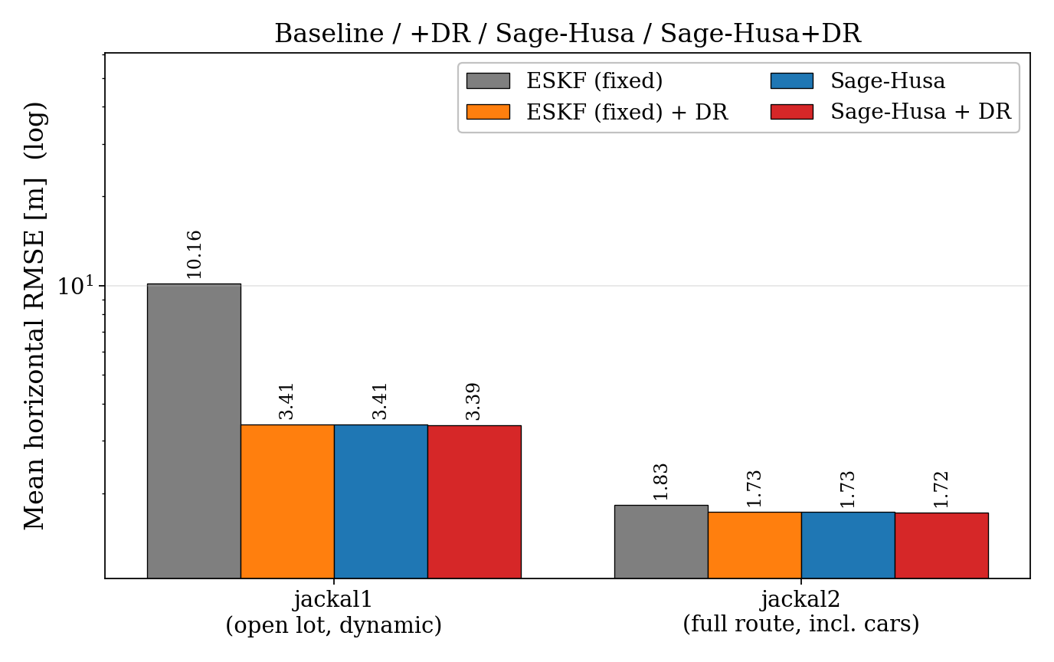
GPS + IMU (No wheel odometry)
Adaptive module that predicts $Σ_{v}$ is redundant with our DR module

Slide 7
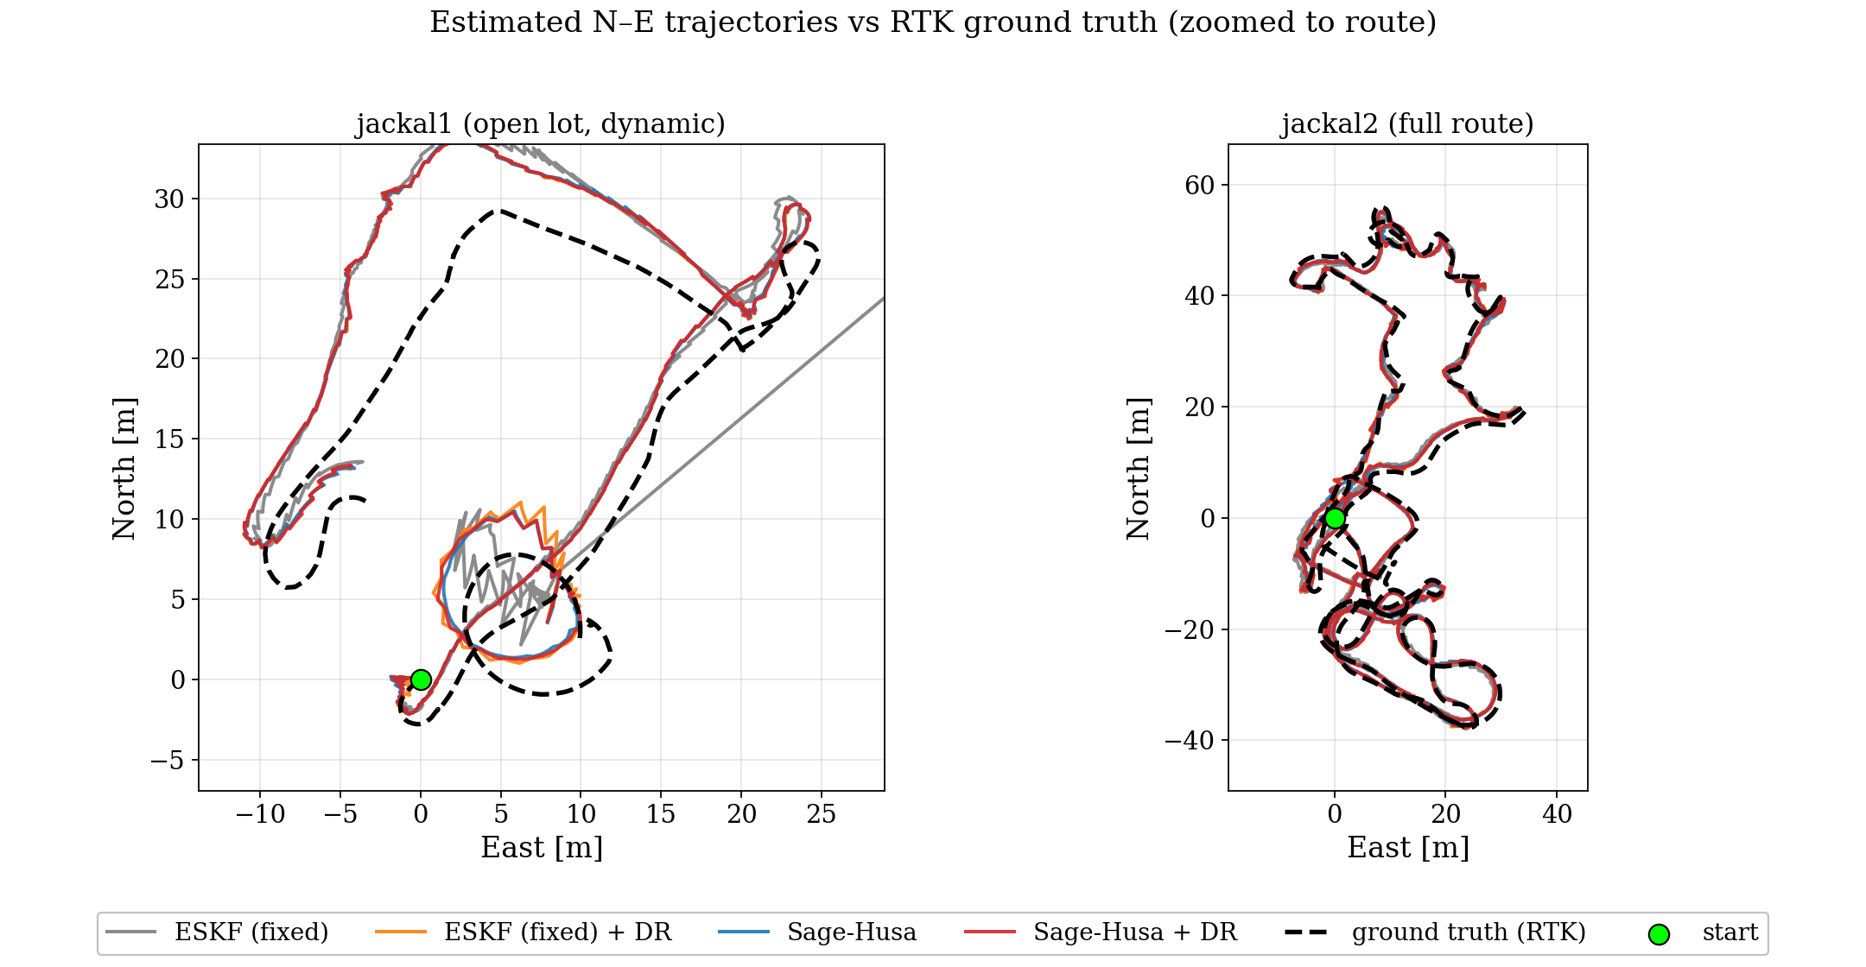
No sensor

Slide 8
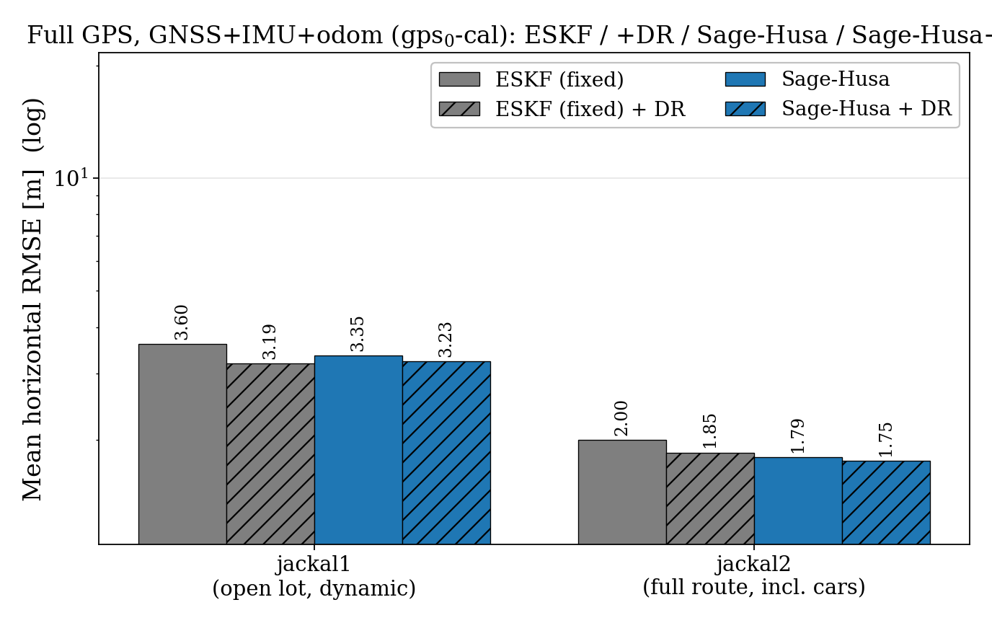
GPS + IMU + Wheel Odometry
Adaptive module + DR module works,
but not dramatic

Slide 9
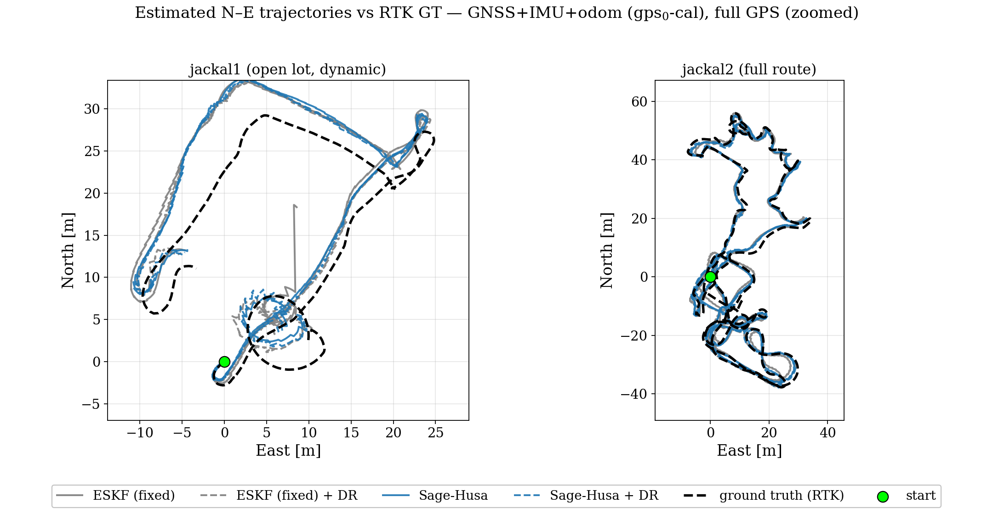
GPS + IMU + Wheel Odometry

Slide 10
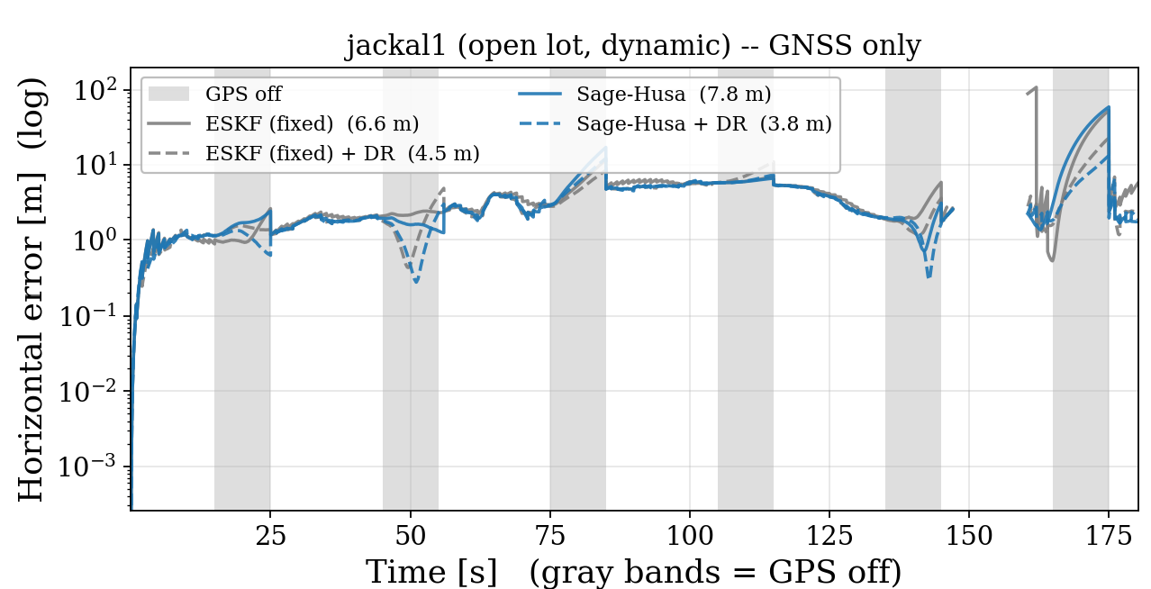
GPS Outage Scenarios

Slide 11
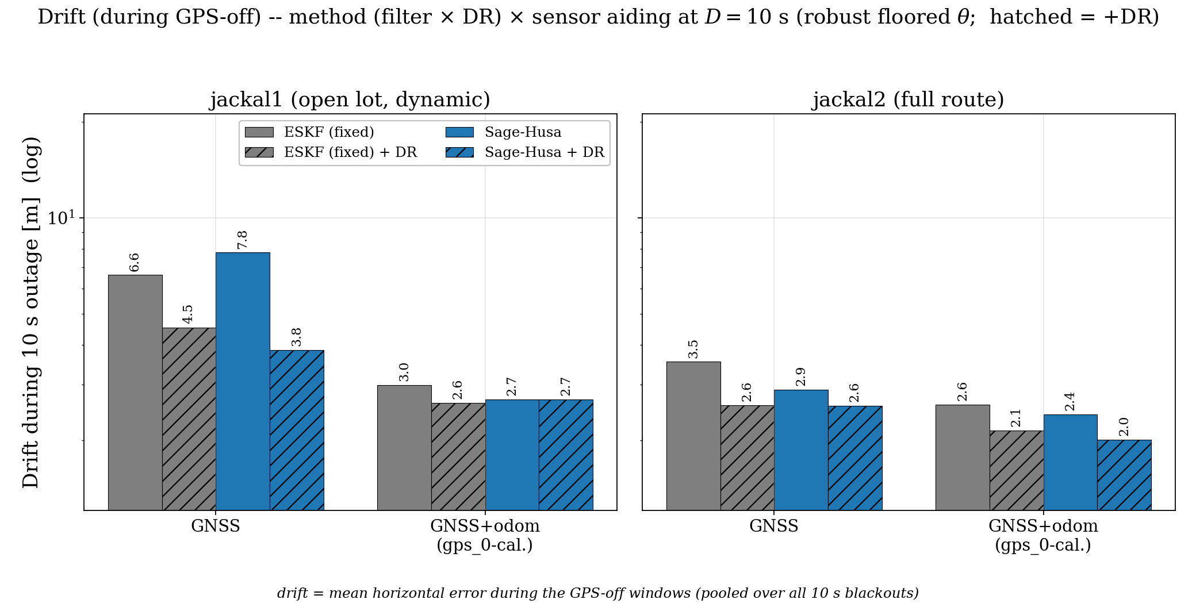
GPS Outage Scenarios – 10 seconds
Adding Odometry helps GPS outage scenarios
Adding Odometry helps GPS outage scenarios

