Slide 1

Project Title – Seasonal Agriculture Performance Analysis
Student Name-Astha Marchattiwar
College Name- Indus Institute of Technology and Engineering
AICTE STU ID : STU6a6256fe207ab1784829694

Slide 2

PROBLEM STATEMENT
Agricultural activities are influenced by seasonal variations in environmental conditions, farming practices, resource availability and market conditions. As a result, agricultural performance may differ from one season to another. However, raw agricultural data does not clearly explain how agricultural performance changes across seasons or what patterns can be observed in different seasonal conditions. The problem is to analyze the given agricultural dataset and investigate seasonal differences in agricultural performance by identifying meaningful patterns, trends, relationships and variations within the available data.

Slide 3
Project Description
This project focuses on analyzing agricultural data collected across different seasons, geographical areas and farming conditions.
The project involves:
1.Exploring and understanding the dataset
2.Cleaning and preparing the data
3.Performing statistical analysis
4.Comparing agricultural performance across seasons
5.Analyzing relationships between important variables
6.Visualizing seasonal patterns
7.Identifying meaningful insights
8.Providing evidence-based recommendations

Slide 4

WHO ARE THE END USERS?
Farmers – To understand seasonal agricultural performance and resource usage.
Agricultural Planners – To support seasonal agricultural planning.
Agricultural Researchers – To study seasonal patterns and relationships.
Agricultural Organizations – To compare performance and identify areas requiring further investigation.
Policy and Planning Stakeholders – To support evidence-based agricultural decision-making.

Slide 5

Technology Used
Programming Language
Python
Libraries
Pandas
NumPy
Matplotlib
Development Environment
Google Colab

Slide 6
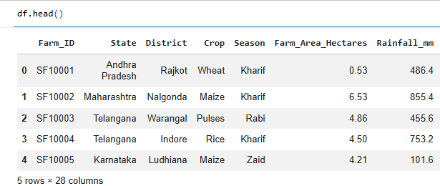
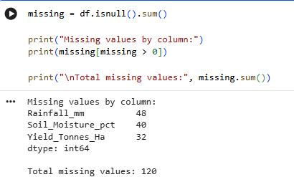
RESULTS-DATASET & DATA PREPARATION
Key Findings
Dataset contains 4000 records and 28 variables.
Missing values were identified in rainfall, soil moisture and yield.

Slide 7
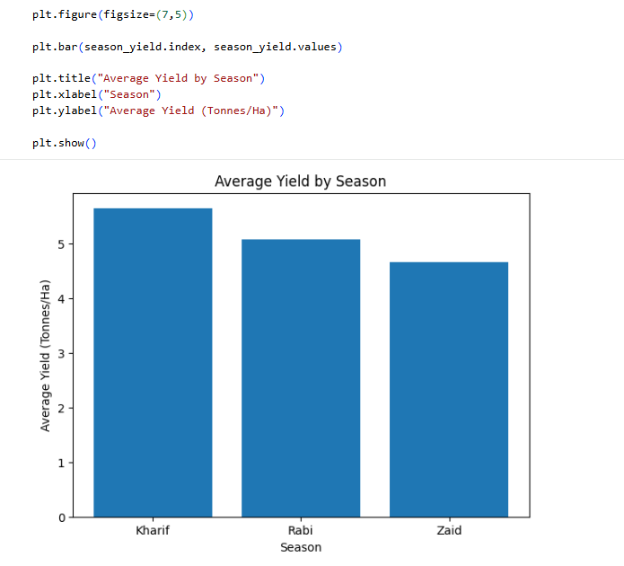
RESULT-SEASONAL YIELD PERFORMANCE
Finding
Kharif records the highest average yield.
Rabi has intermediate average yield.
Zaid records the lowest average yield.
Therefore, agricultural yield varies across seasons.

Slide 8
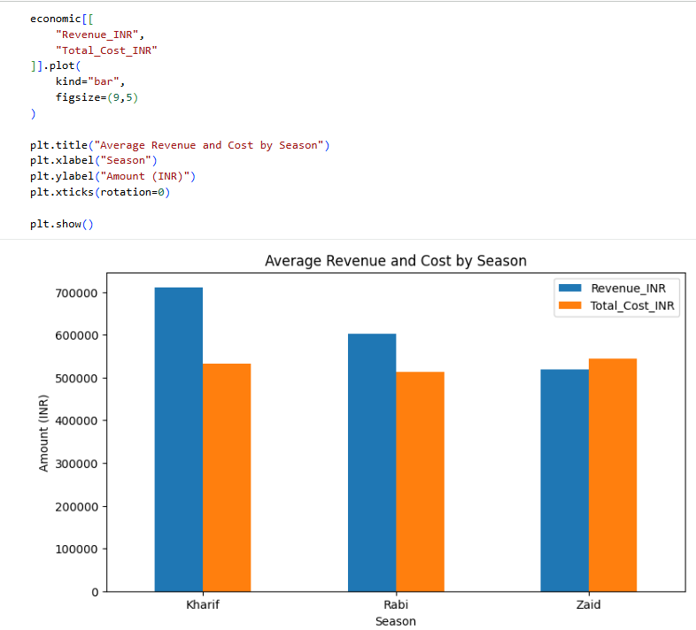
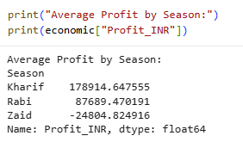
RESULTS-SEASONAL ECONOMIC PERFORMANCE
Finding
Kharif records the highest average revenue.
Kharif records the highest average profit.
Zaid shows the weakest economic performance.
Economic outcomes therefore differ across seasons.

Slide 9
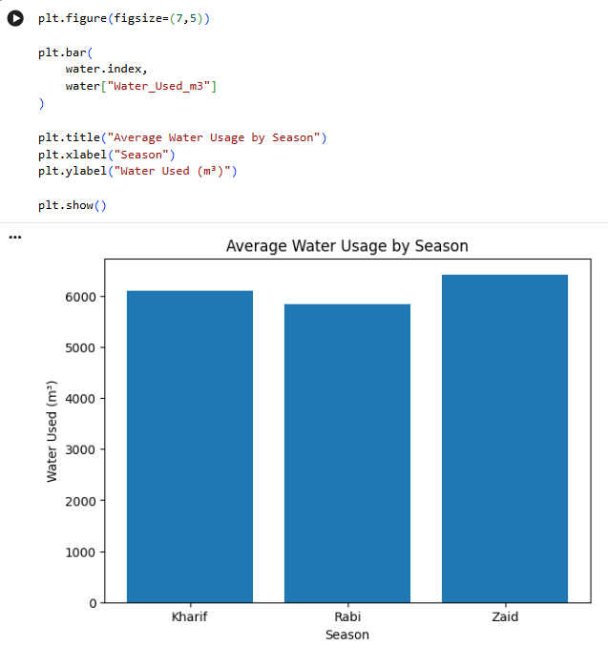
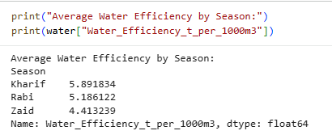
RESULTS-WATER USAGE & EFFICIENCY
Finding
Zaid records the highest average water usage.
Zaid records the lowest average water-use efficiency.
Water-resource utilization varies across seasons.
This represents an important seasonal difference in resource usage.

Slide 10
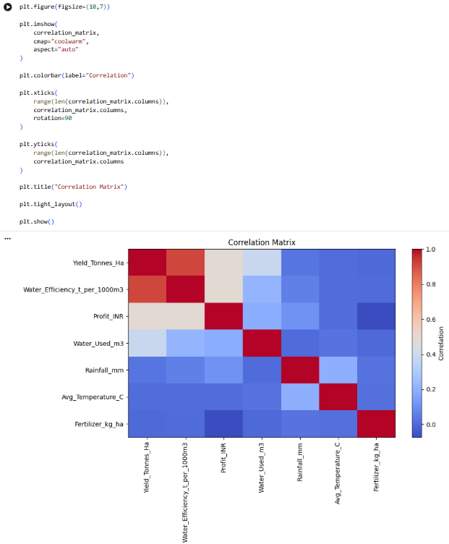
RESULTS-CORRELATION MATRIX

Slide 11
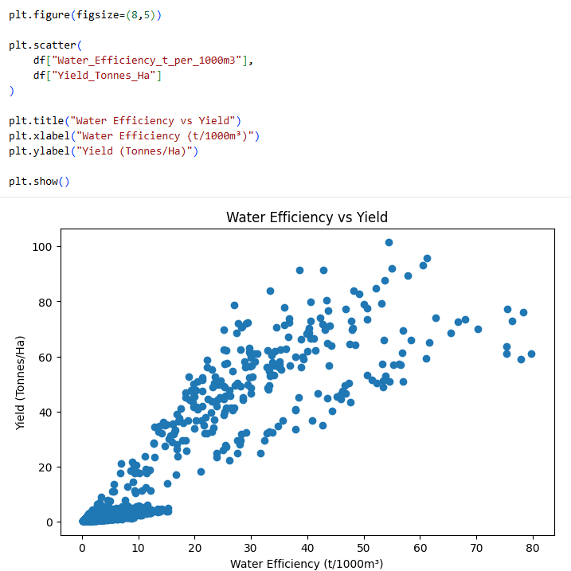
RESULTS-WATER EFFICIENCY V/S YIELD SCATTER PLOT

Slide 12
Future scope
Extend the analysis using data from more years and geographical regions.
Analyze seasonal patterns at state, district and crop levels.
Include additional environmental and soil-related variables.
Study seasonal trends over longer periods.
Integrate more detailed market and weather information.
Develop interactive visualizations for easier exploration of agricultural data.
Future studies may use predictive techniques after sufficient historical data is available.

Slide 13
GitHub Link
https://github.com/astha-marc/Seasonal-Agriculture-Performance-Analysis.git

Slide 14

VOIS Course completion certificate -
Course name- Data Visualization

Slide 15
Thank you
.
.

