Slide 1
EXPLORATORY DATA ANALYSIS
Employee Wellness Analysis
Who seeks mental health treatment at work, and what XYZ Technical Solutions can do about it
Employee mental-health survey · 1,048 responses · 28 attributes

Slide 2
Why study mental health at work?
INTRODUCTION
THE CENTRAL QUESTION
Why it matters
!
XYZ lost an important employee to a health crisis. Leadership wants evidence on who is at risk and where support gaps lie.
Which employees need, or may soon need, mental health support, and what drives them to seek it?
Our approach
?
Clean the survey data, run 12 targeted analyses in 4 themes, and turn the patterns into recommendations.
Deliverables
✓
A documented Jupyter notebook with all code and charts, plus this presentation.
12 analyses • 4 categories • 1 notebook

Slide 3
Workplace mental-health survey, 1,048 respondents
DATASET BACKGROUND
1,048
28
61%
48.9%
survey responses
attributes
from the US
sought treatment
One row per employee
Demographic, workplace, support, attitudes
UK 15%, Canada 6%
Target variable: treatment
Target: treatment (Yes / No), whether the employee has sought mental health treatment.
Messy by design: free-text gender, impossible ages, Excel-corrupted labels and heavy missingness all needed fixing before any chart could be trusted.

Slide 4
Four families of variables
UNDERSTANDING THE DATA
1
Demographic
2
Workplace factors
Age, Gender, Country, state
Company size, remote work, tech company, self-employed
3
Employer support
4
Attitudes & outcomes
Benefits, care options, wellness programme, seek help, anonymity, leave
Family history, work interference, disclosure willingness, stigma, and the target: treatment

Slide 5
Cleaning and feature engineering
DATA PREPARATION
Added columns
Preparation steps
Age_clean
Ages 18–75 kept, rest set to NaN
Profiled shape, dtypes, missing values and duplicates (0 found)
Fixed 6 impossible ages by treating them as missing
Collapsed 37 gender spellings into 3 groups
Repaired Excel auto-dated company sizes
Imputed, labelled or dropped missing values
Gender_clean
Male / Female / Other-Non-binary
no_employees_clean
Restored labels, ordered categories
work_interfere_clean
Blank → 'Not Applicable'
age_bin
Seven age bands for charts

Slide 6
Four problems found, four fixes applied
DATA QUALITY
1
2
3
4
Age outliers
Messy gender
Corrupted labels
Missing values
Problem
Problem
Problem
Problem
-1726 to 99,999,999,999 in raw data
37 free-text spellings
'25-Jun' and '5-Jan' in company size
self_employed 18, work_interfere 236, comments 916
Fix
Fix
Fix
Fix
6 invalid values → NaN. Clean range 18–65, median 31.
Mapped to Male 830 / Female 206 / Other 12.
Restored to '6-25' and '1-5' with ordered categories.
Mode-fill, 'Not Applicable' label, column dropped.

Slide 7
12 analyses across 4 categories
ANALYSIS ROADMAP
Who responded
Treatment & risk
Workplace & employer
People & culture
1
Age distribution
4
Treatment overall
7
Company size
10
Gender and age
2
Gender distribution
5
Family history
8
Benefits awareness
11
Stigma and disclosure
3
Respondent geography
6
Work interference
9
Employer support
12
Factor ranking

Slide 8
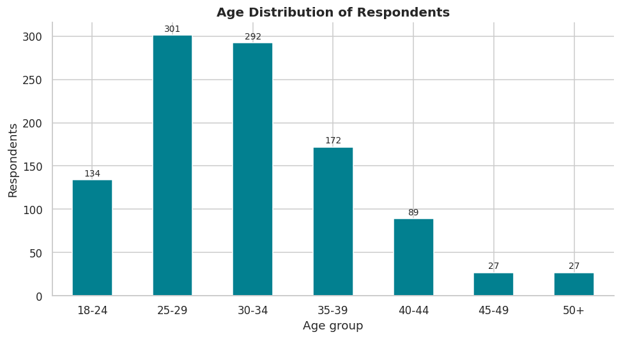
Age Distribution of Respondents
CATEGORY 1 · WHO RESPONDED
57% aged 25–34
Share of respondents in the 25–34 bands
Median age 31, cleaned range 18–65
6 impossible ages were removed
A young workforce: early wellness intervention matters

Slide 9
Age Distribution of Respondents
CATEGORY 1 · WHO RESPONDED
Code
bins = [17, 24, 29, 34, 39, 44, 49, 75]
labels = ["18-24", "25-29", "30-34", "35-39", "40-44",
"45-49", "50+"]
df["age_bin"] = pd.cut(df["Age_clean"], bins=bins,
labels=labels)
counts = df["age_bin"].value_counts().reindex(labels)
ax = counts.plot(kind="bar", color=PRIMARY, rot=0)
ax.set(title="Age Distribution of Respondents", xlabel="Age
group", ylabel="Respondents")
bar_labels(ax)
plt.tight_layout(); plt.show()
share_25_34 = counts[["25-29", "30-34"]].sum() / counts.sum()
* 100
print(f"Respondents aged 25-34: {share_25_34:.1f}%")
Chart generated from the notebook's code cell

Slide 10
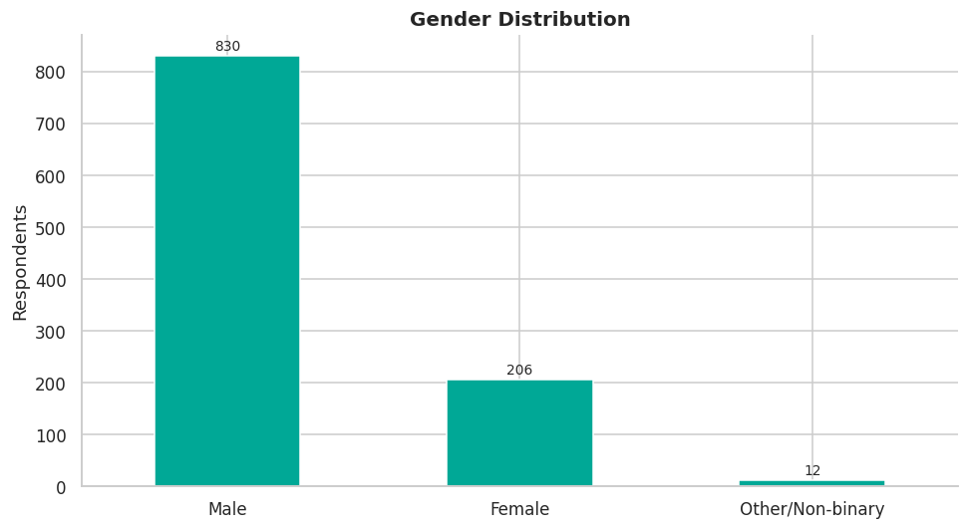
Gender Distribution
CATEGORY 1 · WHO RESPONDED
79% male
Male 830 · Female 206 · Other 12
Strongly male-dominated sample
Gender comparisons must be read with this imbalance in mind
Findings may not generalise evenly to XYZ

Slide 11
Gender Distribution
CATEGORY 1 · WHO RESPONDED
Code
counts = df["Gender_clean"].value_counts()
ax = counts.plot(kind="bar", color=ACCENT, rot=0)
ax.set(title="Gender Distribution", xlabel="",
ylabel="Respondents")
bar_labels(ax)
plt.tight_layout(); plt.show()
print((counts / counts.sum() * 100).round(1).astype(str) + "
%")
Chart generated from the notebook's code cell

Slide 12
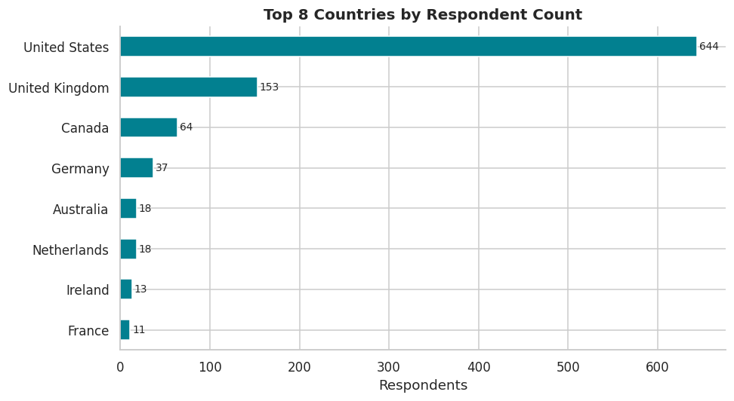
Respondent Geography
CATEGORY 1 · WHO RESPONDED
61.5% from the US
UK 14.6%, Canada 6.1%
US and UK together make up three-quarters of responses
Healthcare access and culture may confound patterns
Validate against XYZ's own locations

Slide 13
Respondent Geography
CATEGORY 1 · WHO RESPONDED
Code
top = df["Country"].value_counts().head(8)
ax = top.sort_values().plot(kind="barh", color=PRIMARY)
ax.set(title="Top 8 Countries by Respondent Count",
xlabel="Respondents", ylabel="")
bar_labels(ax)
plt.tight_layout(); plt.show()
print((df["Country"].value_counts(normalize=True).head(3) *
100).round(1).astype(str) + " %")
Chart generated from the notebook's code cell

Slide 14
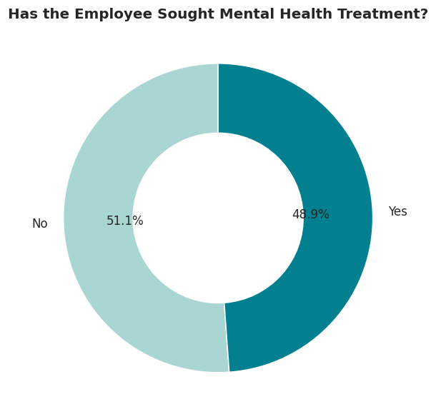
Treatment-Seeking Overall
CATEGORY 2 · TREATMENT & RISK
48.9%
Have sought treatment (512 of 1,048)
Nearly an even split
A mainstream issue, not a fringe one
Supports organisation-wide, not opt-in-only, support

Slide 15
Treatment-Seeking Overall
CATEGORY 2 · TREATMENT & RISK
Code
counts = df["treatment"].value_counts()
fig, ax = plt.subplots(figsize=(5.5, 5.5))
ax.pie(counts, labels=counts.index, autopct="%1.1f%%",
startangle=90,
colors=["#A9D6D2", PRIMARY],
wedgeprops=dict(width=0.45, edgecolor="white"),
textprops={"fontsize": 11})
ax.set_title("Has the Employee Sought Mental Health
Treatment?")
plt.tight_layout(); plt.show()
print(counts)
Chart generated from the notebook's code cell

Slide 16
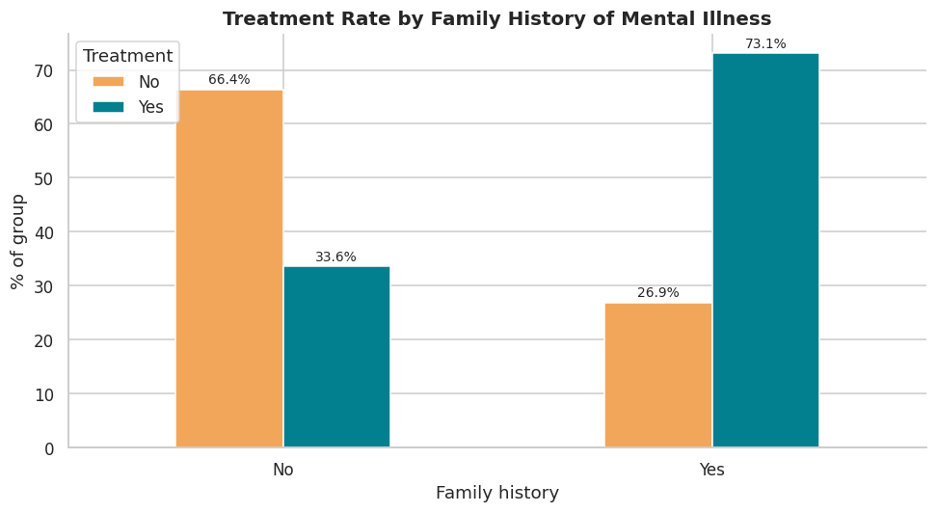
Family History vs Treatment
CATEGORY 2 · TREATMENT & RISK
73.1% vs 33.6%
Treatment rate with vs without family history
More than twice the rate (chi-square p < 0.001)
Cramér's V = 0.38, second strongest factor
A clear, askable risk marker

Slide 17
Family History vs Treatment
CATEGORY 2 · TREATMENT & RISK
Code
ct = pd.crosstab(df["family_history"], df["treatment"],
normalize="index") * 100
ax = ct.plot(kind="bar", color=[WARM, PRIMARY], rot=0)
ax.set(title="Treatment Rate by Family History of Mental
Illness",
xlabel="Family history", ylabel="% of group")
ax.legend(title="Treatment", loc="upper left")
bar_labels(ax, "{:.1f}%")
plt.tight_layout(); plt.show()
display(treatment_rate(df, "family_history"))
Chart generated from the notebook's code cell

Slide 18
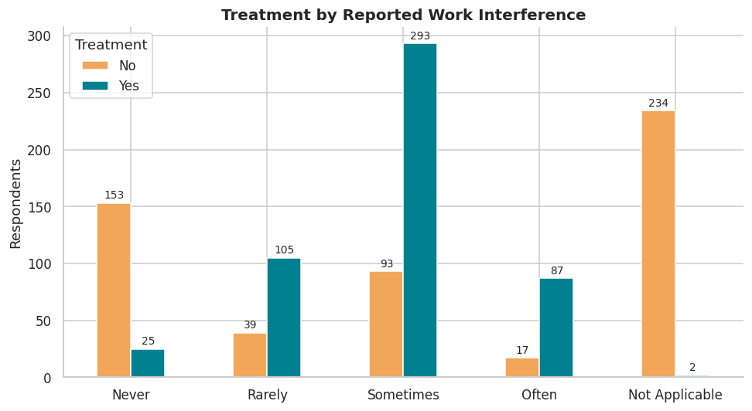
Work Interference vs Treatment
CATEGORY 2 · TREATMENT & RISK
84% vs 14%
Treated: interferes 'Often' vs 'Never'
Rarely 73%, Sometimes 76%
'Not Applicable' (no condition) is only ~1%, so this is partly circular
Read it as a severity cue managers can act on

Slide 19
Work Interference vs Treatment
CATEGORY 2 · TREATMENT & RISK
Code
order_wi = ["Never", "Rarely", "Sometimes", "Often", "Not
Applicable"]
ct = pd.crosstab(df["work_interfere_clean"],
df["treatment"]).reindex(order_wi)
ax = ct.plot(kind="bar", color=[WARM, PRIMARY], rot=0)
ax.set(title="Treatment by Reported Work Interference",
xlabel="", ylabel="Respondents")
ax.legend(title="Treatment")
bar_labels(ax)
plt.tight_layout(); plt.show()
display(treatment_rate(df, "work_interfere_clean", order_wi))
Chart generated from the notebook's code cell

Slide 20
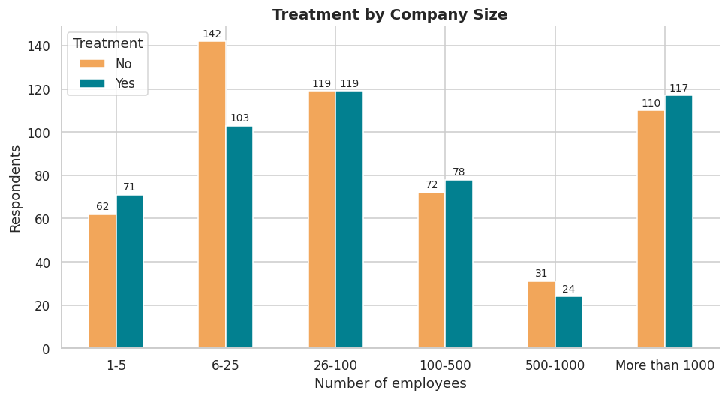
Company Size vs Treatment
CATEGORY 3 · WORKPLACE & EMPLOYER
42% to 53%
Treatment rate across company-size bands
No statistically significant difference (p = 0.18)
Slightly higher at 1–5 employees (53%)
Culture matters more than structure

Slide 21
Company Size vs Treatment
CATEGORY 3 · WORKPLACE & EMPLOYER
Code
ct = pd.crosstab(df["no_employees_clean"], df["treatment"])
ax = ct.plot(kind="bar", color=[WARM, PRIMARY], rot=0)
ax.set(title="Treatment by Company Size", xlabel="Number of
employees", ylabel="Respondents")
ax.legend(title="Treatment")
bar_labels(ax)
plt.tight_layout(); plt.show()
display(treatment_rate(df, "no_employees_clean", ORDER_SIZE))
Chart generated from the notebook's code cell

Slide 22
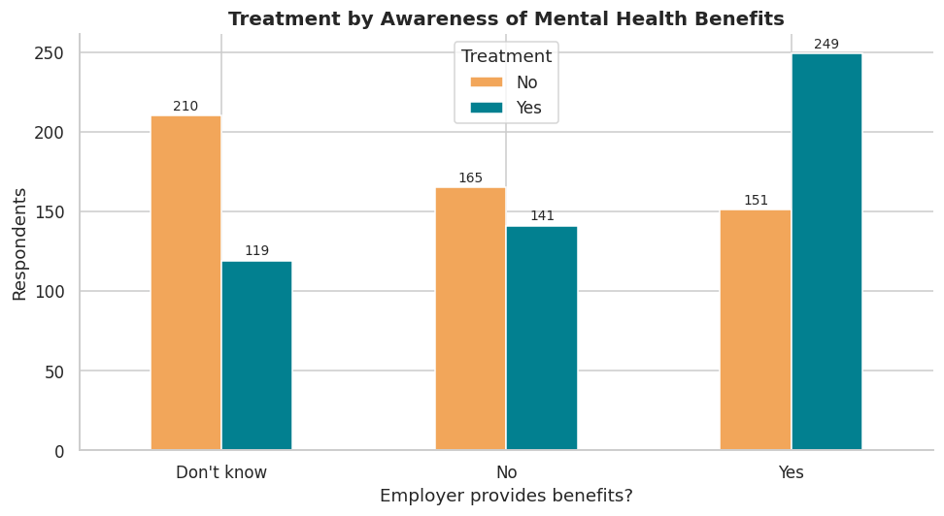
Benefits Awareness vs Treatment
CATEGORY 3 · WORKPLACE & EMPLOYER
62% vs 36%
Know benefits exist vs 'Don't know'
Those answering 'No' sit at 46%
Awareness, not just existence, goes with usage
Communicate what already exists

Slide 23
Benefits Awareness vs Treatment
CATEGORY 3 · WORKPLACE & EMPLOYER
Code
ct = pd.crosstab(df["benefits"], df["treatment"])
ax = ct.plot(kind="bar", color=[WARM, PRIMARY], rot=0)
ax.set(title="Treatment by Awareness of Mental Health
Benefits", xlabel="Employer provides benefits?",
ylabel="Respondents")
ax.legend(title="Treatment")
bar_labels(ax)
plt.tight_layout(); plt.show()
display(treatment_rate(df, "benefits"))
Chart generated from the notebook's code cell

Slide 24
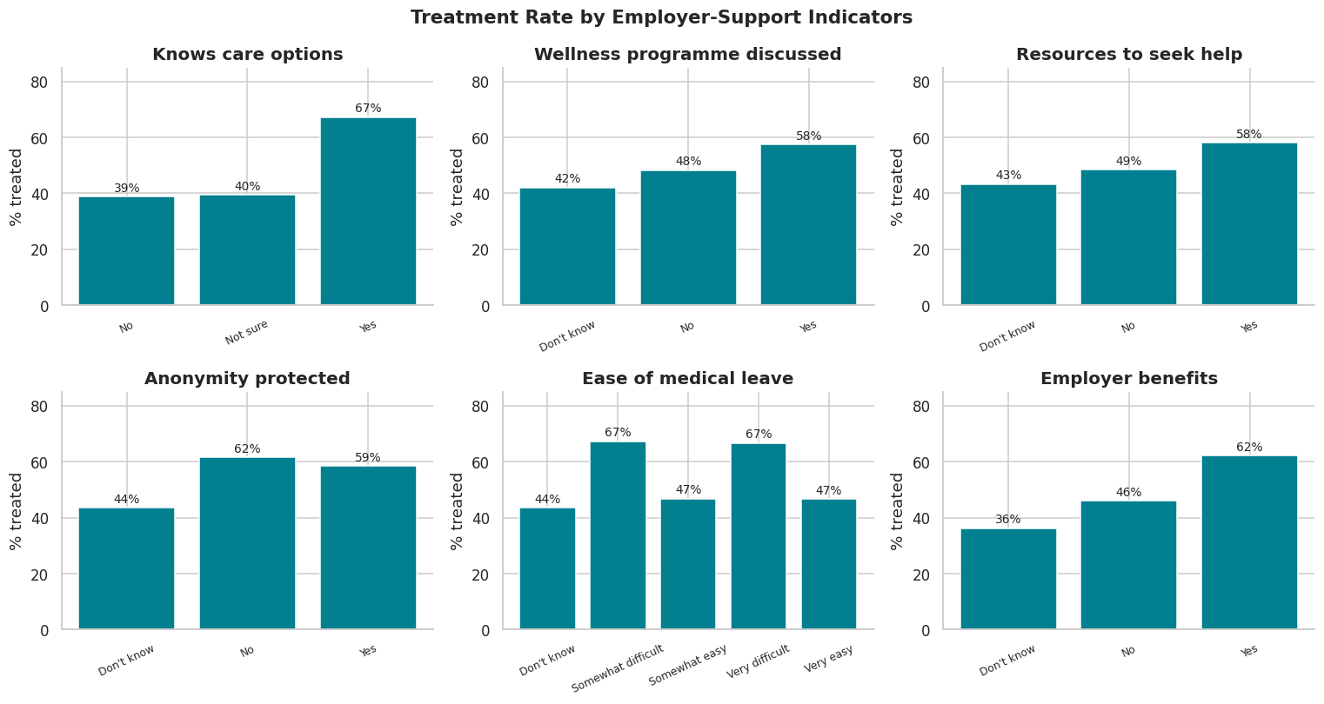
Employer Support vs Treatment
CATEGORY 3 · WORKPLACE & EMPLOYER
67% vs 39%
Care options is the biggest employer-side signal
Wellness programme 58% vs 42%; seek-help resources 58% vs 43%
Association, not proof of cause: users know more

Slide 25
Employer Support vs Treatment
CATEGORY 3 · WORKPLACE & EMPLOYER
Code
support = {"care_options": "Knows care options",
"wellness_program": "Wellness programme discussed",
"seek_help": "Resources to seek help", "anonymity":
"Anonymity protected",
"leave": "Ease of medical leave", "benefits":
"Employer benefits"}
fig, axes = plt.subplots(2, 3, figsize=(14, 7.5))
for ax, (col, title) in zip(axes.ravel(), support.items()):
t = treatment_rate(df, col)
ax.bar(t.index, t["treatment_rate_%"], color=PRIMARY)
ax.bar_label(ax.containers[0], fmt="%.0f%%", padding=2,
fontsize=9)
ax.set(title=title, ylim=(0, 85), ylabel="% treated")
ax.tick_params(axis="x", rotation=25, labelsize=8)
plt.suptitle("Treatment Rate by Employer-Support Indicators",
fontsize=14, fontweight="bold")
plt.tight_layout(); plt.show()

Slide 26
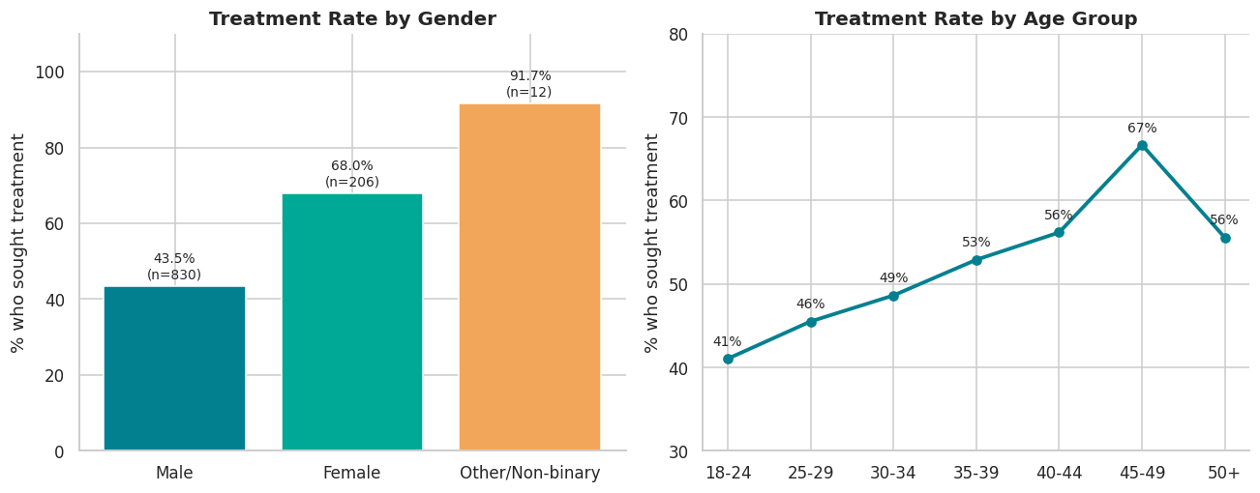
Gender and Age vs Treatment
CATEGORY 4 · PEOPLE & CULTURE
68% vs 43.5%
Treatment-seeking rises with age, 41% at 18–24
Other/Non-binary 92% but only 12 people
Target outreach to younger men, who seek help least

Slide 27
Gender and Age vs Treatment
CATEGORY 4 · PEOPLE & CULTURE
Code
fig, axes = plt.subplots(1, 2, figsize=(12, 4.8))
g = treatment_rate(df, "Gender_clean", ["Male", "Female",
"Other/Non-binary"])
axes[0].bar(g.index, g["treatment_rate_%"], color=[PRIMARY,
ACCENT, WARM])
axes[0].bar_label(axes[0].containers[0],
labels=[f"{v:.1f}%\n(n={n})" for v, n in
zip(g["treatment_rate_%"], g["n"])], padding=3,
fontsize=9)
axes[0].set(title="Treatment Rate by Gender", ylabel="% who
sought treatment", ylim=(0, 110))
a = treatment_rate(df, "age_bin", labels)
axes[1].plot(a.index.astype(str), a["treatment_rate_%"],
marker="o", color=PRIMARY, lw=2.5)
for x, y in zip(a.index.astype(str), a["treatment_rate_%"]):
axes[1].annotate(f"{y:.0f}%", (x, y), textcoords="offset
points", xytext=(0, 9), ha="center", fontsize=9)
axes[1].set(title="Treatment Rate by Age Group", ylabel="% who
sought treatment", ylim=(30, 80))
plt.tight_layout(); plt.show()

Slide 28
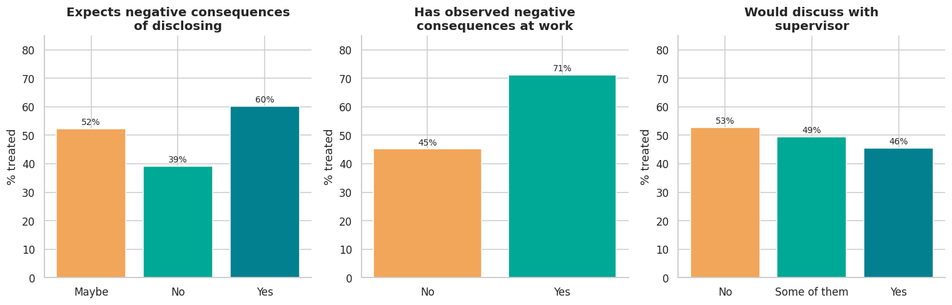
Stigma and Disclosure vs Treatment
CATEGORY 4 · PEOPLE & CULTURE
71% vs 45%
Fear of consequences: 60% vs 39%
Treated staff are less willing to tell a supervisor
Offer confidential channels beyond line managers

Slide 29
Stigma and Disclosure vs Treatment
CATEGORY 4 · PEOPLE & CULTURE
Code
fig, axes = plt.subplots(1, 3, figsize=(14, 4.6))
panels = [("mental_health_consequence", "Expects negative
consequences\nof disclosing"),
("obs_consequence", "Has observed
negative\nconsequences at work"),
("supervisor", "Would discuss with\nsupervisor")]
for ax, (col, title) in zip(axes, panels):
t = treatment_rate(df, col)
ax.bar(t.index, t["treatment_rate_%"], color=[WARM,
ACCENT, PRIMARY][: len(t)])
ax.bar_label(ax.containers[0], fmt="%.0f%%", padding=2,
fontsize=9)
ax.set(title=title, ylim=(0, 85), ylabel="% treated")
plt.tight_layout(); plt.show()

Slide 30
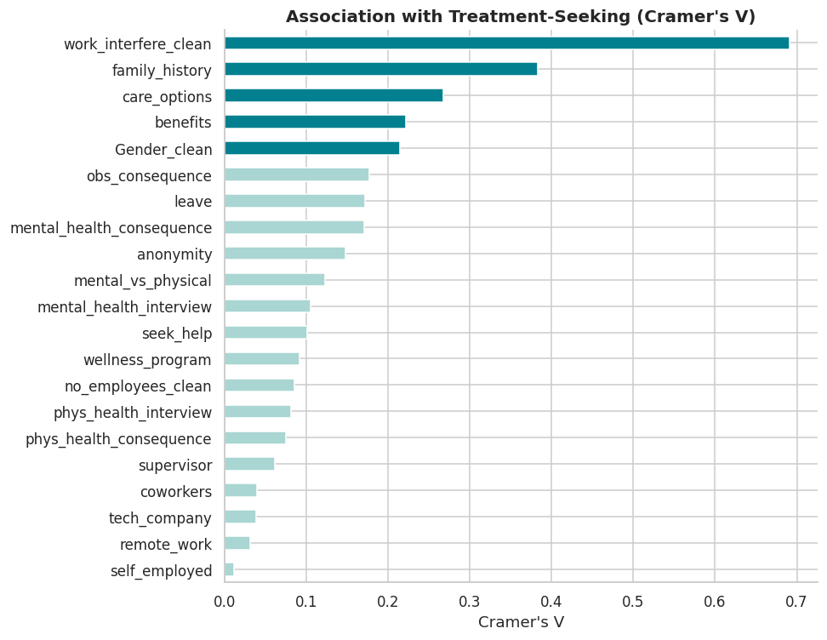
Which Factors Matter Most?
CATEGORY 4 · PEOPLE & CULTURE
V = 0.69
Work interference: strongest association
Family history 0.38, care options 0.27, benefits 0.22
Remote work, tech company, self-employed ≈ 0
Cramér's V: 0 = none, 1 = perfect

Slide 31
Which Factors Matter Most?
CATEGORY 4 · PEOPLE & CULTURE
Code
def cramers_v(x, y):
ct = pd.crosstab(x, y)
chi2 = chi2_contingency(ct)[0]
n = ct.values.sum()
return np.sqrt(chi2 / (n * (min(ct.shape) - 1)))
candidates = ["family_history", "work_interfere_clean",
"benefits", "care_options", "wellness_program",
"seek_help", "anonymity", "leave",
"mental_health_consequence", "phys_health_consequence",
"coworkers", "supervisor",
"mental_health_interview", "phys_health_interview",
"mental_vs_physical", "obs_consequence",
"no_employees_clean", "remote_work",
"tech_company", "self_employed", "Gender_clean"]
assoc = (pd.Series({c: cramers_v(df[c].astype(str),
df["treatment"]) for c in candidates})
.sort_values())
ax = assoc.plot(kind="barh", color=[PRIMARY if v >= 0.2 else
"#A9D6D2" for v in assoc], figsize=(9, 7))
ax.set(title="Association with Treatment-Seeking (Cramer's
V)", xlabel="Cramer's V", ylabel="")
plt.tight_layout(); plt.show()
assoc.sort_values(ascending=False).head(5).round(3).to_frame("
Cramer's V")
Chart generated from the notebook's code cell

Slide 32
What the data says
KEY INSIGHTS
73% vs 34%
84% vs 14%
67% vs 39%
Family history is the strongest independent risk factor
Work interference is the strongest signal, partly circular with the target
Knowing care options goes with far higher treatment-seeking
48.9%
p = 0.18
71% vs 45%
Nearly half have sought treatment: mainstream, not fringe
Company size has no significant effect; remote work ≈ 0
Stigma is visible to those who need care

Slide 33
Practical next steps for XYZ
RECOMMENDATIONS
Communicate benefits and care options
Awareness goes with a ~26-point higher treatment rate. Make existing programmes visible.
1
Train managers on warning signs
Self-reported work interference is an actionable cue for a supportive check-in.
2
Build in proactive check-ins
With ~49% already seeking support, do not rely on opt-in programmes alone.
3
Protect anonymity
Treated staff are less willing to tell supervisors. Offer confidential channels.
4
Validate on XYZ's own data
Re-run this analysis on XYZ's internal survey before finalising any programme.
5

Slide 34
Reading the results with care
LIMITATIONS & NEXT STEPS
Limitations
Next steps
Association is not causation
Self-reported answers carry recall and social-desirability bias
Sample skews young, male and US/UK-based
Gender collapsed to three groups; 'Other' has only 12 people
Build a predictive model (logistic regression, gradient boosting) to flag who may need support
Run the same analysis on XYZ's own survey
Track programme impact over time

