Slide 1
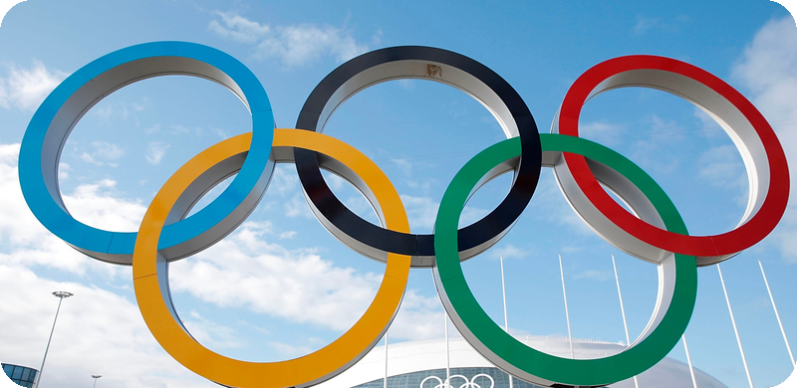
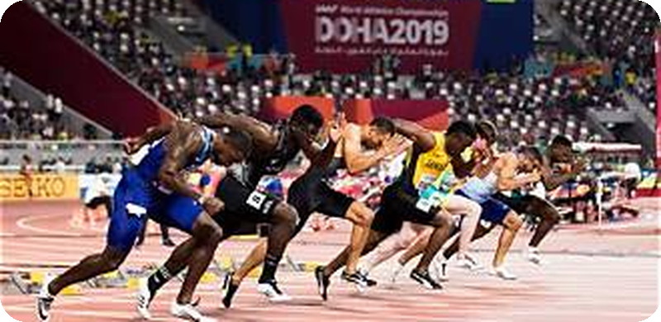
Olympic Athlete Analysis
OLYMPIC
ATHLETE
ANALYSIS
Notes:
Introduce the project and the team. An EDA of the 120 Years of Olympic History dataset, where each row is one athlete in one event.

Slide 2
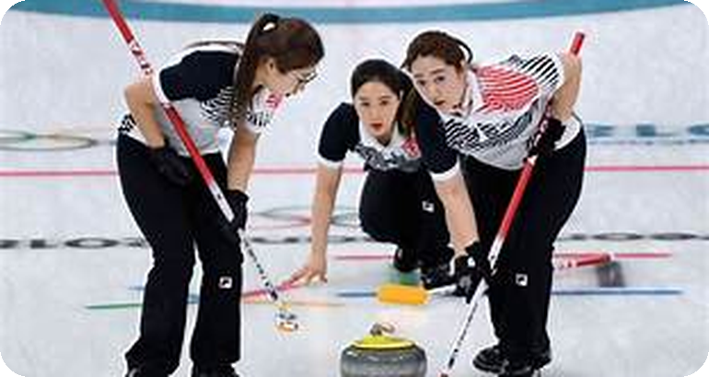
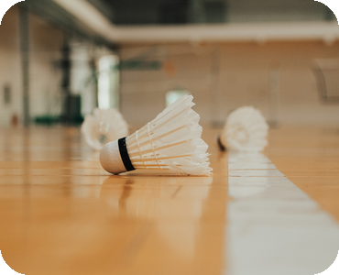
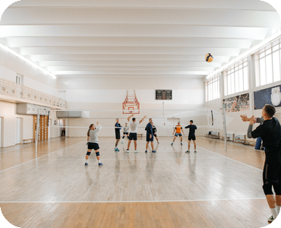
Olympic Athlete Analysis
ABOUT THIS
PROJECT
An exploratory data analysis of 271,116 athlete records spanning 120 years of Olympic history, from Athens 1896 to Rio 2016.
Exploratory Data Analysis is the step where a raw dataset is summarised, questioned and visualised before any modelling begins. It is how patterns are uncovered, anomalies are spotted and assumptions are tested.
This project applies that process to 120 years of Olympic competition: understanding the data, cleaning it with justified decisions, exploring it for patterns, and interpreting what those patterns say about how the Games have changed.
Notes:
Frame the purpose: EDA comes before modelling and is what makes any later conclusion trustworthy.

Slide 3
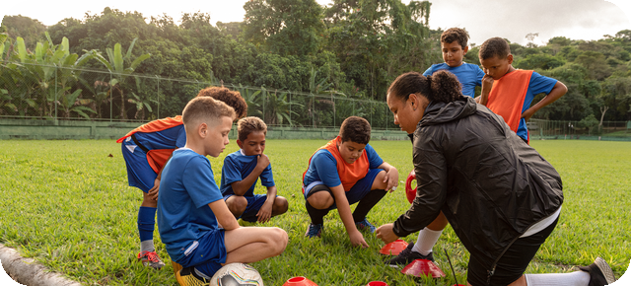
Olympic Athlete Analysis
PROJECT
OBJECTIVES
Understand the data
01
Establish the structure, grain and scope of all 15 variables before touching anything.
Clean and prepare
02
The analysis follows a standard EDA workflow: understand the data, clean it carefully, then explore it for patterns worth reporting.
Resolve duplicates, missing values and outliers with decisions that are justified, not automatic.
Explore and visualise
03
Surface patterns in participation, geography, physique and performance.
Interpret the findings
04
Translate each chart into a clear, defensible insight about Olympic history.
Notes:
These four objectives map directly onto the four sections of the notebook.

Slide 4
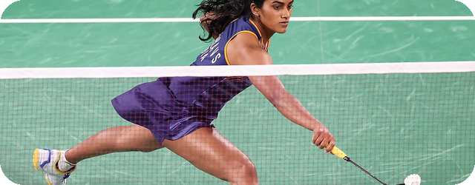
Olympic Athlete Analysis
ABOUT THE
DATASET
15 Columns
135,571 Athletes
Two Seasons
ID, Name, Sex, Age, Height, Weight, Team, NOC, Games, Year, Season, City, Sport, Event, Medal.
Unique competitors. A repeated ID is expected, not an error, since one athlete enters many events.
Summer and Winter Games, held together until 1992 and on a staggered cycle from 1994 onward.
Each row represents one athlete competing in one event, recording their age, height, weight, nationality, sport and medal outcome across every Games from 1896 to 2016.
Notes:
Explain the grain of the data: athlete-event, not athlete. This matters for every count later.

Slide 5
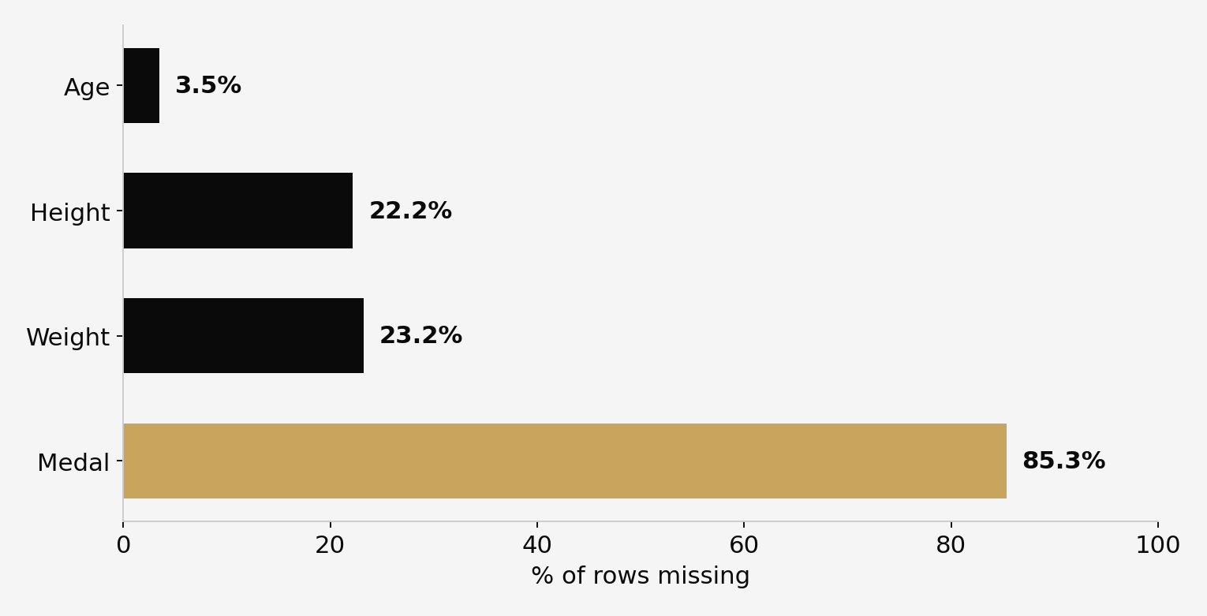
Olympic Athlete Analysis
DATA QUALITY
CHECK
85.3% of Medal values blank
Age, Height and Weight carry real gaps of 3.5%, 22.2% and 23.2%. The Medal column is different: a blank simply means the athlete did not win, so it is a meaningful value rather than a defect and must not be dropped.
Notes:
Key point: not every blank is missing data. Treating Medal as missing would have destroyed 85% of the dataset.

Slide 6

Olympic Athlete Analysis
CLEANING THE
DATA
Removed exact duplicates
01
1,385 fully identical rows dropped, leaving 269,731 records for analysis.
Kept repeated athlete IDs
02
Every cleaning decision was investigated first and applied only where it genuinely improved the data.
A swimmer in five races appears five times by design, so these rows were retained.
Relabelled the Medal column
271,116 → 269,731 rows
03
Blanks became 'No Medal', making non-winners explicit instead of missing.
Imputed body measurements
04
Age, Height and Weight filled with the median of each Sport and Sex group.
Notes:
Median within Sport+Sex preserves realistic body types; a single global average would flatten a gymnast into a shot putter.

Slide 7

Olympic Athlete Analysis
FEATURE
ENGINEERING
Original variable
01
Medal records contain Gold, Silver, Bronze or No Medal.
Derived feature
02
A derived feature was created from the existing Medal column to support medal-status analysis.
Medal → Medalist
Medalist classifies each record as True or False based on medal status.
Purpose
03
The feature makes medal-status comparisons easier in later EDA.
Used in analysis
04
Medalist was used to compare athlete characteristics by medal status.
Notes:
Medalist = Medal != 'No Medal'. This boolean flag is what powers the medalist-vs-non-medalist age comparison later.

Slide 8
Olympic Athlete Analysis
OUTLIERS WERE
INVESTIGATED,
NOT DELETED
Age up to 97
Height 226 cm
Weight 214 kg
The oldest entries come from the historical Art Competitions held between 1912 and 1948.
The tallest athlete is Yao Ming, a genuine basketball record rather than a typo.
The heaviest are super heavyweight judo and wrestling competitors.
The IQR method flagged extreme values in Age, Height and Weight. Each was traced back to a real competitor, so all were kept.
Deleting these rows would erase real athletic diversity instead of correcting an error.
Notes:
This is the strongest methodological point in the project: outlier does not mean error.

Slide 9
Olympic Athlete Analysis
GENDER PARTICIPATION
PYTHON — SOURCE CODE
gender_count = df['Sex'].value_counts()
plt.figure(figsize=(7, 7))
plt.pie(
gender_count.values,
labels=gender_count.index,
autopct='%1.1f%%',
startangle=90
)
plt.title('Male vs Female Athlete Participation')
plt.show()

Slide 10
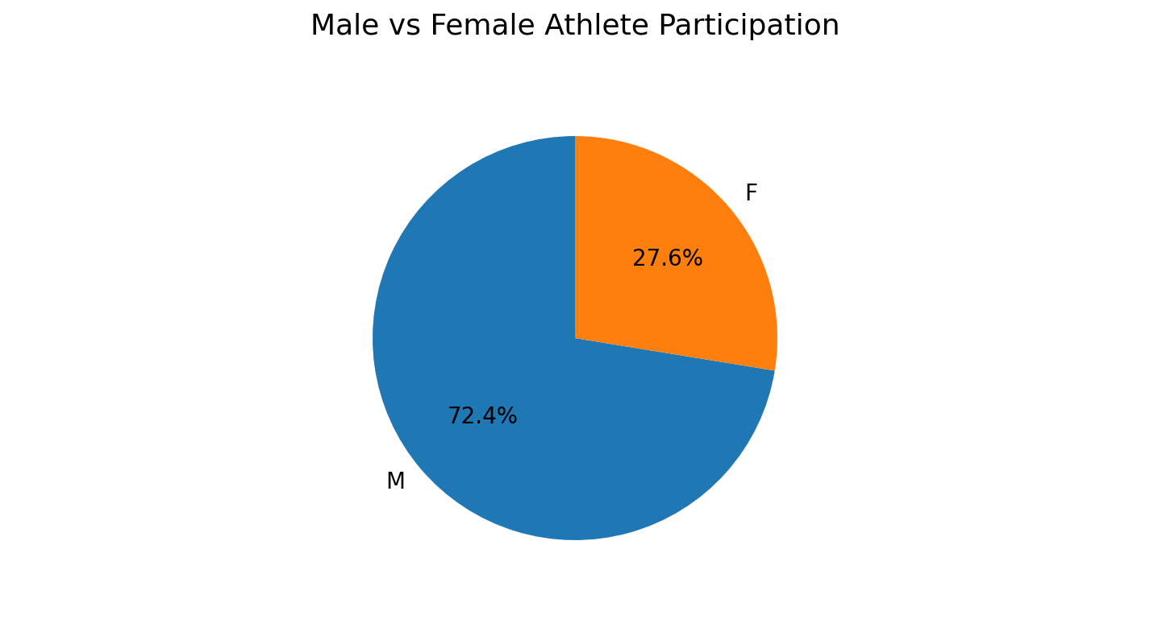
Olympic Athlete Analysis
GENDER
PARTICIPATION
72.4% male · 27.6% female
Male athlete-events outnumber female ones 2.6 to 1 (195,353 vs 74,378, or 72.4% vs 27.6%). Women first appear in the data in 1900 and don't cross roughly 40% until the 2000s — by 2016 female participation reaches 45.5%, so the all-time split is pulled toward male by over a century of male-only or male-dominated Games.
Notes:
Largest structural change in the dataset. Point out the 1994 split before anyone asks about the sawtooth.
CODE:
# 2. Male vs Female Participation
gender_count = df['Sex'].value_counts()
plt.figure(figsize=(7, 7))
plt.pie(
gender_count.values,
labels=gender_count.index,
autopct='%1.1f%%',
startangle=90
)
plt.title('Male vs Female Athlete Participation')
plt.show()

Slide 11
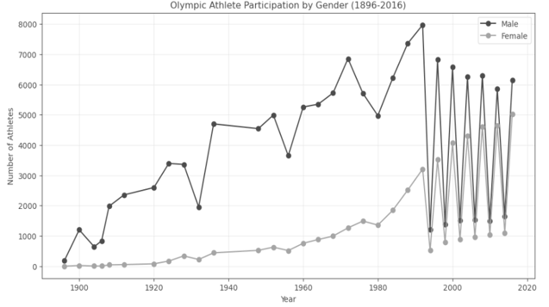
Olympic Athlete Analysis
GENDER PARTICIPATION: GROWTH IN FEMALE PARTICIPATION
0 → 45% female by 2016
Female participation began at zero in 1896 and reached 5,034 athletes in 2016, close to the 6,145 men competing. Growth accelerated sharply after the 1980s. The zigzag from 1994 onward reflects the staggered Winter and Summer schedule, not a data problem.
Notes:
Largest structural change in the dataset. Point out the 1994 split before anyone asks about the sawtooth.
CODE:
# 2. Male vs Female Participation
gender_count = df['Sex'].value_counts()
plt.figure(figsize=(7, 7))
plt.pie(
gender_count.values,
labels=gender_count.index,
autopct='%1.1f%%',
startangle=90
)
plt.title('Male vs Female Athlete Participation')
plt.show()

Slide 12
Olympic Athlete Analysis
MEDAL DISTRIBUTION BY NOC
PYTHON — SOURCE CODE
medals_only = df[df['Medal'] != 'No Medal']
top10_nocs = medals_only.groupby('NOC').size().sort_values(ascending=False).head(10).index.tolist()
Breakdown = medals_only[medals_only['NOC'].isin(top10_nocs)].groupby(['NOC','Medal']).size().unstack(fill_value=0)
breakdown = breakdown.reindex(top10_nocs)[['Gold','Silver','Bronze']]
breakdown.plot(kind='bar', figsize=(12,6), color=['gold','silver','#cd7f32'])
plt.title('Top 10 Countries by Medal Count (1896-2016)')
plt.xlabel('Country (NOC)')
plt.ylabel('Medal Count')
plt.xticks(rotation=45)
plt.legend(title='Medal Type')
plt.tight_layout()
plt.show()

Slide 13
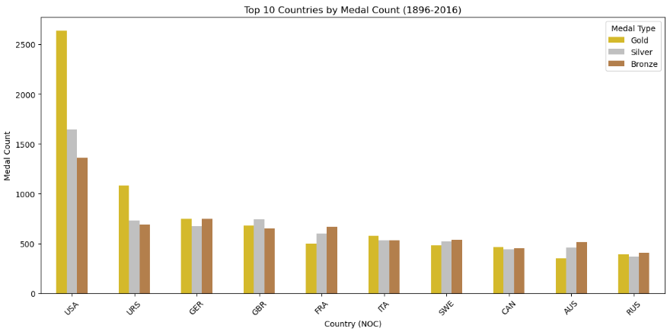
Olympic Athlete Analysis
MEDAL
DISTRIBUTION BY NOC
USA 5,637 medals
The USA leads with 5,637 medal-events, more than double the next-highest country (the Soviet-era URS, 2,503). The top 10 NOCs alone account for 53.2% of all 39,772 medal-events ever recorded, showing medal success has stayed concentrated in a small group of historically dominant nations.
Notes:
Caveat the count: it is medals awarded per athlete-event, not medal events won.
CODE:
medals_only = df[df['Medal'] != 'No Medal']
top10_nocs = medals_only.groupby('NOC').size().sort_values(ascending=False).head(10).index.tolist()
breakdown = medals_only[medals_only['NOC'].isin(top10_nocs)].groupby(['NOC','Medal']).size().unstack(fill_value=0)
breakdown = breakdown.reindex(top10_nocs)[['Gold','Silver','Bronze']]
breakdown.plot(kind='bar', figsize=(12,6), color=['gold','silver','#cd7f32'])
plt.title('Top 10 Countries by Medal Count (1896-2016)')
plt.xlabel('Country (NOC)')
plt.ylabel('Medal Count')
plt.xticks(rotation=45)
plt.legend(title='Medal Type')
plt.tight_layout()
plt.show()

Slide 14
Olympic Athlete Analysis
AGE PROFILE
PYTHON — SOURCE CODE
import matplotlib.pyplot as plt
plt.figure(figsize=(10,6))
plt.hist(
df['Age'],
bins=40,
color='steelblue',
edgecolor='black'
)
plt.axvline(
df['Age'].median(),
color='red',
linestyle='--',
label=f'Median: {df["Age"].median():.0f}'
)
plt.title('Distribution of Olympic Athlete Ages (1896-2016)')
plt.xlabel('Age')
plt.ylabel('Number of Athlete-Events')
plt.legend()
plt.show()

Slide 15
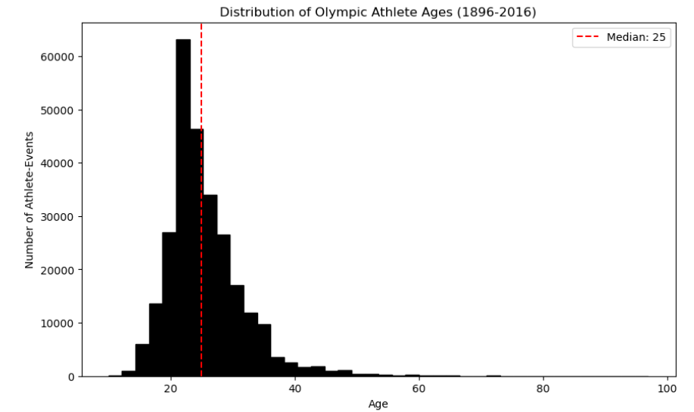
Olympic Athlete Analysis
AGE
PROFILE
Median age 25
Most competitors fall between 18 and 30, peaking around 20 to 23. The distribution is right skewed with a long tail reaching 97, driven by age independent disciplines such as shooting, equestrian, sailing and the historical Art Competitions.
Notes:
The Olympics is overwhelmingly a young adult competition, with narrow but real exceptions.
CODE:
plt.figure(figsize=(10,6))
plt.hist(
df['Age'],
bins=40,
color='steelblue',
edgecolor='black'
)
plt.axvline(
df['Age'].median(),
color='red',
linestyle='--',
label=f'Median: {df["Age"].median():.0f}'
)
plt.title('Distribution of Olympic Athlete Ages (1896-2016)')
plt.xlabel('Age')
plt.ylabel('Number of Athlete-Events')
plt.legend()
plt.show()

Slide 16
Olympic Athlete Analysis
PHYSIQUE BY SPORT
PYTHON — SOURCE CODE
sport_counts = df['Sport'].value_counts()
big_sports = sport_counts[
sport_counts > 1000
].index
avg_height = (
df[df['Sport'].isin(big_sports)]
.groupby('Sport')['Height']
.mean()
.sort_values()
)
top_bottom = pd.concat([
avg_height.head(5),
avg_height.tail(5)
])
plt.figure(figsize=(10, 7))
plt.barh(
top_bottom.index,
top_bottom.values
)
plt.axvline(
df['Height'].mean(),
linestyle='--',
label=f'Overall Average: {df["Height"].mean():.0f} cm'
)
plt.xlabel('Average Height (cm)')
plt.title('Shortest vs Tallest Average Height by Sport')
plt.legend()
plt.tight_layout()
plt.show()

Slide 17
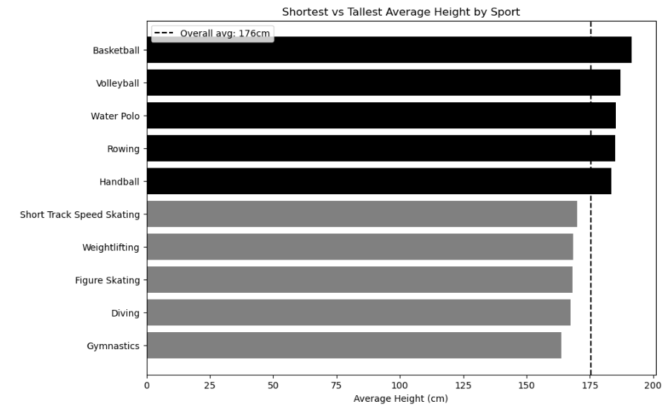
Olympic Athlete Analysis
PHYSIQUE BY
SPORT
A 27 cm spread
Average height varies by 27.6 cm across sports, from Gymnastics (163.8 cm) at the low end to Basketball (191.5 cm) at the high end, against an overall average of 175.6 cm. The pattern tracks each sport's physical demands: compact, low-centre-of-gravity builds for gymnastics vs. height-driven advantages in basketball and volleyball.
Notes:
Only sports with more than 1,000 records are included, so the averages are stable.
CODE:
sport_counts = df['Sport'].value_counts()
big_sports = sport_counts[sport_counts > 1000].index
avg_height = (
df[df['Sport'].isin(big_sports)]
.groupby('Sport')['Height']
.mean()
.sort_values()
)
top_bottom = pd.concat([avg_height.head(5), avg_height.tail(5)])
plt.figure(figsize=(10, 7))
plt.barh(top_bottom.index, top_bottom.values)
plt.axvline(
df['Height'].mean(),
linestyle='--',
label=f'Overall Average: {df["Height"].mean():.0f} cm'
)
plt.xlabel('Average Height (cm)')
plt.title('Shortest vs Tallest Average Height by Sport')
plt.legend()
plt.tight_layout()
plt.show()

Slide 18
Olympic Athlete Analysis
SPORT POPULARITY
PYTHON — SOURCE CODE
top5_sports = df['Sport'].value_counts().head(5).index.tolist()
trend = df[df['Sport'].isin(top5_sports)].groupby(['Year','Sport']).size().unstack(fill_value=0)
trend = trend[top5_sports]
plt.figure(figsize=(12,6))
for sport in top5_sports:
plt.plot(trend.index, trend[sport], marker='o', markersize=3, label=sport)
plt.title('Participation Trend: Top 5 Sports Over Time')
plt.xlabel('Year')
plt.ylabel('Number of Athlete-Events')
plt.legend()
plt.grid(alpha=0.3)
plt.show()

Slide 19
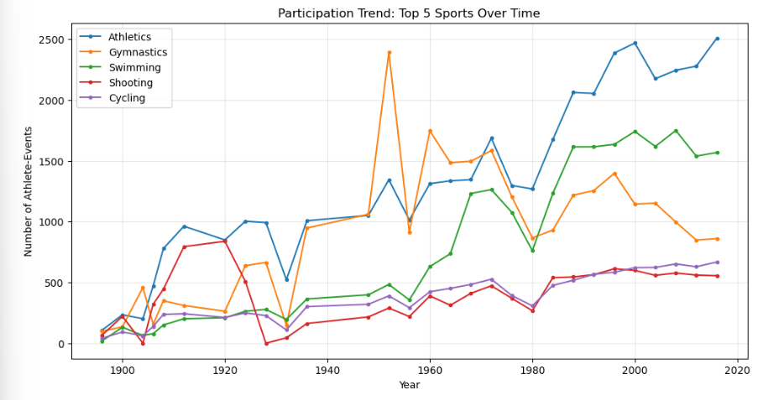
Olympic Athlete Analysis
SPORT
POPULARITY
Athletics pulls away
Athletics is the most-recorded sport with 38,624 athlete-events, well ahead of Gymnastics (26,707) and Swimming (23,195). It also stays the largest sport in nearly every individual Games, showing consistent dominance rather than a one-time spike.
Notes:
The 1952 gymnastics spike is a one-off expansion of the event programme.
CODE:
top5_sports = df['Sport'].value_counts().head(5).index.tolist()
trend = df[df['Sport'].isin(top5_sports)].groupby(['Year','Sport']).size().unstack(fill_value=0)
trend = trend[top5_sports]
plt.figure(figsize=(12,6))
for sport in top5_sports:
plt.plot(trend.index, trend[sport], marker='o', markersize=3, label=sport)
plt.title('Participation Trend: Top 5 Sports Over Time')
plt.xlabel('Year')
plt.ylabel('Number of Athlete-Events')
plt.legend()
plt.grid(alpha=0.3)
plt.show()

Slide 20
Olympic Athlete Analysis
GLOBAL EXPANSION
PYTHON — SOURCE CODE
yearly_nocs = df.groupby('Year')['NOC'].nunique()
plt.figure(figsize=(12, 6))
sns.lineplot(
x=yearly_nocs.index,
y=yearly_nocs.values,
marker='o'
)
plt.title('Growth of Olympic Globalization')
plt.xlabel('Year')
plt.ylabel('Number of Participating NOCs')
plt.xticks(rotation=45)
plt.grid(axis='y', linestyle='--', alpha=0.4)
plt.tight_layout()
plt.show()

Slide 21
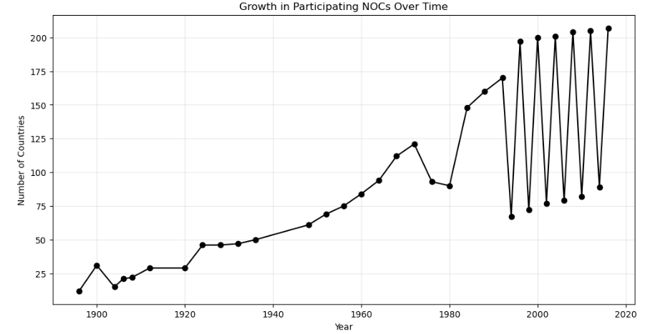
Olympic Athlete Analysis
GLOBAL
EXPANSION
12 → 207 Participating NOCs
Participating NOCs grew from just 12 in 1896 to a peak of 207 in 2016 — a roughly 17-fold increase — tracking the 20th century's wave of decolonization and new nations joining the international community.
Notes:
Globalisation is the clearest long-run trend in the dataset.
CODE:
yearly_nocs = df.groupby('Year')['NOC'].nunique()
plt.figure(figsize=(12, 6))
sns.lineplot(x=yearly_nocs.index, y=yearly_nocs.values, marker='o')
plt.title('Growth of Olympic Globalization')
plt.xlabel('Year')
plt.ylabel('Number of Participating NOCs')
plt.xticks(rotation=45)
plt.grid(axis='y', linestyle='--', alpha=0.4)
plt.tight_layout()
plt.show()

Slide 22
Olympic Athlete Analysis
AGE DISTRIBUTION BY MEDAL STATUS
PYTHON — SOURCE CODE
df['Medalist'] = df['Medal'] != 'No Medal'
medalist_age = df[df['Medalist']]['Age']
non_medalist_age = df[~df['Medalist']]['Age']
plt.figure(figsize=(10,6))
plt.hist(non_medalist_age, bins=40, alpha=0.5, label='No Medal', color='gray', density=True)
plt.hist(medalist_age, bins=40, alpha=0.6, label='Medalist', color='gold', density=True)
plt.title('Age Distribution by Medal Status')
plt.xlabel('Age')
plt.ylabel('Density (normalized)')
plt.legend()
plt.show()

Slide 23
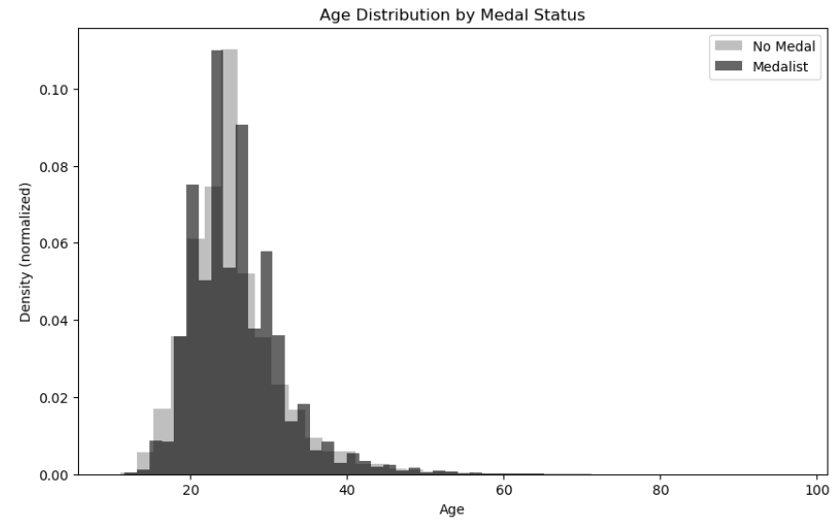
Olympic Athlete Analysis
AGE DISTRIBUTION BY MEDAL STATUS
25.9 vs 25.4 years
Medalists average 25.9 years vs. 25.4 for non-medalists (median 25 vs. 24). The gap is statistically significant (t-test, p < 0.001) given the huge sample size, but substantively tiny — under a year — so age has almost no real predictive power over who medals.
Notes:
A deliberate negative result. Showing what does not predict success is as valuable as showing what does.
CODE:
df['Medalist'] = df['Medal'] != 'No Medal'
medalist_age = df[df['Medalist']]['Age']
non_medalist_age = df[~df['Medalist']]['Age']
plt.figure(figsize=(10,6))
plt.hist(non_medalist_age, bins=40, alpha=0.5, label='No Medal', color='gray', density=True)
plt.hist(medalist_age, bins=40, alpha=0.6, label='Medalist', color='gold', density=True)
plt.title('Age Distribution: Medalists vs Non-Medalists')
plt.xlabel('Age')
plt.ylabel('Density (normalized)')
plt.legend()
plt.show()

Slide 24
Olympic Athlete Analysis
HEIGHT AND WEIGHT
PYTHON — SOURCE CODE
#Relationship Between Height and Weight (Correlation)
import matplotlib.pyplot as plt
# Step 1: Calculate correlation between Height and Weight
correlation = df['Height'].corr(df['Weight'])
print("Correlation:", correlation)
# Step 2: Take a small sample so the chart isn't too crowded
sample = df.sample(2000)
# Step 3: Plot Height vs Weight
plt.scatter(sample['Height'], sample['Weight'])
plt.title('Height vs Weight')
plt.xlabel('Height (cm)')
plt.ylabel('Weight (kg)')
plt.show()

Slide 25
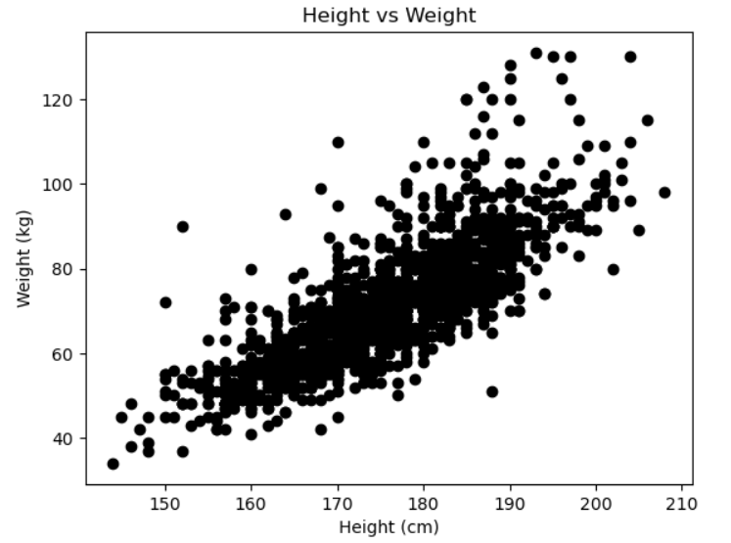
Olympic Athlete Analysis
HEIGHT AND
WEIGHT
Correlation 0.7971
Height and Weight correlate at 0.797, a strong positive relationship confirming the expected physiological link: taller athletes are systematically heavier across the dataset, with scatter concentrated in a clear upward band.
Notes:
Correlation of 0.797 on the cleaned data. Mention that imputation tightens this slightly.
CODE:
correlation = df['Height'].corr(df['Weight'])
print("Correlation:", correlation)
sample = df.sample(2000)
plt.scatter(sample['Height'], sample['Weight'])
plt.title('Height vs Weight')
plt.xlabel('Height (cm)')
plt.ylabel('Weight (kg)')
plt.show()

Slide 26
Olympic Athlete Analysis
KEY INSIGHTS
Eight findings that hold up across 120 years of competition.
Gender gap nearly closed
Medal distribution varies across NOCs
01
02
From no women in 1896 to 45% of the field in 2016.
5,637 medals, more than double the next nation, with a higher gold share.
A young competitor
Body type follows sport
03
04
Median age 25, with most athletes aged 18 to 30.
A 27 cm height gap separates the tallest and shortest disciplines.
Athletics dominates
Olympics went global
05
06
Athletics has held consistently high participation, pulling ahead of other sports since 1980.
Participating nations grew from 12 in 1896 to 207 in 2016.
Age shows limited association with medal status
Height and weight track
07
08
Medalists and non medalists differ by only half a year.
A correlation of 0.80 links taller athletes to greater body weight.
Notes:
Close the analysis section with all eight headline results before the conclusion, matching the notebook's expanded Key Insights section.

Slide 27
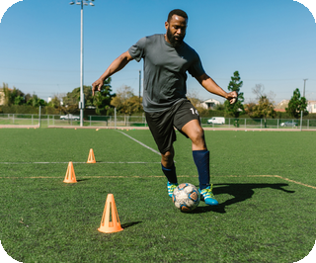
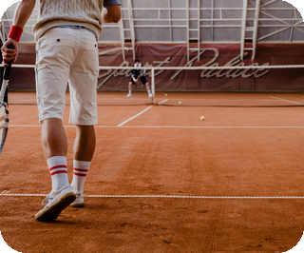
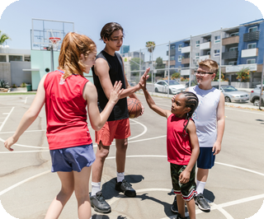
Olympic Athlete Analysis
CONCLUSION
AND OUTLOOK
Method
Limitation
Next steps
Missing values, duplicates and outliers were investigated before being changed, so genuine history was preserved.
Imputed body measurements and athlete level medal counts should be read with care.
Model medal probability from sport, physique and host nation advantage.
In 120 years the Games moved from a small all male contest between 12 nations to a global event with 207 participating NOCs and near equal gender representation. Physical attributes follow the demands of each sport, while the analysis shows that medals status is not strongly associated with age alone.
Notes:
End on method: the care taken with the data is what makes the insights trustworthy.

Slide 28
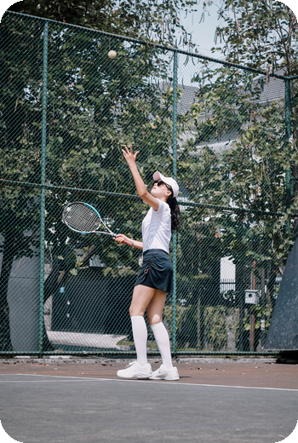

Olympic Athlete Analysis
THANK YOU
Notes:
Thank the audience and open the floor for questions.

