Slide 1
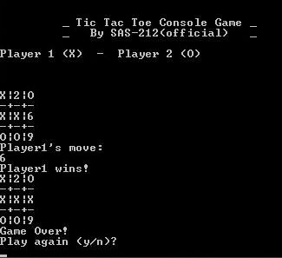
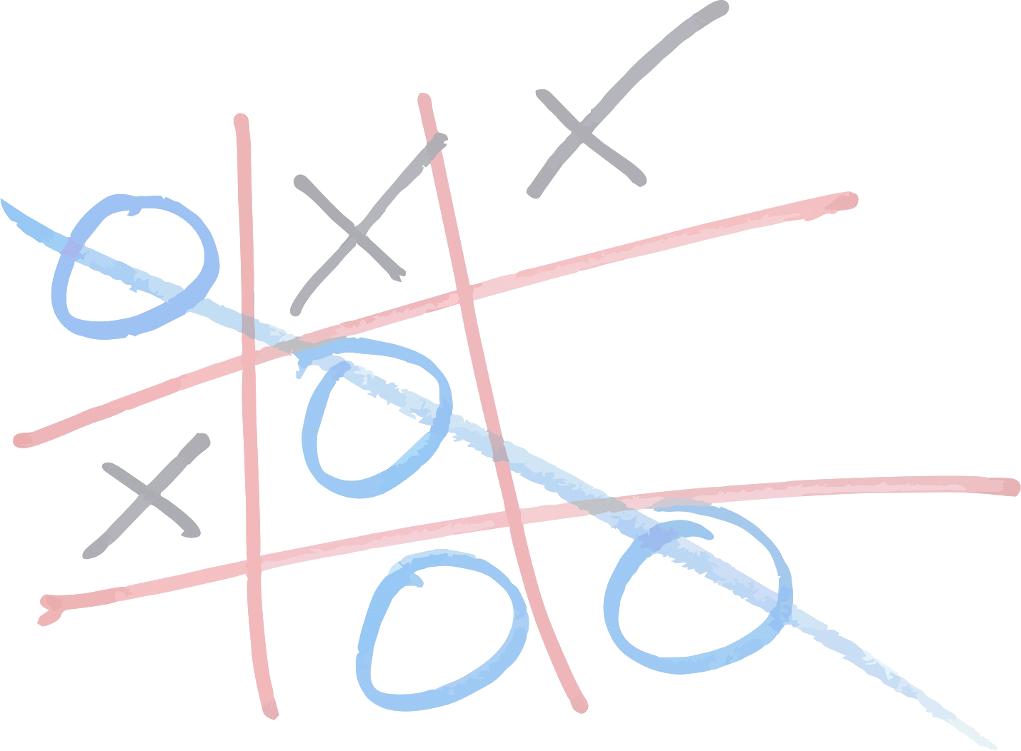
Tic Tac Toe
(Console Game) C++ Program
Presented By : Group
SAS - 212 (OFFICIAL)
Saad Wazir, Sidra Batool, Kamran Shah, Abdul Rehman, Haseeb Ullah, Shafaq Arif & Bushra

Slide 2

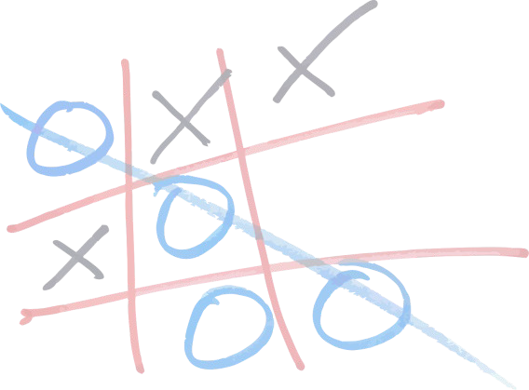

SAS-212 (OFFICIAL)
Tic Tac Toe | (Console Game)
C++ Program
Sidra Batool
Tic Tac Toe
(Console Game) C++ Program
Preston University
ISLAMABAD 1421 – 212012 / BSCS

Slide 3
Tic-tac-toe (or Noughts and crosses, Xs and Os) is a pencil- and-paper game for two players, X and O, who take turns marking the spaces in a 3×3 grid. The player who succeeds in placing three respective marks in a horizontal, vertical, or diagonal row wins the game.
This program is a game program, Tic Tac Toe. Most of us have played this game in school days, we have make a C++ program on it.
Presented by: Sidra Batool | 1421 – 212012 / BSCS

Slide 4
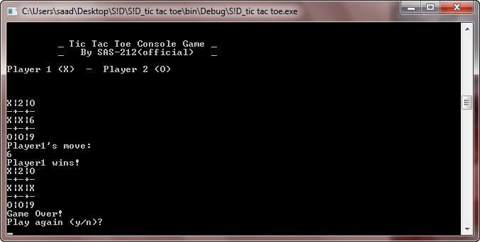
This game uses board to control players In each turn players enter a number and choose a move
Simplify programing assumes that player one always moves first and uses X's Player two moves at 2nd position and uses O's
A Sample Screen Shot of a Game
Presented by: Sidra Batool | 1421 – 212012 / BSCS

Slide 5
How the program structured :
At the time when program start we initialize variables, and we run the game loop until the game end or players choose to quit
The game consists of three steps
•
•
•
Display board Get players move
Check for game end
Presented by: Sidra Batool | 1421 – 212012 / BSCS

Slide 6
SAS-212 (OFFICIAL)
Tic Tac Toe | (Console Game)
C++ Program
Shafaq Arif
Preston University
ISLAMABAD 1421 – 312126 / BSCS
Initialization Of Variables & explanatory statements
Tic Tac Toe C++ Program

Slide 7
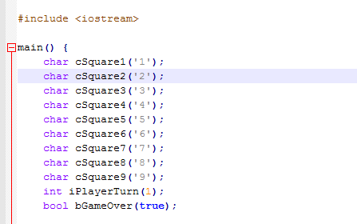
This portion of code is for initialization of variables, the variables of squares are initializing with the characters from 1 to 9.
The player turn will be initializing to 1 because since the player 1 makes the first turn
Game over is initialize to true but that does not really matter for this program because after game loop game check itself for winner.
Presented by: Shafaq Arif | 1421 – 3121236 / BSCS

Slide 8

Program comments are explanatory statements that you can include in the C++ code that you write and helps anyone reading its source code. All programming languages allow for some form of comments.
C++ supports single line and multi-line comments. All characters available inside any comment are ignored by C++ compiler.
C++ comments start with /* and end with */. For example:
// This is a comment
/* C++ comments can also span multiple lines
*/
Presented by: Shafaq Arif | 1421 – 3121236 / BSCS

Slide 9
SAS-212 (OFFICIAL)
Tic Tac Toe | (Console Game)
C++ Program
Bushra Urooj
Game Loops
Preston University
ISLAMABAD 1421 – 312129 / BSCS
Tic Tac Toe C++ Program

Slide 10
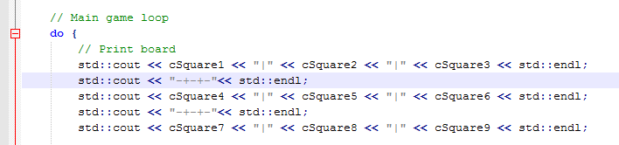
Game Loops
After initialization game began to move forward for main game loop these loops are while and do while loop which are encapsulated in statements that what to do or not to do.
Once we enter the game loop
The first thing will be done is print the game board which displays the tic tac toe game board in console window Remember we initialize these squares with characters from 1 to 9 for basic console input and output.
Presented by: Bushra Urooj | 1421 – 312129 / BSCS

Slide 11
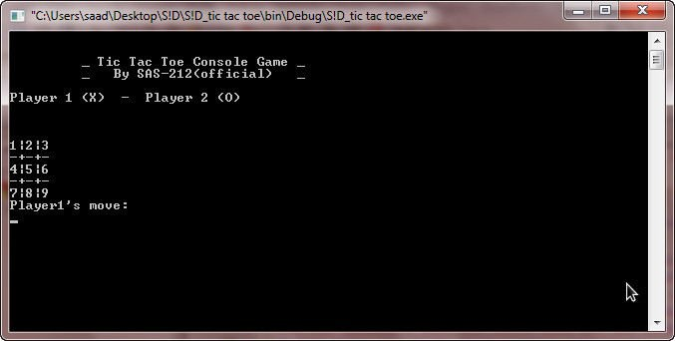
Game Loops
Notice that the console window prompts the player for move
The player's moves are handled by the next portion of code
When we run the program the board looks like this
Presented by: Bushra Urooj | 1421 – 312129 / BSCS

Slide 12
SAS-212 (OFFICIAL)
Tic Tac Toe | (Console Game)
C++ Program
Haseeb Ullah
Game Loops
( player's moves )
Preston University
ISLAMABAD 1421 – 212008 / BSCS
Tic Tac Toe C++ Program

Slide 13
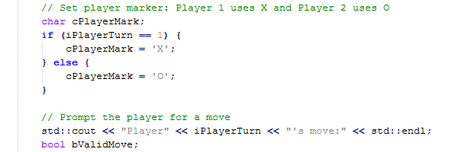
cPlayerMark determines that first player has X and second has 0 This portion of statements check for player turn if it's not the first player move its promoted the move to next player
Then the next line gets the valid move of the player
Presented by: Haseeb Ullah| 1421 – 212008 / BSCS

Slide 14
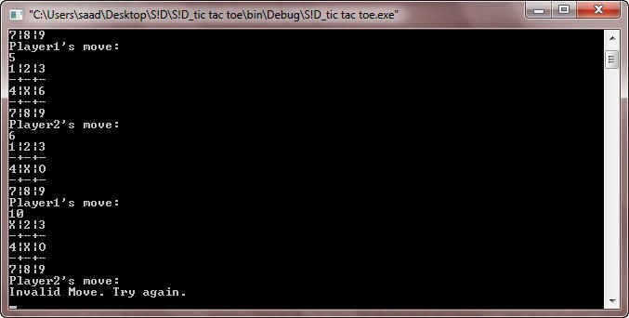
If players input an invalid move it's prompted for another move and says try again like this ..
A Screen Shot of an Invalid Move
Presented by: Haseeb Ullah| 1421 – 212008 / BSCS

Slide 15
SAS-212 (OFFICIAL)
Tic Tac Toe | (Console Game)
C++ Program
Kamran Shah
Game Loops
( player's moves )
Preston University
ISLAMABAD 1421 – 212271 / BSCS
Tic Tac Toe C++ Program

Slide 16
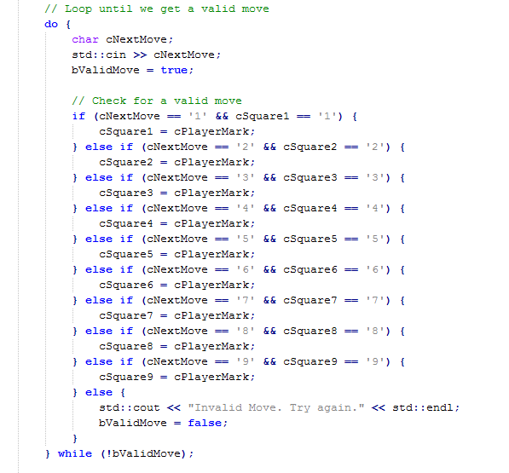
The cin statement gets the valid move for the player
Notice that it's begin with another loop it has pretty much statements to check the conditions.
The check for valid move is pretty large branch of square check.
Presented by: Kamran Shah| 1421 – 212271 / BSCS

Slide 17
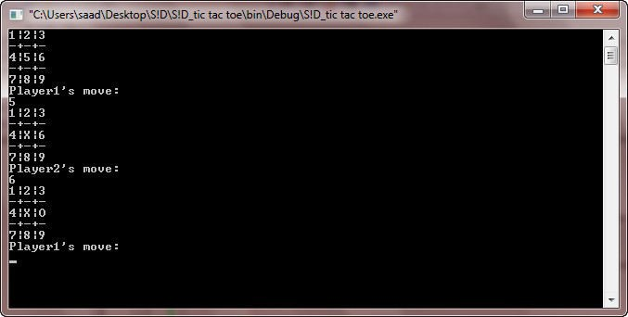
Each branch of the if statement makes two check, the first input check that the input is valid digit from 1 to 9 and second check is for make sure of the input is digit not an character, second check also make sure that the number which is entered not entered Previously
once a player moves the square changes like this.
Presented by: Kamran Shah| 1421 – 212271 / BSCS

Slide 18
SAS-212 (OFFICIAL)
Tic Tac Toe | (Console Game)
C++ Program
Saad Wazir
Game Loops
( player's moves )
Preston University
ISLAMABAD 1421 – 212019/ BSCS
Tic Tac Toe C++ Program

Slide 19
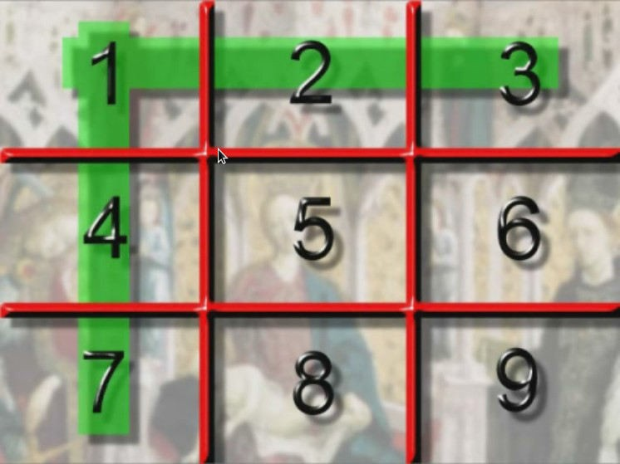
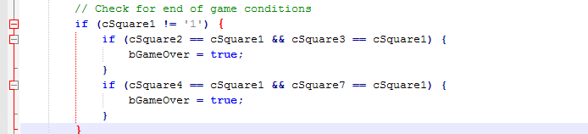
After the valid move the series of checks perform to check the games conditions.
Note there are the nine ways to end the game, 8 conditions to win the game and 1 condition for draw the game.
The first conditions check the ending game condition through
the walls of 1st square.
Presented by: Saad Wazir | 1421 – 212019 / BSCS

Slide 20
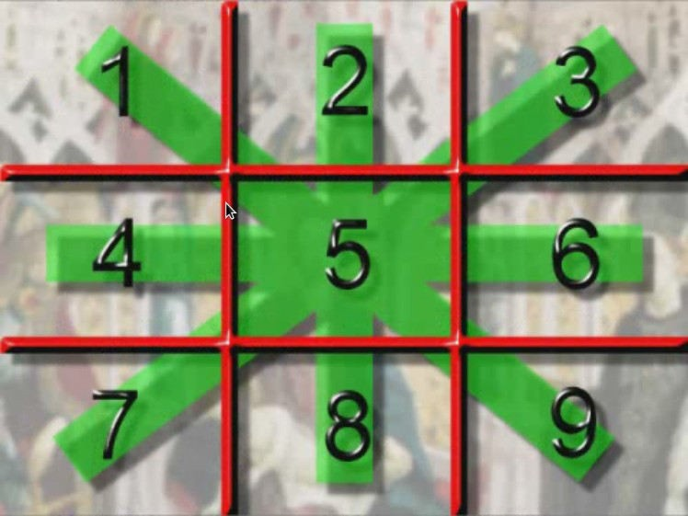
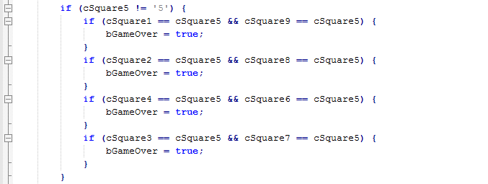
The second if statement handles the 4 cases from the middle 5th square .
Presented by: Saad Wazir | 1421 – 212019 / BSCS

Slide 21
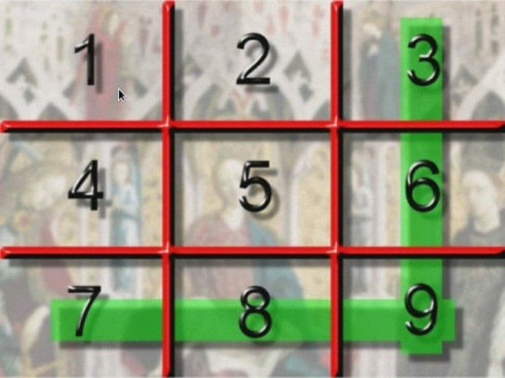
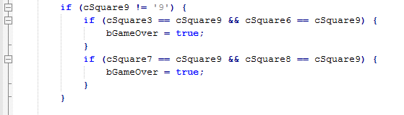
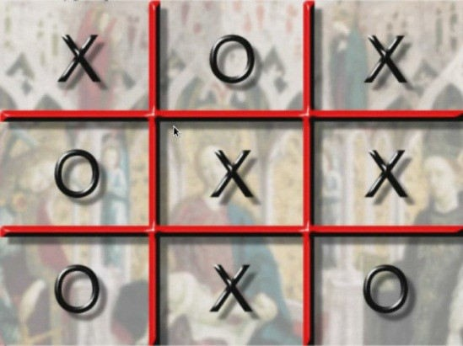
The third if statement handles the 2 cases from the 9th square
In each of these cases we check that the squares not equals to its number character.
This check ensures that we have an extra O and the other two checks make sure that the other two squares have the same O in the series like this one Those cases cover the win condition however game will be ended and draw like this.
Presented by: Saad Wazir | 1421 – 212019 / BSCS

Slide 22
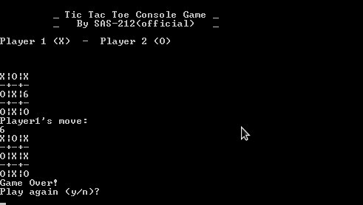
Screen Shot “ Game Draw”
Presented by: Saad Wazir | 1421 – 212019 / BSCS

Slide 23
SAS-212 (OFFICIAL)
Tic Tac Toe | (Console Game)
C++ Program
Abdul Rehman
Game Loops (Final Check)
Preston University
ISLAMABAD 1421 – 212010 / BSCS
Tic Tac Toe C++ Program

Slide 24
After that we print the ending board of the game and tells whose win and ask the user to play another game or quit If the user want play again the looping is continue and the board will be reset and the player turn also set back to 1
On the other hand the game will be quit .
Presented by: Abdul Rehman| 1421 – 212010 / BSCS

Slide 25
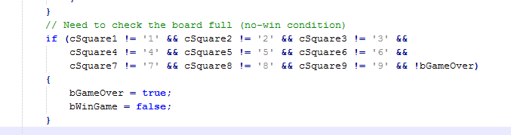
The final check takes cover of the case that game will be draw and all the squares will be marked.
When we determine that the game is over we run through over final condition
If the game is over we check for the game that someone is win the game Boolean which we set at the last part, if some has won then it will be last one or last player which is moved.
Presented by: Abdul Rehman| 1421 – 212010 / BSCS

Slide 26
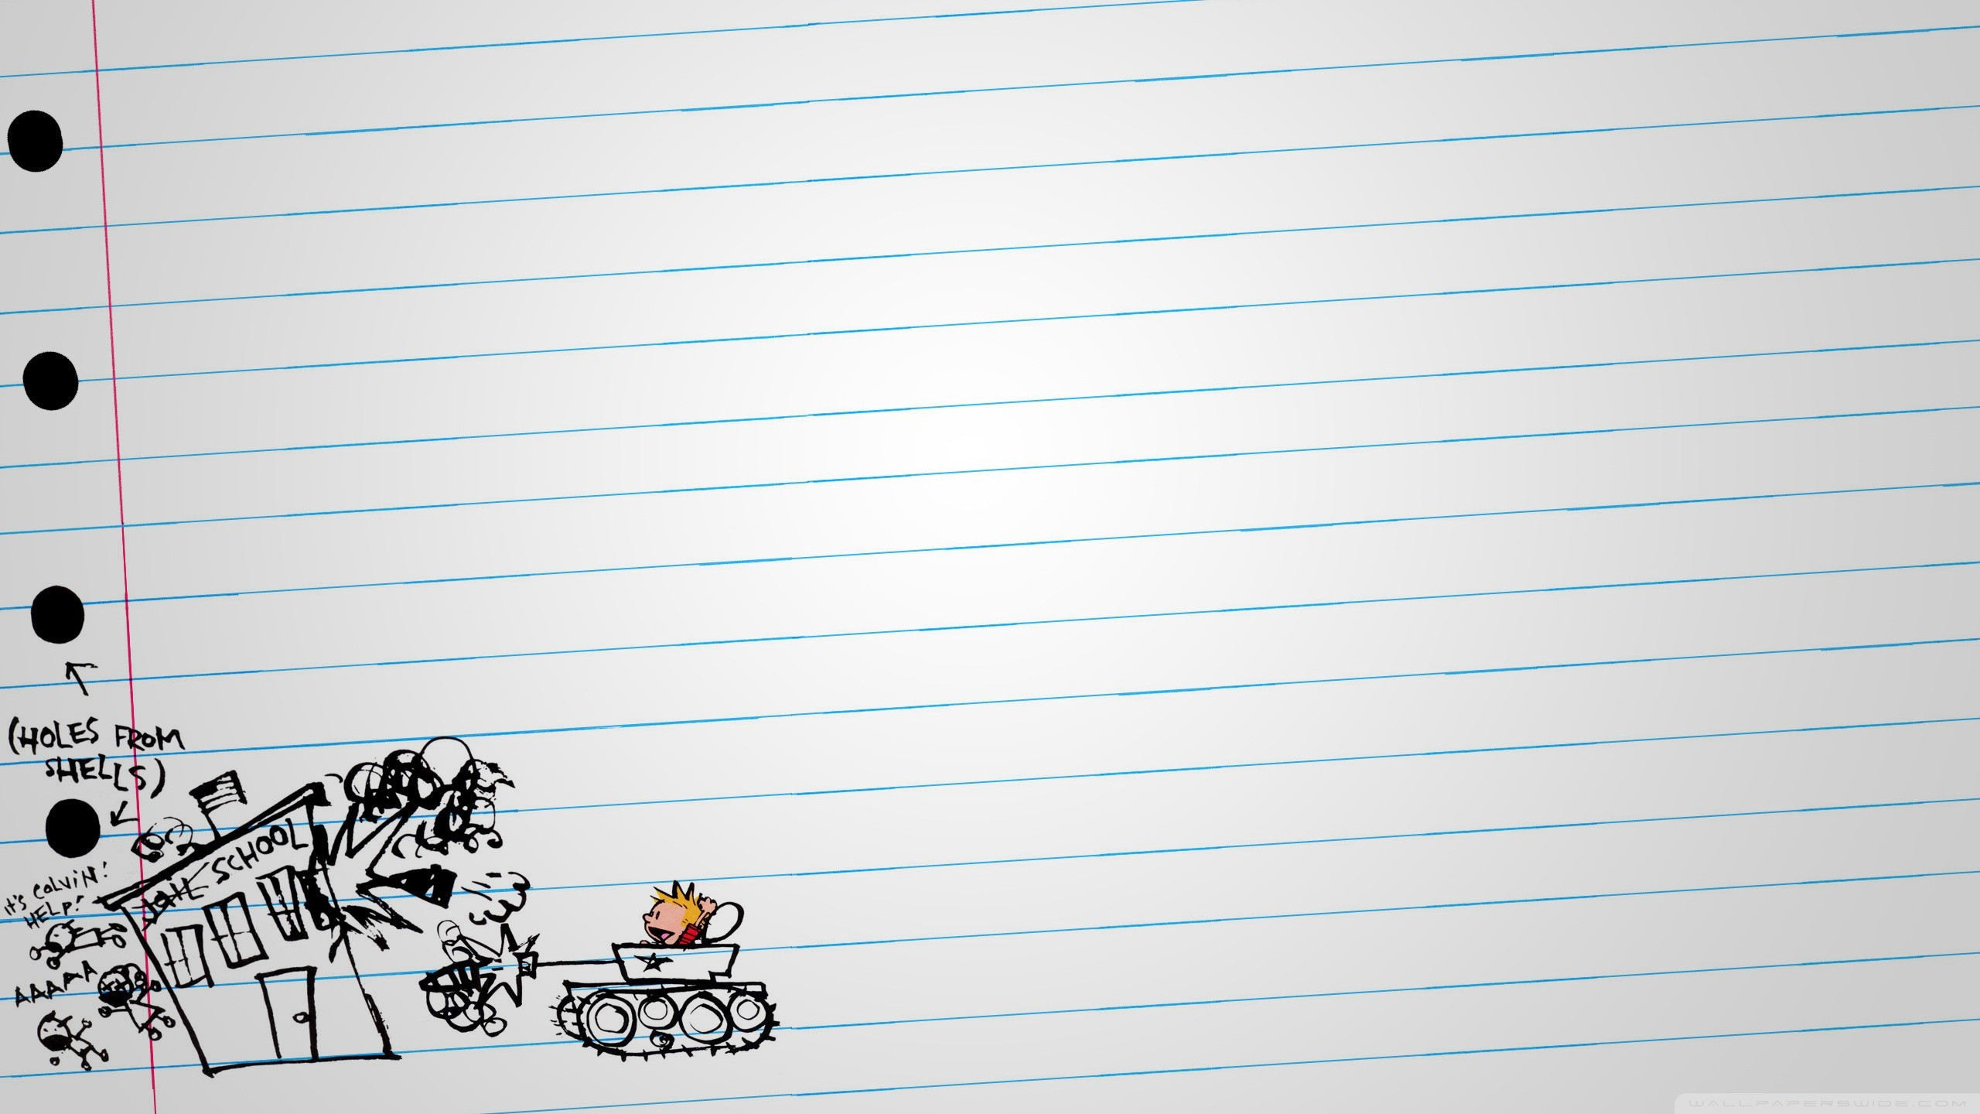
Game)
C++
Program
Tac
Toe
| (Console
Tic
ALLAH Hafiz
_{Hope y}ou Enjoy & Learn Something
Reference
:
2007
Xoax
)
( C++
Lesson
# 9
xoax.net
SAS-212
(OFFICIAL)

