Slide 1
INVESTMENT ASSIGNMENT SUBMISSION
Name: PRIYANKA ASTHANA

Slide 2
Business Objective
Spark Funds wants to make investments in a few companies.
The objective is to identify the best sectors, countries, and a suitable investment type for making investments. The overall strategy is to invest where others are investing, implying that the 'best' sectors and countries are the ones 'where most investors are investing'.
Spark Funds has two minor constraints for investments:
It wants to invest between 5 to 15 million USD per round of investment
It wants to invest only in English-speaking countries because of the ease of communication with the companies it would invest in

Slide 3
Goals of data analysis
Business goal is to facilitate decision making for SparkFunds CEO by presenting investment and funding type analysis in different countries. We will also analyse which are the sectors in which top 3 English speaking countries are investing. To achieve this, we will follow a methodology as described below.
Source
Data
Merge Data
Clean Data
Funding Type
Analysis
Sector Analysis
Data Visualization
Country
Analysis

Slide 4
Investment type analysis
Objective : Calculate the most representative value of the investment amount for each of the four funding types (venture, angel, seed, and private equity)
Constraint : Spark Funds wants to invest between 5 to 15 million USD per investment round
Based on calculations, venture type investment is most suitable for Spark Funds
Funding Type | Amount (million USD)
angel | 1.05
Private_equity | 74.85
seed | 0.72
venture | 12.10

Slide 5
Country analysis
Spark Funds wants to see the top nine countries which have received the highest total funding for recommended venture type funding.
Spark fund wants to invest in English speaking countries.
Country Code | Amount Raised (USD)
USA | 207345.60392
GBR | 18420.980421
CAN | 9078.46071
CHN | 8189.876491
IND | 8079.91516
DEU | 5732.918266
FRA | 5144.622483
ISR | 3996.600576
ESP | 3333.066278
Top 3 English Speaking Country
USA
GBR
INDIA

Slide 6
Sector analysis
Country | Main Sector | Total Amount Invested | Total Count
USA | Social, Finance, Analytics, Advertising | 10379.75603 | 1179
USA | Social, Finance, Analytics, Advertising | 10379.75603 | 1179
USA | Manufacturing | 3376.159534 | 379
USA | Social, Finance, Analytics, Advertising | 10379.75603 | 1179
USA | Others | 11441.14883 | 1293
IND | Entertainment | 237.304824 | 26
IND | Entertainment | 237.304824 | 26
IND | Others | 589.442653 | 65
IND | Cleantech / Semiconductors | 89.855661 | 11
IND | Others | 589.442653 | 65
GBR | Social, Finance, Analytics, Advertising | 986.919413 | 115
GBR | News, Search and Messaging | 719.293021 | 81
GBR | Cleantech / Semiconductors | 567.986522 | 60
GBR | Manufacturing | 312.945583 | 33
GBR | Social, Finance, Analytics, Advertising | 986.919413 | 115

Slide 7
Potential Investment Opportunity
Plot showing investment for each funding type – Venture FT is in range of 5 to 15 million USD

Slide 8
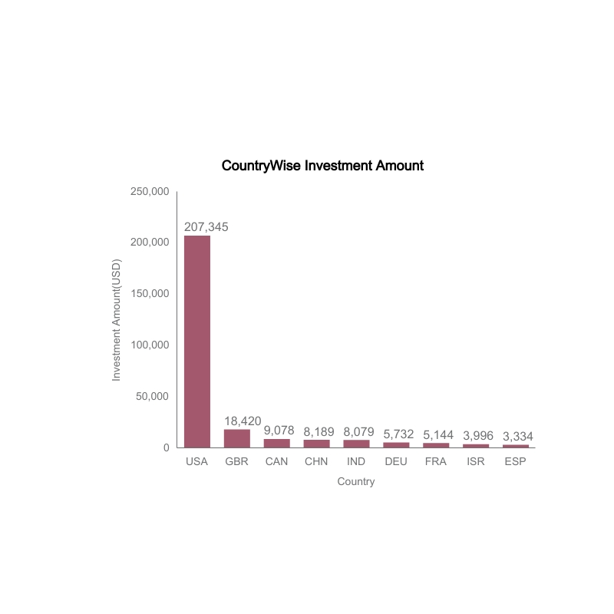
Top 9 countries with total amount of investments for funding type venture
Spark Funds wants to invest in top 3 English speaking countries. So USA, GBR, India are countries to invest. Let us analyze sectors in these countries to invest

Slide 9
Top 3 Sectors in USA, GBR, India

Slide 10
Conclusions
As per data analysis, Spark Fund is recommended to invest in venture funding type as it meets the financial constraints.
Spark Fund should invest in USA, Great Britain (GBR) and India in their top 3 sectors respectively
USA | Social , Finance, Analytics, Advertising, Manufacturing, Others
Great Britain | Social , Finance, Analytics, Advertising, Manufacturing, CleanTech
India | Entertainment, Others, CleanTech

