Slide 1
LENDING CLUB EDA ASSIGNMENT SUBMISSION
Name: PRIYANKA ASTHANA
Rahul Sharma

Slide 2
Business Objective
LendingClub is the largest online loan marketplace, facilitating personal loans, business loans, and financing of medical procedures. Borrowers can easily access lower interest rate loans through a fast online interface.
Like most other lending companies, lending loans to ‘risky’ applicants is the largest source of financial loss (called credit loss). The credit loss is the amount of money lost by the lender when the borrower refuses to pay or runs away with the money owed. In other words, borrowers who default cause the largest amount of loss to the lenders. In this case, the customers labelled as 'charged-off' are the 'defaulters'. If one is able to identify these risky loan applicants, then such loans can be reduced thereby cutting down the amount of credit loss.
Aim of this case study is identification of risky applicants using EDA.
The company wants to understand the driving factors (or driver variables) behind loan default which are strong indicators of default. The company can utilise this knowledge for its portfolio and risk assessment.

Slide 3
Goals of data analysis
Business goal is to gain insight using loans dataset for Charged-Off applicants. To achieve this, we will follow a methodology as described below.
Source
Data
Clean Data(Drop Empty Columns)
Univariate
Analysis
Data Visualization
Recommendation
Bivariate Analysis

Slide 4
Univariate Analysis
Objective : Frequency Plotting of variables to gain insight.
Initial Observations :
85.6% have Fully Paid the loan
14.4% are 'Charged Off
36 months loan is preferred for both ‘PAID FULLY’ and ‘CHARGED OFF’
Home ownership as “OWN” is approximately same for both ‘PAID FULLY’(7.7%) and ‘CHARGED OFF’(7.9%). So owning house does not give any insights.

Slide 5
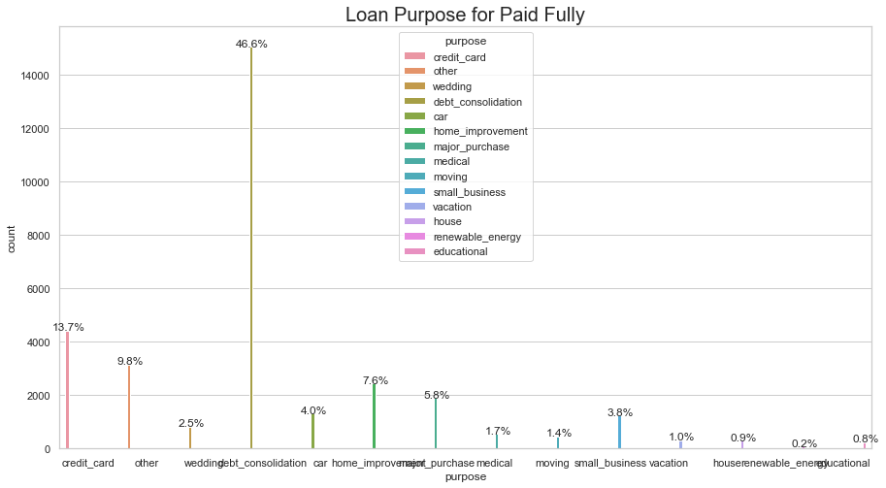
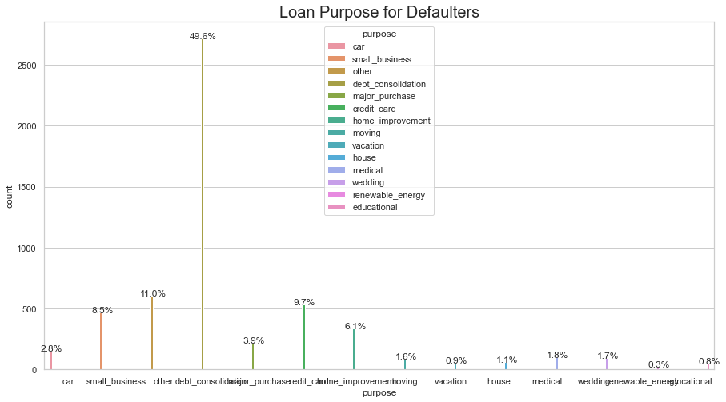
Univariate Analysis – Loan Purpose Frequency plot
Debt Consolidation is the top reason for loans.
Top 5 loan purpose for Charged Off applicants –
Debt Consolidation(49.6%), Other(11%) , CreditCard(9.7%), Small Business(8.5%), Home improvement(6.1%)

Slide 6
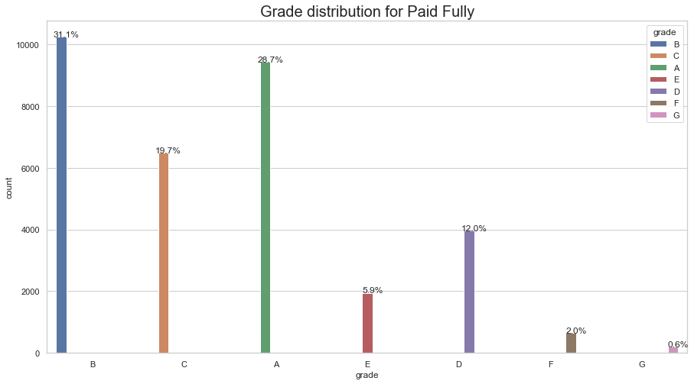
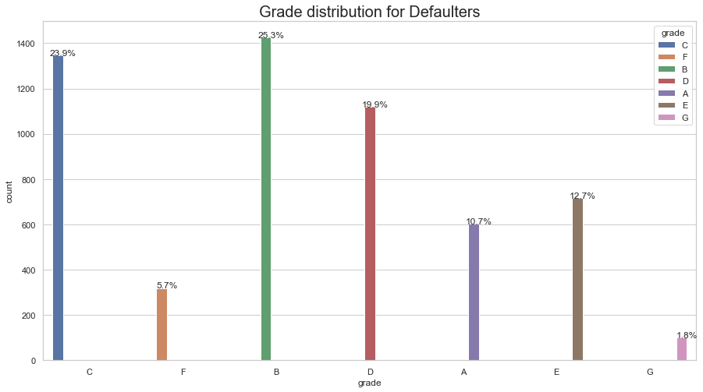
Univariate Analysis – Grade Frequency plot
80 % Defaulters are in Grade B (25.3%), C (21.9%), D(19.9%), E (12.7%)
80% Paid Fully are in Grade A(28.7%), B(31.1%) and C (19.7%)

Slide 7
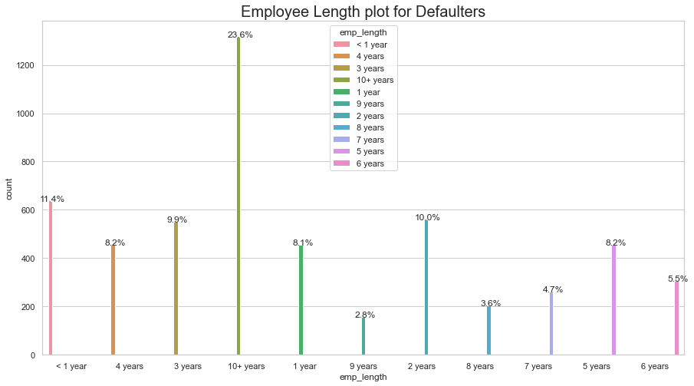
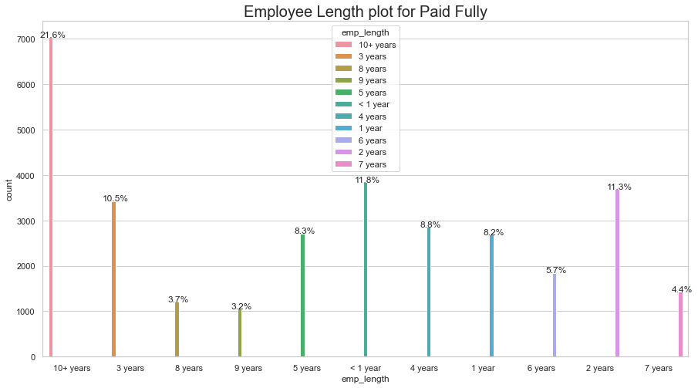
Univariate Analysis – emp_length Frequency plot
60 % of the applicants are less than 8years of experience

Slide 8
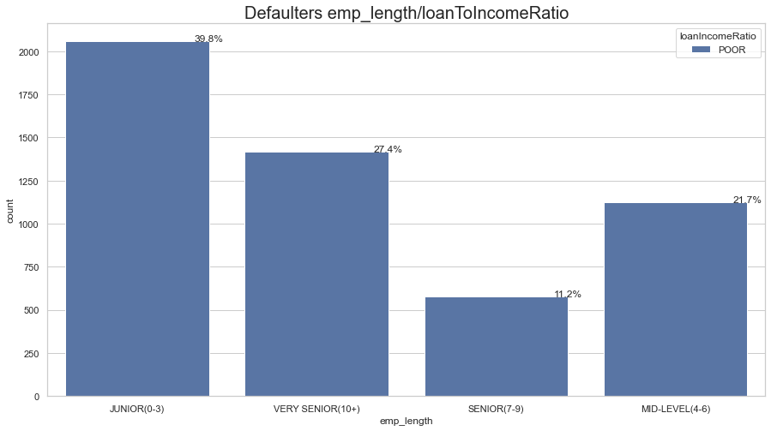
Bivariate Analysis – emp_length/loanIncomeRatio
Applicants at Junior, Very Senior, Mid level have Poor loanIncomeRatio so they are risky applicants

Slide 9
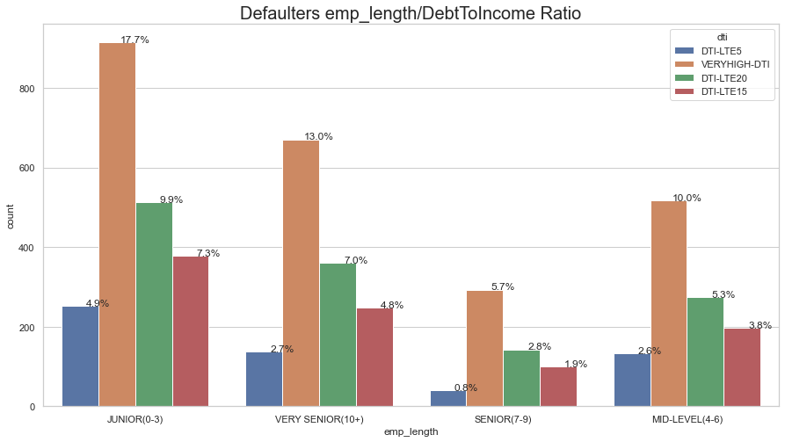
Bivariate Analysis – emp_length/DebtToIncome ratio
Applicants at Junior and Very Senior level have High DebtToIncome Ratio so they are risky applicants

Slide 10
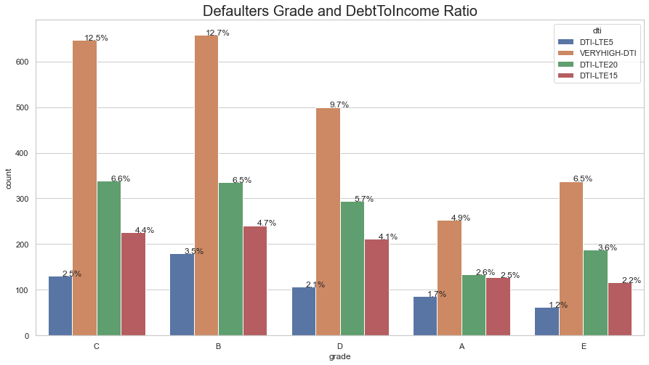
Bivariate Analysis – Grade/DebtToIncome ratio
Applicants in Grade B,C and D have High DebtToIncome Ratio so they are risky applicants

Slide 11
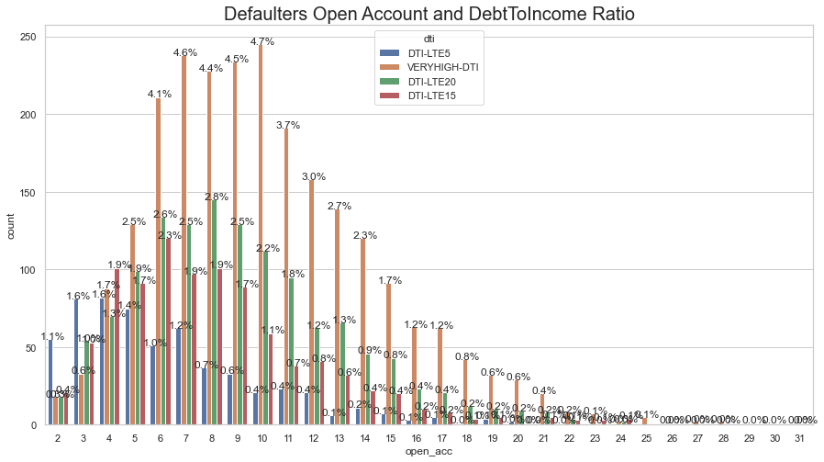
Bivariate Analysis – Defaulters address state and DebtToIncome plot
DebtToIncome ratio increases as number of open accounts increases

Slide 12
Recommendations
As per data analysis, following observations are seen and thorough verification process should be followed-
Applicants at Junior level and Very Senior level (10+ years) with High and Very High DTI are risky applicants
Applicants in state of CA have high DTI so thorough verification process should be followed in state of CA.
Applicants whose loan purpose is Debt consolidation, Others, small business have high risk of being charged off
Loans in grade B and C are more likely to be charged-off
Applicants across all levels have poor ratio of loan amount and annual income. Such loans should be judiciously sanctioned. ~40% applicants at Junior level have POOR loan/Income ratio. So this should be paid attention

