Slide 1
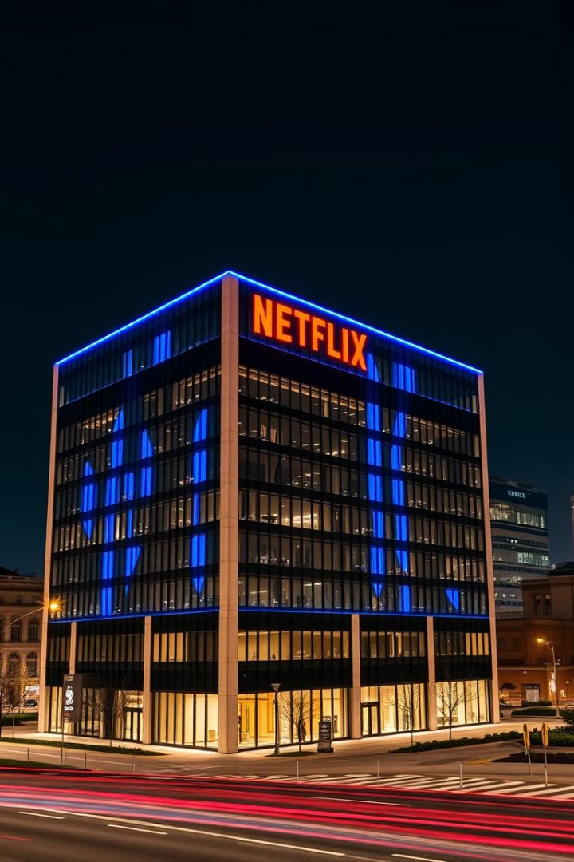
Netflix Global Subscriber Trends: A Data-Driven Analysis by Shivam Asthana, MBA 2024
This comprehensive data analysis, conducted by Shivam Asthana, a Master of Business Administration graduate in 2024, examines the key drivers behind Netflix's global subscriber growth and retention trends. By leveraging insights on viewing habits, regional preferences, and content performance, this project aims to optimize Netflix's content strategy, improve personalized recommendations, and enhance the overall user experience to boost long-term profitability and customer loyalty.

Slide 2

Global Subscriber Growth Trends
2016-2018: Rapid Expansion
2021-2023: Intensifying Competition
Netflix experienced exponential growth, adding over 50 million new subscribers globally, driven by investments in original content and international market expansion.
The streaming landscape became increasingly competitive, with the emergence of new players and evolving consumer preferences. Netflix adapted by strengthening its content pipeline and personalization capabilities to maintain subscriber growth.
1
2
3
2019-2020: Steady Increase
Subscriber growth continued, albeit at a more moderate pace, as Netflix focused on enhancing the user experience and expanding its content library to cater to diverse regional preferences.

Slide 3
Analyzing User Engagement and Churn
Viewing Habits
Churn Drivers
Regional Differences
Netflix's comprehensive data on user viewing patterns reveals insights into content preferences, session durations, and device usage across different regions. This information helps the company tailor its content and user experience to better meet the evolving needs of its global audience.
By analyzing user retention data, the analysis identifies key factors contributing to subscriber churn, such as content availability, pricing, and competing service offerings. This knowledge enables Netflix to implement targeted strategies to improve customer loyalty and minimize undesirable attrition.
Netflix's subscriber base exhibits diverse preferences and behaviors based on geographic location. This analysis delves into regional nuances, allowing the company to optimize its content, marketing, and pricing strategies to cater to the unique needs of different markets and enhance subscriber engagement.

Slide 4
Content Strategy Optimization
1
Data-Driven Content Curation
2
Personalized Recommendations
3
Regional Content Localization
By leveraging insights from viewing data, Netflix can strategically curate and produce content that aligns with the preferences and viewing habits of its global subscriber base. This data-driven approach ensures the company's content investments deliver maximum engagement and retention.
Netflix's recommendation engine is a key driver of user engagement and loyalty. This analysis provides recommendations on enhancing the personalization algorithms to offer more tailored suggestions, ultimately improving the user experience and reducing churn.
To cater to diverse global markets, Netflix should focus on localizing its content offerings, including dubbing, subtitling, and producing region-specific original programming. This strategy will help the company better resonate with subscribers in different cultural and linguistic contexts.

Slide 5
Enhancing the User Experience
Seamless Multidevice Experience
Improved Content Discovery
Netflix should continue to optimize its user interface and functionality across various devices, ensuring a consistent and seamless viewing experience for subscribers, regardless of the platform they use to access the service.
By refining its search and discovery mechanisms, Netflix can help users navigate its expansive content library more efficiently, enabling them to find and engage with the most relevant and appealing titles.
Personalized Notifications
Expanded Accessibility
Leveraging user data, Netflix should provide personalized notifications to subscribers about new content releases, upcoming seasons of their favorite shows, and other relevant updates, further enhancing engagement and retention.
To cater to a diverse global audience, Netflix should continue to invest in accessibility features, such as improved subtitling, audio descriptions, and support for various languages, ensuring an inclusive user experience.

Slide 6




Leveraging Data for Improved Profitability
Subscriber Insights
Content Performance Analysis
Personalized Monetization
By deeply understanding user preferences, engagement patterns, and churn drivers, Netflix can make strategic decisions to optimize its content investments, pricing structures, and marketing efforts to drive long-term profitability.
Analyzing the performance of its content offerings, including viewership, user ratings, and engagement metrics, will enable Netflix to identify high-performing titles and allocate resources accordingly, maximizing the return on its content investments.
Leveraging user data, Netflix can implement personalized pricing and monetization strategies, such as tailored subscription plans and add-on features, to capture greater value from its subscriber base while maintaining high levels of customer satisfaction.

Slide 7




Regional Growth Opportunities
Emerging Markets
Mobile-First Approach
Strategic Partnerships
Localization Efforts
Netflix should continue to focus on expanding its presence in high-growth, underserved markets, such as parts of Asia, Africa, and Latin America, to capture market share and drive subscriber growth in these regions.
Continued investment in localization, including language support, regional content production, and culturally relevant marketing, will enable Netflix to better cater to the preferences and needs of diverse global audiences.
Recognizing the increased mobile consumption of content, Netflix should optimize its platform and content delivery for mobile devices, especially in regions where mobile is the primary means of accessing digital entertainment.
Forging strategic partnerships with local telecommunication providers, content creators, and other ecosystem players can help Netflix expand its reach and tap into new customer segments in various regional markets.

Slide 8
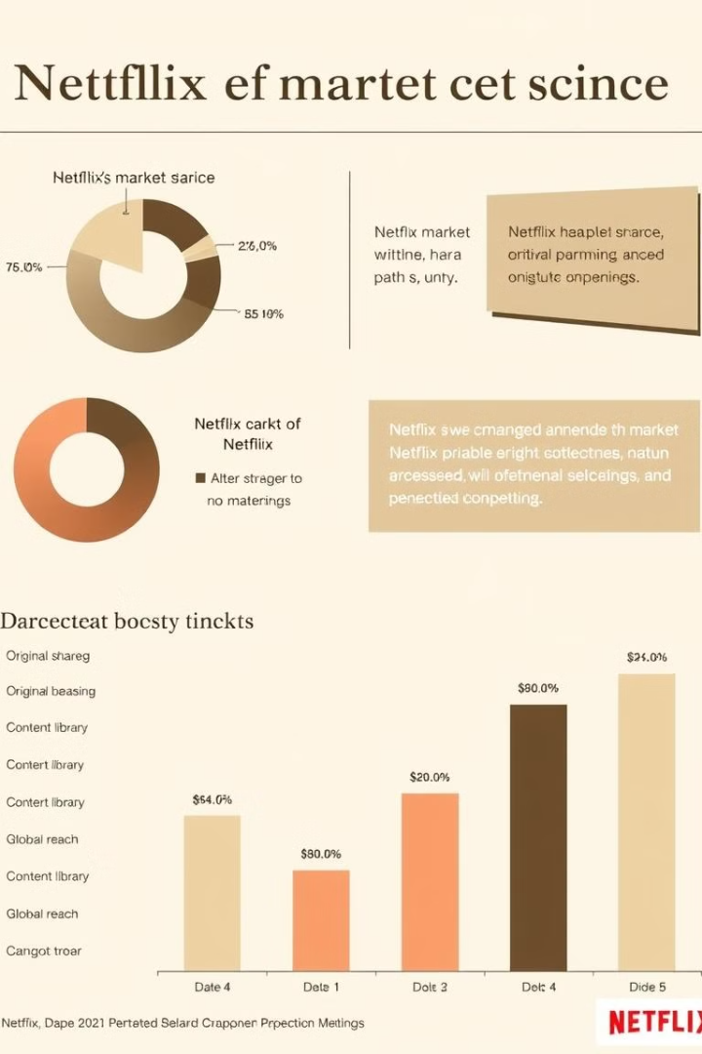
Strengthening Competitive Advantage
Key Competitive Factors
Netflix's Strengths
Recommended Strategies
Content Breadth and Quality
Netflix's extensive content library and continued investment in original programming
Further diversify content offerings, invest in local and regional content, and leverage data-driven content curation
Personalization and Recommendation
Netflix's advanced recommendation engine and user data analytics capabilities
Enhance personalization algorithms, leverage user insights to improve recommendations, and expand personalized features
User Experience and Accessibility
Netflix's focus on seamless multi-device experience and accessibility features
Continually optimize the user interface, expand accessibility options, and provide a consistent, high-quality experience
Global Expansion and Localization
Netflix's successful international expansion and localization efforts
Prioritize growth in underserved markets, invest in regional content production, and deepen local partnerships

Slide 9

Conclusion: Unlocking Netflix's Full Potential
This comprehensive data analysis provides Netflix with a roadmap to unlock its full potential and solidify its position as the global leader in the streaming industry. By leveraging deep insights into user engagement, content performance, and regional growth opportunities, Netflix can optimize its strategies to drive sustainable subscriber growth, enhance customer loyalty, and maximize long-term profitability. With a continued focus on data-driven innovation, personalized user experiences, and strategic global expansion, Netflix is poised to cement its dominance in the rapidly evolving streaming landscape.

