Slide 1
Industrial Workforce Classification
Data Analysis & Machine Learning Project
Aastha Saxena

Slide 2
Problem Statement
• Analyze workforce distribution across industries
• Classify industry categories using ML
• Identify trends in Main and Marginal workers
• Build interactive Streamlit dashboard

Slide 3
Tools & Technologies Used
• Python
• Pandas & NumPy
• Matplotlib
• Scikit-learn
• Streamlit
• Jupyter Notebook

Slide 4
Approach
1. Data Cleaning & Column Standardization
2. Exploratory Data Analysis (EDA)
3. Feature Engineering
4. Model Training (Logistic Regression)
5. Dashboard Deployment

Slide 5
EDA Insights
• Main workers significantly higher than marginal workers
• Rural workforce larger than urban workforce
• Gender gap exists in industrial participation
• Certain industries dominate employment share

Slide 6
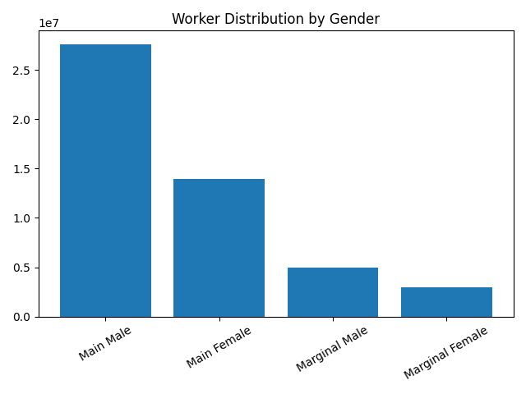
Worker Distribution by Gender

Slide 7
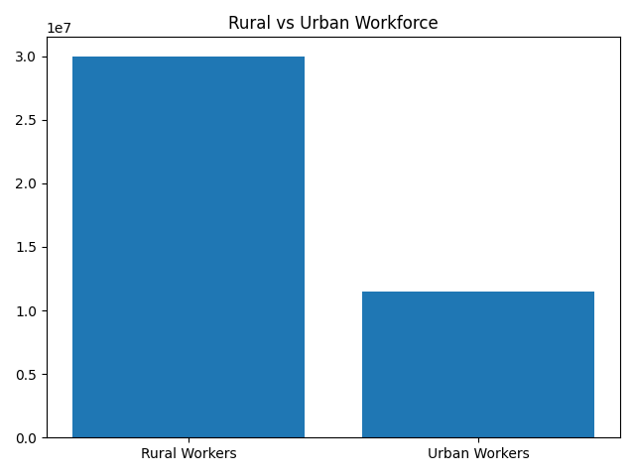
Rural vs Urban Workforce

Slide 8
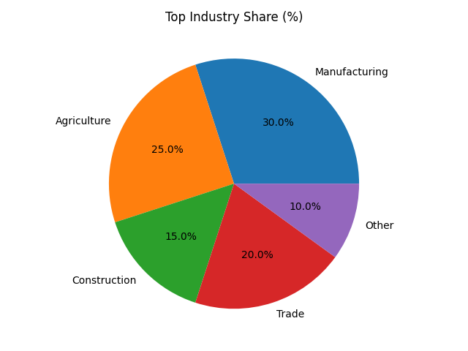
Industry Share

