Slide 1

TRAVEL &TOUR MANAGEMENT
GUIDED BY-
Mr. Rakesh Tiwari
SUBMITTED BY-
ASTHA SHARMA
NEHA CHAUKIKAR
PINKY BILARE
NIKITA GAUTAM

Slide 2
KEYPOINTS
Introduction
Description
Purpose
Scope
Assumption
Hardware & software requirements
Project overview
Salient features
Intended user
Data flow diagram
Use case diagram
E-R diagram
Packages
Advantages
Risks
Conclusion

Slide 3
Introduction-
A travel agency is a retail business that sells travel related products and services to customers on behalf of suppliers as airlines, hotels, railways, sightseeing tours and package holidays . They help you find a vacation to go on and at the cheapest price. There are travel agencies that serve as general sales agents for foreign travel companies, allowing them to have offices in countries other than where their headquarters are located. The British company Cox & Kings is sometimes said to the oldest travel agency in the world , established in 1758.
Our product “Travel and Tour Management Software” is the simulation of policies and services provided by travel agencies enhanced with technical support. We are providing a software for travel agencies to deal with national as well as international tourists, which is easy to use for technical and non technical users as well.

Slide 4
DESCRIPTION

Slide 5
Purpose-
The purpose of this document is to describe all the requirements
for the travel and tour management system. The intended audience
includes all stakeholders in the potential system.
Developers should consult this document and its revisions as the only source of requirements for the project.
The Travel & tourism management and its team members should use this document and its revisions as the primary means to communicate confirmed requirements to the development team.
The development team expects many face-to-face conversations that will undoubtedly be about requirements and ideas for requirements.

Slide 6
Scope-
The proposed software product is the travel and tourism management system. The system will be used to provide information to the customers about
the travel agency. This software also give information about various tourist
places in India as well as abroad.
Also this software give information about the expenses.
Our software takes all the information and records of customers while registering them. Customer can view all the information about agency directly through the software. They can resister themselves if they want to use our tour packages.
The current system in use for this purpose is a paper-based system. Brochures are used by travel agencies for it. These can be replaced by
our software. It saves paper which is economically beneficial for travel agencies as well as good for environment.
Our product is a desktop application. Future prospects of this project is that we can enhance it to web based application thus our services will be provided online.

Slide 7
Assumption-
Employees and customers have basic computer operating skills.
Any employee working at the travel agency can log in as administrator. A password will be provided to the agency by us.
Customer provides all necessary details while registering.
Customer doesn’t have to see profile of other registered customers.
Employee will manage the information of customer. Customer’s e profile can be viewed by employee.
Travel agency is covered by insurance policy.

Slide 8
Hardware & Software Requirement
Software required is turbo C++
This software can run on windows XP and windows 7.
Microprocessor used is Intel core duo.
Hard disk : minimum 59.8 KB
RAM : minimum 60 KB

Slide 9
Project Overview

Slide 10
Salient features
Different admin and customer login facility is provided.
Our product will provide information about packages provided
by travel agencies.
Software will provide tourist guide book to the customers.
Software will also provide traveling tips to the customers
Customers can submit their queries to the agency.
System administrator can answer queries of customers.
Customer can give their feedback about the services provided
by the travel agency.
User can view frequently asked questions and their answers as well as
feedback.
Customers can contact to the agency via email and telephone.
Administrator can submit or change contact details.
Booking for package can be done himself by customer.
Every package include details about category of package,
validity, departure, transportation, accommodation, duration
and net expenses.
Package ID will be mentioned with each package.

Slide 11
Intended user
Administrator of travel agency.
Employees of a company going along for Corporate tour.
Students and teachers going for School or college trip.
Tourist who want a family trip.
Personal tour.

Slide 12
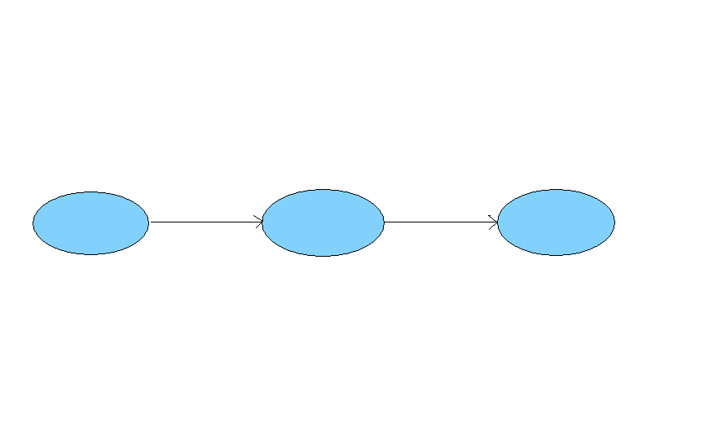
DATA FLOW DIAGRAM
Level 0-
Admin
Travel & Tour Management
Customer

Slide 13
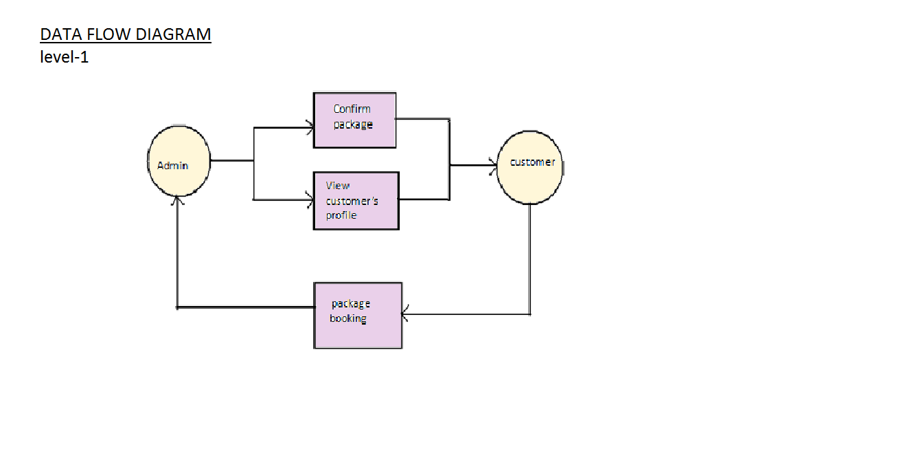

Slide 14
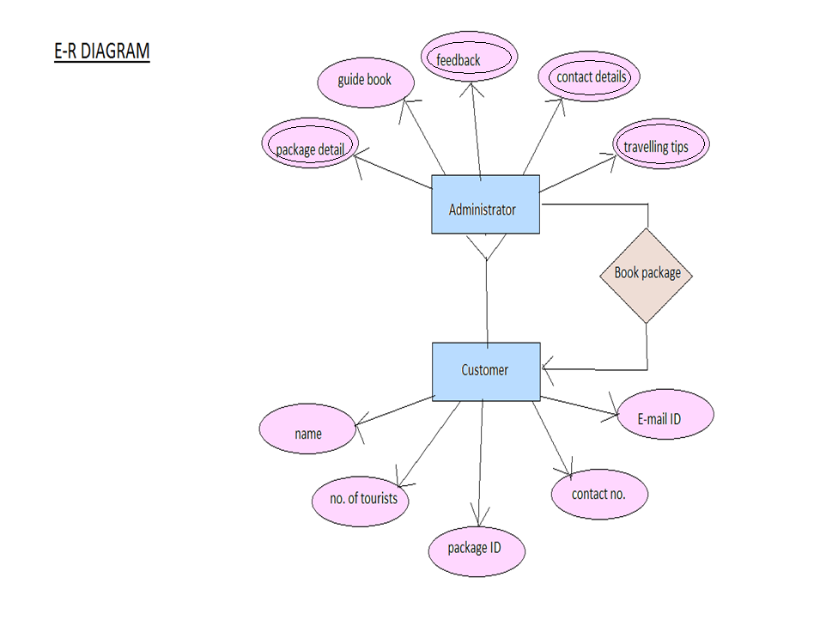

Slide 15
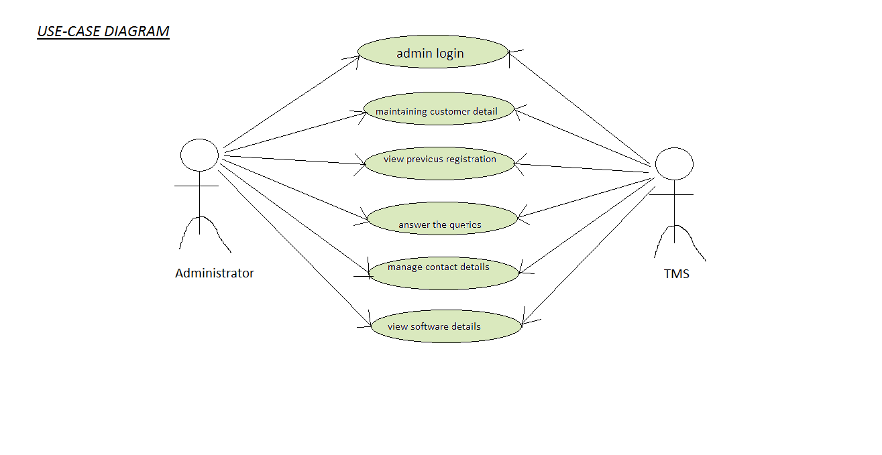

Slide 16
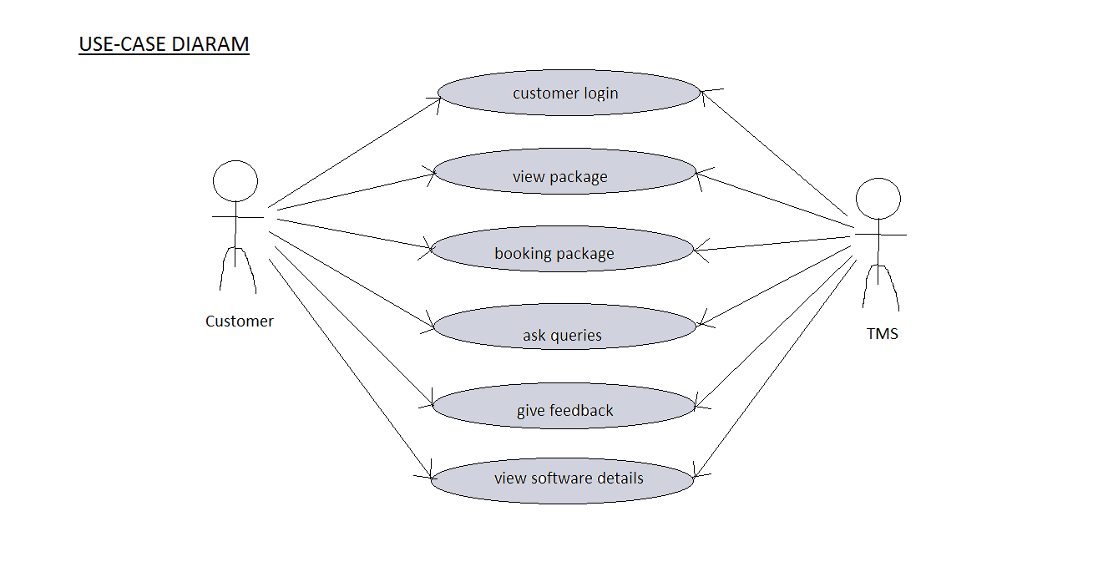

Slide 17
Tour Packages

Slide 18
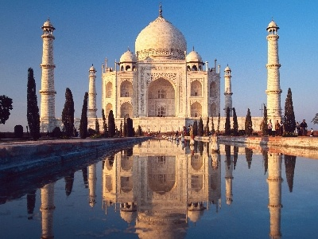
BEAUTY OF HIMALAYAS AND
TAJ MAHAL

Slide 19
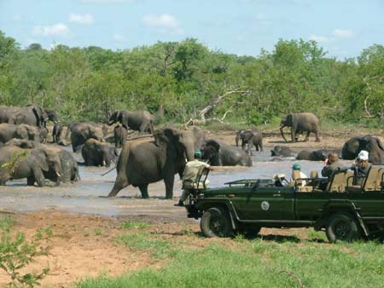
SOUTH AFRICAN DELIGHT

Slide 20

GORGEOUS MALDIVES

Slide 21
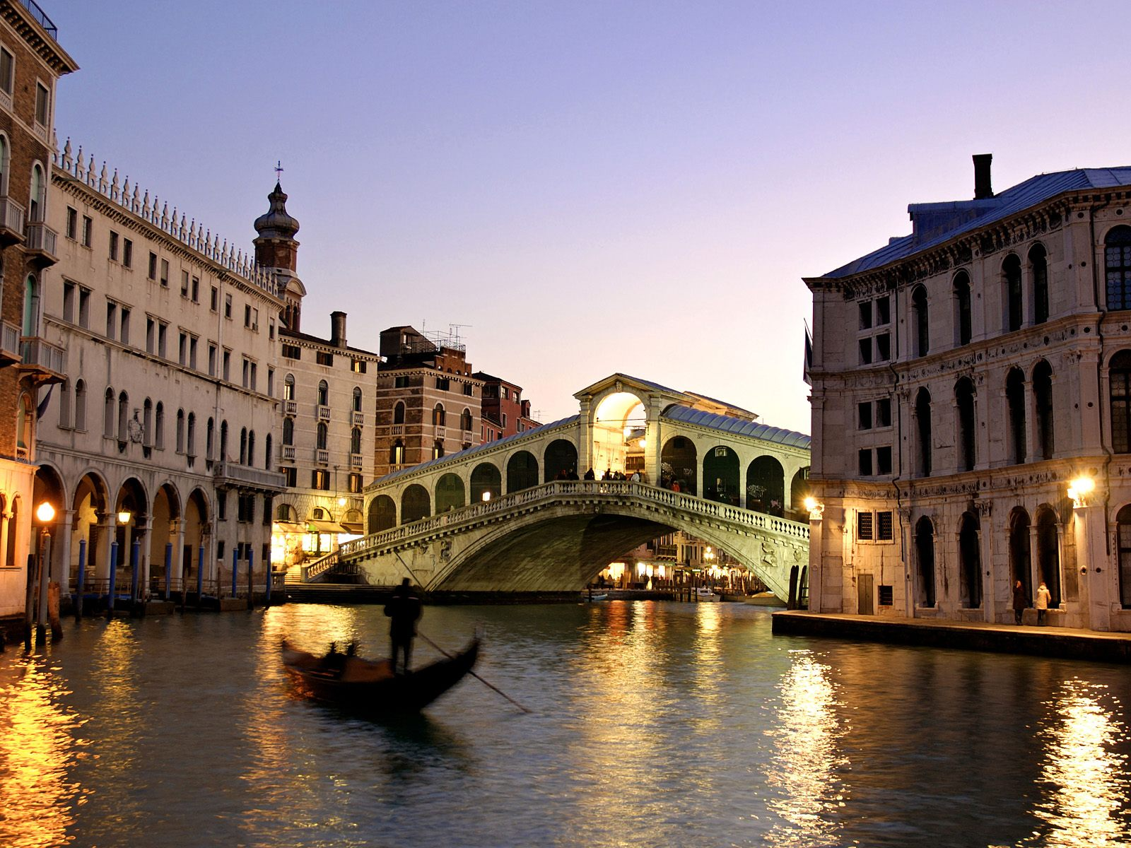
CLASSIC ITALY

Slide 22
Advantages of the Product
No hardware purchase or maintenance is needed.
Easy access
Can be easily provided worldwide.
Improved efficiency, reduce costs.
Software will be designed in that way that it will provide rich
user experience, so that the users would get attracted
towards it.
Automated process of requesting and approving travel.
Speedy access
Software will Satisfy travelers & employees with
its superior service.

Slide 23
Result
Administrator can log in via facility of administrator login required a password. His name will be asked by the program. After login he can view the tour packages, guide book. Travel tips, FAQ, Feedback given by customers, previous booking details, contact information, software details.
Customer can login by same procedure but password is not required. He can view tour packages, guide book, traveling tips, FAQ, Feedback, Contact details and he can register himself for the tour and the package will be booked for him.

Slide 24
RISKS
Our software is not platform independent.
Product should be developed within deadline.

Slide 25
Conclusion
Project took 15 days to complete.
Project is developed modularly.

Slide 26


Slide 27
QUESTION
PLEASE???

