Slide 1
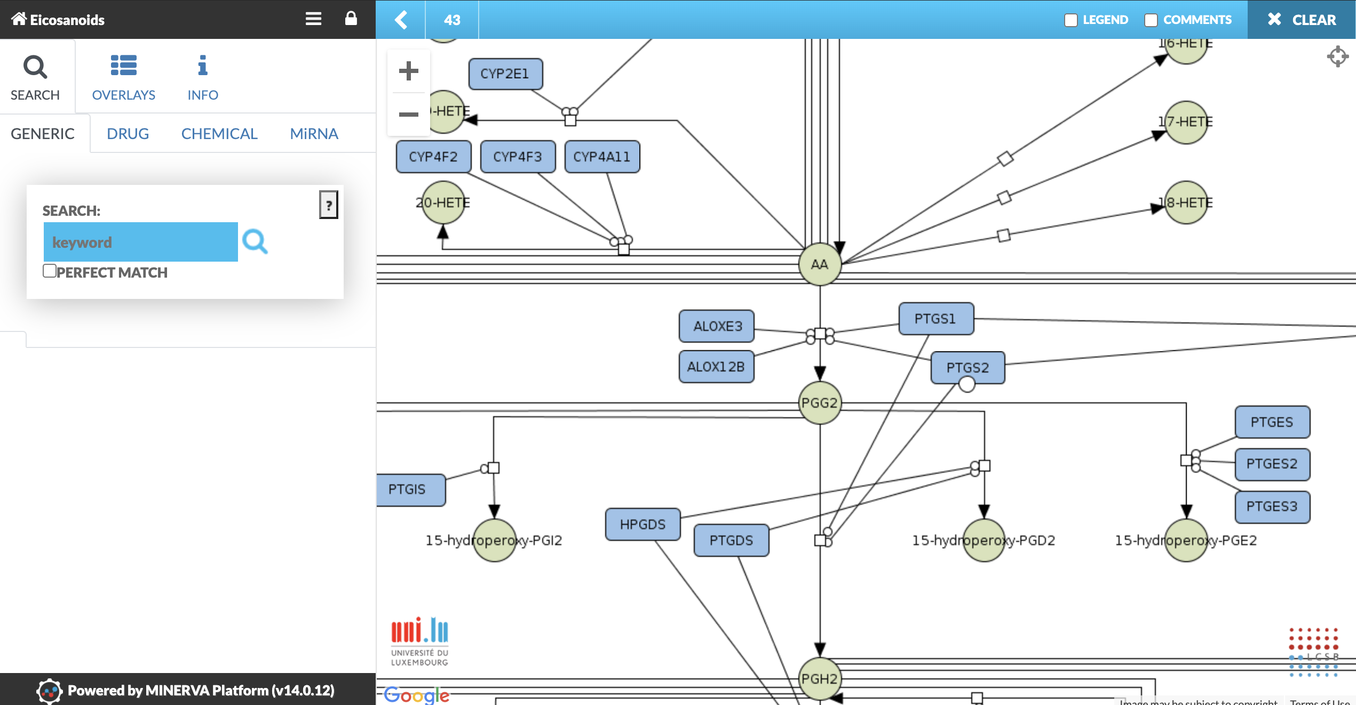
Adding comments

Slide 2
Adding comments

Slide 3
asth
ma
map

Slide 4
asth
ma
map

Slide 5
asth
asth
asth
ma
ma
ma
map
map
map

Slide 6
asth
asth
asth
ma
ma
ma
map
map
map

Slide 7
asth
asth
asth
ma
ma
ma
map
map
map

Slide 8
asth
asth
asth
ma
ma
ma
map
map
map

Slide 9
systems
disease
medicine
maps

