Slide 1
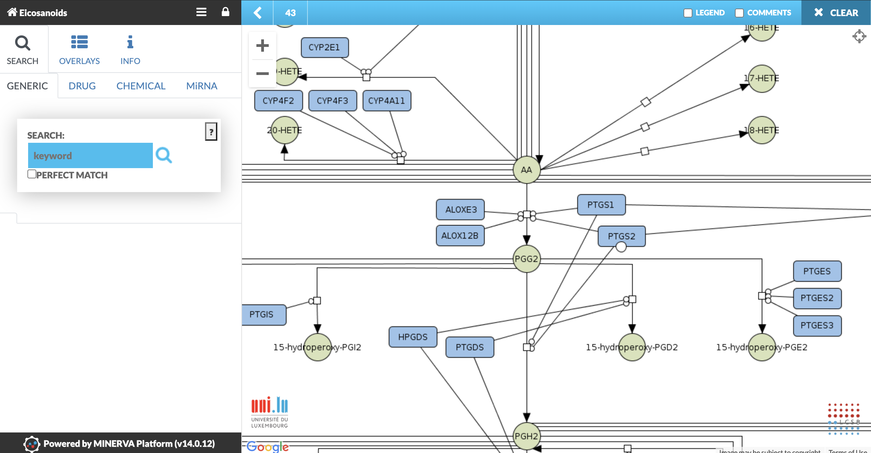
Adding comments

Slide 2
Adding comments

Slide 3
Adding comments

Slide 4
Commenting

Slide 5
Adding comments

Slide 6
Adding comments

Slide 7
Adding comments

Slide 8
asth
ma
map

Slide 9
asth
ma
map

Slide 10
asth
asth
asth
ma
ma
ma
map
map
map

Slide 11
asth
asth
asth
ma
ma
ma
map
map
map

Slide 12
asth
asth
asth
ma
ma
ma
map
map
map

Slide 13
asth
asth
asth
ma
ma
ma
map
map
map

Slide 14
asth
asth
asth
ma
ma
ma
map
map
map

Slide 15
asth
asth
asth
ma
ma
ma
map
map
map

Slide 16
asth
asth
asth
ma
ma
ma
map
map
map

Slide 17
systems
disease
medicine
maps

