Slide 1





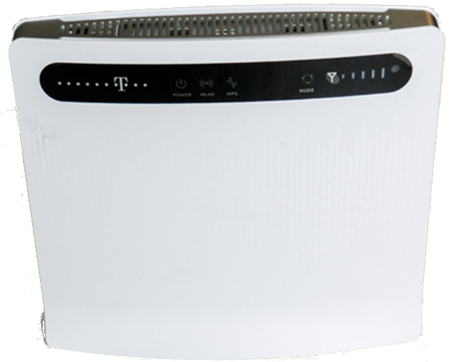


WIFI
internet
Ethernet
Switch
Switch
Router
GSM
Switch
internet
Ethernet
Switch
Switch
Router
GSM

Slide 2
WIFI
PC3
internet
Ethernet
Switch
Switch
Router
GSM

Slide 3



S
Switch
M
internet
Ethernet
Switch
Switch
Router
GSM
M2
S
S2
Switch
M
internet
Ethernet
Switch
Switch
Router
GSM

Slide 4

WIFI
Router
internet
Ethernet
GSM
Switch
Switch
M
S
WIFI
Router
GSM
internet
Switch
Ethernet
Switch
M
S2
S
M2

Slide 5

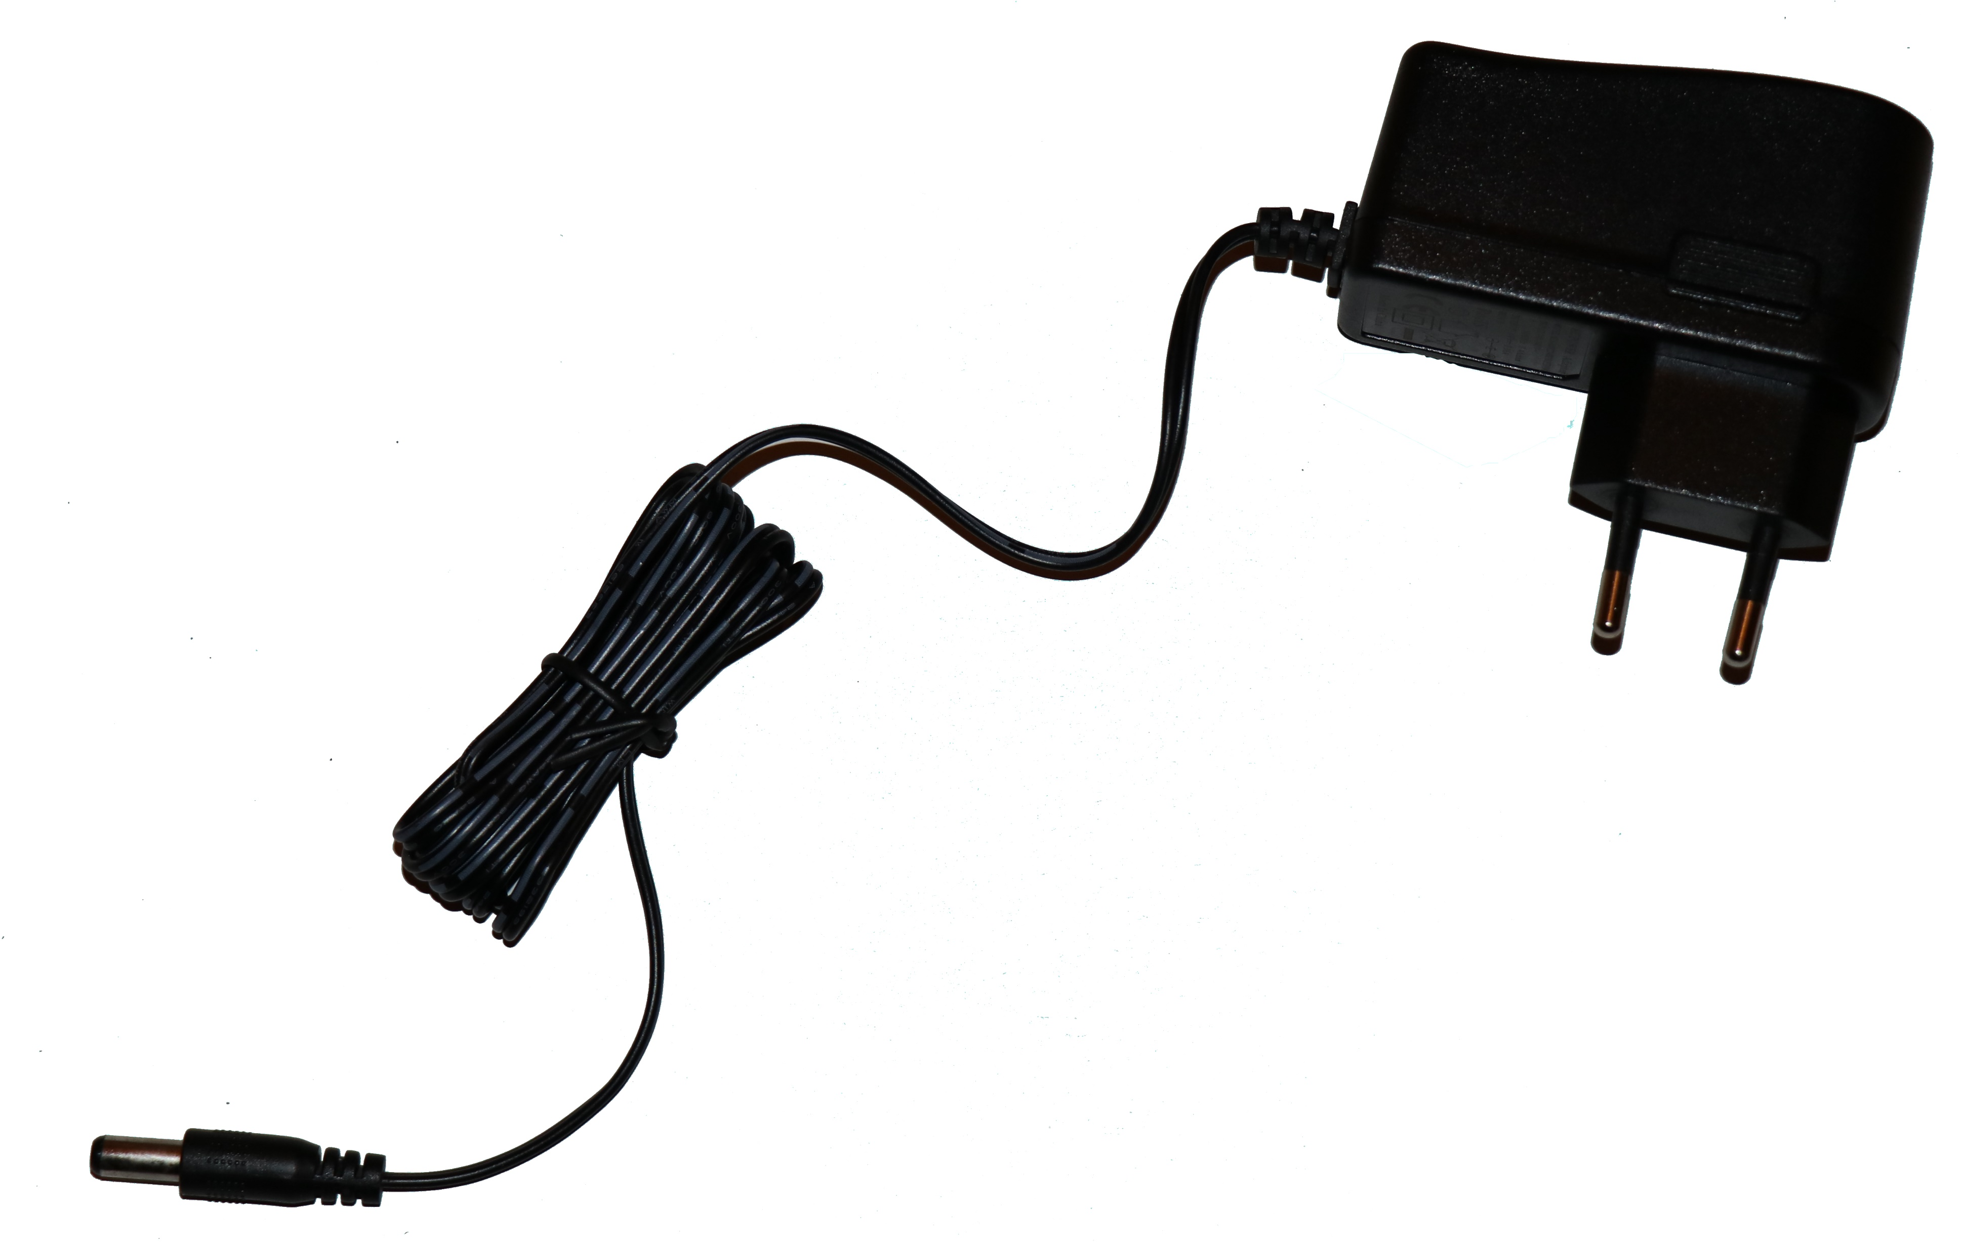
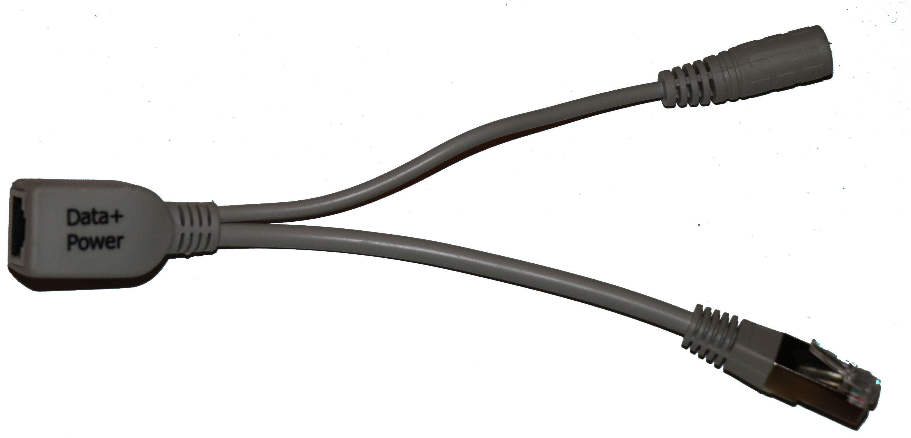
POE Switch
Switch

