Slide 1
Chapter 3
Classification

Slide 2
“Some Algorithms”
Some algorithms are sensitive to input training data order and perform poorly if they receive many similar instances in a row (pg. 83)
On the other hand, shuffling may not always be appropriate. For example, when working with time series data, such as stock market prices, weather (and manufacturing process data?)

Slide 3
Some algorithms
Some algorithms can handle multiple classes directly (pg. 96)
Random Forest Classifiers
Naïve Bayes Classifiers
Some classifiers are strictly binary classifiers (pg. 96)
Support Vector Machine Classifiers
Linear Classifiers
Some classifiers scale poorly with the size of the training set (pg. 96)
Support Vector Machines train faster on many small data sets compared to one large data set

Slide 4
Some Algorithms
Some algorithms don’t support multilabel classification (pg. 102)

Slide 5
Vocabulary review
Binary classifier – A classifier that distinguishes between 2 classes
Skewed data sets – Some classes are more frequent than others
Confusion matrix – Matrix where each row is an actual class and each column is a predicted class
Negative class – not the class the binary classifier is trying to accurately predict
Positive class – the class the binary classifier is trying to accurately predict

Slide 6
Vocabulary review
True negative – When the binary classifier accurately predicts something as the negative class
False positive – When the binary classifier predicts the negative class as the positive class
False negative – When the binary classifier predicts the positive class as the negative class
True positive – When the binary classifier predicts the positive class as the positive class

Slide 7
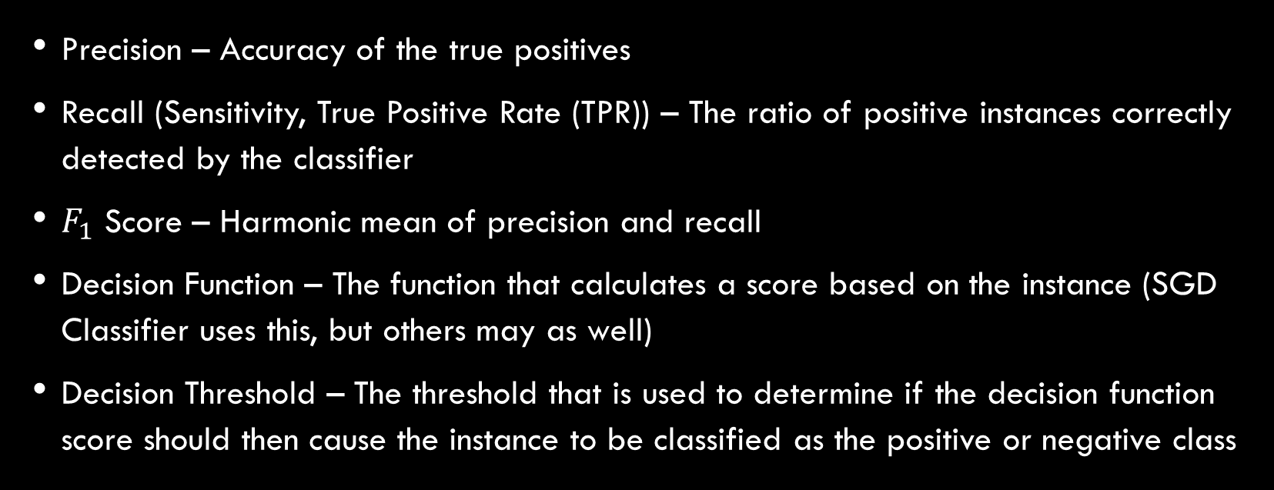
Vocabulary review
Precision – Accuracy of the true positives
Recall (Sensitivity, True Positive Rate (TPR)) – The ratio of positive instances correctly detected by the classifier
$F_{1}$ Score – Harmonic mean of precision and recall
Decision Function – The function that calculates a score based on the instance (SGD Classifier uses this, but others may as well)
Decision Threshold – The threshold that is used to determine if the decision function score should then cause the instance to be classified as the positive or negative class

Slide 8
Vocabulary review
Receiver Operating Curve (ROC) – True positive rate against false positive rate
Multiclass (Multinomial) Classifiers – Distinguish between more than two classes
One Versus All (OvA) (or One versus the rest) – Strategy used to convert a binary classifier into a multiclass classifier
One Versus One (OvO) – Strategy used to convert a binary classifier into a multiclass classifier

Slide 9
Vocabulary review
Multilabel classification – Predictions are more than one label per instance
Multioutput multiclass classification (multioutput classification) – Generalization of multilabel classification where each label can have multiple classes

Slide 10
Additional Information
https://www.kaggle.com/c/digit-recognizer

