Slide 1
Chapter 6
Decision Trees

Slide 2
Overview
Decision trees can perform both classification and regression
Can perform multi-output tasks
Fundamental component of Random Forests, one of the most powerful machine learning algorithms (next chapter)
Don’t require features to be scaled
White box model, i.e. fairly intuitive and predictions are easy to interpret
Contrast random forest and neural nets
Able to estimate the probability that an instance belongs to a certain class

Slide 3
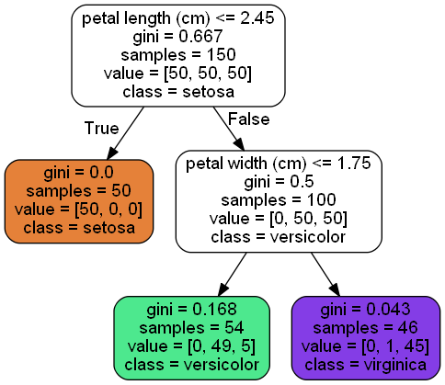
Tree Structure

Slide 4
Components of the classification tree
Question
If component isn’t a leaf node, then something like “is petal length less than 2.45”
GINI
Measures the node’s “impurity”, i.e. how many incorrect classes are predicted by this node
Samples
How many training instances the node applies to
Value
How many training instances of each class the node applies to
Class
The predicted class

Slide 5

More about gini
GINI of 0.0 means all training instances this node applies to belongs to the same class
Equation
Examples:
1st Node gini = 1 – (50/150)^2 – (50/150)^2 – (50/150)^2 = 0.6667
Depth-1 Left Node gini = 1 - (50/50)^2 - (0/50)^2 – (0/50)^2 = 0.0
Depth-1 Right Node gini = 1 – (0/50)^2 – (50/100)^2 – (50/100)^2 = 0.5
$$G_{i}=\sum_{k=1}^{n}{p_{i, k^{2}}}$$

Slide 6
Algorithm
Sklearn’s CART algorithm produces binary trees
Other algorithms exist that can produce trees whose nodes have more than two children
See ID3

Slide 7
Estimation probability
The probability is the ratio of the class component of the node to the samples component of the node
Exercise: Flower whose petals are cm long and 1.5 cm wide. Find the node it belongs to on the tree structure.
What class will this flower be predicted as
What is the probability the flower is this class
What is the probability the flower is the other classes
Compare answer with book

Slide 8
CART Algorithm In words
Classification and Regression Tree
Split the training set in two based on a single feature and a threshold
For example, Petal Length <= 2.45
Split each subset in using the same logic as above
Stop once the maximum depth has been reached or no split that reduces impurity can be found

Slide 9
Cart algorithm in depth
The CART algorithm choose the feature and threshold used for splitting the sets by searching for the feature and threshold that minimizes the impurity of the child sets
The CART algorithm is _greedy_, i.e. it finds the best solution at each step, but not the overall optimal solution
Finding an optimal tree is an _NP-Complete_ problem with complexity O(exp(m)) time, which makes finding the optimal solution for even a small number of training instances prohibitive

Slide 10
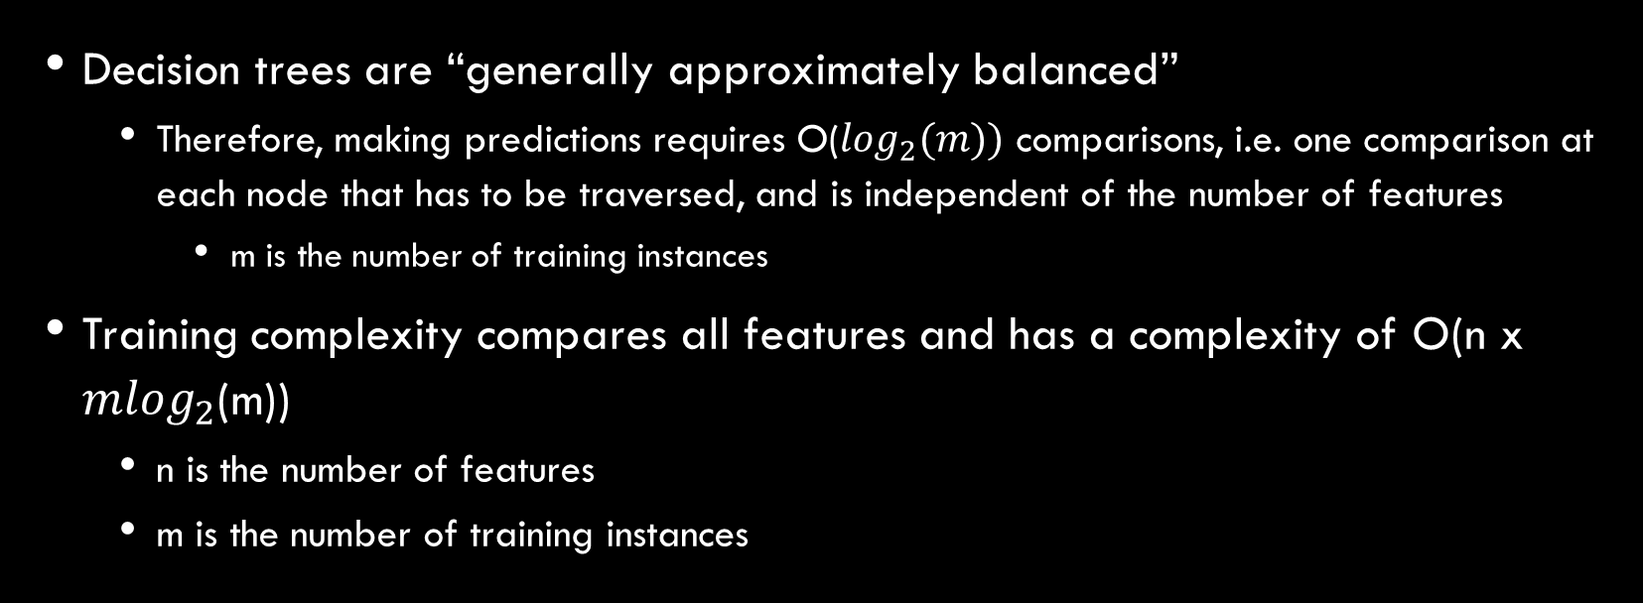
Computation complexity
Decision trees are “generally approximately balanced”
Therefore, making predictions requires O($\log_{2}(m))$ comparisons, i.e. one comparison at each node that has to be traversed, and is independent of the number of features
m is the number of training instances
Training complexity compares all features and has a complexity of O(n x ${mlog}_{2}$(m))
n is the number of features
m is the number of training instances

Slide 11
Gini or entropy
A different way to calculate impurity is _entropy_
Entropy and gini produce similar trees
When the trees differ entropy tends to produce more balanced trees, whereas gini tends to put the most frequent class in its own branch
Gini is faster to calculate

Slide 12
regularization
Left unconstrained, decision trees will tend to overfit
Called a _nonparametric model_ because the number of parameters is not predetermined before training
Compared to _parametric model_, such as a linear model which has a known number of parameters it will use
In sklearn, increasing min_* hyperparameters or reducing max_* hyperparameters will regularize the model
For instance reducing max_depth will help prevent overfitting

Slide 13
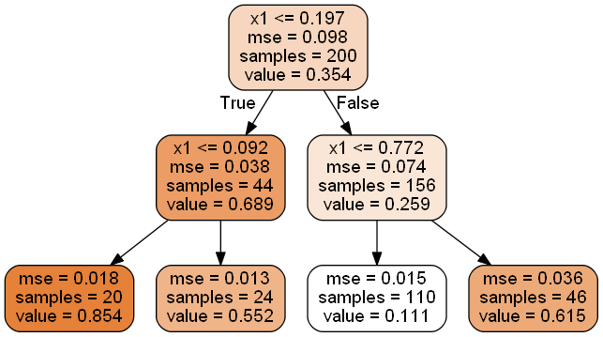
regression

Slide 14
Components of the classification Regression tree
Question
If component isn’t a leaf node, then something like “is petal length less than 2.45”
MSE
Measures the mean squared error over the instances the node applies to
Samples
How many training instances the node applies to
Value
The average target value of the samples in the node
The algorithm splits each region to make the most training instances as close as possible to the value

Slide 15
Instability
Decision trees like to create boundaries that are perpendicular to an axis
So models trained on instances that are separated in a that are not perpendicular to an axis may not generalize well
Decision tree are sensitive to small variations in data
Sklearn is stochastic, so you may get different results on the same training instances if you don’t use the random_state hyperparameter
Random forests help with these issues (next chapter)

