Slide 1
AI-Powered Adaptive Traffic Management System
An Edge-Enabled Cyber-Physical System for Congestion analysis
and Intelligent Signal Control
Track : Open Innovation in Mobility
Team Name : CAPSLOCK CREW
TEAM MEMBERS : ASTIK SARKAR ;AARUSH ABHILASH
INSTITUTE : VELLORE INSTITUTE OF TECHNOLOGY
Optimizing Urban Traffic Flow through Artificial Intelligence, Edge Computing,
and Cyber-Physical Systems

Slide 2
Problem Statement
Fixed-Time Traffic Signals :
Conventional signals operate on predefined timings regardless of actual traffic conditions.
This leads to inefficient traffic management during varying traffic loads.
Traffic Congestion During Peak Hours:
High vehicle density causes long queues and increased delays at intersections.
Congestion significantly impacts daily urban mobility.
Increased Fuel Consumption:
Prolonged idling at signals results in unnecessary fuel wastage.
This contributes to higher operating costs and environmental pollution.
Longer Waiting Times:
Drivers experience excessive delays even when roads are relatively clear.
Fixed signal timings fail to prioritize real-time traffic demand.
Lack of Real-Time Adaptation:
Existing systems cannot dynamically respond to changing traffic conditions.
This limits overall traffic flow efficiency and road utilization.

Slide 3
Our Solution
Real-Time Vehicle Detection
YOLOv8 detects vehicles such as cars, motorcycles, buses, and trucks from traffic video feeds.
Dynamic Congestion Estimation
Traffic conditions are evaluated using Vehicle Count, Occupancy Ratio, and Queue Depth.
Adaptive Signal Timing
Signal durations are adjusted dynamically based on congestion levels rather than fixed schedules.
Cyber-Physical Architecture
Integrates AI-based traffic analysis with a physical traffic signal controller for automated decision-making.
Scalable Smart-City Deployment

Slide 4
System Architecture
Traffic Video Feed
↓
Dynamic ROI Selection
↓
YOLOv8 Vehicle Detection
↓
Vehicle Count
Occupancy Ratio
Queue Depth
↓
Exponential Smoothing
↓
Congestion Analysis Engine
↓
HIGH / LOW Classification
↓
Arduino Communication (Serial Communication)
↓
Adaptive Traffic Signal Control

Slide 5
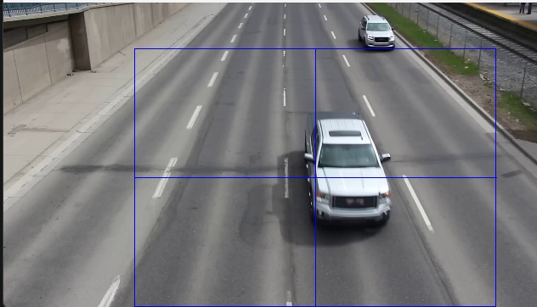
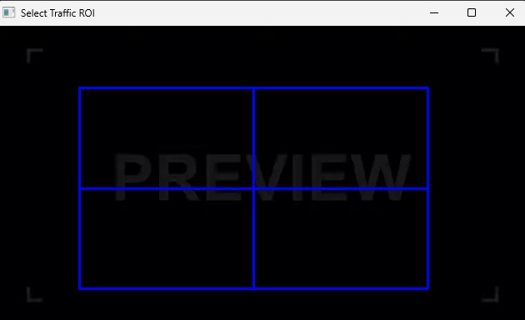
ROI-Based Traffic Monitoring
• Dynamic ROI selection
• Adaptable to different roads and camera angles
• Virtual signal reference line
• Focused traffic analysis
• Reduced computational overhead
(this is generally before the start of the processing of the video)

Slide 6
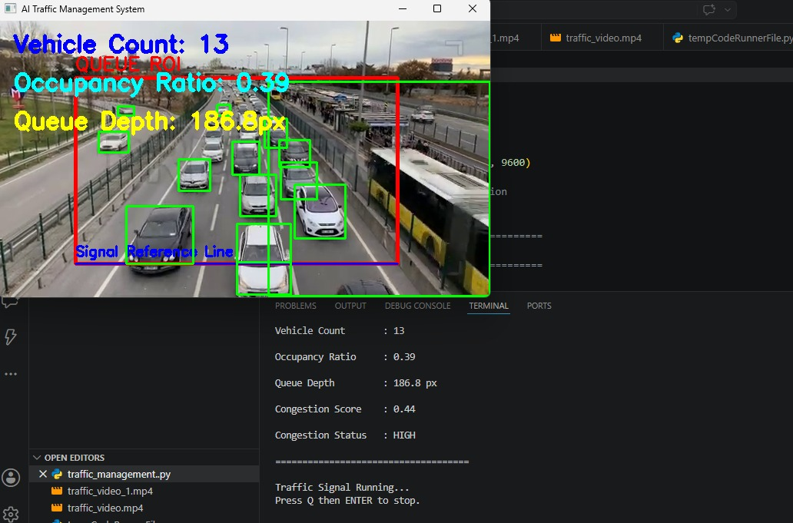
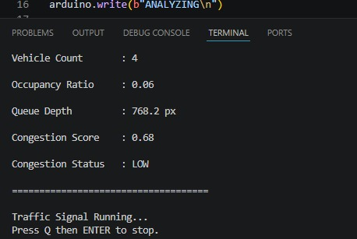
AI Detection & Traffic Parameters
YOLOv8 detects Cars, Motorcycles, Buses and Trucks.
Parameters:
• Vehicle Count-
• Occupancy Ratio-
• Queue Depth-
Data set1/video1(high congestion) Data set2/video2(low congestion)

Slide 7
Congestion Analysis Engine
Multi-Parameter Congestion Model
Instead of relying only on vehicle count, the system evaluates congestion using three
complementary traffic indicators:
Occupancy Ratio (40%)
Measures the proportion of road space occupied by vehicles.
Reflects traffic density and road utilization.
Queue Depth (40%)
Estimates how far the traffic queue extends from the signal reference line.
Indicates the severity of congestion and waiting conditions.
Vehicle Count (20%)
Represents the total number of detected vehicles within the ROI.
Provides supporting information but does not fully represent congestion alone.
Why This Weight Distribution?
Vehicle count alone can be misleading because many vehicles may still be moving
smoothly. Occupancy Ratio captures traffic density.
Queue Depth captures the extent of traffic buildup.
Giving higher importance to Occupancy Ratio and Queue Depth provides a more realistic
representation of actual congestion conditions.

Slide 8
Adaptive Signal Control
Analysis Phase
🟢 Continuous Green Signal
While ROI selection, vehicle detection, and congestion analysis are being performed, the signal remains GREEN.
This indicates that the AI system is actively processing traffic data and no final congestion decision has yet been made.
It ensures uninterrupted traffic flow during the analysis stage.
LOW Congestion | HIGH Congestion
🔴 Red = 10 sec | 🔴 Red = 5 sec
🟢 Green = 5 sec | 🟢 Green = 12 sec
🟡 Yellow = 2 sec | 🟡 Yellow = 2 sec
Longer red duration due to lower traffic demand | Longer green duration to clear congestion faster
Balanced signal allocation | Reduced waiting time and improved traffic throughput

Slide 9
Results
Real-Time Vehicle Detection using YOLOv8
Dynamic Congestion Classification (HIGH / LOW)
Adaptive Traffic Signal Control
Continuous Traffic Monitoring and Analysis
Innovation
Dynamic ROI Selection for different road scenarios
Multi-Parameter Congestion Analysis Engine
AI + Cyber-Physical System Integration
Edge Computing-Based Decision Making
Real-Time Adaptive Signal Optimization
Impact
Reduced Traffic Congestion
Reduced Vehicle Waiting Time
Improved Traffic Flow Efficiency
Better Road Utilization
Foundation for Smart City Traffic Management

Slide 10
Future Scope & Business Potential
IoT Integration → Cloud Dashboard → Multi-Intersection Coordination → Smart City
Deployment
Business Model & Future Commercialization
Smart Traffic Management as a Service (TMaaS)
Deploy AI-powered traffic monitoring systems at intersections and urban road networks.
Municipal corporations and smart city authorities can subscribe to the platform through
annual service contracts.
Revenue generated through software licensing, maintenance, and analytics services.
Smart City & Government Partnerships
Partner with Smart City Missions, Municipal Corporations, and Traffic Police Departments.
Provide real-time congestion monitoring and adaptive signal optimization.
Reduce traffic delays, fuel wastage, and urban transportation inefficiencies.
Cloud-Based Traffic Analytics Platform
Aggregate traffic data from multiple intersections into a centralized dashboard.
Offer traffic insights, congestion trends, peak-hour analysis, and infrastructure
planning recommendations. Revenue through subscription-based analytics services.

Slide 11
Future Scope & Business Potential
Revenue Streams
1)Government & Smart City Contracts
2)Annual Software Licensing
3)Traffic Analytics Dashboard Subscriptions
4)IoT Infrastructure Integration Services
5)Maintenance & Support Services
6)Urban Mobility Data Insights
"Our long-term vision is to transform this prototype into a city-scale
AI-powered Traffic Management Platform that enables smarter, safer, and more
efficient urban mobility across India."

