Slide 1
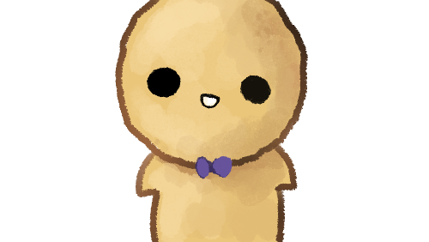
PHONOS
A TIME MANAGEMENT APP

Slide 2
DELIVERABLES
Needfinding
Paper Prototype
Revised
Interview and Feedback
Digital Mockup
Simulation
Interview and Feedback
From InVision Studio

Slide 3
Revised Needfinding

Slide 4
Too many hobbies and activities
Unorganized schedule
Procrastination due to social media use
The Problem

Slide 5
Students need a way to organize and be reminded of all their tasks and schedules.
Students need to avoid unproductivity and procrastination because of distractions (e.g. social media)
Students need to develop goal-setting skills and discipline
USER NEEDS

Slide 6
“Organizing students' tasks with discipline and using your phone can go hand-in-hand, after all.”
POINT OF VIEW

Slide 7
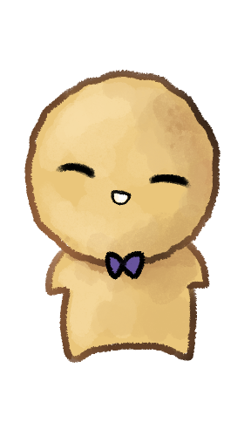
The Solution
Phonos.
Provides easy viewing of tasks
Offers categories for organization
Fun features

Slide 8
Paper Prototype & Digital Mockup
INTERVIEW

Slide 9
Video

Slide 10
Paper Prototype
FEEDBACK
BEFORE REVISION

Slide 11
“The interface is very cute and simple – it’s very easy to use and I like the cute character. I want to see more functions so the demo could be a bit longer"
Jelreene Adiao
18 years old
1st Year College
Digital Animations Student

Slide 12
Keith Orbinar
"Masaya po siya, cute din ng design, tapos medyo nakakalito?"
18 years old
1st Year College
Multimedia Arts Student

Slide 13
Vanessa Timo
“Maganda yung interface ng prototype, kaso lang lagyan pa ng functions yung ibang tasks para mas interactive siya"
21 years old
2nd Year College
Network Systems Student

Slide 14
Paper Prototype
FEEDBACK
AFTER REVISION

Slide 15
Jelreene Adiao
“I’m very satisfied that I can do more with this prototype, and I hope you could develop the app in the future"
18 years old
1st Year College
Digital Animations Student

Slide 16
Vanessa Timo
“Organized naman na lahat, pero hindi siya user-friendly lalo na hindi mo alam lahat ng functions"
21 years old
2nd Year College
Network Systems Student

Slide 17
Zenaida Chavez
"I think that the app is very functional, and it easily sorts my tasks into categories. I also like the simply designed layouts and colors, and the "Trophy" category makes me motivated to be more productive. Good luck and I hope this gets developed!”
20 years old
2nd Year College
Security and Forensics Student

Slide 18
Digital Mockup
INTERVIEW

Slide 19
Digital Mockup
FEEDBACK
BEFORE REVISION

Slide 20
“Una, yung category na pinili ko school, pero pag in-add ko siya, Hobbies yung nakalagay. Tapos, pagka-click mo ng calendar syempre pipili ka ng date kung kailan mo gagawin, pag binalik mo sa home, nawawala siya. Tapos, sa pipili ng kulay, bumabalik pa rin sa home. Yung interface niyo, cute naman siya. So far, yun lang naman yung problema. Overall, maganda naman yung interface niyo."
Christian Murillo
19 years old
2nd Year College
IT Student

Slide 21
Digital Mockup
FEEDBACK
AFTER REVISION

Slide 22
Patricia Manalang
"It is simple to use and has a very nice color scheme, It also makes the tasks very organized and I also like the Trophies category. It makes it a better and fun experience.”
19 years old
2nd Year College
Security and Forensics Student

Slide 23
Digital Mockup Simulation
INVISION STUDIO

