Slide 1
GyroSphere
Estimated timeline and current progress

Slide 2
Two primary phases :
December ‘21:
Get Manual Control over the robot
January ‘22:
Make the Robot aware of its surroundings and make it autonomously follow a given path.

Slide 3
December-1st week:
Planning of the design and Features to be added:
Structure of the Internal Driving unit
Orientation and placement of the wheels.
Matplotlib plot of the Design

Slide 4
December-2nd Week:
Kinematics of the bot:
Vector Calculations of the net velocities given to the Outer surface by the motors.
Verification of these kinematics through pybullet simulation.

Slide 5
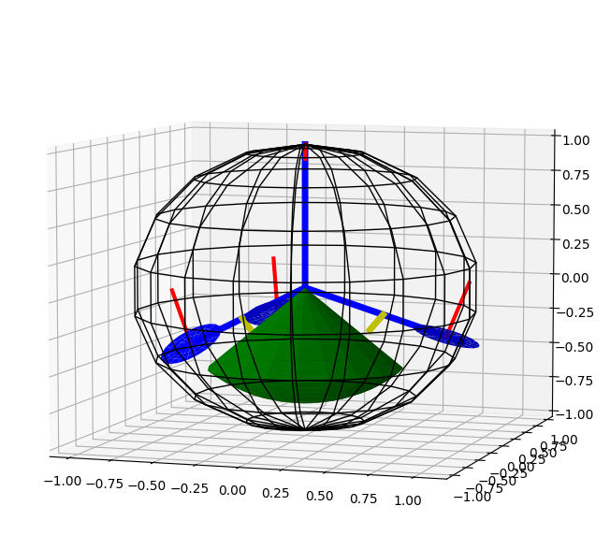
December-3rd Week:
Delivery of the first sample URDF file.
Basic urdf will be made in Solidworks.
Testing and simulation of traction in Blender.
Testing of the kinematics on URDF in Gazebo and making necessary changes.
Learning and doing literature survey on Model Predictive Controller
Get a basic algorithm to be applied and equations to be optimized.
December-4th Week:
Implementing, optimizing and fine tuning the MPC and related equations to keep the Internal Driving Unit (IDU) upright at a fixed angle.

Slide 6
January-1st week:
Establishing full Manual control over the robot i.e. Making it go forward, backward, leftward or rightward as per commands from the operator.
Reading and understanding Localization and methods that can be appointed for it.
January-2nd week:
Deciding and Implementation of the the best Localization systems which can be applied to our bot.

Slide 7
January-3rd week
Improving upon localization and its finalization.
Reading and understanding Navigation and Path planning in the obtained Environment and writing basic algorithms for it.
January-4th week
Implementing the Algorithms for Navigation and Path Planning.
Completion of Simulation part for the project.

Slide 8
Thank you

