Slide 1
Gyrosphere
Astitva Gupta
Electrical Engineering part 2

Slide 2
Introduction what is Gyro-sphere?
Gyro-sphere is a mobile robot with an spherical structure as the outer body and the primary actuator for locomotion.
A gyro-sphere or a spherical bot has some certain advantages over other types of robots-
This way, the robot's internal mechanism can be separated from the external environment very effectively.
The Robot can always stay movable unless its hampered by severe mechanism failure from the inside despite of its orientation.
it offers much more mobility than any other driving mechanism.

Slide 3
Existing designs
The Current designs of Gyrosphere have a central axis connected to the external spherical shell via two motors at each end. A central mass is hanged from this axis via either a servo motor or a prismatic joint. The side motors are the driving actuators of this robot. They make the robot move backward and forward when the pendulum is at the center. When the pendulum is tilted or moved to one side of the robot the main axis tilts due to gravity. This causes unsymmetric movement of left and right sides at the point of contact with the ground and the robot turns.
Gyrospheres have been used for surveillance, environmental exploration etc. They have capabilities to be used as amphibious bots too.

Slide 4
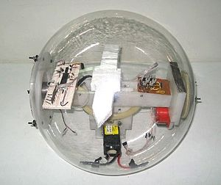

Slide 5
Shortcomings of the design
This design is incapable of making sharp changes in its direction of movement depending upon the maximum amount of tilt that can be offered to the pendulum.
The agility of this robot coms from axis tilting(in order to turn or change orientation etc.) ,thereby making it unsuitable and unsafe to transport goods and people.

Slide 6
My Design and suggestions
Obj : Making a Gyrosphere that can steer in any direction irrespective of its current orientation. While trying to keep its internals upright.
How to achieve this?
Making a Gyrosphere with an internal tetrahedron skeleton with wheels attached at the end of these arms through BLDC motors. These wheel will be making direct contact with the inner surface of the Gyrosphere. The angular velocity of all wheels will add up give the resultant angular velocity to the external main sphere and steer it as per our desire.
To keep the internal skeleton upright, one central pendulum will be attached to it which in robot will consist the battery and the control electronics and weights if needed with mechanism to damp it to increase stability.

Slide 7
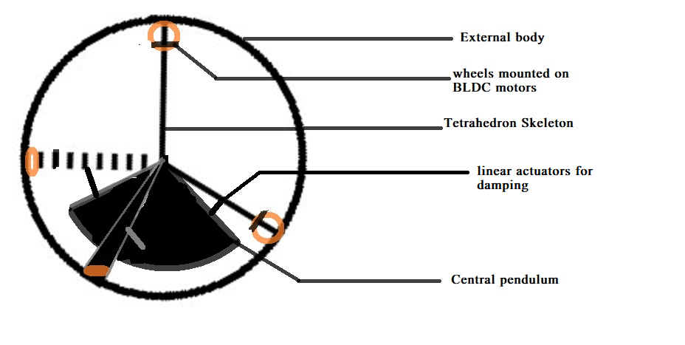
Rough model

Slide 8
Dynamics
Let be the angular velocities of each inside wheel and be the desired angular velocity.
So
Also where will be determined by the physical parameters such as max speed the motors can give, max contact friction btw wheels and inside walls of Gyrosphere etc.
Finally we need to minimize to get maximum out of the power source.
The linear actuators can be used to damp the central pendulum if gets too unstable using feedback based on a mounted Inertial measurement unit.

Slide 9
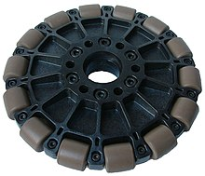
To reduce friction in the direction perp to motion of the wheels driving the internal surface ,we will use omni wheels.
Omni wheels or poly wheels are wheels with small discs (called rollers) around the circumference which are perpendicular to the turning direction. The effect is that the wheel can be driven with full force, but will also slide laterally with great ease. These wheels are often employed in holonomic drive systems.

Slide 10
Future plans
Mechanical batteries can be used as an internal power source and its gyroscopic effect can be used to keep the axis of the robot maintained.
Replacing the internal tetrahedron skeleton with another spherical roll cage keeping the position of the actuators same so that roll cage can be used as a space for transport.

Slide 11
Thank You

