Slide 1
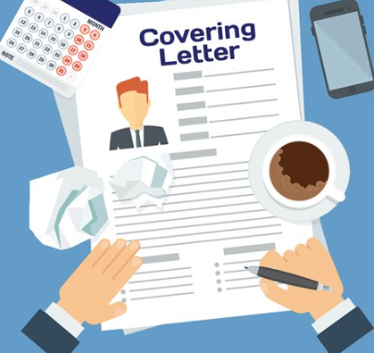
APPLICATION LETTER
PROJEK PENGUATAN PROFIL PELAJAR PANCASILA (P5)
TEMA KEBEKERJAAN
The 2rd Grade

Slide 2
DEFINITION
Application letter (a cover letter) is a document sent with your resume to provide additional information on your skills and experience.

Slide 3
The Structure of Cover Letter
Contact Section : Your contact information .If you are uploading or mailing a letter, put the information at the top of the page and with an email cover it should be below your signature.
Employer Address
Salutation: Greeting at the beginning of a cover letter.
Body: The body includes the sections where you explain why you are interested in and qualified for the job for which you are applying.
Closing: Closing statement as a professional manner.

Slide 4
Each Section of Cover Letter
Your Contact Information Name Address City, State Zip Code Phone Number Email Address
Date
Employer Contact Information (if you have it) Name Title Company Address City, State Zip Code

Slide 5
Section of Cover Letter
Salutation -Dear Mr./Ms. Last Name,
-If you do not have a contact name, you can skip the salutation entirely. or, you can use Dear Hiring Manager, To whom it may concern..etc
-If you do not know the gender of your contact, you can write out the person's full name, e.g., "Dear Cory Black"or "Dear Michael Jordan."

Slide 6
Section of Cover Letter
Body of Cover Letter -First Paragraph The first paragraph should include information on why you are writing. Mention the position you are applying for and where you found the job listing. Include the name of a mutual contact, if you have one.
-Middle Paragraph(s) The next section should describe what you have to offer the employer. Mention specifically how your qualifications match the job you are applying for. This section is where you're making a pitch for your fit as an employee and show what makes you a great candidate.

Slide 7
Section of Cover Letter
-Final Paragraph Conclude your cover letter by thanking the employer for considering you for the position. Include information on how you will follow-up. Optionally, you can briefly restate why you would be a good fit for the position.

Slide 8
Section of Cover Letter
Complimentary Close Respectfully yours, warm regards...etc
Signature
Handwritten Signature (for a hard copy letter)

Slide 9
Formatting Tips
Font choices: Use professional font such as Times New Roman, Arial, or Calibri. in a 10 or 12 point size.
Email versus hard copy letters: . If you are emailing your cover letter, you'll need to pay particular attention to the subject line of your email.
Letter Spacing: Your letter should be single-spaced. Include a space between every paragraph, and in general, a space between each section of the letter. (That is, there should be a space between the address and the date, and then again between the date and the salutation.)

Slide 10
Formatting Tips
Email Spacing: In an email cover letter, where many sections are left off, you will want to include a space between the salutation and between each paragraph, and another space before your complimentary close.
Proofreading: Details counting in cover letters. Make sure to avoid errors by carefully proofreading your letter.

Slide 11


