Slide 1
DATA-QUALITY FINDINGS
OpenAQ New Delhi Measurements
Pipeline & Data-Quality Assessment — Detecting, Quantifying and Diagnosing Failures Across 18,000 Sensor Readings
Extract: openaq_new_delhi_measurements.xls | 18,000 rows · 18 sensors · 12 parameters

Slide 2
Executive Summary
Five findings; two are critical and should block downstream trend analysis until addressed
2
99.7%
42.1%
3
Distinct monitoring deployments
merged into one file
of NOx readings are
chemically implausible
of expected 15-min slots
are missing (source claims 0%)
parameters carry two
different units
The extract silently blends a 2016 legacy station with a 2025 current station — no field distinguishes them.
NOx sensor readings are ~1,000x smaller than they should be relative to NO + NO2 — a likely calibration/unit defect.
The source's own "coverage" metadata claims 100% completeness on every row while real gaps run as high as 55%.
Recommended immediate action: add a station identifier, quarantine the NOx stream, and stop trusting the coverage field.

Slide 3
Scope & Method
Built as a small analytics system: profile → quality rules → exceptions → root cause → KPI layer
1
2
3
4
5
Profile
Quality rules
Exceptions
Root cause
KPI layer
Row counts, nulls, cardinality, date range per sensor
11 SQL rules across 5 dimensions (DQ001–DQ011)
17,465 row/gap-level exceptions preserved for investigation
WHEN / WHERE / WHAT changed, evidence-graded
Quality scorecard + trend + source breakdown
Dataset scope
Period analyzed | Feb 5–24, 2016 and Feb 18–Mar 6, 2025 (two disjoint windows)
Grain | One row = one sensor's reading for one 15-minute interval
Rows / sensors / parameters | 18,000 rows · 18 sensors · 12 parameters
Out of scope | Pipeline rebuild, incident response, ML-based anomaly detection

Slide 4
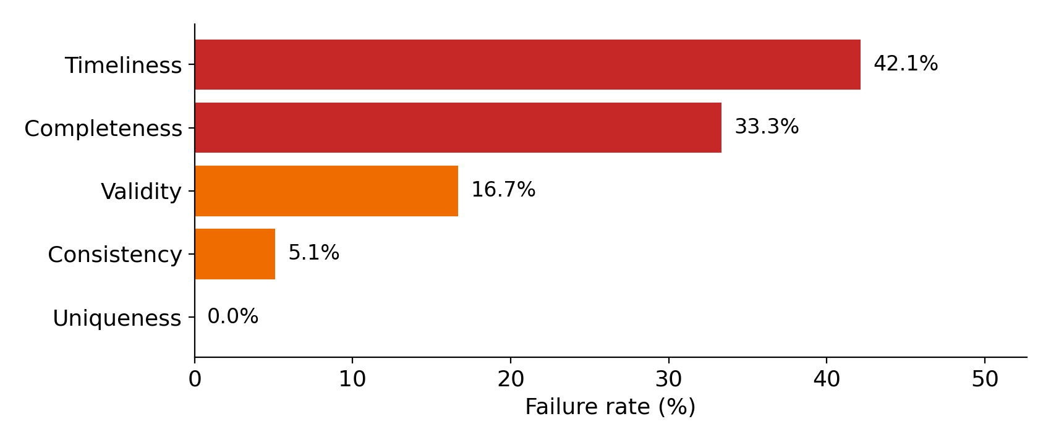
Data-Quality Scorecard
Failure rate by dimension — timeliness and completeness are the primary risk areas
Dimension | Failure rate | Severity
Timeliness | 42.1% | High
Completeness | 33.3% | Mixed
Validity | 16.7% | High
Consistency | 5.1% | Critical
Uniqueness | 0.0% | Pass
Note: Completeness blends value/key-field completeness (100% pass) with a structural gap in coordinates/summary metadata (100% fail) — see Finding 4.

Slide 5
Finding 1 — Two Deployments Merged, No Field to Tell Them Apart
Critical
 | Legacy station | Current station
Sensor IDs | 35, 36, 392–399 | 12234782–90, 14340713–15
Date range | Feb 5–24, 2016 | Feb 18 – Mar 6, 2025
PM2.5 range | 17 – 637 µg/m³ | 17 – 204 µg/m³
Gap rate (DQ009) | 55.1% | 20.7%
Likely cause
Most consistent with a station relocation, hardware refresh, or an OpenAQ location_id change between 2016 and 2025 that was not carried into this export.
Evidence
Sensor-level profiling shows a complete, non-overlapping split by both sensor-ID range and date range — no timestamp overlap exists between the two groups.
Business impact: Any trend/aggregate analysis treating this as one continuous series silently compares two deployments — 2016 pollutant levels are far higher, which could be misread as "improvement" rather than a change in instrumentation or siting.
Recommendation
Add a station_id/location field to the export and confirm with the source owner whether these are the same physical station.

Slide 6
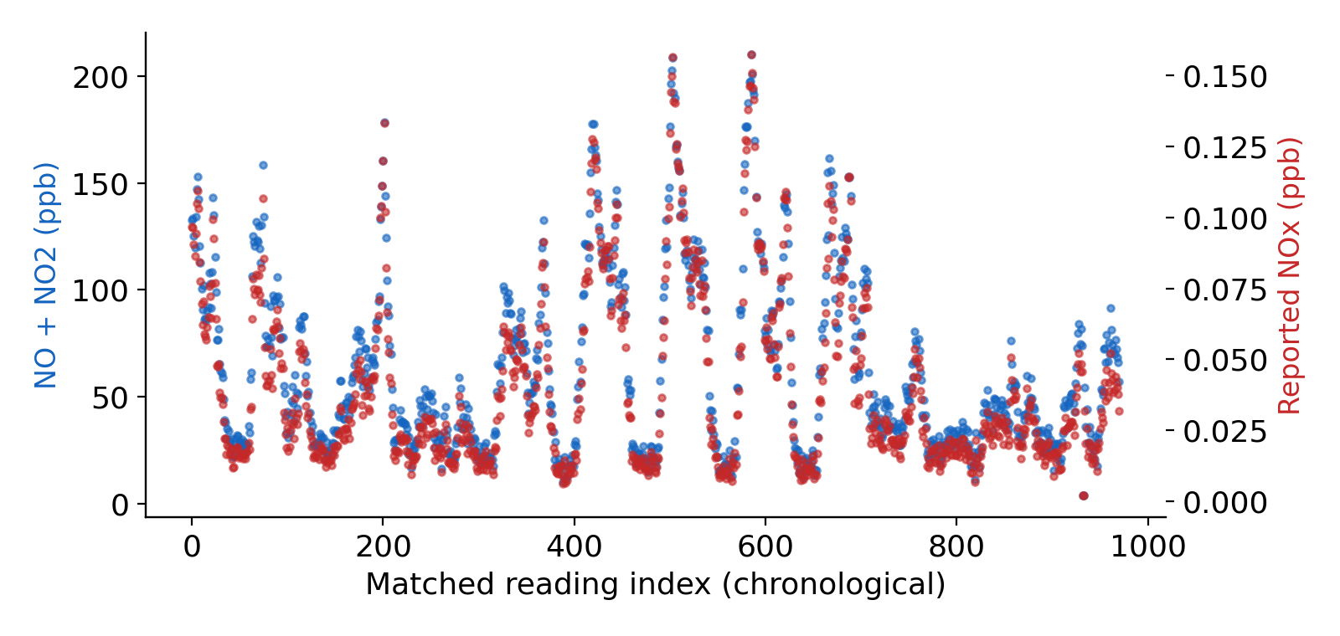
Finding 2 — NOx Stream Is Very Likely Mis-Scaled
Critical
99.7%
of matched readings show NOx below NO alone (chemically impossible: NOx = NO + NO2)
~1,268×–1,900×
the gap between expected and observed NOx — unstable, not a clean unit-conversion factor
Likely cause: sensor calibration or unit-labeling defect in the NOx channel (sensor 14340713). Reported as a likely contributing factor, not a confirmed root cause.
Recommendation: quarantine this stream from reporting until instrumentation review is complete.

Slide 7
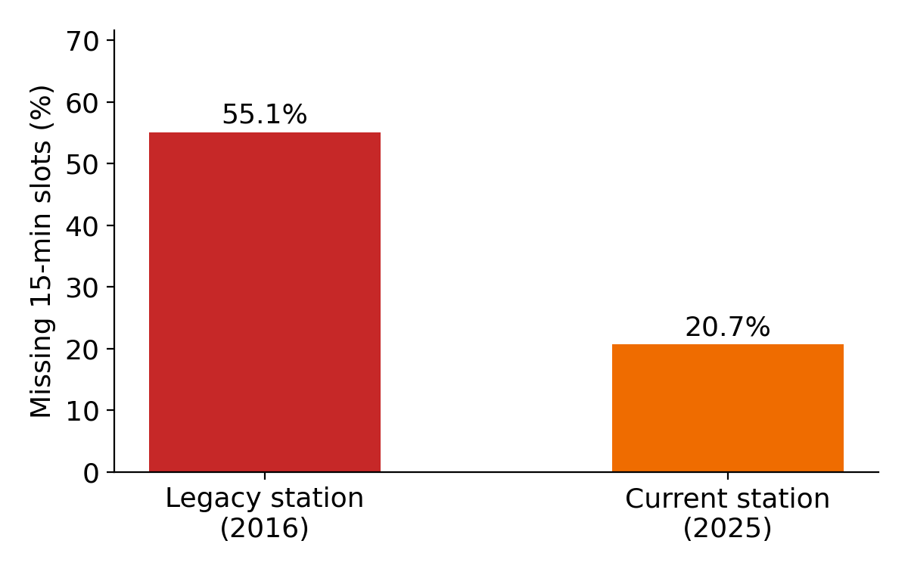
Finding 3 — Source's Own Completeness Metadata Cannot Be Trusted
High
100%
42.1%
of rows claim full coverage (coverage.percentComplete / percentCoverage — constant, zero variation)
of expected 15-minute slots are actually missing when independently reconstructed
Likely cause: the coverage block appears to describe completeness within each row's own 15-minute interval (1 of 1 expected sub-reading) — technically accurate for that narrow definition, but misleading as a series-level completeness signal.
Recommendation: stop using this field as a completeness signal; replace with an independent 15-minute cadence check and SLA alert.

Slide 8
Findings 4 & 5 — Structural Gaps and Mixed Units
Finding 4
Medium
Finding 5
High
Coordinates & summary always null
Three parameters carry two different units
100% of rows — a complete absence, not a partial gap.
Root cause: undetermined from this extract — could be an export-configuration choice or a genuine upstream gap.
Impact: dataset cannot be mapped without an external join to station metadata.
co, no2, so2 each appear under both ppb (2025 station) and µg/m³ (2016 station) — 6,000 of 18,000 rows (33.3%) affected.
Cause: direct consequence of Finding 1 — the two deployments report in different units and nothing in the schema flags this.
Impact: averaging across the full extract without unit conversion produces a meaningless blended figure differing by 2–3 orders of magnitude.

Slide 9
Root-Cause Analysis
Evidence is graded — confirmed defects are separated from likely contributing factors and open unknowns
Confirmed by evidence
Likely contributing factors
Unknowns
Two disjoint sensor-ID / date-range populations exist in one file
NOx is chemically inconsistent with NO/NO2 in the same file
Coverage metadata is constant despite real, measurable gaps
Three parameters carry two units within the same file
Two-deployment split most likely reflects a station relocation or location_id change not carried into the export
NOx defect most consistent with a sensor calibration or firmware/unit-labeling issue
Whether coordinates/summary are expected to populate for this export type at all
The exact pipeline stage responsible for the NOx scaling defect

Slide 10
Recommendations
Prioritized by evidence strength and business impact
# | Recommendation | Owner | Priority
1 | Add a station_id/location field; confirm the 2016/2025 sensor sets with the source owner | Data engineering | Critical
2 | Quarantine the NOx stream (sensor 14340713) pending calibration review | Instrumentation owner | Critical
3 | Replace coverage-field trust with an independent 15-min cadence check + SLA alert | Data/analytics team | High
4 | Investigate why legacy-station gap rate (55.1%) far exceeds current station (20.7%) | Data engineering | High
5 | Add a unit-normalization step (ppb ↔ µg/m³) before cross-deployment aggregation | Data/analytics team | High
6 | Confirm whether coordinates/summary should populate; fix export or remove columns | Data engineering | Medium

Slide 11
Limitations
What this analysis could not establish from the extract alone
No independent ground truth (e.g. an official OpenAQ API pull for the same window) confirms whether the 2016/2025 split is two stations, a relocation, or a backfill artifact.
The NOx unit/scale defect could not be tied to a specific pipeline stage (sensor firmware, ingestion transform, or export step).
coordinates/summary being 100% null could reflect a genuine defect or a field this endpoint isn't expected to populate — not resolvable from the data alone.
Anomaly thresholds use this extract as its own baseline; legitimate seasonal spikes may be indistinguishable from true anomalies without a longer history.
No production incident response, pipeline rebuild, or ML-based detection was undertaken — this is an analytical diagnosis and recommendation only.

Slide 12
Bottom line
This dataset is not yet reliable enough for trend reporting as-is.
Segmenting the two deployments, quarantining the NOx stream, and replacing the coverage-completeness signal are the three changes that unblock trustworthy reporting.

