Slide 1
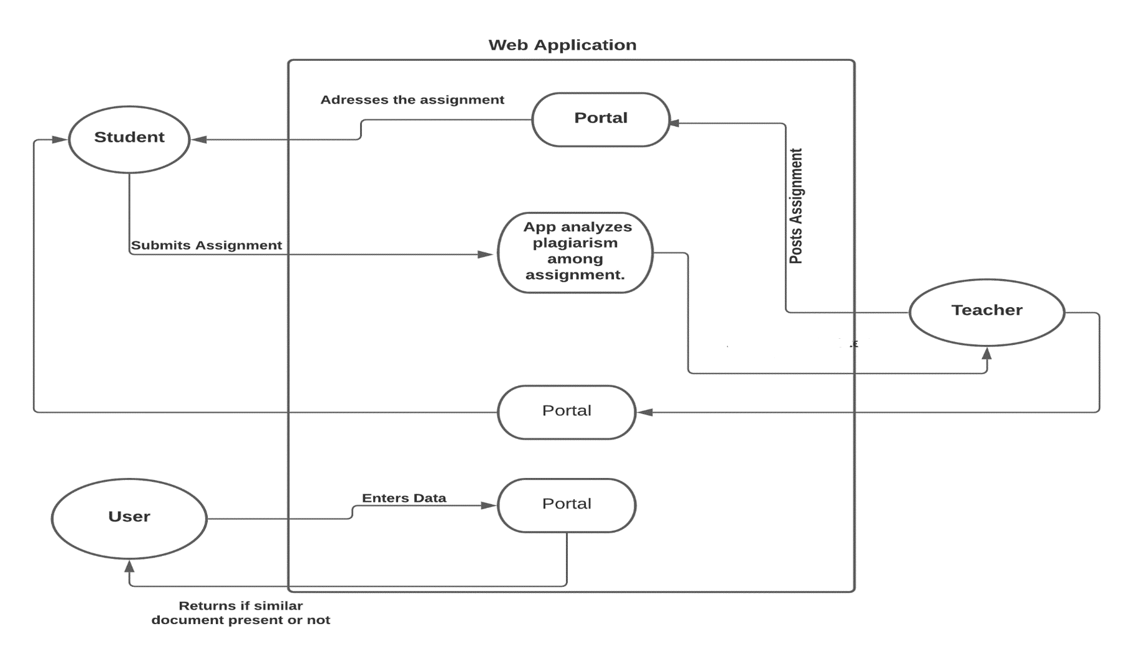

Slide 2
Level 0
GUEST
Login Info
Get Grammatical
Report
Get Plague Report
Upload Content
0
Login Info
Create class
INTERNAL SYSTEM
TEACHERS
Post Assignments
View Assignments
STUDENTS
View Plagiarism Report
Submit Assignments
View Submitted Assignments
View Submission

Slide 3
