Slide 1


Beta Regression for Bounded Biometric Performance A Methodological Proposal for Child Face Recognition
IA650: Data Mining
Summer 2025
Aaron W. Storey 20

Slide 2

The Missing Children Crisis
12 million children in global trafficking annually
Face recognition: Primary identification tool
Current systems fail over time
Statistical models make it worse
1 of 20

Slide 3
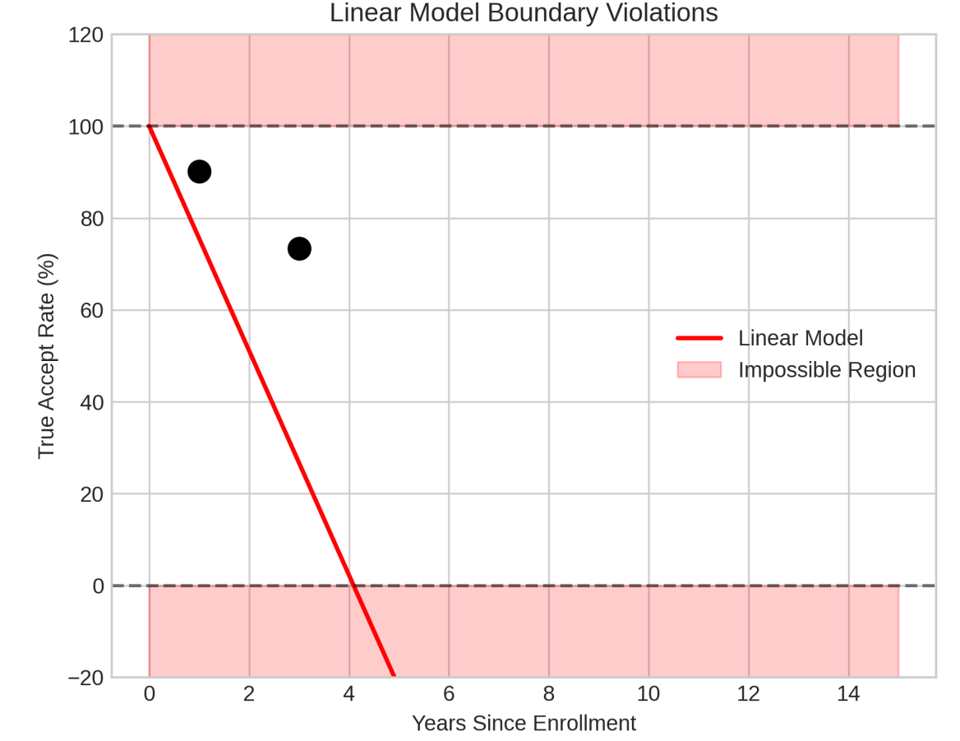
The Problem in One Graph
Linear model predicts:
100% accuracy at enrollment
0% accuracy at 4.1 years
Negative accuracy at 5 years
2 of 20

Slide 4
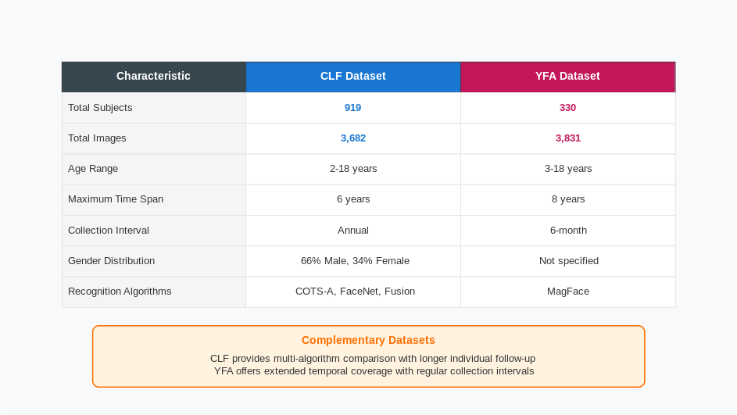
Two Landmark Studies
CLF – Children Longitudinal Face
YFA – Young Face Aging
3 of 20

Slide 5
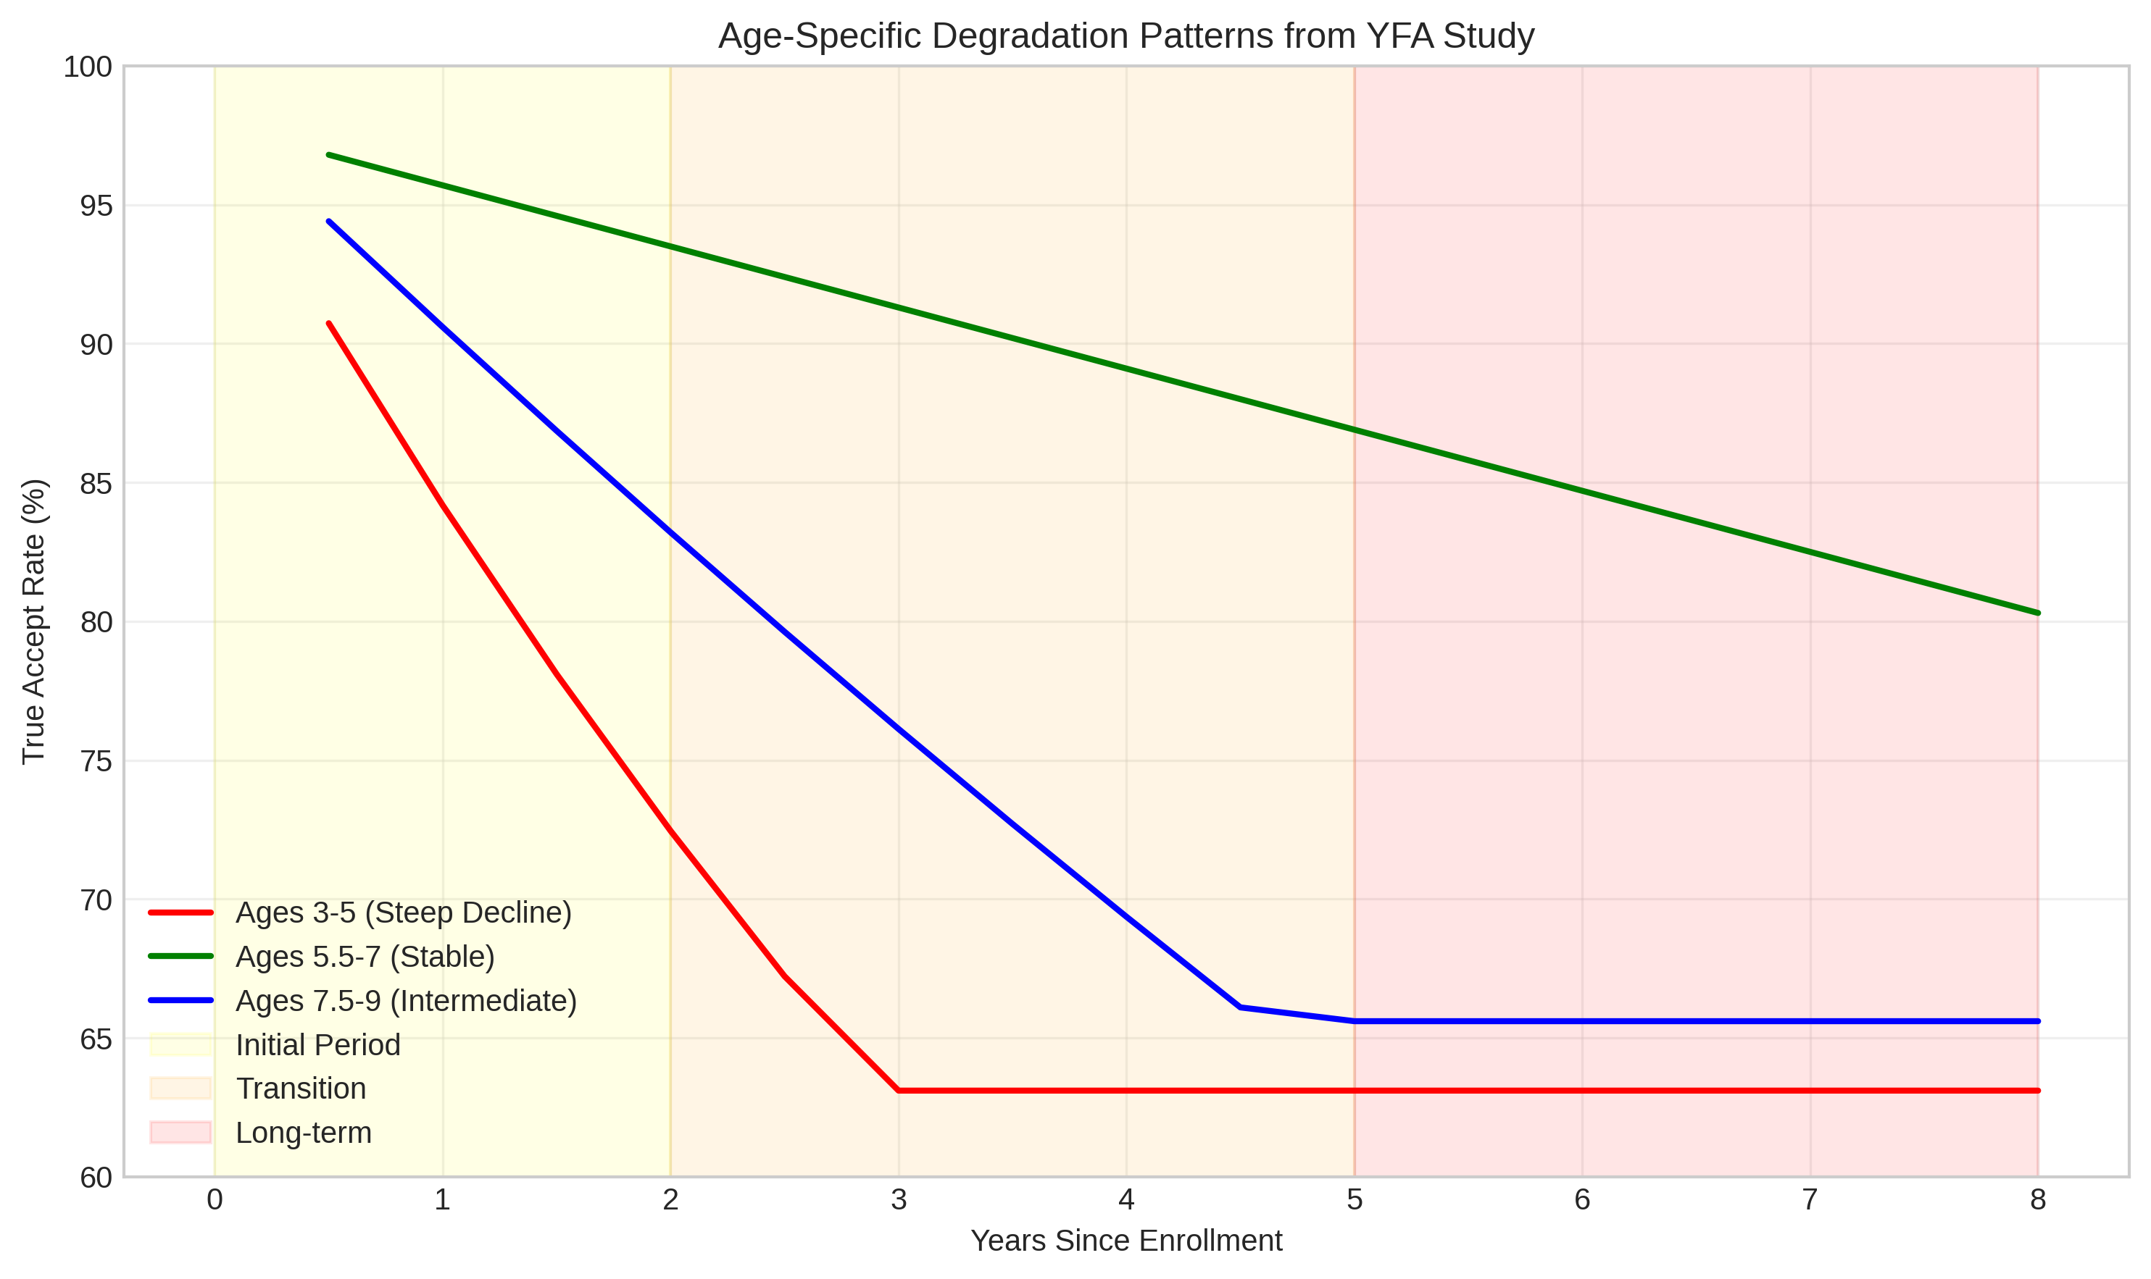
What They Found
Three distinct patterns:
Ages 3-5: Catastrophic decline
Ages 5.5-7: Remarkable stability
Ages 7.5-9: Intermediate
Linear models miss this complexity.
5 of 20

Slide 6
Linear Models’ Three Fatal Flaws
1. Impossible Predictions
Negative accuracy
Over 100% accuracy
2. Wrong Variance
Assumes constant
Reality: peaks at 50%
3. Can’t Curve
Forces straight lines
Misses developmental phases
6 of 20

Slide 7
The Statistical Challenge
Recognition rates are probabilities
- Must stay between 0 and 1
- Variance changes with mean
- Follow curved patterns
Current models ignore all three.
7 of 20

Slide 8
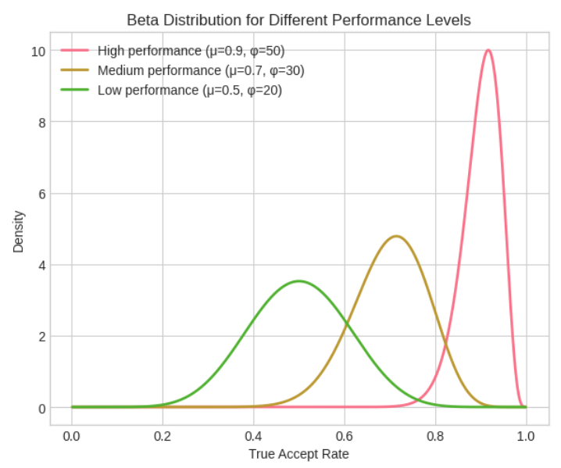
Enter Beta Regression
Beta distribution:
- Lives between 0 and 1
- Flexible shapes
- Natural variance pattern
Perfect for probabilities!
8 of 20

Slide 9
How Beta Regression Works
The Math (Simplified)
Where:
= recognition rate (0 to 1)
logit keeps predictions bounded
represents change in log-odds
9 of 20

Slide 10
Hierarchal Structure
Level 1: Each Measurement
Recognition rate ~ Beta distribution
Age effects (splines)
Time effects (polynomial)
Level 2: Each Child
Random baseline
Random aging rate
Individual differences matter
10 of 20

Slide 11
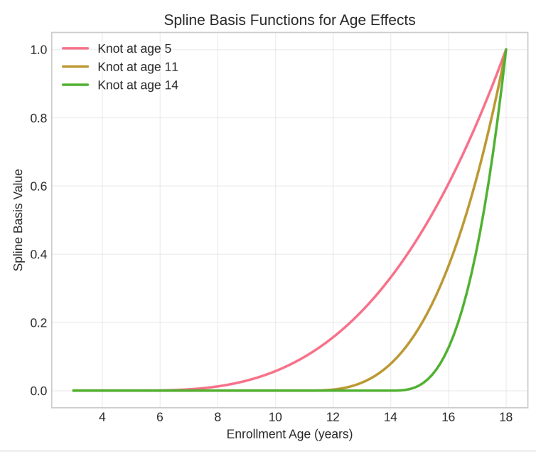
Capturing Age Complexity
Splines bend at key ages:
Age 5: End of early childhood
Age 11: Puberty onset
Age 14: Mid-adolescent
11 of 20

Slide 12
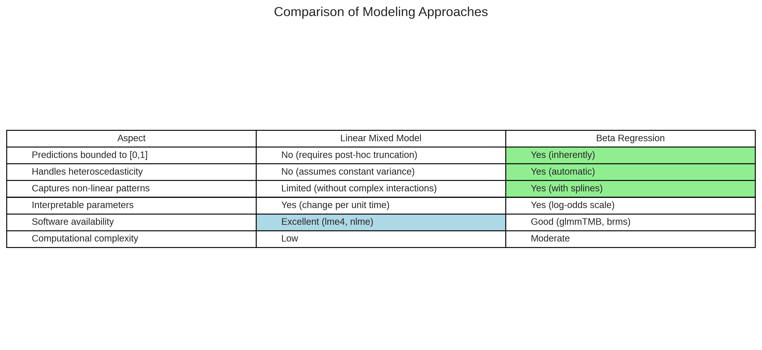
Model Comparison
Beta regression wins on:
Mathematical validity
Variance modeling
Flexibility
Still interpretable
12 of 20

Slide 13
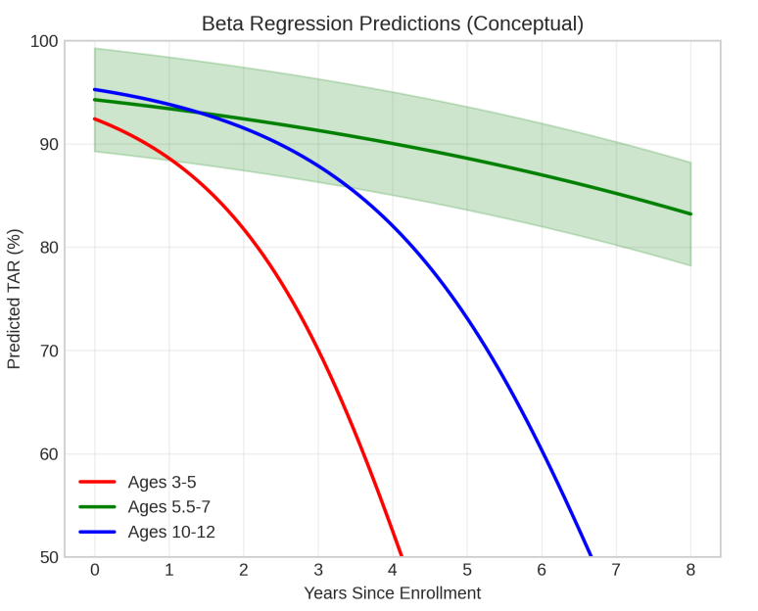
Expected Predictions
Age-specific forecasts:
Young children: Steep but bounded decline
Middle childhood: Stable plateau
Teenagers: Late acceleration
All stay between 0 and 100%
13 of 20

Slide 14
Practical Impact
System Design
Age-adaptive thresholds
Resource allocation by risk
Optimal enrollment timing
Algorithm Development
Focus on vulnerable ages
Realistic benchmarks
Targeted improvements
14 of 20

Slide 15
Implementation Path
Available Now
R: glmmTMB package
Python: PyMC3
Estimation methods ready
Next Steps
Validate on real data
Develop best practices
Create user tools
15 of 20

Slide 16
The Stable Window
Ages 5.5 – 7 maintain 80% accuracy after 8 years.
Policy Implication:
School enrollment at age 6 maximizes
long-term identification
16 of 20

Slide 17
The Stable Window
Ages 5.5 – 7 maintain 80% accuracy after 8 years.
Policy Implication:
School enrollment at age 6 maximizes
long-term identification
17 of 20

Slide 18
Why This Matters
Every modeling improvement could:
Reunite a family
Identify a trafficking victim
Protect a vulnerable child
18 of 20

Slide 19
Key Takeaways
1. Linear models violate math for bounded data
2. Beta regression respects probability laws
3. Implementation uses existing software
4. Validation needed on real datasets
5. Better models save children
19 of 20

Slide 20
Questions
Contact
Email: storeyaw@clarkson.edu
Paper: [Pending Submission]
Code: https://github.com/astoreyai/BetaRegression_Framework
19 of 20

Slide 21

References

Slide 22
Comparative Statistical Analysis of Pediatric Face Recognition Performance Synthesizing Evidence from Two Longitudinal Studies Using Advanced Statistical Methods for Bounded Data
IA650: Data Mining
Summer 2025
Aaron W. Storey 10

Slide 23
Study Overview & Context

Slide 24
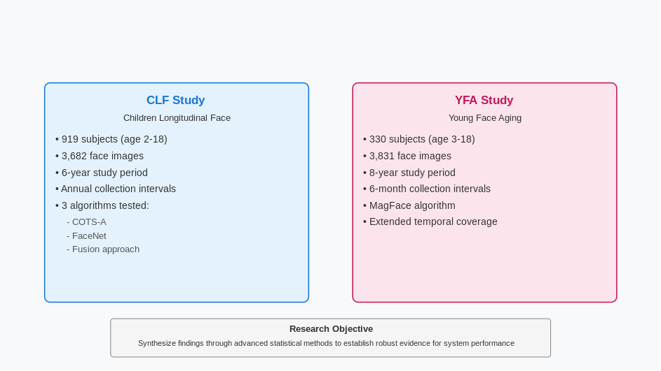
Dataset Characteristics

Slide 25
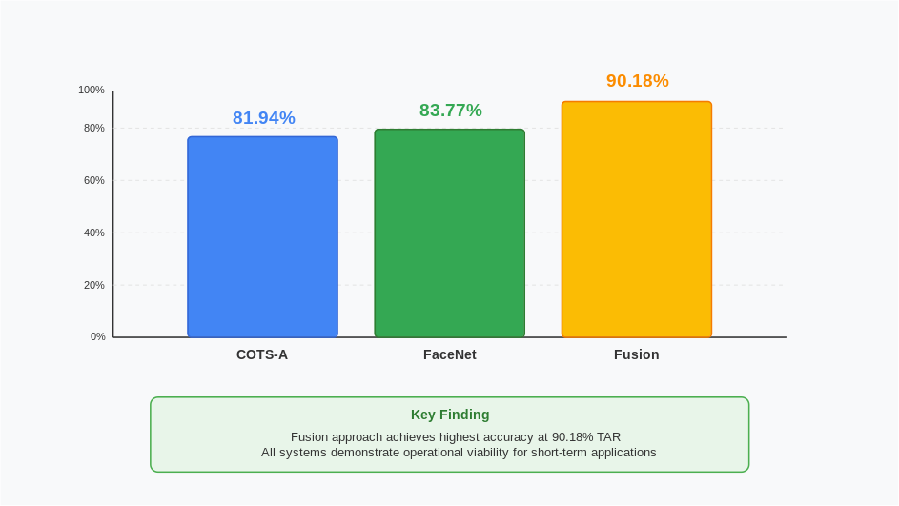
CLF Study – Initial Performance Metrics

Slide 26
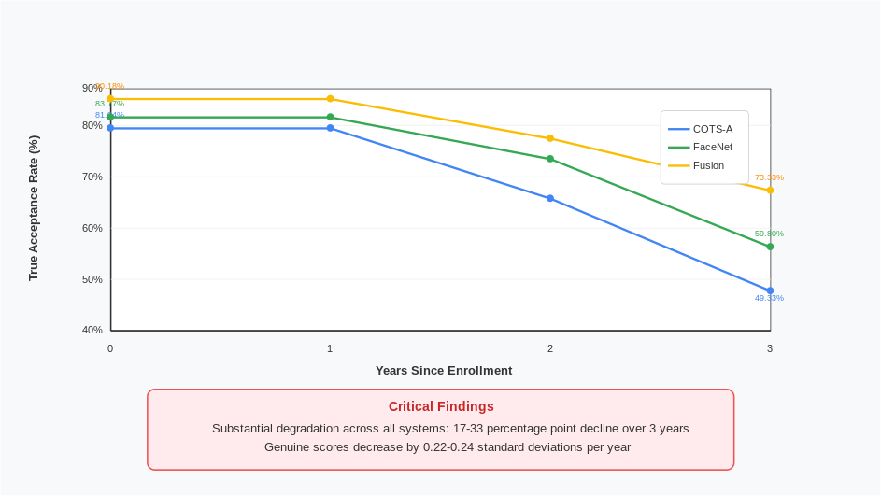
CLF Study – Temporal Degradation Patterns

Slide 27
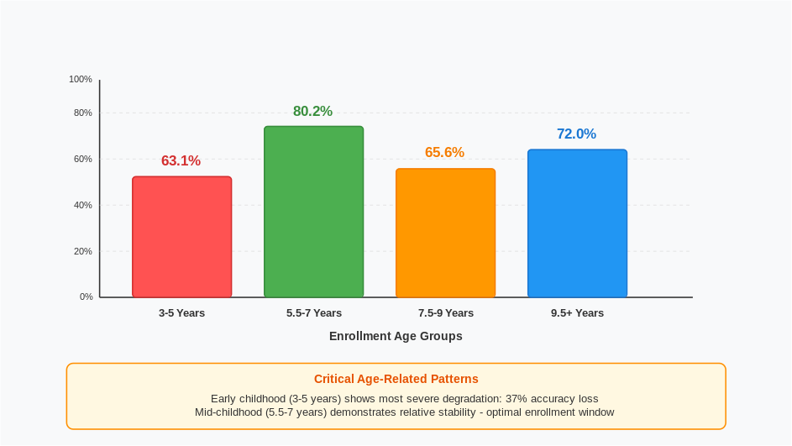
YFA Study – Extended Timeline Results

Slide 28
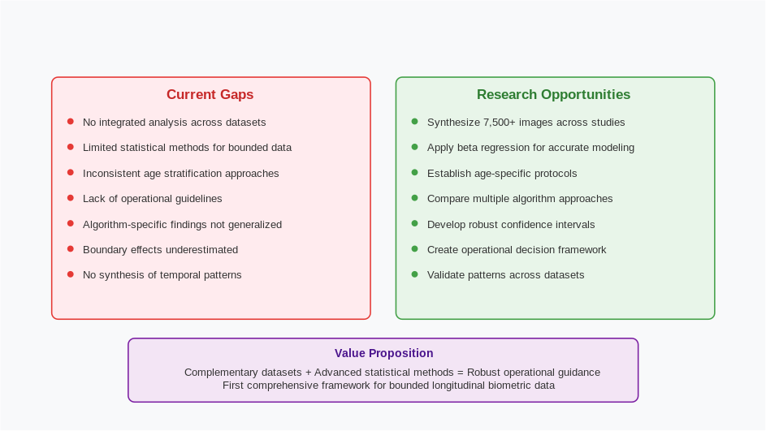
YFA Study – Age-Stratified Performance

Slide 29
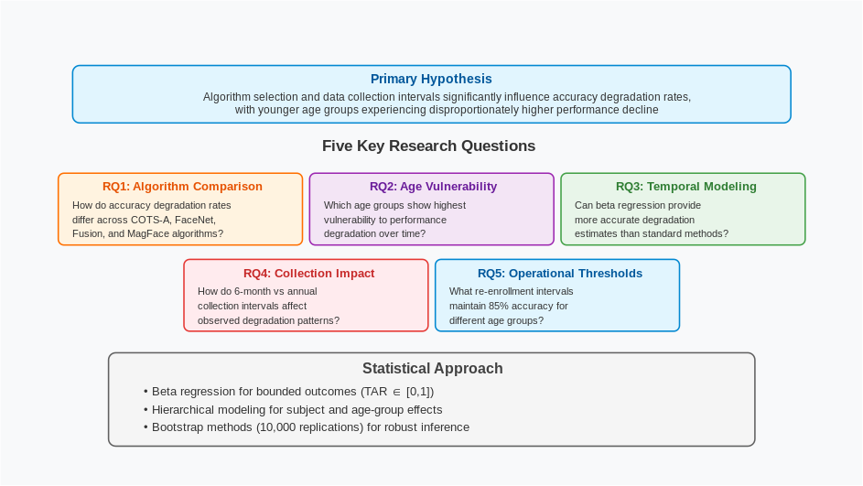
Research Gaps and Opportunities

Slide 30
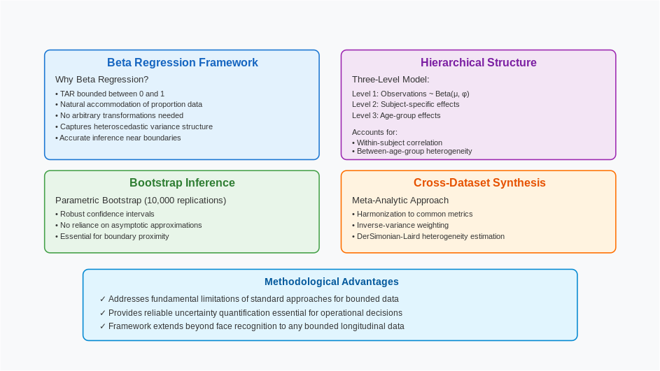
Proposed Statistical Methodology

Slide 31
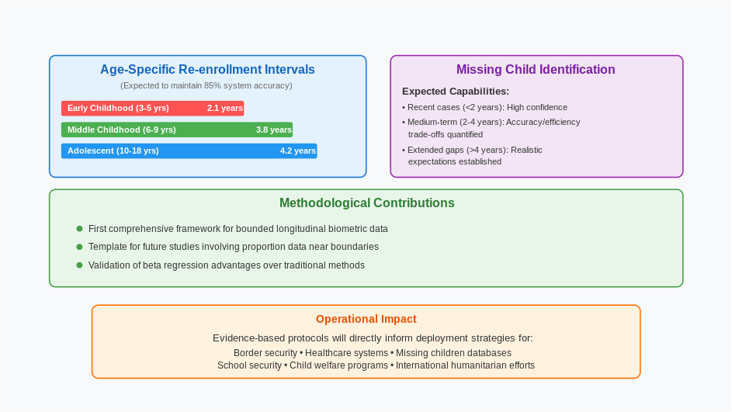
Expected Outcomes & Applications

Slide 32
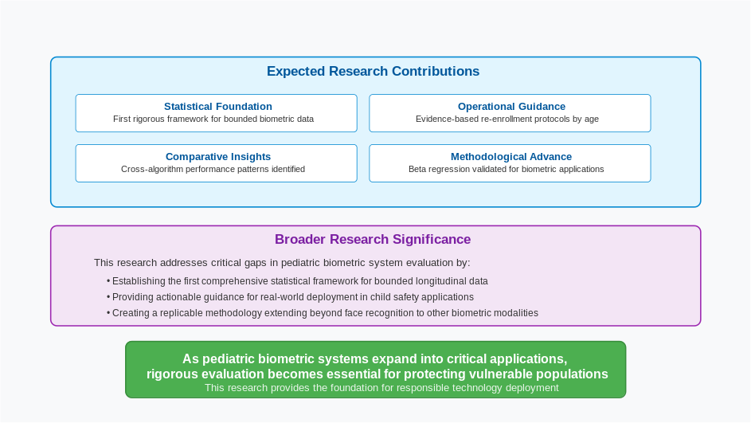
Expected Contributions & Research Significance

