Slide 1


Comparative Statistical Analysis of Pediatric Face Recognition Performance Synthesizing Evidence from Two Longitudinal Studies Using Advanced Statistical Methods for Bounded Data
IA650: Data Mining
Summer 2025
Aaron W. Storey 10

Slide 2
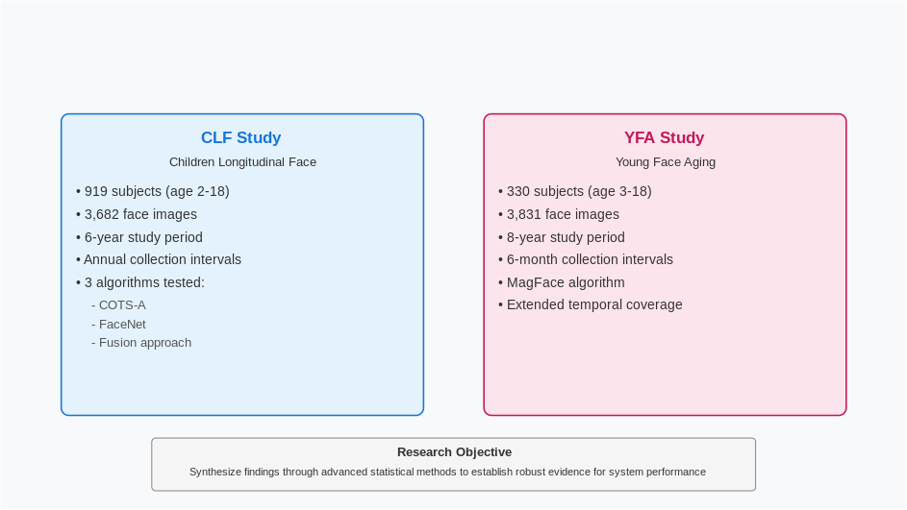
Study Overview & Context

Slide 3
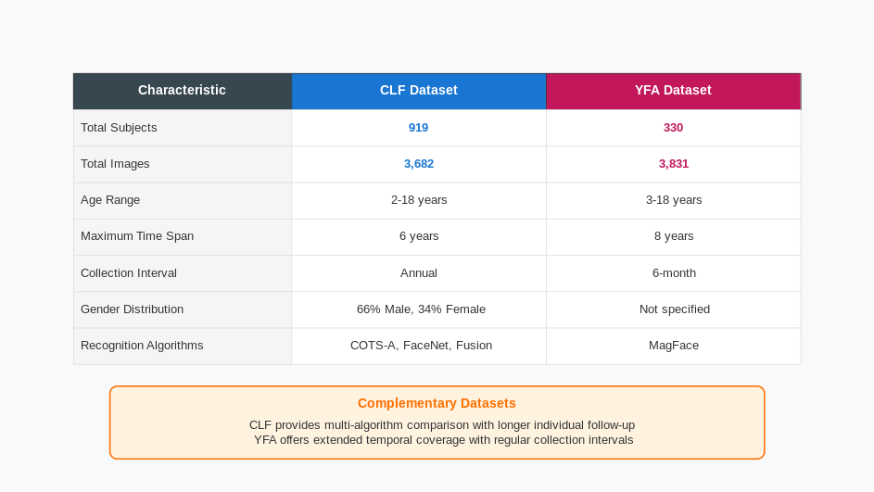
Dataset Characteristics

Slide 4
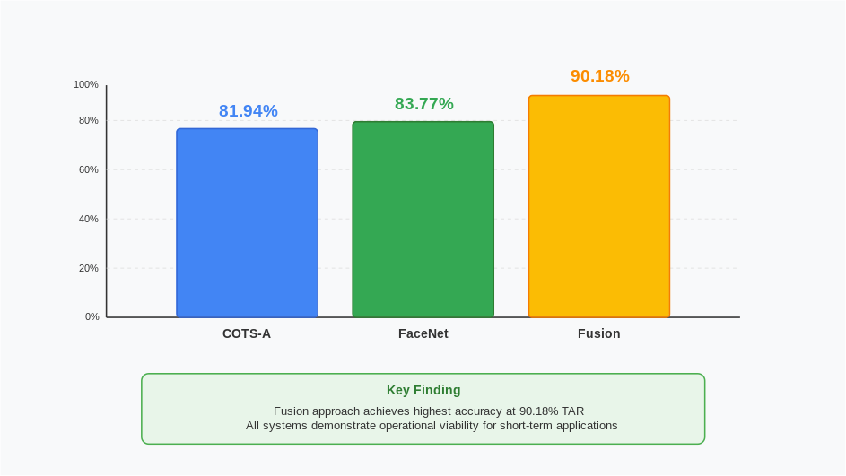
CLF Study – Initial Performance Metrics

Slide 5
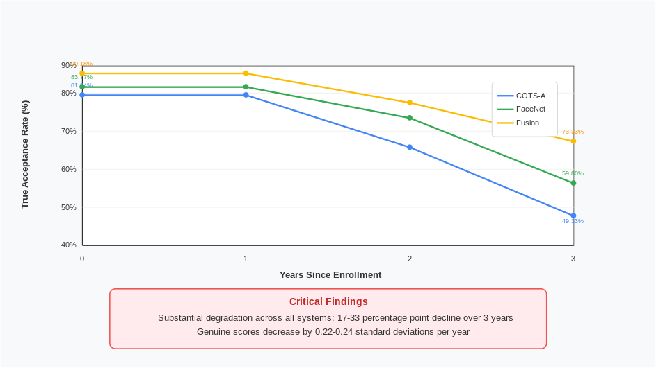
CLF Study – Temporal Degradation Patterns

Slide 6
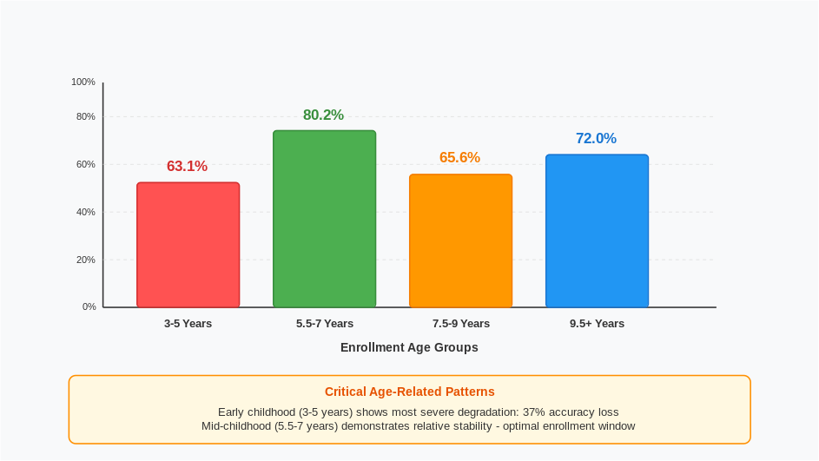
YFA Study – Extended Timeline Results

Slide 7
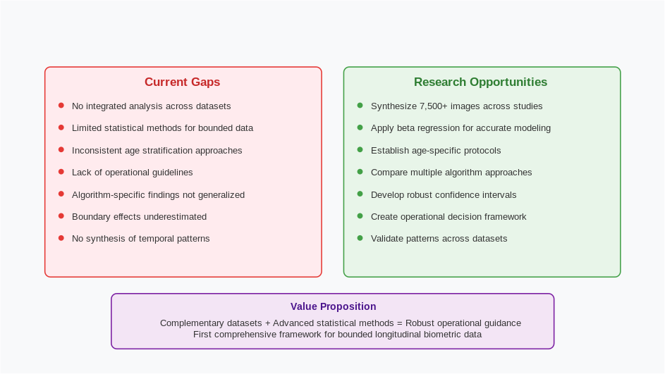
YFA Study – Age-Stratified Performance

Slide 8
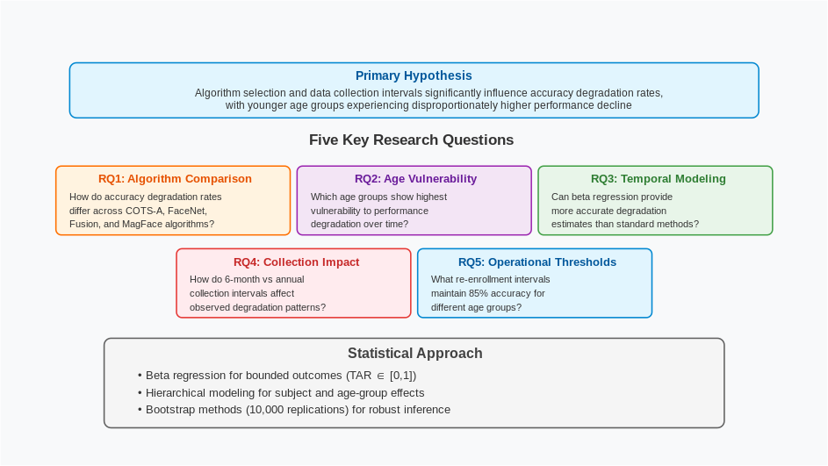
Research Gaps and Opportunities

Slide 9
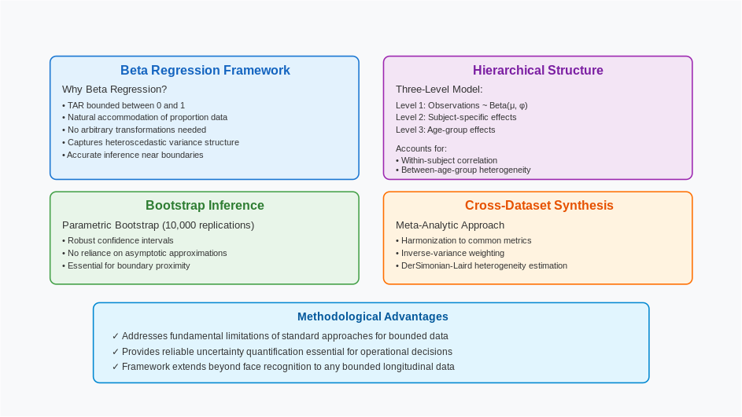
Proposed Statistical Methodology

Slide 10
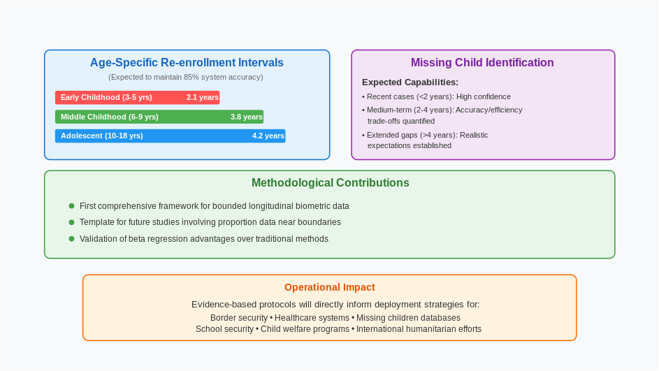
Expected Outcomes & Applications

Slide 11
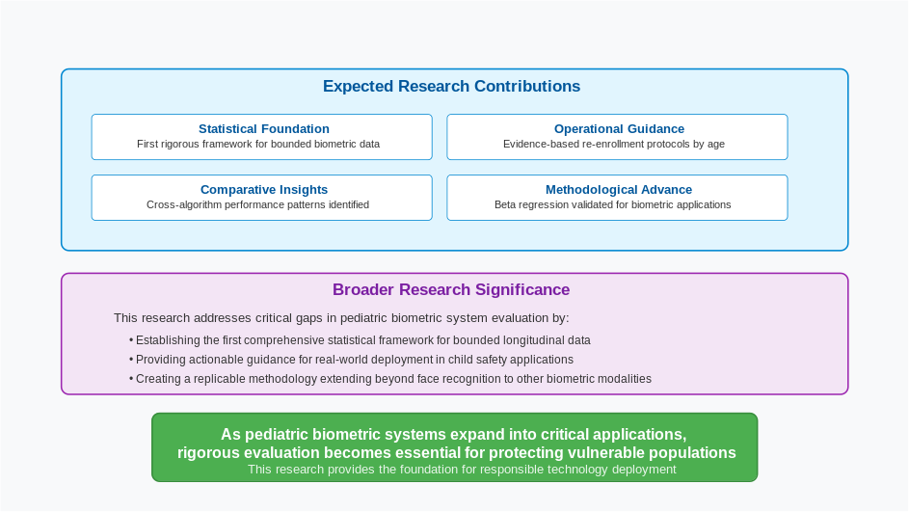
Expected Contributions & Research Significance

Slide 12
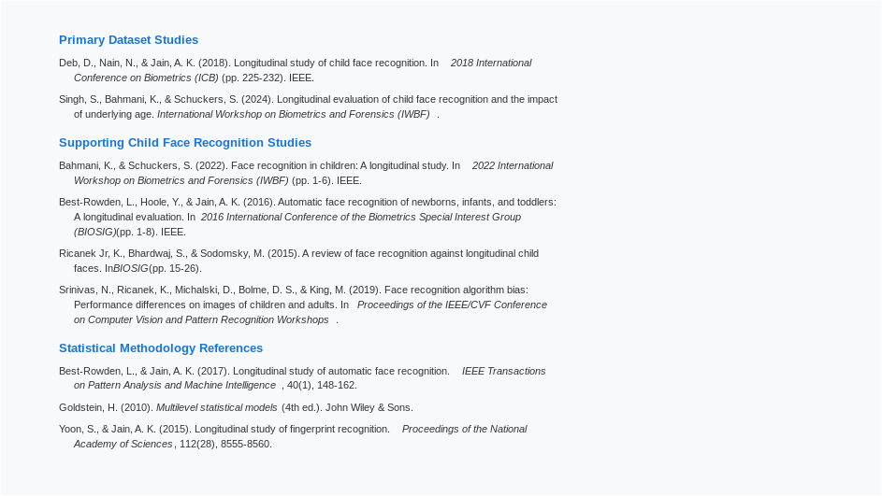
References

