Slide 1
First Amendment Freedoms
Overview & Freedom of Religion

Slide 2
How does the Constitution protect the rights of individuals against government?
Constitution guarantees civil rights & civil liberties
Many in the Bill of Rights & 14th Amendment
Key documents:
Declaration of Independence – all men have unalienable rights; govt exists to protect these rights
Preamble to Constitution – purpose of govt = “secure the blessings of liberty”
Articles I & III guarantee key rights
Civil liberties – freedoms protected from possible govt abuse
Freedom of religion
Freedom of speech
Freedom of press
Right to fair trial
Civil rights – freedoms defended by the govt
Laws banning discrimination

Slide 3
The catch… rights are relative
US citizens can exercise rights AS LONG AS they do not infringe on rights of others
Obscene language?
Blaring music late at night?
Private property?
Advanced notice for protests?
When rights come into conflict with each other 🡪 courts must decide the issue

Slide 4
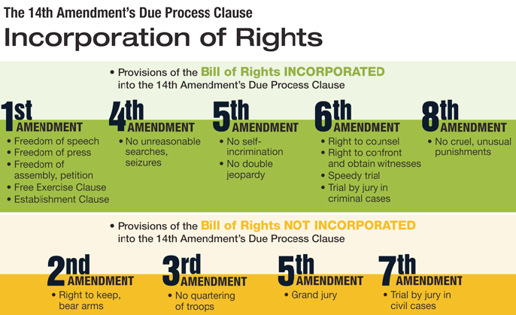
14th Amendment
Bill of Rights originally applied to actions of Federal govt… NOT STATE govt
State constitutions have own bill of rights to protect citizens’ freedoms
14th Amendment, however, extends the BASIC rights protected by the Bill of Rights to citizens of all states
Due Process Clause – no state can deny any person their basic rights and liberties
Process of incorporation – over time, most BOR applied to states, too
Incorporated
Not Incorporated

Slide 5
Remember, even rights not explicitly in the BoR may be protected🡪 9th Amendment
Declares people have rights beyond those specifically listed in the Constitution
Over time, Supreme Court has added these to the list:
Right of a person not to be tried on the basis of unlawfully gained evidence
Right of a woman to choose to have an abortion

Slide 6
The First Amendment
Amendment I. Congress shall make no law respecting an establishment of religion, or prohibiting the free exercise thereof; or abridging the freedom of speech, or of the press; or of the right of the people to peaceably assemble, and to petition the Government for redress of grievances.
Notes:
<number>

Slide 7
Free expression
1st Amendment: right to free expression by speech, writing, and all other means of communication
14th Amendment extends this to citizens of every state
Right to hear what others have to say on public issues
Why is this important?
Only an informed populace can make good decisions about public policy
SC rules that words can be banned if there is a strong risk that they will encourage criminal activity (“clear and present danger rule”)
But SC ruled it is NOT illegal to urge someone to BELIEVE something

Slide 8
Limits to free speech & press
No person has right to libel or slander someone (falsely/maliciously use printed or spoken words, respectively)
Illegal to encourage someone to commit crime
Laws can ban use of obscene words, print & distributing obscene materials, and false advertising

Slide 9
ASSEMBLY & PETITION
Govt has right to set rules on how, when, and where assemblies can take place, including permits
People do not have right to trespass or to assemble or petition on private property
1st Amendment does not protect assemblies or petitions that endanger life, property or public safety

Slide 10
EXAMPLES
Assemblies include public demonstrations as well as organizations such as political parties and interest groups
Petitions can include letters, lobbying, and advertisements
Peaceful marches and parades are protected forms of assembly

Slide 11
CIVIL DISOBEDIENCE
Civil disobedience = knowingly breaking the law in a non-violent way to protest a law or public policy
Courts have held that civil disobedience is not constitutionally protected
Accept legal consequences

Slide 12
LIMITS ON ASSEMBLY
Govt can decide when, where & how (to keep public peace)
Rules must be specific and fairly administered
Must be content neutral
SC agreed govt can require advance notice & permits for demonstrations on public property
SC rules judges & state laws may impose buffer zones
Do not have constitutional right to assemble on private property

Slide 13
FREEDOM OF ASSOCIATION
Right to join w/others to promote political, economic & social causes
People cannot be fired for belonging to associations
Associations do NOT have to accept members if doing so would contradict the beliefs of the association

Slide 14
Civil disobedience
Civil disobedience = knowingly breaking the law in a non-violent way to protest a law or public policy
Courts have held that civil disobedience is not constitutionally protected
Accept legal consequences

Slide 15
Freedom of Religion Protection
Establishment Clause – bans Congress from passing any law establishing a religion
Free Exercise Clause – bans Congress from preventing anyone from freely practicing their own religion
14th Amendment extends these bans to state governments
Thomas Jefferson – the 1st Amendment creates a “wall of separation between church and state.”
No govt law or action can deny right to hold any religious beliefs that they wish
No one has right to break criminal laws, offend public morals, or threaten public safety while practicing their religion

Slide 16
No “official” govt support, but…
Religious property & contributions to religions are not taxed
Oaths of office, national anthem, US coins and currency make reference to god
Limitations of Establishment Clause are still controversial…
Religion & Public Schools
Govt cannot aid nor oppose religion
Public schools cannot sponsor religious exercises such as prayer
Cannot post 10 Commandments in classrooms
Cannot sponsor prayers at graduations or sports games
Cannot ban the teaching of evolution in public schools or require teaching of creation science
CAN let student religious groups meet at school

Slide 17
Laïcité
Which of these two systems do you prefer? Why?
Which offers the most freedom? Explain your answer.
List the pros and cons of the French and American systems.
Notes:
<number>

