Slide 1
The Federal Court System
<number>

Slide 2
Can the Supreme Court pick and choose what it wants to examine?
No…
A case has to be brought before the court through one of several ways…
Usually, lower courts need to hear issue before it can get to the Supreme Court
UNLESS it’s a matter that falls under “original jurisdiction”
More on that later…
<number>

Slide 3
Structure & Function of Federal Judiciary
Federal “judiciary” – two levels:
1. Supreme Court (highest federal court)
2. Inferior courts (LOTS of these)
A. Special courts
B. Constitutional courts
Hears cases involving federal law & interstate cases
Also, interprets constitutionality of law
<number>

Slide 4
Origins
First, Constitution created Supreme Court
Congress decides how many Supreme Court justices
Then, Article III gave Congress power to create rest of federal court system
And it did☺ 🡪 1789
States have their own courts (for state civil and criminal issues)
Most cases are heard in state courts
Example, most murder cases are state issues and so heard in state courts
<number>

Slide 5
Congress Created two types of Inferior Courts
Constitutional Courts
(Art III - It established the judicial branch)
Special Courts
(Art 1 - It established the legislative branch)
Exercise judicial power of US & hears wide range of cases dealing w/federal laws
Include
94 District Courts!
12 US Courts of Appeal
US Court of Appeals for Federal Circuit
US Court of International Trade
These deal explicitly w/expressed powers of Congress
Help Congress do their constitutional job
Include:
US Court of Federal Claims
US Tax Court
US Court of Appeals for Armed Services, etc….
<number>

Slide 6
How do you know what court a case will go to? Federal Jurisdiction
Jurisdiction Types:
Original jurisdiction – court in which case is first heard
Original jurisdiction is like a court getting “dibs” to hear a case b/c of the subject of the case
Concurrent jurisdiction – can be tried in either state or federal courts
If this happens, the federal govt usually lets the state courts take the case
Appellate jurisdiction – rules on cases that were first tried in other courts
Review cases to make sure law was correctly applied (can uphold or overturn earlier decisions)
Federal courts hear cases based on:
Subject matter
Does it involve interpretation of the Constitution, law or treaty? If the answer is yes, then it probably should go to a federal court!
Parties involved
Does it involve people from two or more states? International actors? Ambassadors? If yes, then it should go to the federal level.
Federal courts usually try those cases that ONLY they have the authority to hear
<number>

Slide 7
ALL Federal Judges
President appoints
Senate confirms or rejects
Judges on constitutional courts (Article III courts) are appointed for life
Can be removed by impeachment
Congress decides # of judges
Judges on special courts (Article I) have terms of 8-15 years
NO constitutional qualifications for being a judge! (However, custom = have legal background & experience)
<number>

Slide 8
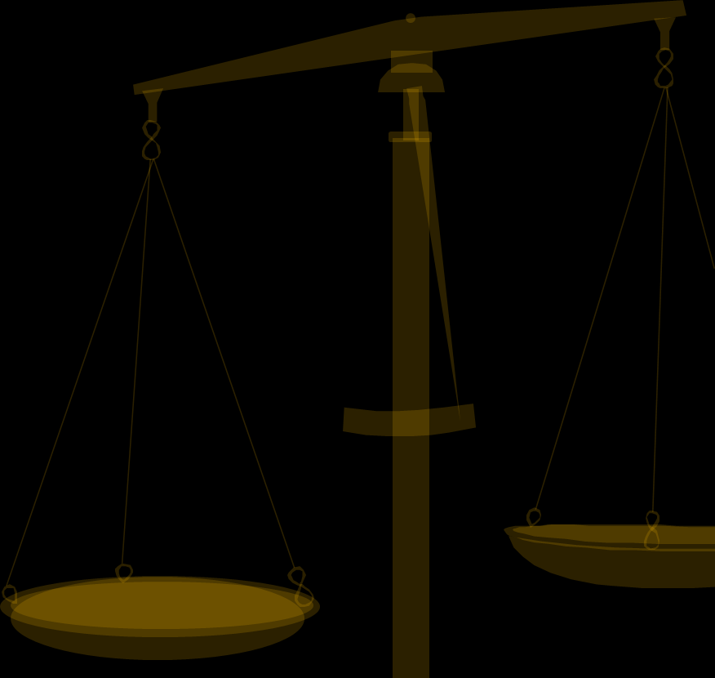
FIRST, LET’S TALK ABOUT INFERIOR COURTS: LEVEL ONE: DISTRICT COURTS
The federal courts: hear criminal & civil cases
Handle about 80% of federal cases
Original Jurisdiction: hear cases for the first time
Responsibilities:
Determining the facts of the case
Hold trials for civil and criminal federal cases
Decide guilt or innocence
This is the only level of federal courts where witnesses testify, juries hear cases, reach verdicts
<number>

Slide 9
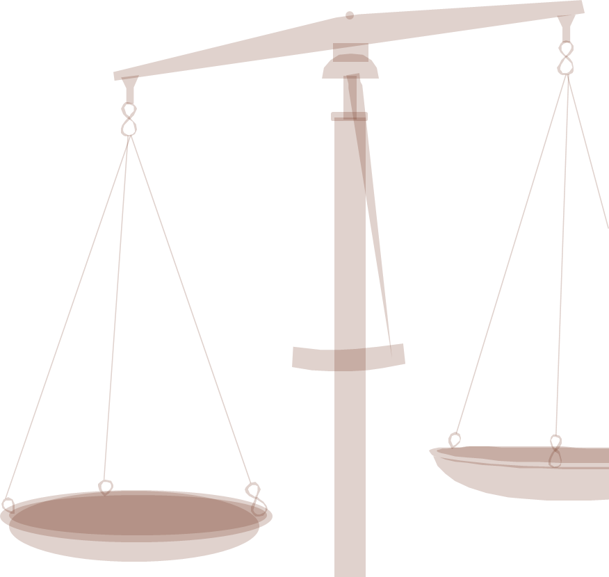
DISTRICT COURTS
Only level that has trials
3judge panels try some cases involving:
apportionment
civil rights
antitrust laws
Foreign Intelligence Surveillance Court (FISA) –11 district court judges issue secret search warrants to monitor suspected spies & terrorists
Number:
Each state has at least one (it’s dependent on population size)
Larger states have multiple district courts (that way they can handle the HUGE case loads)
Total # of US District Courts = 94
Districts are organized into circuits geographically (For example: western states are all in one circuit together)
<number>
Notes:
Number:
Each state has at least one
Larger states have multiple district courts
Total # of US District Courts = 94
Districts are organized into circuits geographically
Only level that has trials
3judge panels try some cases involving:
apportionment
civil rights
antitrust laws
<number>

Slide 10
EXAMPLES OF FEDERAL CASES
Most decisions made at this level are NOT appealed
CIVIL
CRIMINAL
Bankruptcy
Postal
Tax
Civil rights
Bank robbery
Kidnapping
Counterfeiting
Mail fraud
Tax evasion
terrorism
Civil cases: mostly between private parties BUT U.S. maybe a plaintiff or defendant
Criminal cases: US is always prosecutor

Slide 11
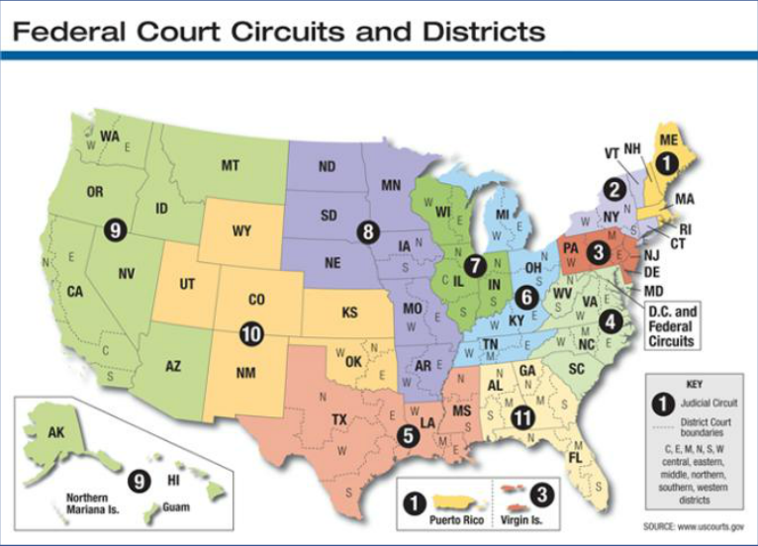

Slide 12

APPEALS COURTS
Review decisions made in lower district courts
Appellate jurisdiction:
Authority to hear a case appealed from a lower court
Number: 13
Types of cases heard:
Cases where an appeal was made from a decision in a district court
Purpose: Created in 1891 to ease burden on the Supreme Court☺
That way cases need to be appealed at a middle level before they get to the Supreme Court (which is really hard to do)
Each “Circuit” has its own court of appeals
<number>

Slide 13

APPEALS COURT
Appeals courts do NOT hold trials-- (review record & arguments of case)
Possible rulings:
Uphold the original decision
Reverse/overturn
Remand the case to the lower court
Less than 1% of decisions are appealed to the Supreme Court
The 13th “Court of Appeals for the Federal Circuit” has nationwide jurisdiction dealing w/appeals from:
Court of International Trade
Court of Federal Claims
Court of Appeals for Veterans Claims
94 district courts if the case appealed involves copyright or patent issues
<number>

