Slide 1
SUPREME COURT
Decide whether laws are constitutional
JUDICIAL REVIEW
Highest court in the land
Jurisdiction: Original and Appellate
POWERS:
Judicial Review (Established in Marbury v. Madison)
Interpret meaning of laws
Final Authority on:
legal questions dealing with Constitution
acts of Congress
US treaties
<number>

Slide 2
SUPREME COURT
Cases heard (actually very few):
Cases that come through appeal
Cases that deal with the Constitution
Hear oral arguments, study written briefs, reach majority decision
9 Justices
1 Chief Justice, 8 Associate Justices
Life term (unless they retire, resign, or die)
Original jurisdiction:
Involving two or more states
Affecting ambassadors and public ministers
<number>

Slide 3
SUPREME COURT
Checks on powers of other branches:
Can require change in law/executive action to fit the Constitution
Require change in Constitution to fit the law if Congress presses issue
Checks on court:
President appoints judges, Senate approves
Congress can impeach and remove judges from office
Can only rule in cases that come to it
<number>

Slide 4
SUPREME COURT CASES
8,000 cases come to Supreme Court – only few hundred are accepted
4 justices have to agree to accept a case
Over half of these are remanded (returned to a lower court without the Court ruling on them)
Either party in a case can petition SC to issue a writ of certiorari agreeing to review case
Writ of certiorari – an order by SC telling lower court to send it specific case to review
OR cases can reach SC by certificate – lower court asks the SC to rule on a confusing issue
Certificate – request by lower court for SC to certify answer to question about proper procedure or rule of law in a case

Slide 5
SC PROCESS
Term – October to June/July
Steps:
Receive written briefs (sometimes interested parties also submit briefs with permission or on request)
Hear oral arguments – typically 30 mins per side
Recess to consider case; conference with each other
Issues opinion
Majority opinion – official ruling of SC; explains decision
Concurring opinion – agrees w/majority but for different reasons
Dissenting opinion – written by justice(s) who disagrees with Court’s decision (does NOT become precedent)
Solicitor general = USG representative
Decides what cases the USG should ask the court to review

Slide 6

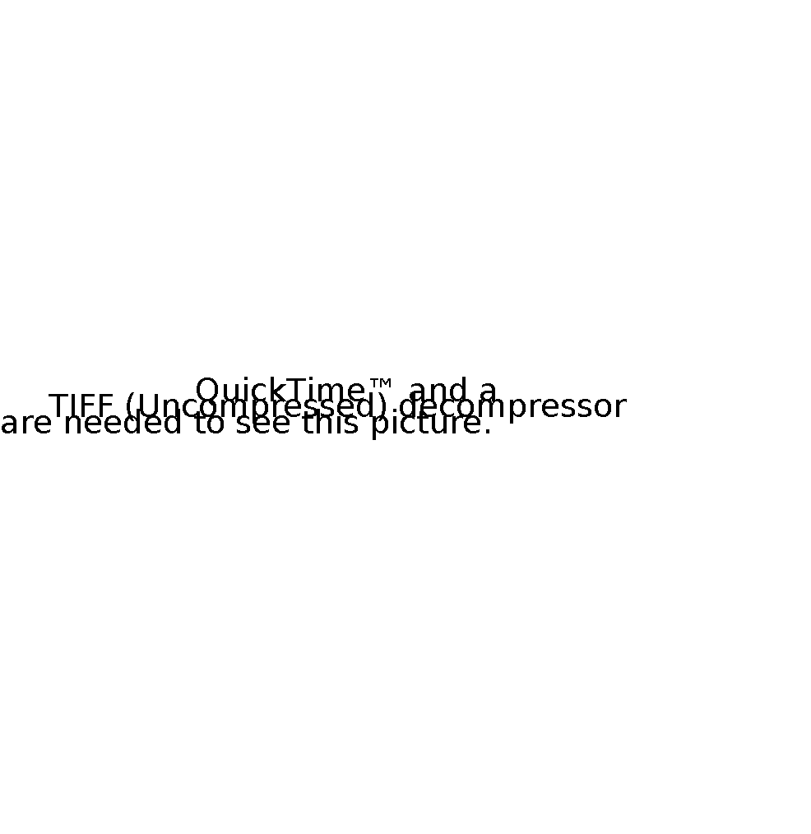


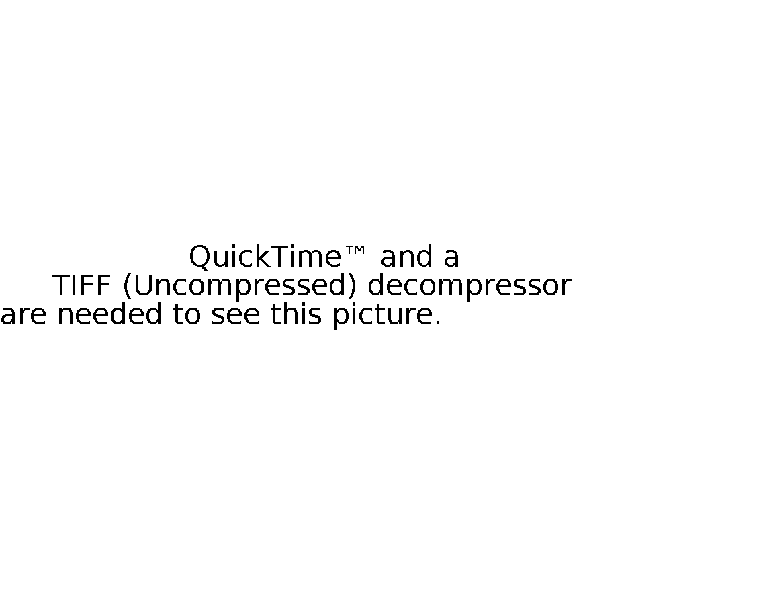


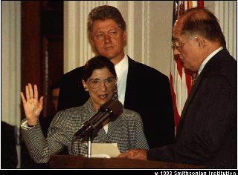

U.S. SUPREME COURT CONFIRMATION PROCESS
Stage 1: Presidential Nomination
FBI
Investigation
WHITE HOUSE
REVIEW
Certification
Stage 2: Senate Judiciary Committee Hearing
INTEREST
GROUP
Influence
MEDIA
Influence
Stage 3: Full Senate Vote
Stage 4: Oath of Office?
Notes:
<number>

Slide 7
Judicial Activism vs. Restraint
Restraint
Activism
Courts should defer to the policy decisions of the legislative and executive branch
Judges should decide cases based upon
Intent of framers & Congress when it was originally written
Precedents set by rulings in similar cases
Judges should take into account how social values and conditions may have changed over time when they interpret the law
Judges can and should make independent decisions when their interpretation of law differs from that of legislative & executive branches
<number>

Slide 8
Exit Ticket
Write one paragraph with a very strong thesis statement addressing the following:
There tends to be very heated argument between those that believe the Supreme Court Justices should demonstrate judicial restraint when deciding cases and those that believe the Justices should be more flexible in their interpretation of the Constitution and should take into account changing social norms and conditions when deciding cases.
What judicial philosophy should federal judges practice when deciding cases and why?
<number>

