Slide 1
Validation of ASTR in Re1000 cavity flow
ASTR: 6th-order compact central + 10th-order compact filter, 128² mesh.
Reference: Botella & Peyret (1998), Chebyshev collocation method, N=128.
Done by Jian Fang, 18/4/2024

Slide 2
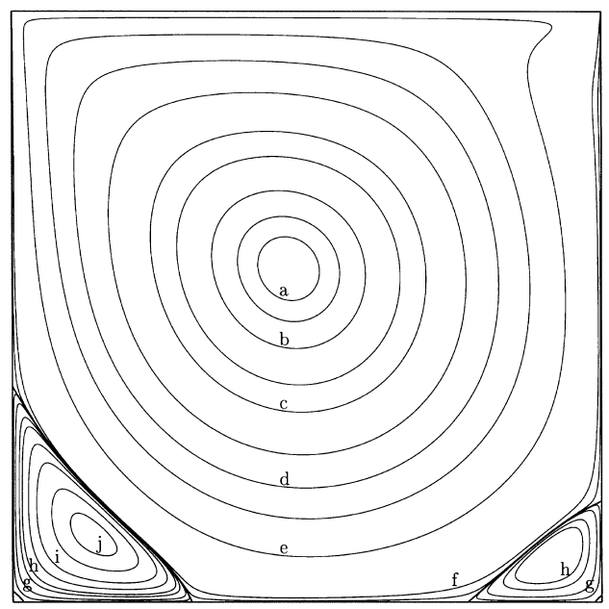
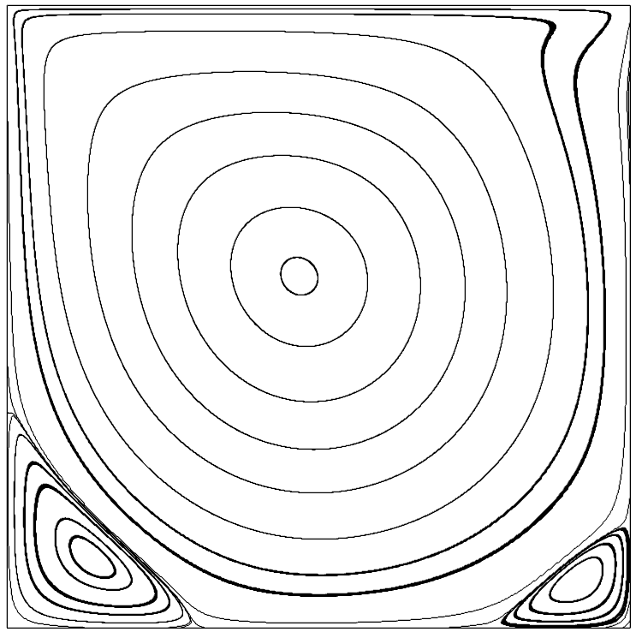
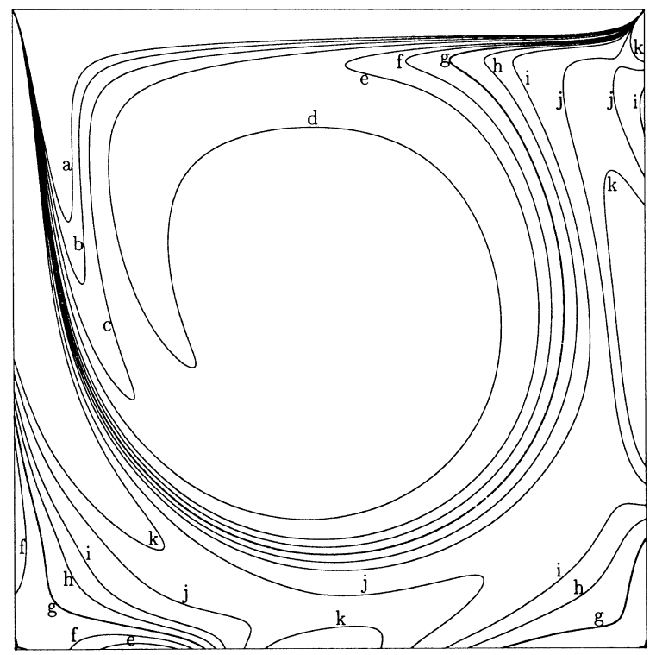
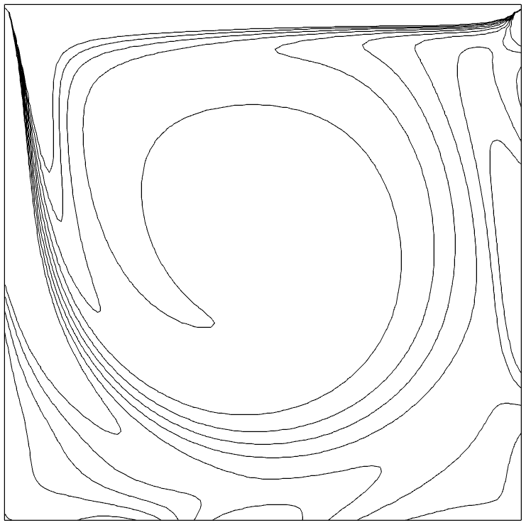
Validation of ASTR in Re1000 cavity flow
ASTR: 6th-order compact central + 10th-order compact filter, 128² mesh.
Reference: Botella & Peyret (1998), Chebyshev collocation method, N=128.
Botella & Peyret (1998), Spectral N=128
ASTR, Compact6 with 128² mesh

