Slide 1
Graphs

Slide 2
What is a Graph?
Represented by a collection of two sets
Vertices and Edges
Two Types (directed and undirected)

Slide 3
Undirected Graph
Doesn’t have any restrictions on how to navigate the graph
A
{B,A}
{C,A}
{A,B}
{A,C}
B
C
{B,C}
{C,B}

Slide 4


Directed Graph
Has an edge associated with a direction
Edges are in ordered pairs and can’t be rearranged.
C
{D --> E}
E
D
{E --> D}
F

Slide 5
Vocabulary
Degree of Vertex: Number of lines intersecting to it.
Path: Sequence of vertices between vertex one and two.
Cycle: Whole loop. Starts and ends on same vertex.
Simple Path: Path with no repeating vertices.
Connected Graph: If there is a path connecting every vertex.
Complete Graph: Edge connecting every pair of vertices.
C
E
D
F

Slide 6
Adjacency Graph
List the origin and the path taken to connect two vertices.
C
Vertex | Connected To
C | E
D | C
E | D,F
F | D
E
D
F

Slide 7
How to Implement In Java

Slide 8
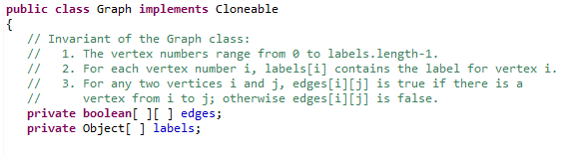

Creation
Boolean edges: Stores if there is a vertex that is connected by those two sides
labels: Stores the connections between vertices.
Initialize both edges and labels.

Slide 9

Adding On
public void addEdge: Allows user to create a new edge.

Slide 10
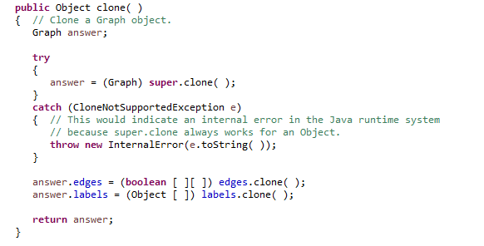
Cloning
Returns a cloned version of our graph.
*Editing this clone will not change the original one.*

Slide 11
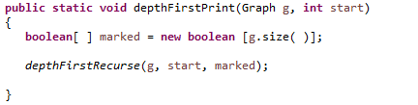
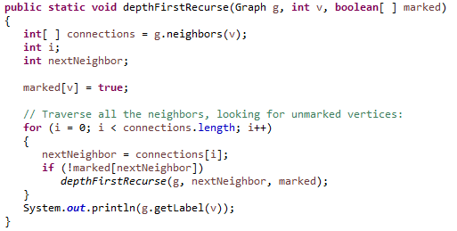
Output
public static void depthFirstPrint: This method allows us to print out the labels of our graph.
*Remember labels tell us how the graph connects {A,B}*
public static void depthFirstRecurse: Is what depthFirstPrint uses to print out the graph’s labels.
*Notice how it calls neighbors() and getLabel()*

Slide 12

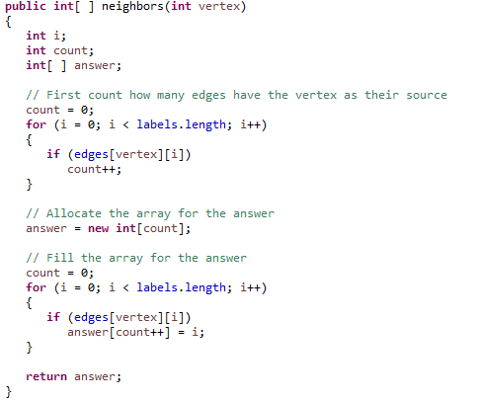
getLabel() and neighbors()
public Object getLabel: Calls the labels() method to return the label of a vertex.
public int[ ] neighbors: Gets all the neighbors of a given vertex. This allows us to get all the labels to build an adjacency graph.

Slide 13


isEdge() and size()
public boolean isEdge: Simple method to determine if the edge exists in the graph.
public int size: Simple method to determine the size of the graph. Remember the size is the number of labels in the graph.

Slide 14


removeEdge() and setLabel()
public void removeEdge: Simple method that removes an edge by setting edge[source][target] = false.
public void setLabel: Allows us to manually modify a label to a new one of our choice.

Slide 15
You now have everything to make your own graph!

