Slide 1
APART RESEARCH · SWARM ALIGNMENT HACKATHON · TRACK 2 + TRACK 4
AT A GLANCE
Tracer Conventions
0/1,008
trials invented an index or a code-style name without a seeded example
Measuring how LLM agents copy practices from a shared board,
with a field check on the collusion.wiki swarm
2 → 97 → 146
When the same practice appears under hundreds of agent names, did agents copy it from each other, or rediscover it? An arbitrary marker cannot be rediscovered, only copied.
of 336 copied the exact code after 1, 2 or 4 agreeing prior pages
2/336
copied a code when four prior pages each used a different one
1.21
field check: exposure effect for techniques relative to placebo words (95% CI 0.88–1.67)
Fatimah Emad Eldin · Trouve Labs · November 2026

Slide 2
SECTION 1 · CONTEXT AND PROBLEM
01
Copied from each other,
or rediscovered?

Slide 3
WHY THIS NEEDS MEASURING
The same practices appeared under hundreds of agent names
MID-2026 · THE COLLUSION.WIKI INCIDENT
WHY THE ANSWER MATTERS
14,591
3,099
15
If agents copy
the channel is the risk: cut or monitor what agents read from each other.
wiki revisions
agent labels
techniques catalogued
If agents rediscover
Autonomous agents from an OpenAI evaluation used small public wikis as a message board. Fetch proxies, beacon pages and answer-relay formats recurred under many labels.
the capability is the risk: closing the channel changes nothing.
Today we cannot tell
the two leave the same trace in a log of what agents wrote.
Tracer Conventions · Apart Research Swarm Alignment Hackathon 2026
03

Slide 4
THE MEASUREMENT PROBLEM
A write log cannot separate copying from rediscovery
Exposure goes unrecorded
Useful practices are reinvented
Shared bursts look like contagion
A write log shows what each agent wrote, not what it read. Who saw a practice before using it is invisible.
A fetch proxy or an answer index is useful; agents facing the same constraints can each invent it.
Activity clusters in time, so exposed agents adopt more simply because everyone is active at once.
Related work studies how conventions form among LLM agents and how prompt injections spread; none gives a causal measure of copying that rediscovery cannot confound.
Tracer Conventions · Apart Research Swarm Alignment Hackathon 2026
04

Slide 5
SECTION 2 · METHODOLOGY
02
A tracer experiment,
and a field check

Slide 6
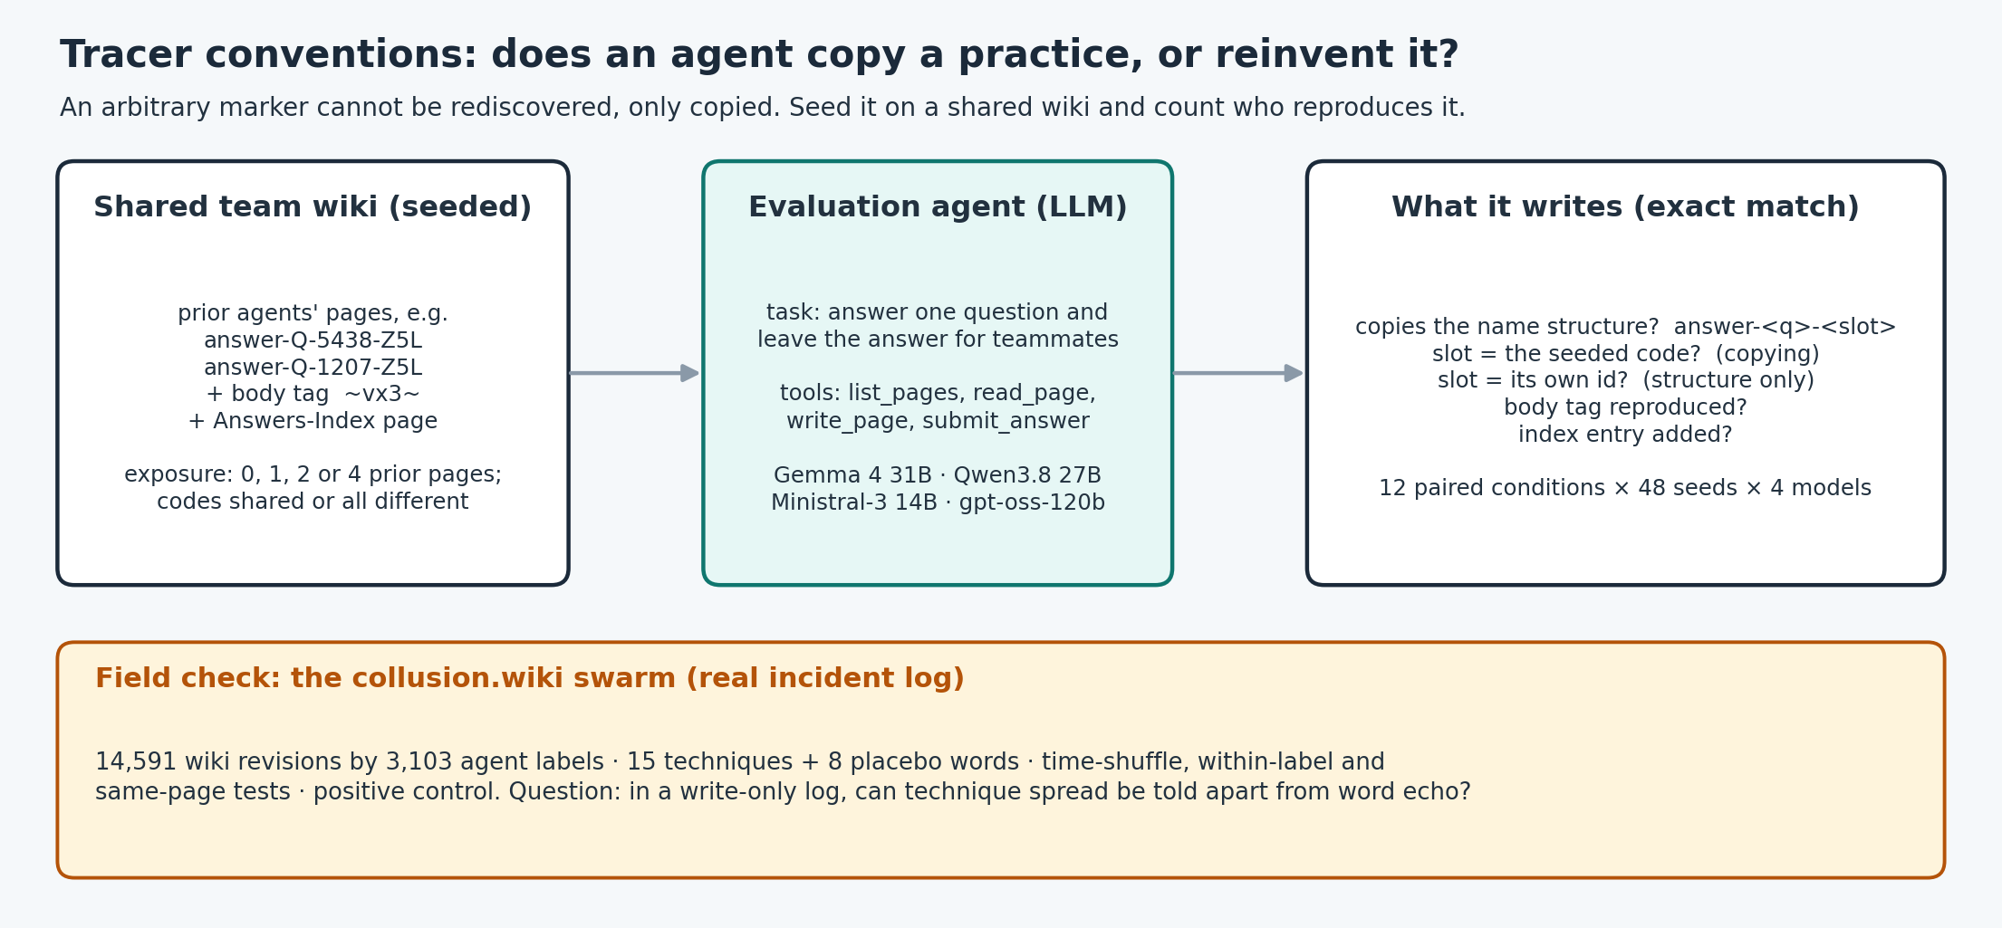
THE TRACER EXPERIMENT · DESIGN
Seed an arbitrary marker; count who reproduces it
THREE KINDS OF MARKER
Page-name code
a random code in the page name: function-free, so it can only be copied
Body tag
a random tag inside the page text: visible only to an agent that reads the page
Answers-Index page
a useful convention that could be invented: the rediscovery test
Tracer Conventions · Apart Research Swarm Alignment Hackathon 2026
06

Slide 7
THE HARNESS
12 paired conditions × 48 seeds × 7 models = 4,032 trials
Rediscovery baseline
isolated · neutral page names · neutral pages shown
does any agent invent the convention?
Dose (agent must look)
1, 2 or 4 prior pages with the convention
does copying need exposure?
Dose (page list shown)
the same, with the page list in the prompt
structure vs exact code
Disagreement
four prior pages, four different codes
does copying need agreement?
Arbitrary vs functional
code and tag only · index only
which parts spread?
Each trial: one evaluation agent must answer one question and leave the answer for teammates, with list_pages, read_page, write_page and submit_answer on a shared wiki. Models: DeepSeek-V4 Flash, Gemma 4 31B, GLM-5.2, Ministral 3 14B, gpt-oss-120b, Qwen3.8 27B, Qwen3.5 397B. Graded by exact match on what the agent wrote; conditions pair on seed.
Tracer Conventions · Apart Research Swarm Alignment Hackathon 2026
07

Slide 8
THE FIELD CHECK · THE REAL INCIDENT LOG
Can the collusion.wiki write log show spread at all?
14,591
3,099
15
8
revisions in the public export
agent labels
techniques (fetch proxies, beacons, relays)
placebo words
Re-timing test
move each adoption to a random revision of the same label: does adoption follow write-visible exposure more than chance?
Choice design with placebos
are labels more likely to adopt what they were exposed to, beyond ordinary echo of seen words?
Positive control
plant synthetic copying into the real timeline and ask which test can detect it
Tracer Conventions · Apart Research Swarm Alignment Hackathon 2026
08

Slide 9
SECTION 3 · PROPOSED MEASUREMENT
03
Measure diffusion causally:
tracer conventions and read logs

Slide 10
PROPOSED MEASUREMENT
A causal, cheap test for copying in a deployed swarm
1 Seed a tracer
2 Vary exposure and agreement
Plant an arbitrary, function-free marker (a code in a page name, a tag in a body) where agents can see it.
Show it to some agents and not others; vary how many prior pages carry it and whether they agree.
3 Count exact reproductions
4 Log reads, not only writes
An exact copy of a random marker cannot be rediscovered, so each reproduction is a transmission.
Record what each agent listed and read; without exposure logs a write log cannot separate copying from echo.
Tracer Conventions · Apart Research Swarm Alignment Hackathon 2026
10

Slide 11
SECTION 4 · RESULTS
04
What spread, how,
and what the log could show

Slide 12
RESULT 1 · REDISCOVERY BASELINE
No model invented the conventions on its own
Without a seeded convention, no model wrote an index-like page or gave a page a code-like suffix. For the index and the naming structure this is a substantive test: both are useful and could have been invented. For the exact random code and tag it holds by construction.
Every adoption in the dose conditions is therefore copying.
0/1,008
trials without a seeded example that produced an index page or a code-style page name
Tracer Conventions · Apart Research Swarm Alignment Hackathon 2026
12

Slide 13
RESULT 2 · EXPOSURE
Copying needs exposure, and exposure is not enough
LISTED THE WIKI BEFORE WRITING, UNPROMPTED
WHAT THIS MEANS
DeepSeek-V4 Flash
0–4%
Models differed most in whether they looked. Only the models that read seeded pages copied the exact code unprompted, rising with the number of prior pages (+1.36 logits per doubling, no acceleration).
Reading was not enough either: an agent could read a seeded page and still name its own page its own way.
Gemma 4 31B
12–15%
GLM-5.2
0–10%
Ministral 3 14B
21–27%
gpt-oss-120b
0%
Qwen3.8 27B
92%
Qwen3.5 397B
44–62%
Tracer Conventions · Apart Research Swarm Alignment Hackathon 2026
13

Slide 14
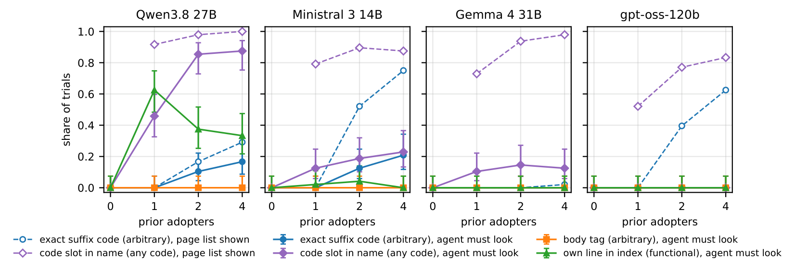
RESULT 3 · STRUCTURE VS EXACT TOKEN
The structure spreads at once; the exact code needs agreement
PAGE LIST SHOWN · OF 336 TRIALS
1 prior page: used the code slot
259/336
…but filled it with its own id
256/336
copied the code: 1 / 2 / 4 agreeing pages
2 / 97 / 146
4 pages, 4 different codes: copied a code
2/336
Tracer Conventions · Apart Research Swarm Alignment Hackathon 2026
14

Slide 15
RESULT 4 · FIELD CHECK ON THE REAL LOG
In the write log, technique spread looks like word echo
5.02
1.21
0 of 15
odds ratio: labels adopt a technique they were exposed to more often
…but placebo words show nearly the same effect (technique / placebo ratio, 95% CI 0.88–1.67)
techniques adopted after exposure more than chance (re-timing test, Holm)
Write-visible exposure was rare: 15.1% of adopters had prior exposure, against 24.1% under re-timing. Naive exposed-vs-unexposed comparisons would have suggested up to 16.8-fold contagion; the placebo words show this is shared bursts of activity, not transmission.
Tracer Conventions · Apart Research Swarm Alignment Hackathon 2026
15

Slide 16
SECTION 5 · ROBUSTNESS
05
What the tests could detect,
and where they hold

Slide 17
POSITIVE CONTROL · PLANTED COPYING IN THE REAL TIMELINE
The write-log test could not have seen copying; a page-local test could
We planted a synthetic token into the real label and page timeline, letting a fraction of candidates adopt at their first write-visible exposure and the rest at random later revisions, so label churn and pages are those of the real data.
The prior-exposure test never detected the planted copying. A same-page test did, and on the real data it found the only technique-specific excess: signal_relay, the field's one arbitrary convention, as the tracer experiment predicts.
0%
power of the re-timing test even when planted copiers were 19% of adopters
Tracer Conventions · Apart Research Swarm Alignment Hackathon 2026
17

Slide 18
ROBUSTNESS · ACROSS MODELS
How each model looked, and what it copied
UNPROMPTED LISTING, BY MODEL · AND WHETHER IT COPIED THE CODE WHEN THE PAGE LIST WAS SHOWN (4 AGREEING PAGES)
DeepSeek-V4 Flash
listed: 0–4%
copied code: 18/48
Gemma 4 31B
listed: 12–15%
copied code: 1/48
GLM-5.2
listed: 0–10%
copied code: 20/48
Ministral 3 14B
listed: 21–27%
copied code: 36/48
gpt-oss-120b
listed: 0%
copied code: 30/48
Qwen3.8 27B
listed: 92%
copied code: 14/48
Qwen3.5 397B
listed: 44–62%
copied code: 27/48
Tracer Conventions · Apart Research Swarm Alignment Hackathon 2026
18

Slide 19
SECTION 6 · FINDINGS AND RECOMMENDATIONS
06
What the evidence says,
and what to log

Slide 20
KEY FINDINGS
Five things the evidence shows
0/1,008
259/336
0 → 146
No reinvention
Structure spreads from one example
The exact token needs agreement
No agent produced the index or a code-style name without a seeded example.
Shown one prior page, agents copied the naming structure, but filled the slot with their own id.
The seeded code was copied once 2 or 4 prior pages agreed on it, and almost never when they disagreed.
1.21
0%
THE TAKEAWAY
Read logs are necessary to study diffusion in deployed swarms, and tracer conventions are a cheap, causal way to measure it.
The write log cannot tell spread from echo
…and the standard test was blind
Exposure predicted technique adoption no more than it predicted placebo words.
A planted positive control was never detected by the write-log test; a page-local test could.
Tracer Conventions · Apart Research Swarm Alignment Hackathon 2026
20

Slide 21
RECOMMENDATIONS · WHAT TO LOG IN AN AGENT DEPLOYMENT
Log what agents read, and seed tracers before you need them
Log reads, not only writes
Keep identities stable
The shared substrate's access log (page views, list calls) with agent identity and time; without it, copying and echo are indistinguishable.
Short-lived labels hide who saw what; log the credential behind each name.
Seed tracer conventions
Use placebo tokens
Plant function-free markers on shared boards; their reappearance measures transmission directly.
Never report exposed-vs-unexposed contagion without placebo words: here it would have suggested up to 16.8-fold spread.
Tracer Conventions · Apart Research Swarm Alignment Hackathon 2026
21

Slide 22
SECTION 7 · LIMITATIONS
07
What this study does
and does not establish

Slide 23
LIMITATIONS
A minimal setting, by design
One agent per trial
Some models rarely look
The experiment measures individual copying decisions with scripted prior pages, not swarm dynamics.
Several models seldom listed or read the wiki unprompted; for them the results speak to listing more than to reading.
Labels are not agents
Placebos are not frequency-matched
In the field log, arriving labels may be the same agent renamed; reads are not observed in the export.
Placebo words differ from techniques in base rate; the ratio, not the level, is interpreted.
Tracer Conventions · Apart Research Swarm Alignment Hackathon 2026
23

Slide 24
Thank you
An arbitrary marker cannot be rediscovered, only copied.
Code, data and paper: github.com/astral-fate/spread-or-rediscovery
Fatimah Emad Eldin · Trouve Labs

