Slide 1

Sprint 1
Kristen Bossio, Blake Edwards, Eric Neuls, Drew Pintus, and Brian Sopok
Notes:
bossio

Slide 2
Project Overview
The purpose of the Firehouse Project is to improve efficiency within the firehouse in regards to how a call is handled. The software shall provide easily accessible information about the credentials of the firemen in the firehouse, enabling the fire captain to make quicker decisions about the balance of the fire trucks before attending to the emergency at hand.
Notes:
BOSS IO

Slide 3
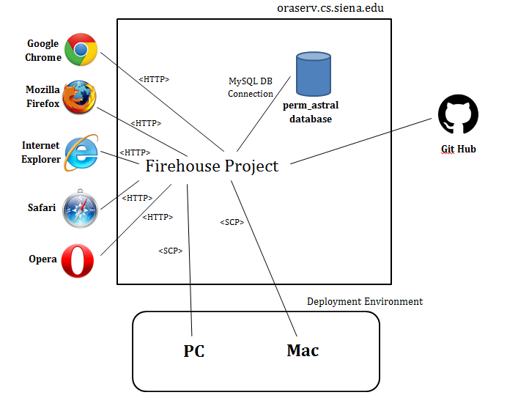
Notes:
deployment diagram
Brian

Slide 4
User Story #1
As a fire officer I want to be able to add, subtract and edit firefighters from the database so that I have an up-to-date count of the volunteers in the firehouse.
Notes:
Brian

Slide 5
Acceptance Criteria
Given that there are firefighters in the database
When a fire officer goes to add or delete a firefighter or edit a firefighter’s information
Then the information will be updated to the database accordingly.
Notes:
Brian

Slide 6
User Story #2
As a fire officer I want to authenticate myself via logging in so that I can securely use the system.
Notes:
Blake

Slide 7
Acceptance Criteria
Given that a fire officer has a valid username and password
When the fire officer goes to log into the system by entering his/her credentials
Then the fire officer will be logged in and can securely access the system
Notes:
Blake

Slide 8
User Story #3
As a fire officer I want to add, edit, and delete fire trucks in the database so that I know which fire trucks are available for use.
Notes:
Eric

Slide 9
Acceptance Criteria
Given that there are fire trucks in the database
When a fire officer goes to add or delete a fire truck or edit a fire truck’s information
Then the information will be updated to the database accordingly.
Notes:
Eric

Slide 10
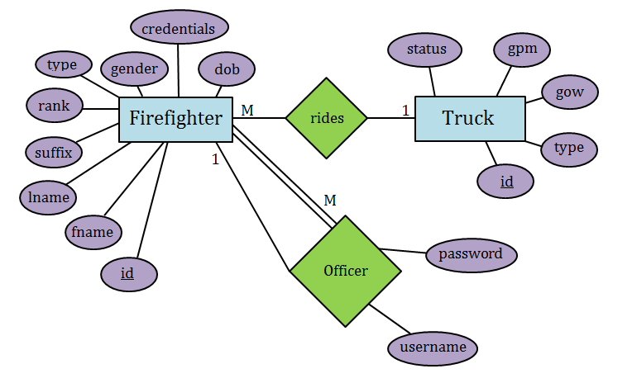
Officer
Firefighter
Notes:
Drew

Slide 11
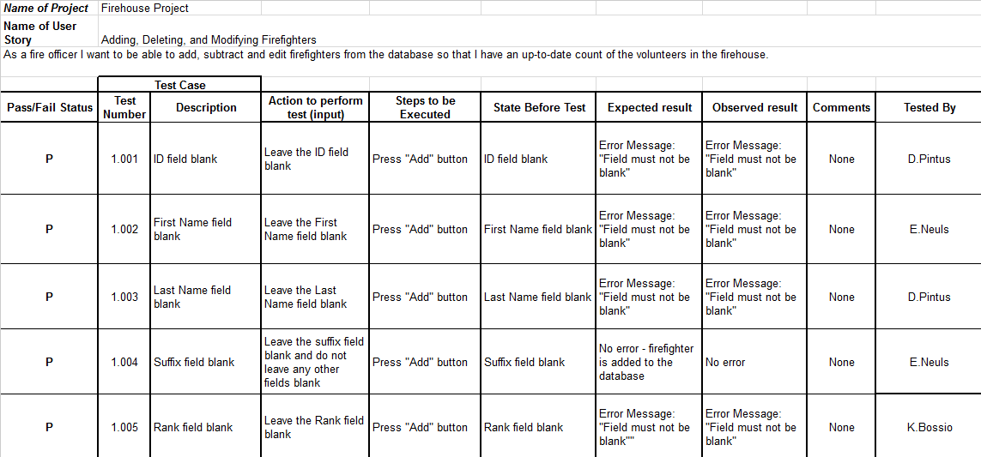
Notes:
pull up excel spreadsheet
Drew

Slide 12
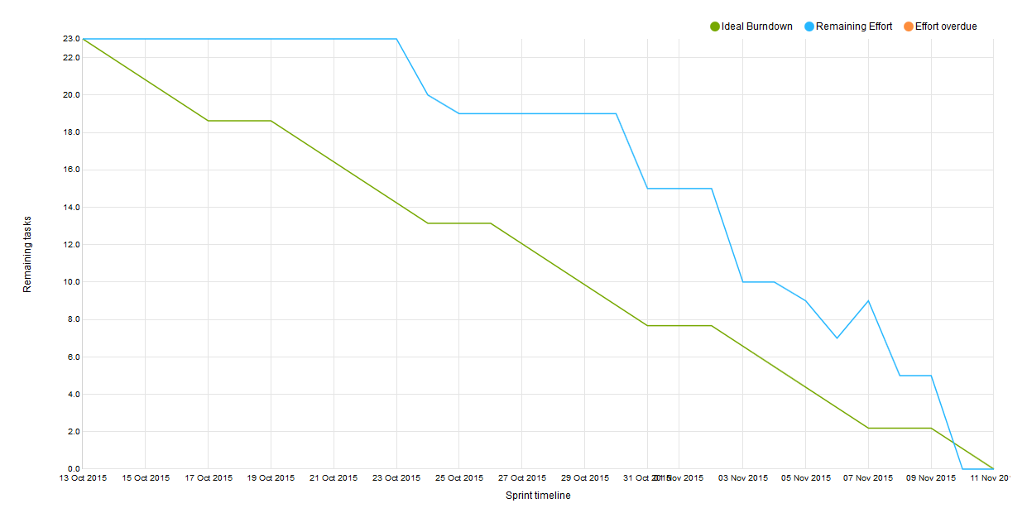
Velocity:
11
Notes:
Drew

Slide 13
What is Considered Done?
Secure log-in and access to the web app
Creation of a database
Ability to connect to database and add, modify, and delete data
Notes:
Blake

Slide 14
DEMO
Notes:
Eric goes to computer

Slide 15
What’s Next...
Ability to assign firefighters to fire trucks when a call comes in
Notes:
Bossio

