Slide 1

SPRINT 3
Kristen Bossio, Blake Edwards, Eric Neuls,
Drew Pintus and Brian Sopok
Notes:
Brian

Slide 2
Project Overview
The purpose of the Firehouse Project is to improve efficiency within the firehouse in regards to how a call is handled. The software shall provide easily accessible information about the credentials of the firemen in the firehouse, enabling the fire captain to make quicker decisions about the balance of the fire trucks before attending to the emergency at hand.
Notes:
Brian

Slide 3
User Story 1
As the officer in charge of the scene I want to be able to add a firetruck so that I have more flexibility in responding to the current situation of a call.
Notes:
Brian

Slide 4
Acceptance Criteria
Given that there are trucks available
And that there is an active call,
When fire officers select a firetruck,
Then that fire truck will be added to the active call.
Notes:
Brian

Slide 5
User Story 2
As a fire officer I want to select a truck so that I can see which firefighters are on it.
Notes:
Eric

Slide 6
Acceptance Criteria
Given that there is an available truck,
When fire officers select a truck,
Then the fire officers can see which firefighters are on it.
Notes:
Eric

Slide 7
User Story 3
As a fire officer, I want to dynamically update call information so that I can respond to calls as soon as they come in.
Notes:
Blake

Slide 8
Acceptance Criteria
Given that a fire officer enters in call information
When a call comes in to the firehouse
Then the fire officer can see the active calls when using the application.
Notes:
Blake

Slide 9
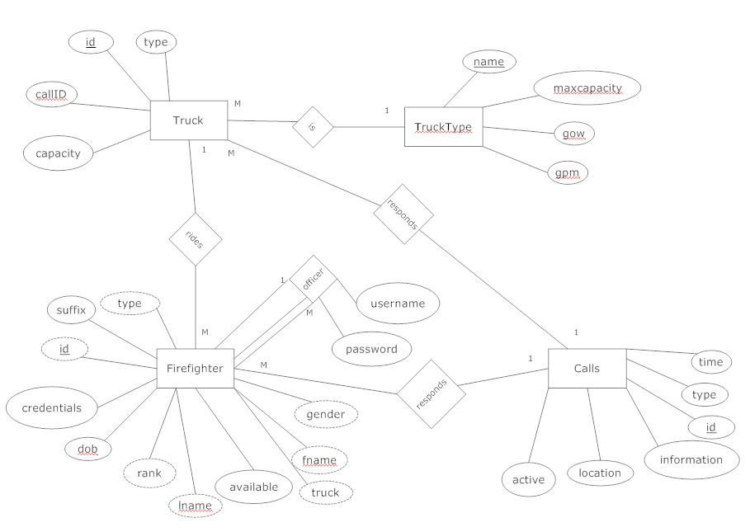
Notes:
Blake

Slide 10
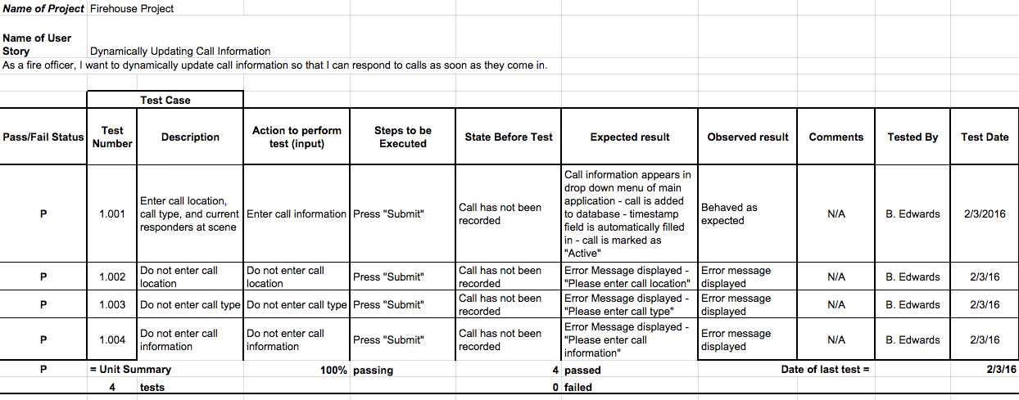
Unit Test Cases
Notes:
Kristen

Slide 11
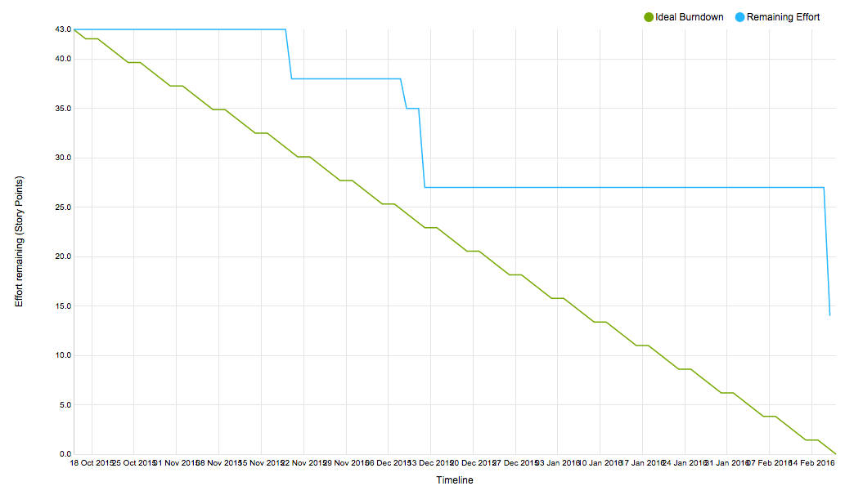
Product Burndown Chart
Notes:
Kristen

Slide 12
Sprint Velocity & Product Velocity
Sprint Velocity: 13
Product Velocity: 11.67
Notes:
Kristen

Slide 13
DEMO
Notes:
Drew

Slide 14
What we did to improve this sprint:
Accurately assigned story points to user stories in backlog
Took on more story points
Notes:
Eric

Slide 15
What can we do to improve future sprints?
Clearly identify the client’s needs
Keep all team members in the email loop
Organize work earlier
Notes:
Drew

Slide 16
Feedback from Product Owner
Pleased with the functionality of our product as well as our teamwork
Notes:
Kristen

