Slide 1

SPRINT 4
Kristen Bossio, Blake Edwards, Eric Neuls,
Drew Pintus and Brian Sopok

Slide 2
Project Overview
The purpose of the Firehouse Project is to improve efficiency within the firehouse in regards to how a call is handled. The software shall provide easily accessible information about the credentials of the firemen in the firehouse, enabling the fire captain to make quicker decisions about the balance of the fire trucks before attending to the emergency at hand.

Slide 3
User Story 1
As a fire officer, I want to view the route from the firehouse to the fire so that I can respond more quickly to the emergency.

Slide 4
Acceptance Criteria
Given that there is an active call
When the fire officer goes to assign firefighters and firetrucks to a call
Then a map to the selected call will appear on the screen.

Slide 5
User Story 2
As a fire officer, I want to be able to mark firefighters as present when they arrive at the firehouse and absent when they leave the firehouse so that I know who is available to respond to calls.

Slide 6
Acceptance Criteria
Given that the firefighter arriving at or leaving from the firehouse is in the system
When the fire officer goes to mark the firefighter as present or absent
Then the firefighter’s availability will be updated in the database.

Slide 7
User Story 3
As a fire officer, I want there to be specific choices for fields on the Add Firefighter, Add Firetruck, and Enter Call pages so that the data entered is consistent.
Notes:
Some of these fields are: gender, rank, type (interior v exterior), dob, credentials for FF
Type, status for FT
Call type for enter call page

Slide 8
Acceptance Criteria
Given that the fire officer is on either the Add Firefighter, Add Firetruck, or Enter Call page
When the fire officer goes to add information to the database through the application
Then the fire officer will be able to select from specific choices for gender (FF), type (FF), rank(FF), credentials (FF), type (FT), status (FT), and call type.

Slide 9
User Story 4
As a fire officer, I want the active calls to appear at the top of the Assignment page so that the process of assignment is quicker and more intuitive.

Slide 10
Acceptance Criteria
Given that the fire officer is logged into the application
When the fire officer goes to the assignment page
Then the active calls shall appear at the top of the page, along with instructions as to how to use the page.

Slide 11
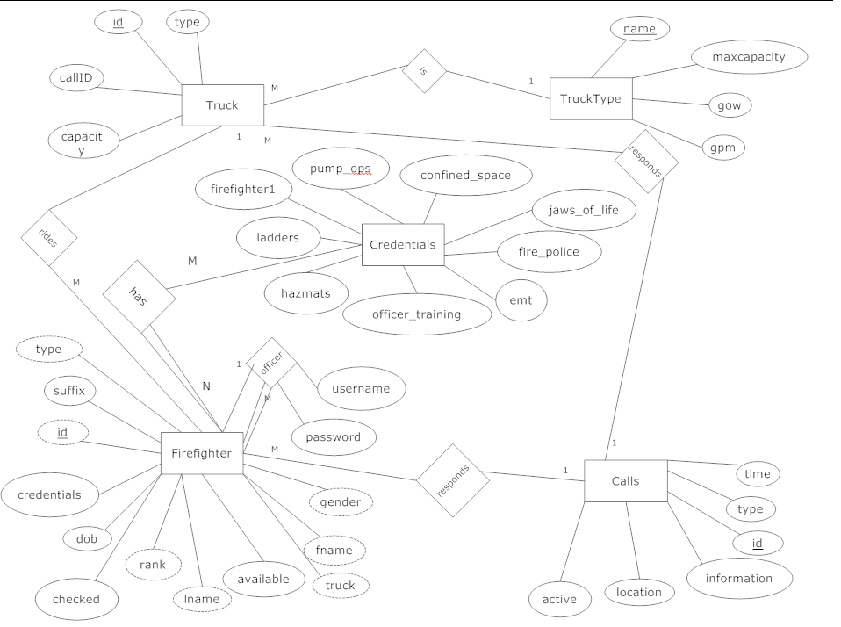

Slide 12
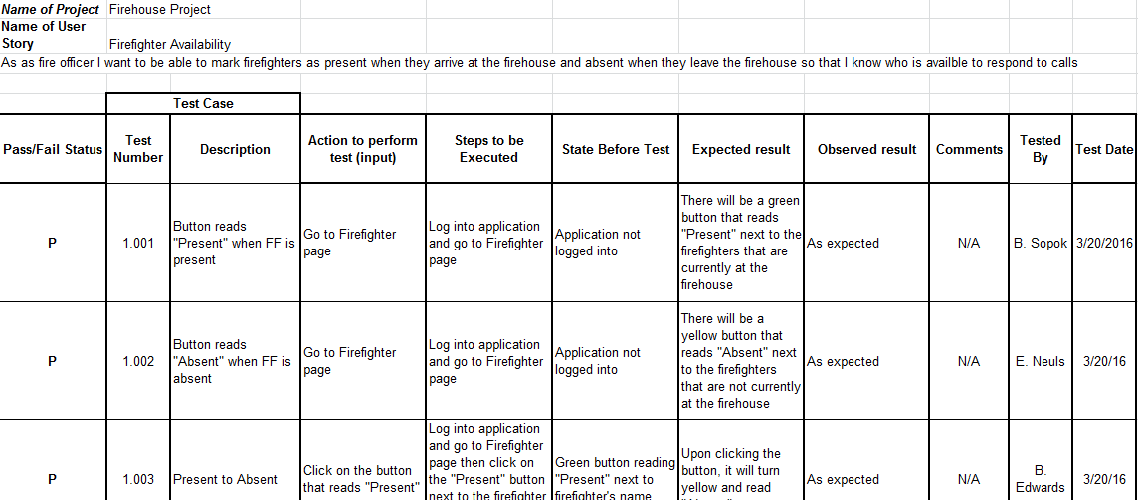

Slide 13
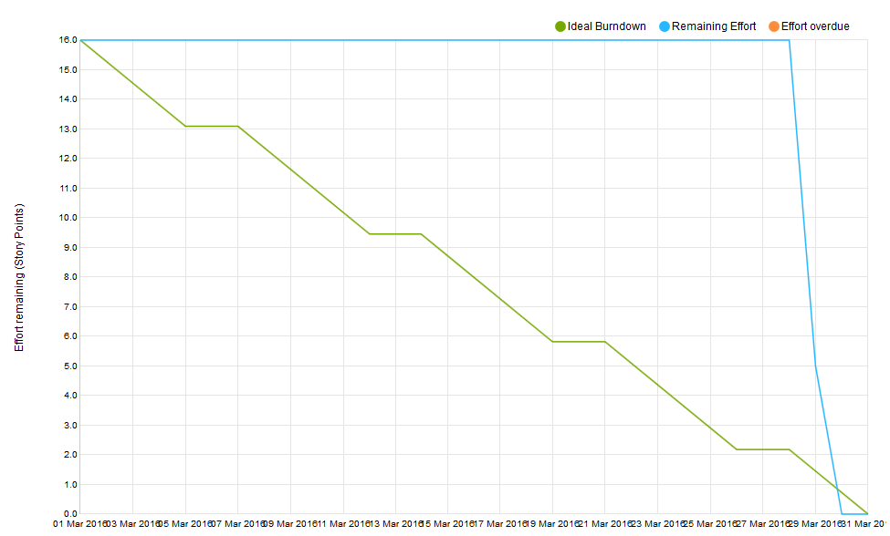
Notes:
Blake - Sprint Burndown

Slide 14
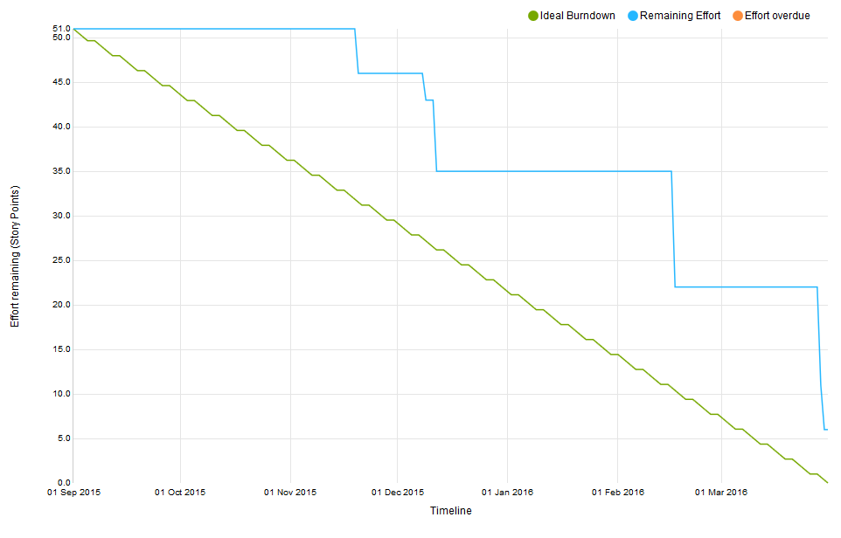
Notes:
Blake - Product Burndown

Slide 15
Sprint Velocity & Product Velocity
Sprint Velocity: 16 pts
Product Velocity: 12.75 pts
Notes:
Blake

Slide 16
DEMO
Notes:
Blake

Slide 17
What we did to improve this sprint:
Better communication between product owner, Scrum Master, and team
Took on more story points
Started work earlier

Slide 18
What can we do to improve future sprints?
More clarification about what client wants
Better version control
More accurate use of YouTrack

Slide 19
Feedback from Product Owner
Application could be more intuitive
Need to rework marking firefighters as present/absent - it’s functional but it could be more intuitive and might work better on a different page
Happy with the integration of Google Maps

