Slide 1

SPRINT 5
Kristen Bossio, Blake Edwards, Eric Neuls,
Drew Pintus and Brian Sopok
Notes:
Blake

Slide 2
Project Overview
The purpose of the Firehouse Project is to improve efficiency within the firehouse in regards to how a call is handled. The software shall provide easily accessible information about the credentials of the firemen in the firehouse, enabling the fire captain to make quicker decisions about the balance of the fire trucks before attending to the emergency at hand.
Notes:
Assume audience is unfamiliar with project
Blake

Slide 3
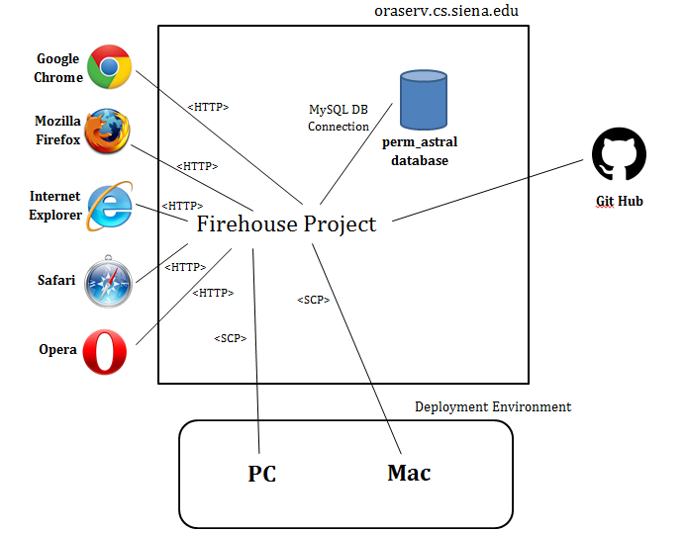
Notes:
Brian
Should we include the Google Maps API somewhere?

Slide 4
User Story #1 - Credentials
As a fire officer I want to maintain (update, delete) the credentials of each firefighter so that I can make sure that each fire truck is sent out with the proper experience on board.
Notes:
Brian

Slide 5
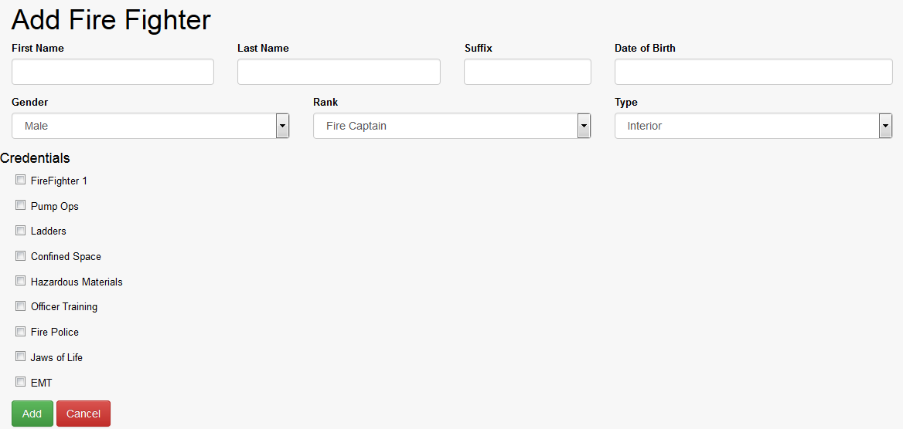
Notes:
Brian

Slide 6
Acceptance Criteria
Given that there is a firefighter in the database
When the fire officer goes to update credentials
Then the fire officer shall be able to select the credentials that apply to the firefighter from a defined list of checkboxes.
Notes:
Brian

Slide 7
User Story #2 - Archiving
As a fire officer I want to archive the data of each call, including the firefighters and fire trucks that responded, so that I have a record of the goings on in the firehouse.
Notes:
LIABILITY ISSUES
Brian

Slide 8
Acceptance Criteria
Given that there is a call and that firefighters and fire trucks responded to the call
When the fire officer goes to mark the call as complete
Then the call information, including the firefighters and firetrucks who responded, as well as any injuries obtained will be stored in the database.
Notes:
Brian

Slide 9
User Story #3 - Report Page
As a fire officer I want to be able to generate a report of each call, which firefighters and firetrucks responded, and if any injuries were obtained so that I have a record if liability issues arise.
Notes:
Eric

Slide 10
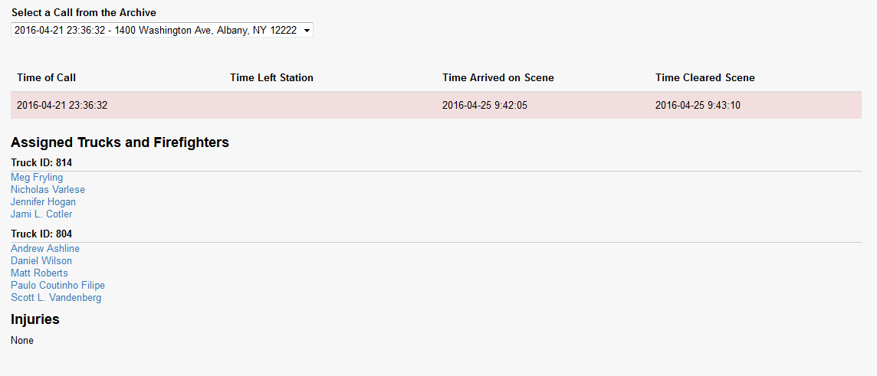
Notes:
Eric

Slide 11
Acceptance Criteria
Given that there is at least one archived call
When the fire officer goes to generate a report
Then the fire office shall be able to view the call information, the firefighters and fire trucks that responded, and injuries obtained on the scene.
Notes:
Eric

Slide 12
User Story #4 - Call Information
As a fire officer, I want to keep track of the time the fire trucks responded to the call, arrived at the call, and left the call so that I have a record for liability’s sake.
Notes:
Eric

Slide 13
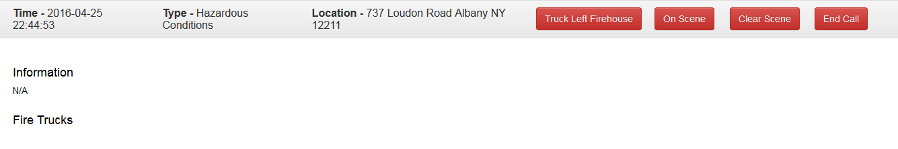
Notes:
Eric

Slide 14
Acceptance Criteria
Given that there is an active call
When when the fire officer goes to mark a call as “Truck Left Firehouse”, “On Scene”, “Clear Scene”, or “End Call”
Then a timestamp will be stored in the database in the appropriate field.
Notes:
Eric

Slide 15
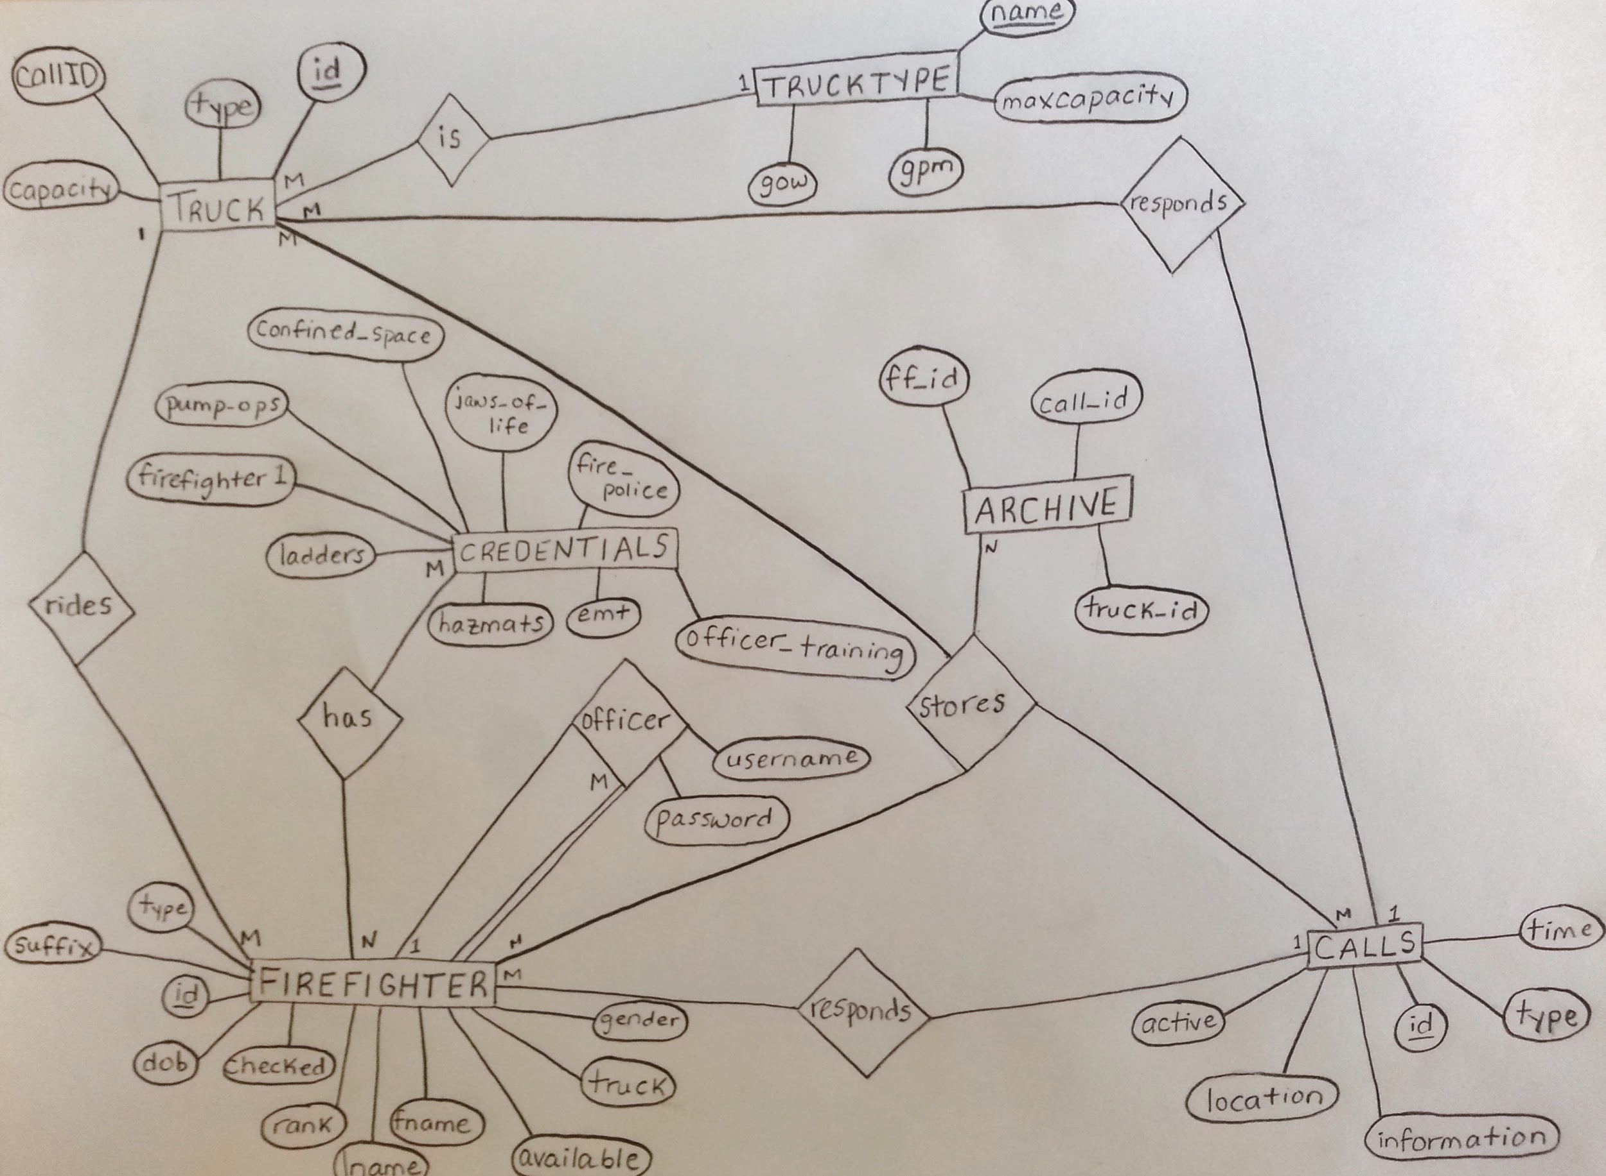
Notes:
Kristen

Slide 16
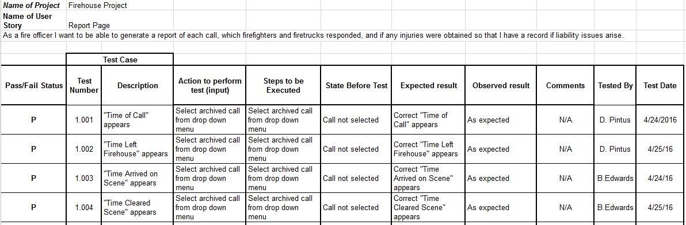
Unit Test Cases
Notes:
Kristen

Slide 17
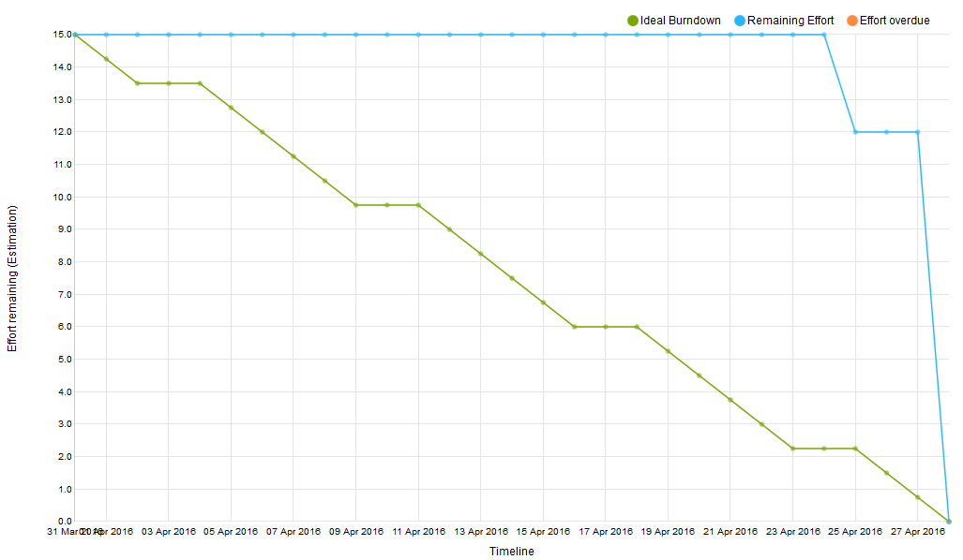
Notes:
Kristen

Slide 18
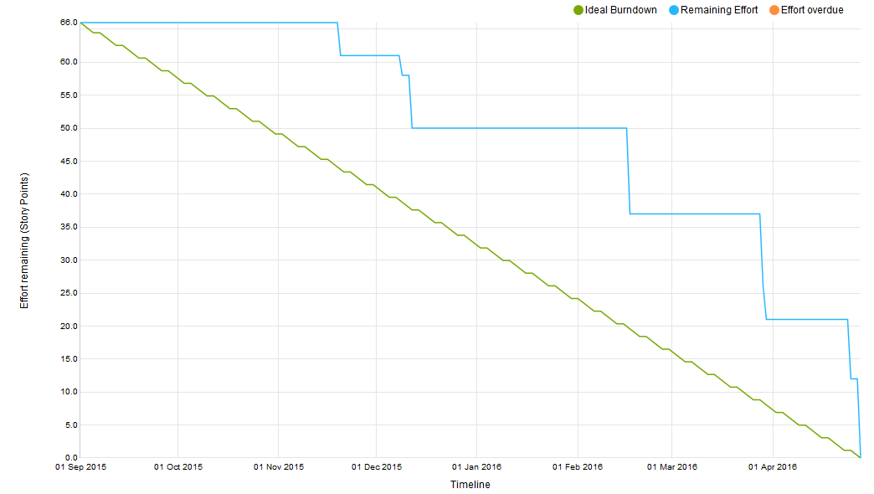
Notes:
Product Burndown -WE COMPLETED EVERYTHING!

Slide 19
Sprint Velocity & Product Velocity
Sprint Velocity: 15 pts
Product Velocity: 13.2 pts
Notes:
Kristen

Slide 20
DEMO
Notes:
Drew

Slide 21
Actions Agreed Upon for this Sprint (#1)
More clarification about what the client wants
Repeated back what client wanted at meetings to make sure that we were seeing eye-to-eye
Notes:
Drew

Slide 22
Actions Agreed Upon for this Sprint (#2)
Better version control
Periodically downloaded copies of project
Thank goodness!
Notes:
Drew

Slide 23
Actions Agreed Upon for this Sprint (#3)
More accurate use of YouTrack
Started working on project before tasks were entered into YouTrack
But, an improvement over last Sprint!
Notes:
Drew

Slide 24
Lessons Learned (#1)
Make sure the client’s requests are fully understood
Notes:
Drew

Slide 25
Lessons Learned (#2)
Frequently backup project files (and/or use version control)
Notes:
Blake

Slide 26
Lessons Learned (#3)
Working individually while still being able to bounce ideas off the rest of the team allows for tasks to be completed quicker and more efficiently
Notes:
Eric

Slide 27
Lessons Learned (#4)
Pair programming allows collaboration of different skillsets and as such is extremely effective
Notes:
Brian

Slide 28
Lessons Learned (#5)
No matter how long you’ve been working on an application, it is important to keep in mind that someone will be using it for the first time.
Make sure the software is intuitive
Notes:
Kristen

Slide 29
Questions?

