Slide 1

Sprint 2
Kristen Bossio, Blake Edwards, Eric Neuls, Drew Pintus, and Brian Sopok
Notes:
Drew

Slide 2
Project Overview
The purpose of the Firehouse Project is to improve efficiency within the firehouse in regards to how a call is handled. The software shall provide easily accessible information about the credentials of the firemen in the firehouse, enabling the fire captain to make quicker decisions about the balance of the fire trucks before attending to the emergency at hand.
Notes:
Drew

Slide 3
User Story 1
As a fire officer I want to see the credentials of each fireman so that I can balance the firetrucks correctly.
Notes:
Blake

Slide 4
Acceptance Criteria
Given that there are firefighters in the system
And that they have credentials,
When the fire officers go to balance the firetrucks,
Then the fire officers can see the credentials of the firefighters.
Notes:
Blake

Slide 5
User Story 2
As a fire officer I want to be able to select a fireman and which truck I want to put said fireman on so that we can quickly respond to the call.
Notes:
Brian

Slide 6
Acceptance Criteria
Given that there is an emergency
And that there are fire trucks available
And that the selected fireman responded to the given call
And that there is space on the selected fire truck
When the fire officers go to select a fireman and a firetruck
Then the fire officer is able to assign the fireman to the fire truck.
Notes:
Brian

Slide 7
User Story 3
As a fire officer, I want to see call information on the screen so that I can accurately respond to the call.
Notes:
Eric

Slide 8
Acceptance Criteria
Given that there is an active call
When the fire officer goes to assign firefighters to fire trucks
Then the call information will be displayed at the top of the page
Notes:
Eric

Slide 9
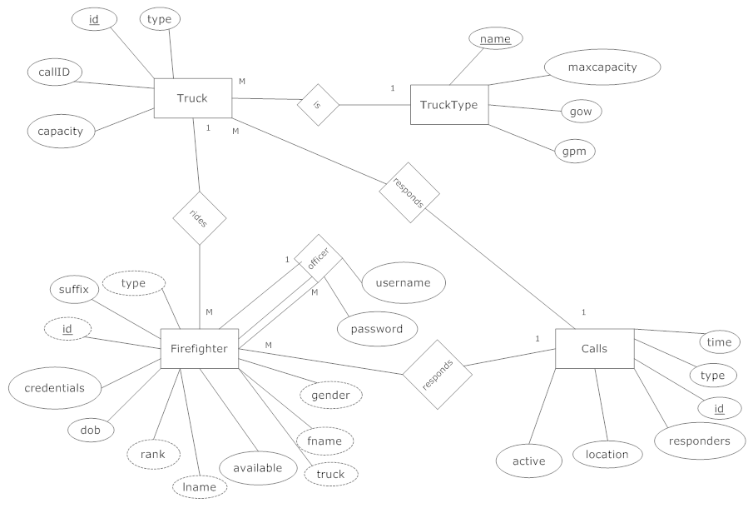
Notes:
Kristen

Slide 10
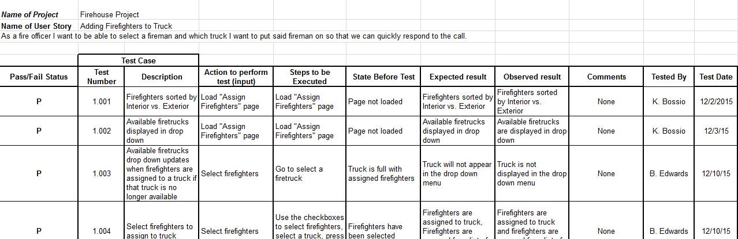
Unit Test Cases
Notes:
Kristen

Slide 11
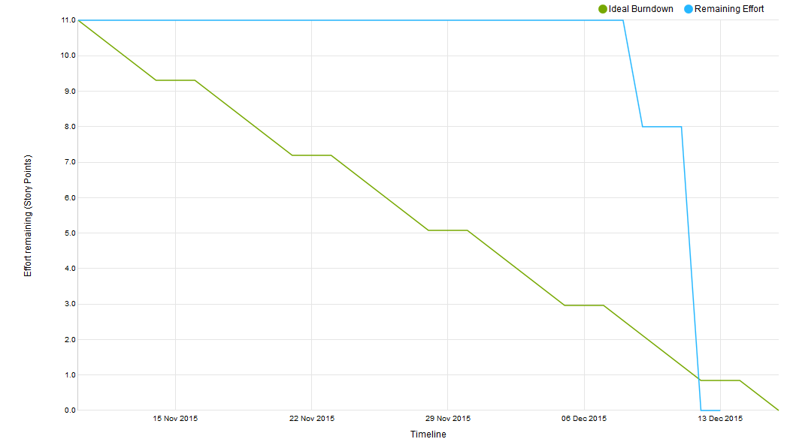
Velocity: 11
Notes:
Kristen

Slide 12
DEMO
Notes:
Drew

Slide 13
Action Items from Sprint 1 Retrospective
Schedule meetings more often
Organize work earlier
Use version control
Notes:
Kristen

Slide 14
Action Items for Sprint 3
More frequent meetings with the client
Take on more story points
Adjust story points accurately for future user stories
Notes:
Eric

Slide 15
Feedback from Product Owner
We completed what we set out to do for Sprint 2
There is a lot of functionality to add in future sprints, but what we have now is what he wanted
Notes:
Blake

