Slide 1
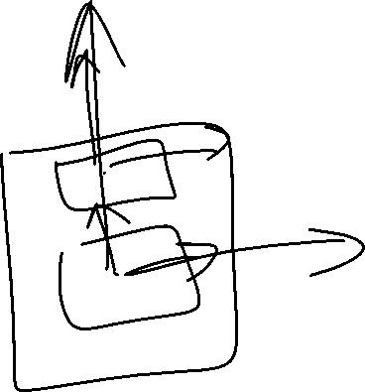
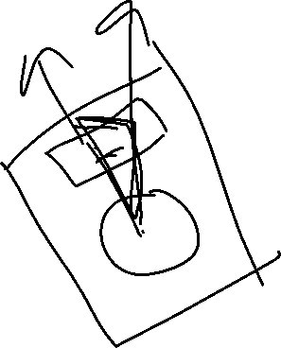
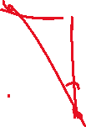
B
A
Hyp = sqrt(A^2 + B^2)
Gear
0,0
Db
0,1
Diff x = g,x – db,x
Diff y = g,y –db,y
Create 2 lines
L1 =

Slide 2


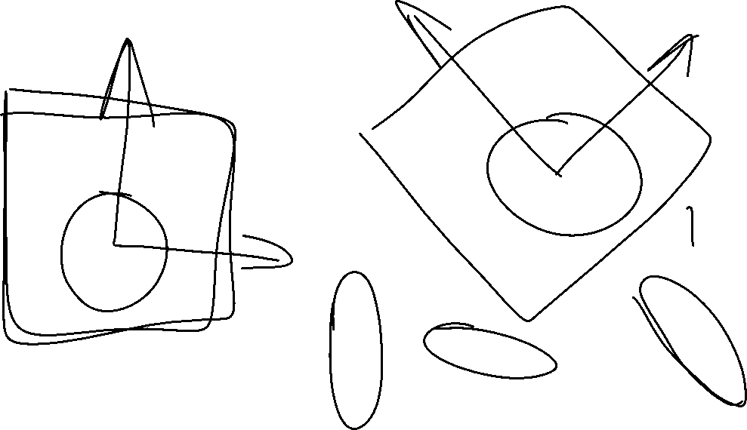



Slide 3





