Slide 1
Trajectory Bundling Across Vector Tile Levels
Author: Andrew Strelke
Advisor: Professor David Koop
Computer and Information Science

Slide 2

Vector Tiles
Map data is often tiled so that only the information that is needed is sent to a user
Tiles are generated at different zoom levels to allow fast navigation
In the past, maps were rasterized as large images and then cut into raster tiles
Today, new technologies support sending the vector data itself down to the client as vector tiles
Raster images (left) become pixelated after scaling while vector images (right) remain crisp.

Slide 3
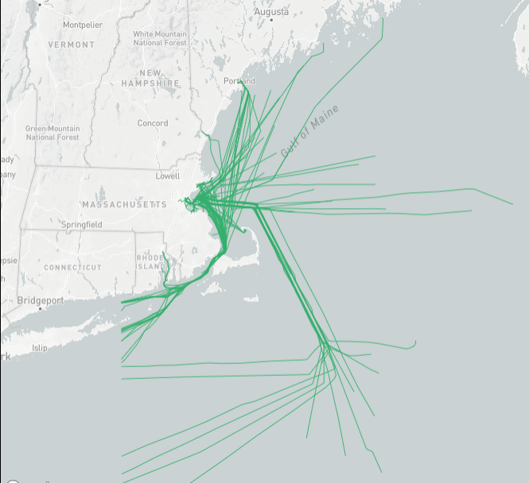
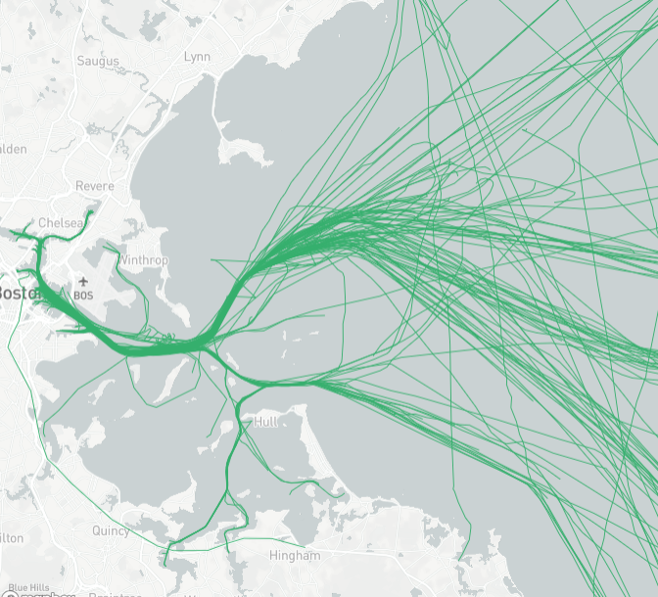
Trajectory Bundling
With large-scale data, it can be difficult to see patterns because the density of data introduces overlap and clutter
Trajectory bundling seeks to merge (sub-)trajectories that have similar paths to reduce the clutter
From a distance, it helps to bundle lots of trajectories together, but as we zoom in, these bundles should be decomposed to show individual paths
Our goal is to create trajectory bundles that naturally bundle and unbundle when moving through different vector tile levels

Slide 4
Data
We use Automated Identification System (AIS) data of marine vessel locations collected by the US Coast Guard and made available on marinecadastre.gov
Data is transmitted by ships every 1-5 minutes
Data is split into different Universal Traverse Mercator (UTM) zones

Slide 5
TRACLUS
Bundling implemented using the TRACLUS algorithm.
TRACLUS is a trajectory clustering framework that partitions a trajectory into a set of line segments, and then groups similar line segments together into a cluster [Lee et al., 2007]
Parameters used for TRACLUS include:
Epsilon: The distance in which to look for line segments to cluster
MinLns: Minimum number of line segments per cluster
Y: Smoothing value. Determines the minimum length for two consecutive points in a representative trajectory or bundle.
Cost Advantage: Value between 0-1, used to prevent oversimplification when partitioning line segments.

Slide 6
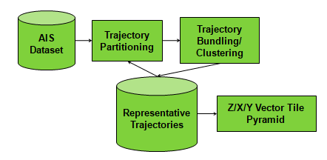
TRACLUS Improvements
In order to ensure continuity between vector tile levels, we want trajectories bundled in a zoomed-in level to remain in the same bundle as we zoom out
TRACLUS was re-written to recursively bundles trajectories from the bottom level up.
Parameter values start off small when bundling trajectories at bottom levels, but as the levels go up these value increase exponentially.

Slide 7
TRACLUS Parameters
The key to obtaining a successful set of representative trajectories for each level is knowing what values to set the parameters as.
If epsilon is set too large then it will cluster lines that are too far apart, and if epsilon is too small then nearby lines that should be clustered will not.
The smoothing parameter 'Y' determines how far apart each point in the represented trajectory should be. This parameter should be set to some value greater than 0 to ensure represented trajectories do not come out looking fluctuated, but setting this value too high will cause over-simplification.
The cost advantage parameter 'costAdv' is used to prevent over-simplification when partitioning the trajectories. This value should be relatively low to ensure that the trajectories are still being simplified when needed during partitioning (0 < costAdv <= 1).

Slide 8
Optimal Parameters
Unfortunately, there is not a formal method for coming up with these parameters; instead they are obtained through visual inspection and domain knowledge [Lee et al., 2007]
For the Zone 19 data, the most optimal parameters seem to be around e=12, Y=3, and costAdv=1
MinLns is kept at 1 when performing recursive bundling to ensure that no trajectories are lost at lower levels when the epsilon value is too low to form clusters
You can set the levels parameter to as high as you want, but generating more then 13 levels of vector tiles will take awhile and may even cause the script to crash as a response of the heap being out of memory (this can sometimes be fixed by increasing the memory limit within the Node.js command prompt)

Slide 9
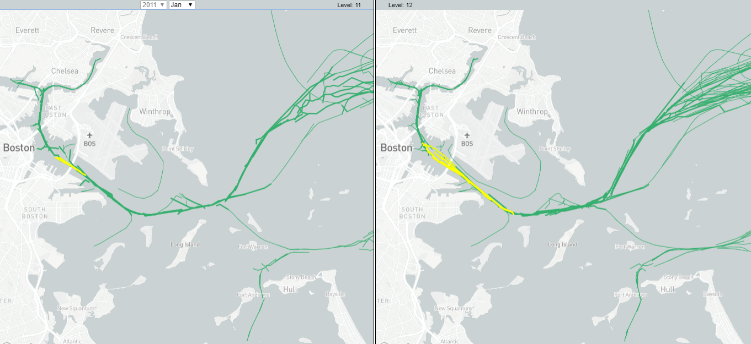
Results
Vector tiles use Mapbox vector tile specification and tools
Highlighting show how the bundles are created
A bundle on the left is composed of trajectories (or bundled trajectories) highlighted on the right map

Slide 10
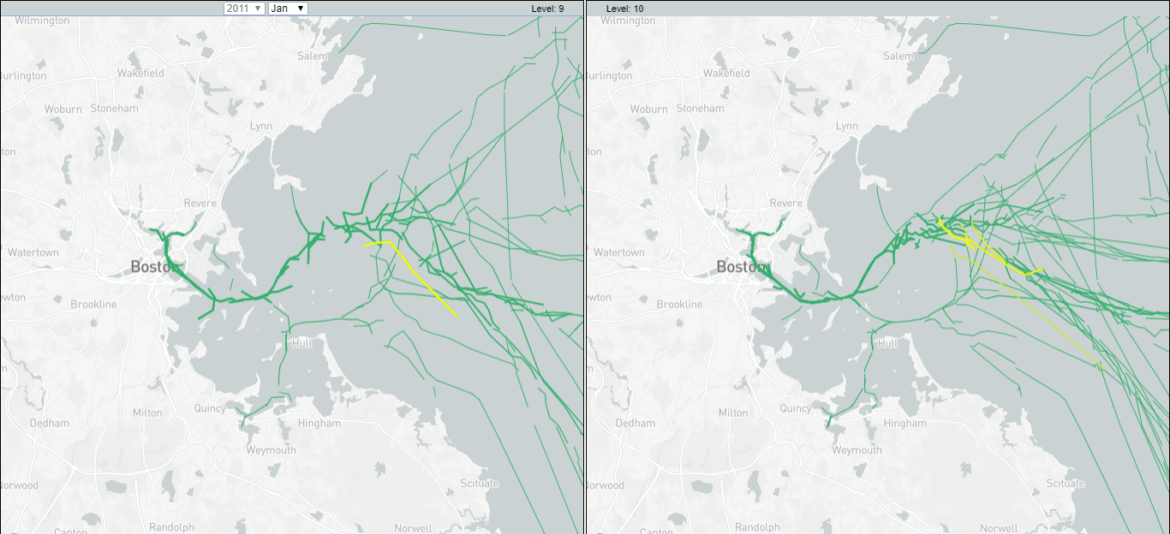
Results

Slide 11
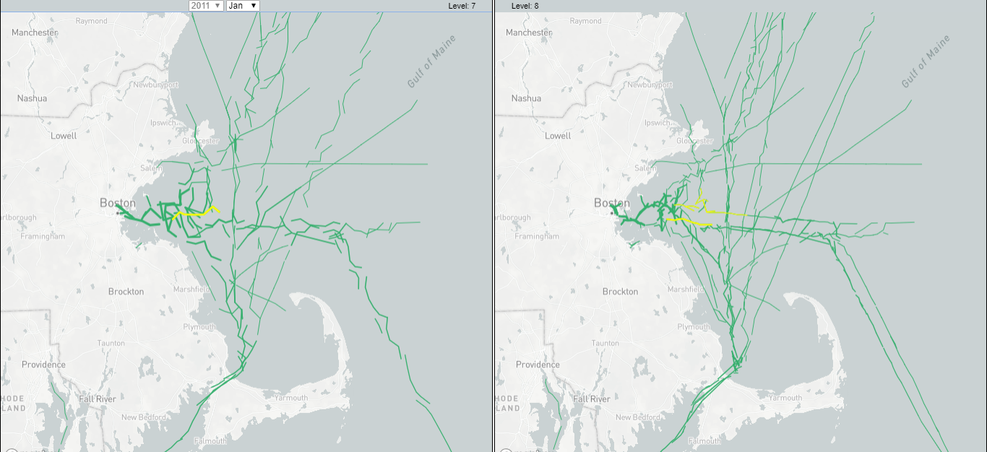
Results

Slide 12
Future Work
Examine other bundling algorithms that seek to identify where to split trajectories up for optimal bundling:
DBSCAN
Waypoint Clustering
Detecting commuting patterns with a 2-distance approximation using frechet distance
Evaluate the effectiveness of the technique
Optimize front-end performance

Slide 13
References
[1] Lee, J.G., Han, J. and Whang, K.Y., 2007, June. Trajectory clustering: a partition-and-group framework. In Proceedings of the 2007 ACM SIGMOD international conference on Management of data (pp. 593-604). ACM.
[2] Buchin, K., Buchin, M., Gudmundsson, J., Löffler, M. and Luo, J., 2008, December. Detecting commuting patterns by clustering subtrajectories. In International Symposium on Algorithms and Computation (pp. 644-655). Springer, Berlin, Heidelberg.
[3] Liu, B., de Souza, E.N., Matwin, S. and Sydow, M., 2014, October. Knowledge-based clustering of ship trajectories using density-based approach. In Big Data (Big Data), 2014 IEEE International Conference on (pp. 603-608). IEEE.
[4] Pallotta, G., Vespe, M. and Bryan, K., 2013. Vessel pattern knowledge discovery from AIS data: A framework for anomaly detection and route prediction. Entropy, 15(6), pp.2218-2245.

