Slide 1
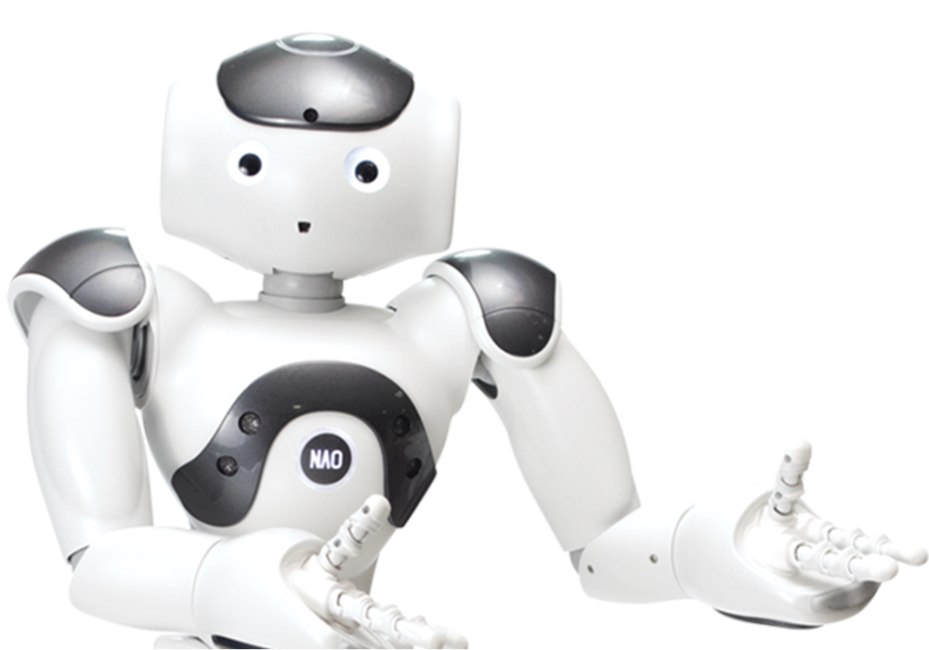
NAO ROBOTICS IN EDUCATION
CSE 611 MS Project
Ahmet Sen
Astrid Gomes
Harshali Talele
Mansi Wagh
Preeti Kumari

Slide 2
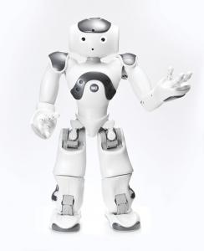
TASK 1 : Reading a book
Name of the book
What Do You Do with an Idea? by Kobi Yamada
Storage
Stored as .txt file on GitHub then in Nao’s memory
Each page stored with a page number as key
Features
Nao reads the book page by page
Nao records the last page number read
Reads from last page read on continuing
Can start over from page 1 when asked
Nao stops reading on a touch stimulus on left/right toe

Slide 3
What is achieved from this task ?
Teachers can store multiple books on GitHub, provide the new URL to the python script
Hearing stimulus of students are enhanced
Sight stimulus of students are activated with Nao’s reading
Focus of students are improved by hearing/seeing a robot in classroom
Challenges faced
Learning curve with Choregraphe IDE
Importing text to Nao’s memory
Debugging Nao’s firmware and reproducing the same on simulation

Slide 4
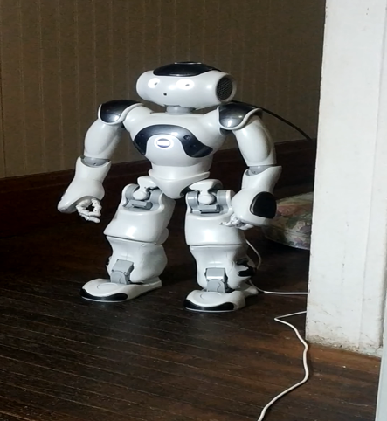
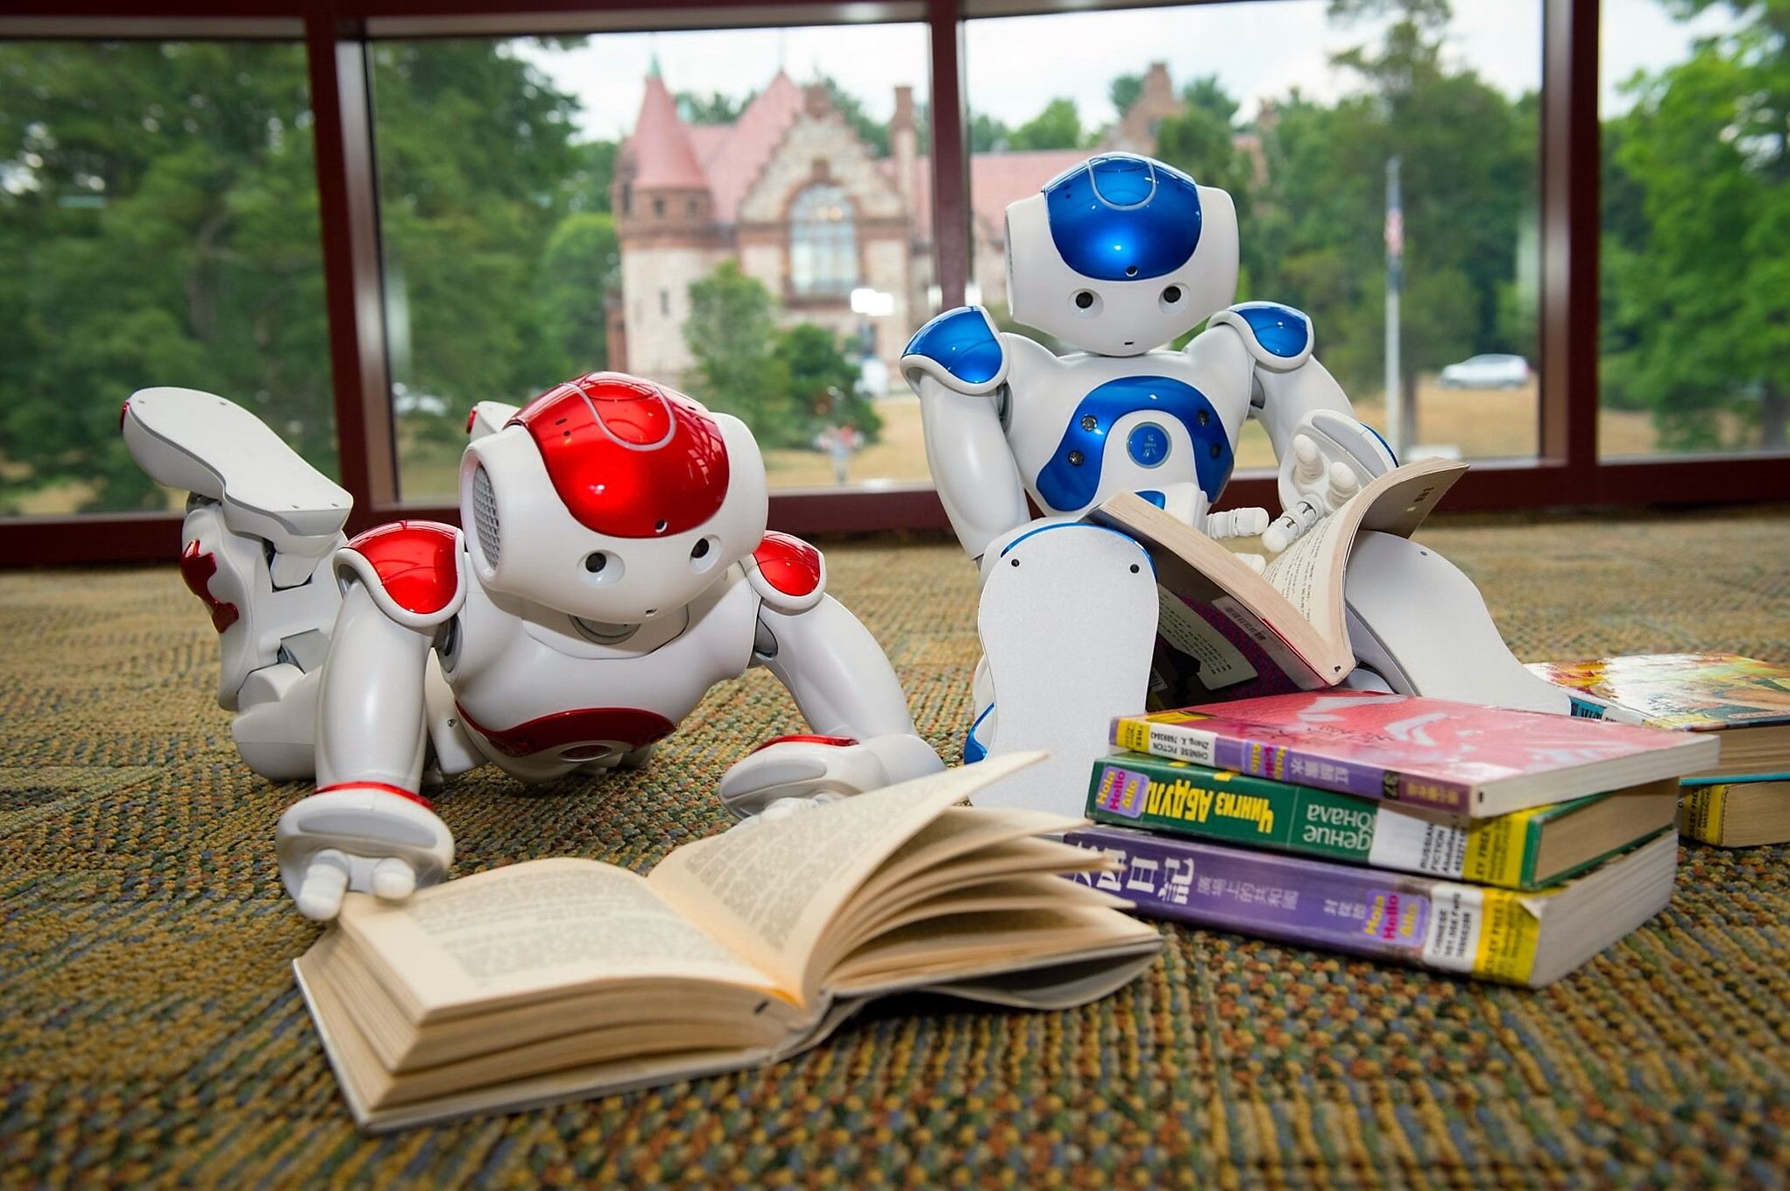
Video Presentation of Nao Reading a Book
Nao_Read_Page.mp4

Slide 5
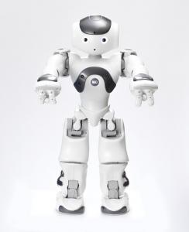
TASK 2 : Rock, Paper and Scissors Game (AI Based)
AI Model
Convolutional Neural Network with 3 layers
Kernal size 5 on each stage
Dataset
Rock,Paper & Scissors dataset from kaggle and tensorflow
Stored and trained model in local machine
The model is accessed using EC2 instance of Amazon AWS
Accuracy of Classification
Validation accuracy on dataset = 98%
Low accuracy on realistic data

Slide 6
What is achieved from this task ?
Enhancing sight and hearing stimulus in students
Animated actions stimulate mental activity of students
Engaging hearing senses of students to increase their focus on task at hand
Challenges faced
Many variables in real time data for preprocessing of images
Need training on realistic captured data
Need to capture images from Nao’s camera and use for training,
for realistic results

Slide 7
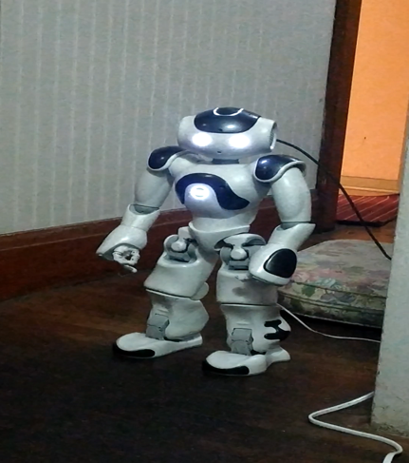

Video Presentation of Nao Playing Rock, Paper and Scissors Game
Nao_Rock_Paper_Scissors.mp4

Slide 8
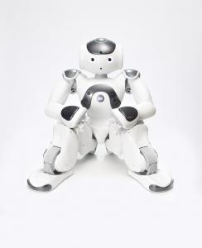
TASK 3 : Engaging with student activity (Trivia)
Sample of questions asked, what stimulus does it evoke
Simple mathematical, sound and gesture recognition questions
Improving mental, hearing and visual stimulus in students.
Where are the question/answers stored
Questions stored in text files on github repository
Correct answers stored in Nao’s internal memory
Features of Trivia Game
Students are encouraged to play more by giving compliments on correct answers
Multiple attempts on incorrect answer
Score given at the end of every correct answer before proceeding to next question
Can be discontinued anytime

Slide 9
What is achieved from this task ?
Stimulating mental activity in students by making them perform mathematical calculations
Improving general knowledge of students
Engaging hearing and visual senses of students to increase their focus on task at hand
Challenges faced
Problems in making Nao recognize speech

Slide 10
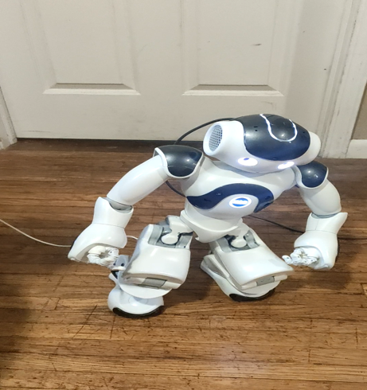

Video Presentation of Nao Playing Trivia
Nao_Trivia.mp4

Slide 11
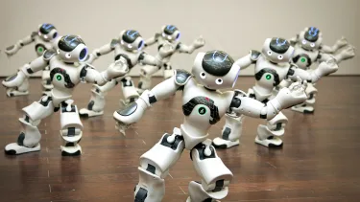
FUTURE SCOPE
Work on Calming Conversation Activity task
Reading more books from the storage
Teaching specific features can be added to the reading book feature
Playing Trivia with more than 1 student
Improving accuracy of Rock, Paper and Scissors game
Recognizing faces of students while playing a game

Slide 12
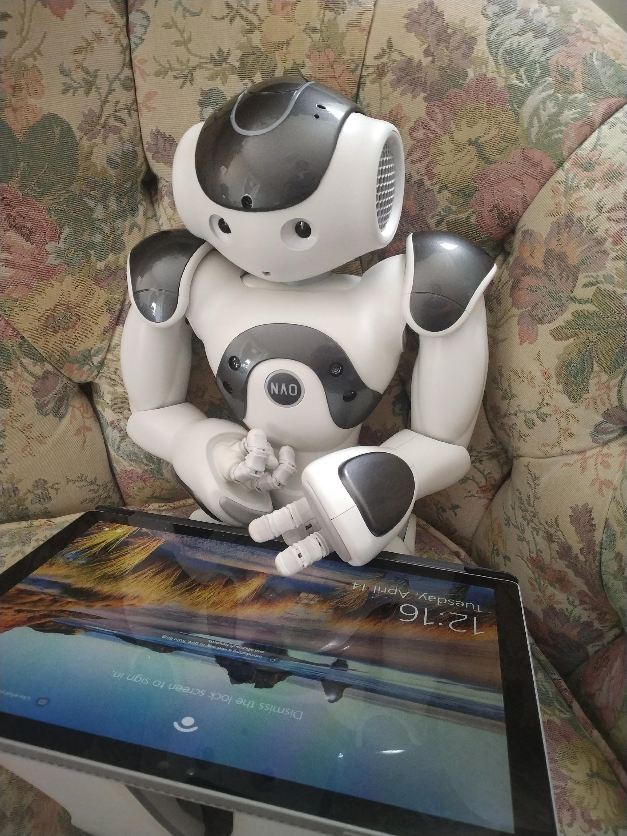
THANK YOU!

