Slide 1
MCB Coding Club - ggplot2 intro
Let’s start with some inspo:
https://www.r-graph-gallery.com/

Slide 2
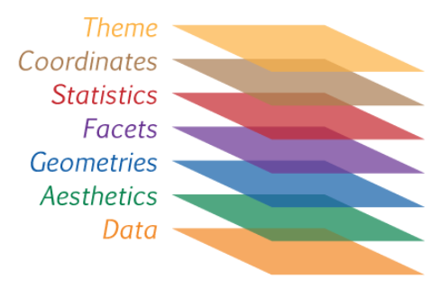
ggplot2
The basics of plotting:
Plots are layered
ggplot() is the basic function, and has several arguments:
data = the dataframe in long format
mapping = aes()
Within aes(), x= column_with_x_axis data, y=column_with_y_axis_data
Within aes(), fill argument can be used to display two or more classes (e.g. NST vs ST) in different colours. color() argument only colours outside of graphing element (not filled in)
geoms can then be added to this:
geom_line() for line graphs
geom_bar() for bar plots
geom_boxplot() for box and whisker
geom_violin() for violin plots
geom_errorbar() for error bars
geom_tile() for heatmaps, etc.
Mappings can be made within geoms, if you don’t want the mapping to be specified in the ggplot layer (as this applies to the whole plot and not just one layer). This means you can map data from more than one data frame to the same plot.

Slide 3
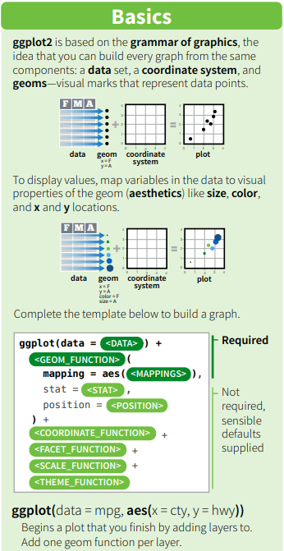


Slide 4
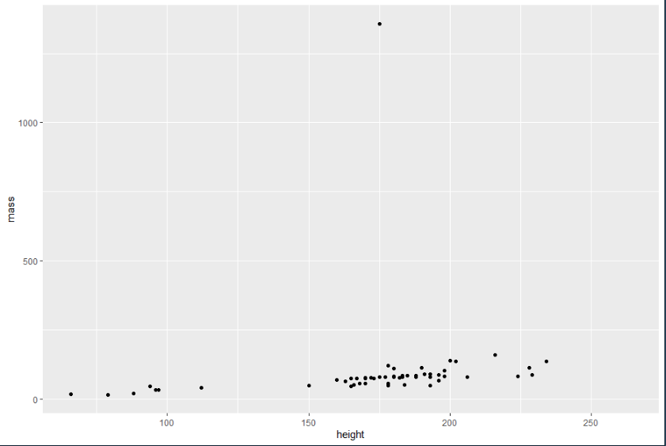

Slide 5
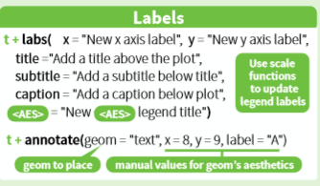
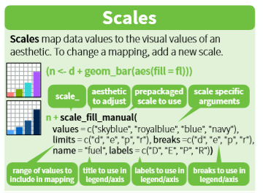
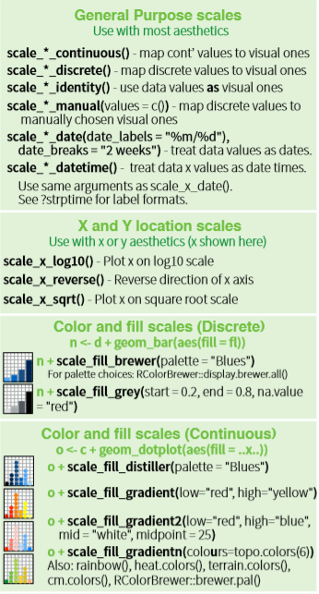
ggplot2 cont.
The basics of plotting:
Plots are layered cont.:
labs() command adds labels to your plot. Arguments are x, y, title and subtitle.
scale_x_continuous and scale_y_continuous – modify sequence of numbers using breaks argument (e.g. breaks = seq(0,100,10). scale_x_discrete and scale_y_discrete for discrete data (not continuous). Numerous scale functions can be added – scale_ylog10 scales the y axis in log values without modification of the original data.

Slide 6
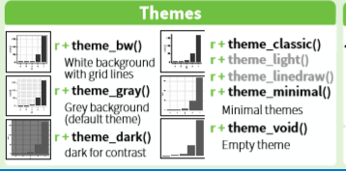
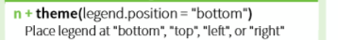
theme() command allows you to tweak the appearance of your plot.
Check the documentation, but some arguments I commonly use:
axix.text(element_text(size=x)) – changes axis text size to x
legend.background(element_rect(colour=x)) – changes legend background colour
legend.text(element_text(size=x) – changes legend text size to x
panel.grid(element_blank()) – removes grid lines
Combined with element_text() to modify text, element_rect to modify rectangular spaces or element_blank() to remove parameter

Slide 7

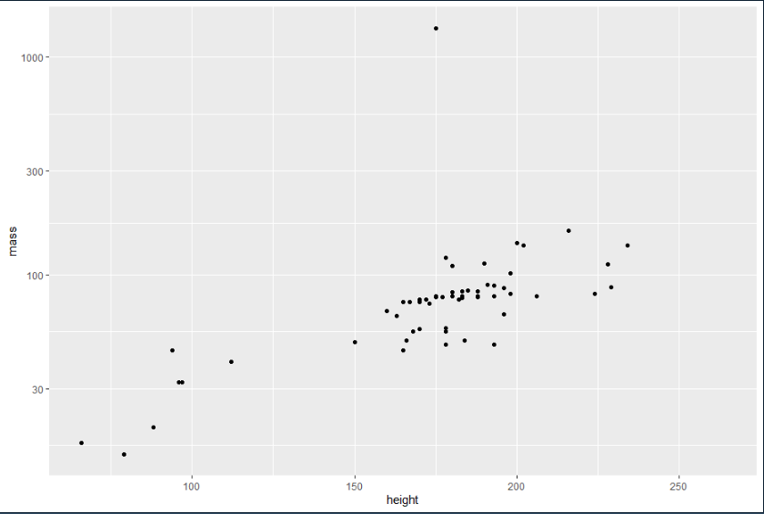

Slide 8

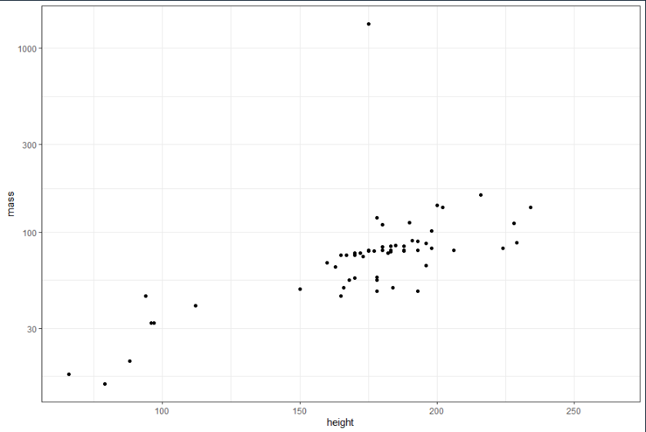

Slide 9
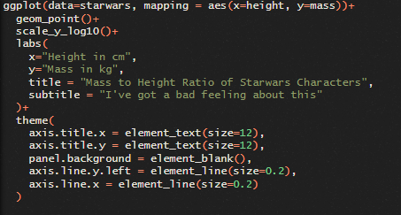
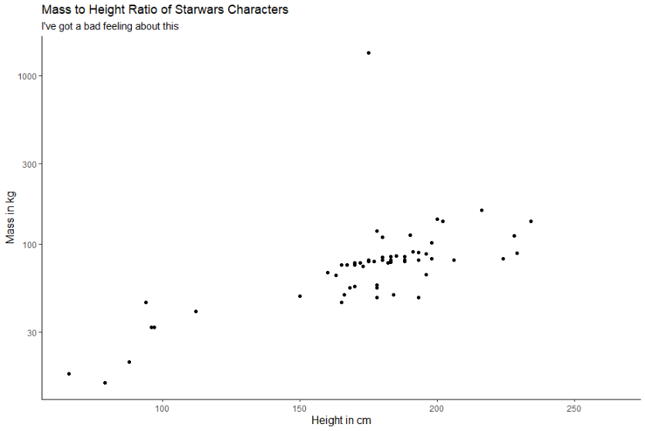
Looks better, can be improved to give more info

Slide 10
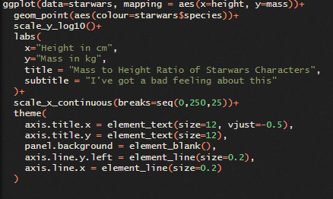
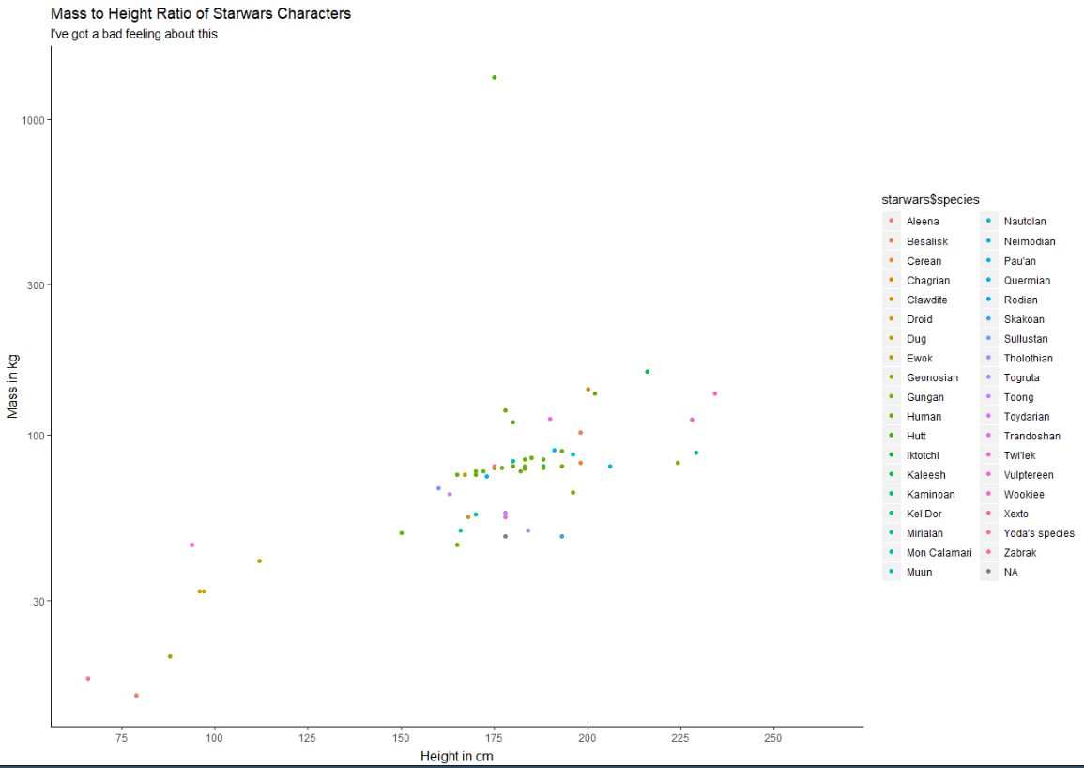

Slide 11
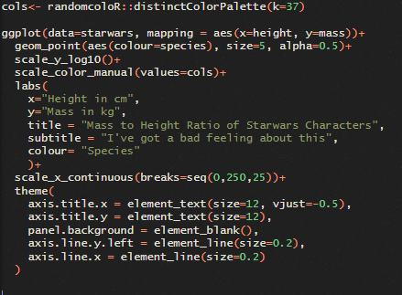
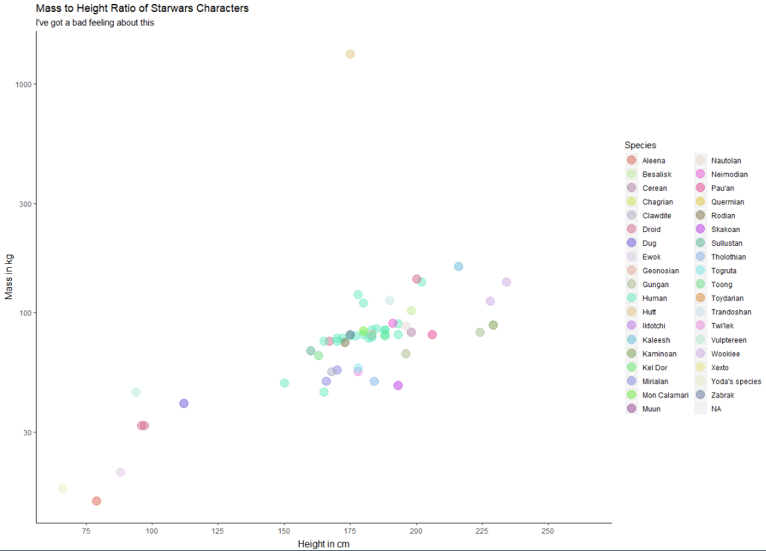
Using a random colour generator here, because we have more than 7 colours – if you have fewer classes, you can use scale_colour_brewer for built in palettes like dark2.
Colours easier to distinguish and have some opacity, so you can see the colour beneath, in the case of overlap.

Slide 12
Let’s go to our absolute and relative water content data.
We want to make:
A bar graph of the RWC values with sd for each tissue type and sampling point
A line graph with the average RWC values and sd for each tissue type and sampling point
A box and whisker plot with the AWC values for each tissue type and sampling point
A violin plot with the AWC values for each tissue type and sampling point

