Slide 1
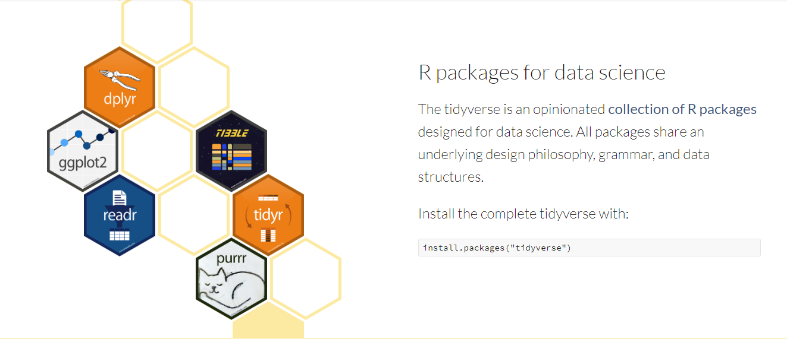
https://www.tidyverse.org/

Slide 2
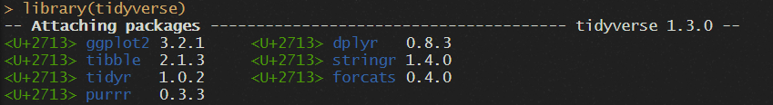
Where to learn more: https://r4ds.had.co.nz/

Slide 3

Where to learn more: https://r4ds.had.co.nz/

Slide 4
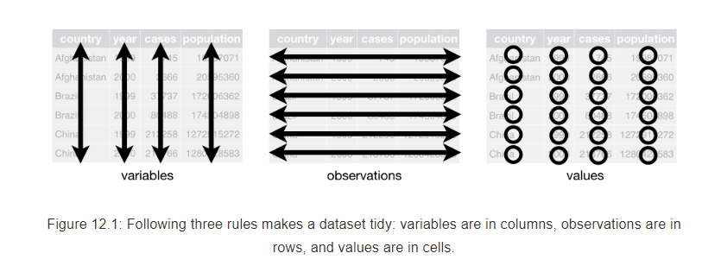

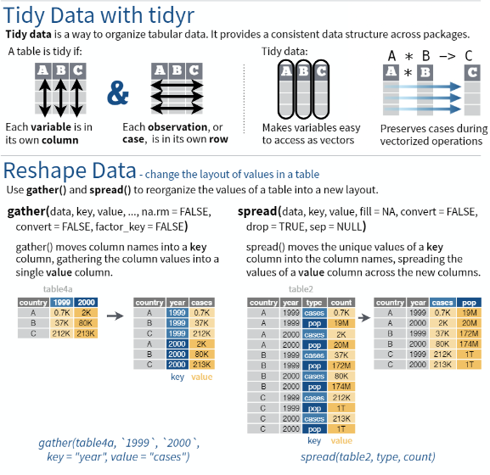
What makes a dataset tidy?
https://r4ds.had.co.nz/

Slide 5
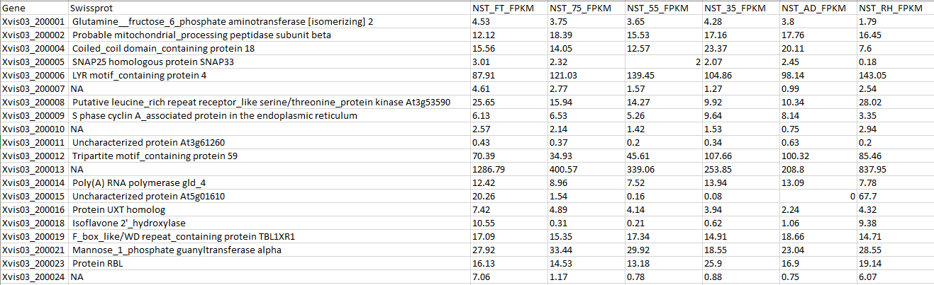
Is this data tidy?
fpkm.csv

Slide 6
For data storage, this is fine, but for doing any kind of plotting with ggplot2 or any summarization, long format is better for use in R.
We need to rearrange this so that it is in long format, not wide format

Slide 7
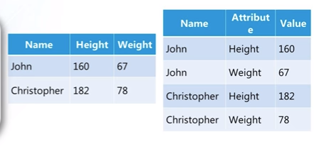
What is long format?
One observation per row

Slide 8
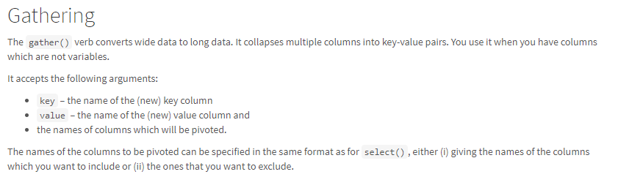
How to do this in R tidyr package
key
value

Slide 9
To exercise 1! Gathering the fpkm data set

Slide 10
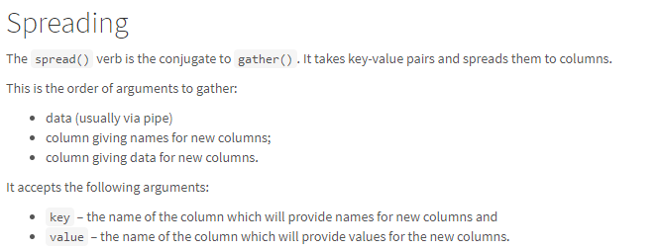

Slide 11
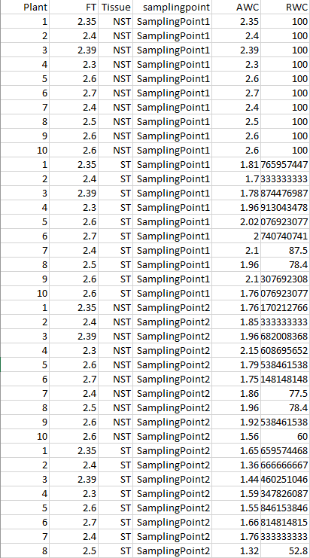
Is this data wide or long?
Long!
Know thy data

