Slide 1
Bilingual
Psychological
Services
English
Español
Team of professionals here to help:
Video Intro
Video Intro
Video Intro
Meet Eugenia
Meet Oscar
Meet Nelida
Map
Call us:
XXX-XXX-XXXX
Insurances accepted.

Slide 2
Bilingual
Psychological
Services
English
Español
Team of professionals here to help:
Video Intro
Video Intro
Video Intro
Meet Eugenia
Meet Oscar
Meet Nelida
Map
Call us:
XXX-XXX-XXXX
Insurances accepted.

Slide 3

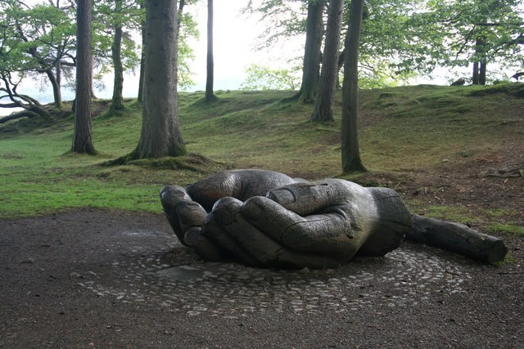


http://www.montanainstitute.com/blog/2014/9/7/helping-others-helps-you
http://www.geograph.org.uk/photo/2406841
http://www.ashleybridget.com/blogs/lifestyle/10354285-helping-others-is-helping-yourself
http://www.livebold.org/helping-others-finish-strong/

Slide 4
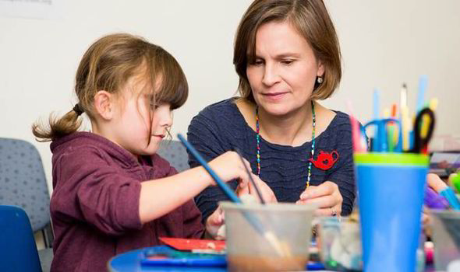
http://www.express.co.uk/life-style/life/462805/Tesco-Mum-Of-The-Year-winner-on-helping-children-cope-with-cancer-through-art-therapy

