Slide 1
Traffic equations
Astrid Langsrud, Håkon Gryvill, Julie Wilberg, William Hornslien

Slide 2

The Equations
${\text{ρ}}_{t}{+(\text{ρ}ν)}_{x}=q\left(t\right)ɸ$(x)
ρ($ν_{t}+νν_{x}$) = $\frac{\text{ρ}}{τ}$ (V($\text{ρ}$) - $ν$) - $c_{0}^{2}{\text{ρ}}_{x}+μν_{xx}$

Slide 3
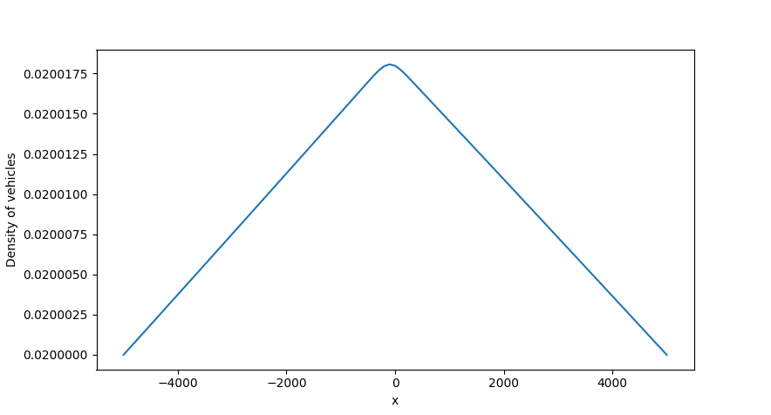
Lax-Friedrichs
Density of vehicles per meter

Slide 4

Lax-Friedrichs
$u_{m}^{n+1}=\frac{u_{m−1}^{n}+u_{m+1}^{n}}{2}−\frac{k}{2h}\left(f_{m+1}^{n}−f_{m−1}^{n}\right)+ks_{j}^{n}$

Slide 6
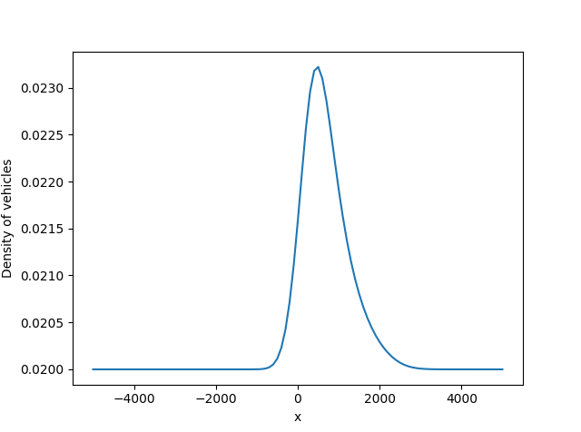
Lax-Wendroff
Density of vehicles per meter

Slide 7

Lax-Wendroff
Analysis
$τ_{m}^{n}$=O($k^{2})+\text{O}{(h}^{2}$)+ O($k h^{2}$)

Slide 8
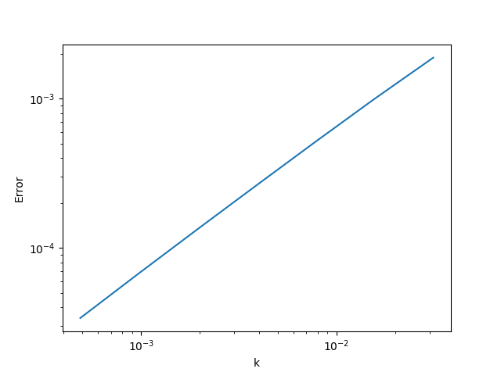
Lax-Wendroff
Convergence plot

Slide 9
References
Lee, H.Y., Lee, H.-W. & Kim, D., (1999), Dynamic states of a continuum traffic equation with on-ramp, Physical Review, 59(5)
Helbing, H., Treiber M., (1999), Simulation of Macroscopic Traffic Equations, Institute of Theoretical Physics, University of Stuttgart

