Slide 1
Traffic equations
Astrid Langsrud, Håkon Gryvill, Julie Wilberg, William Hornslien

Slide 2
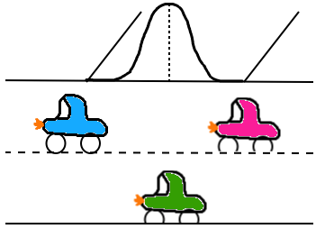

The Equation
1) ${\text{ρ}}_{t}{+(\text{ρ}ν)}_{x}=q\left(t\right)ɸ$(x)
2) ρ($ν_{t}+νν_{x}$) = $\frac{\text{ρ}}{τ}$ (V($\text{ρ}$) - $ν$) - $c_{0}^{2}{\text{ρ}}_{x}+μν_{xx}$
$\text{ρ}$ = density of vehicles
$ν$ = vehicle speed
Notes:
$ɸ$(x) is a normaldistribution
$q\left(t\right)$ is the entry speed of the vehicles

Slide 3

$u_{t}+{f(u)}_{x}=s$($u$)
$u=\left({⍴ \atop ν}\right)$
$f\left(u\right)=\left({⍴ \atop \frac{1}{2}{ ν}^{2}+c_{0}^{2} ln⁡(⍴)}\right)$
$s\left(u\right)=\left({q\left(t\right)ɸ(x) \atop \frac{1}{τ} V\left(⍴\right)−ν}\right)$

Slide 4
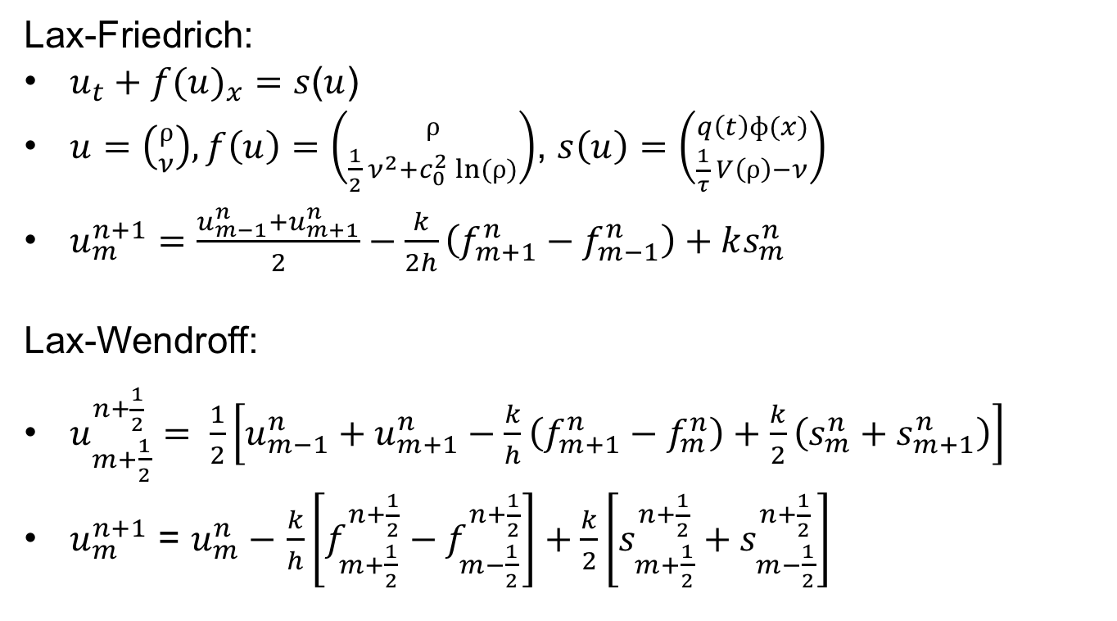
Lax-Friedrich:
$u_{t}+{f(u)}_{x}=s$($u$)
$u=\left({⍴ \atop ν}\right), f\left(u\right)=\left({⍴ \atop \frac{1}{2}{ ν}^{2}+c_{0}^{2} ln⁡(⍴)}\right)$, $s\left(u\right)=\left({q\left(t\right)ɸ(x) \atop \frac{1}{τ} V\left(⍴\right)−ν}\right)$
$u_{m}^{n+1}=\frac{u_{m−1}^{n}+u_{m+1}^{n}}{2}−\frac{k}{2h}\left(f_{m+1}^{n}−f_{m−1}^{n}\right)+ks_{m}^{n}$
Lax-Wendroff:
$u_{m+\frac{1}{2}}^{n+\frac{1}{2}}= \frac{1}{2}\left[u_{m−1}^{n}+u_{m+1}^{n}−\frac{k}{h}\left(f_{m+1}^{n}−f_{m}^{n}\right)+\frac{k}{2}\left(s_{m}^{n}+s_{m+1}^{n}\right)\right]$
$u_{m}^{n+1}$ = $u_{m}^{n}−$ $\frac{k}{h}\left[f_{m+\frac{1}{2}}^{n+\frac{1}{2}}−f_{m−\frac{1}{2}}^{n+\frac{1}{2}}\right]+\frac{k}{2}\left[s_{m+\frac{1}{2}}^{n+\frac{1}{2}}+s_{m−\frac{1}{2}}^{n+\frac{1}{2}}\right]$

Slide 5
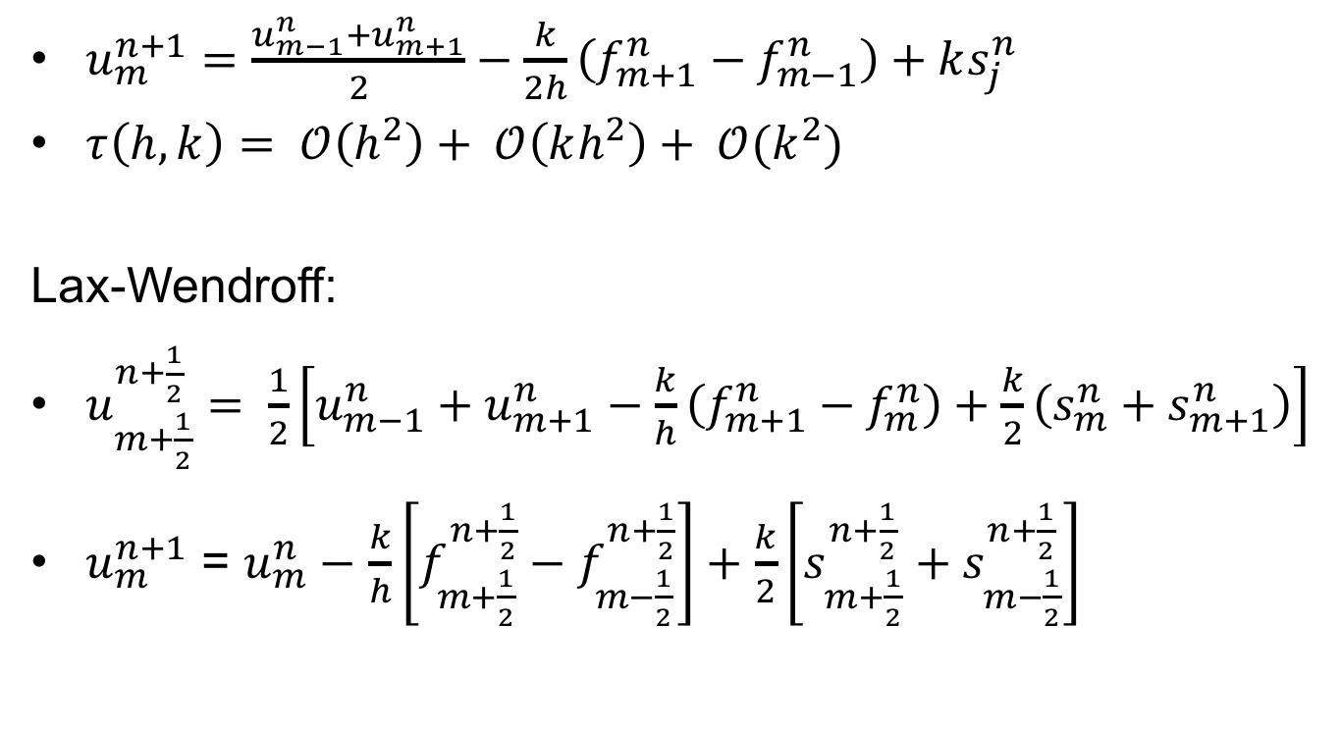
Error Analysis
$u_{m}^{n+1}=\frac{u_{m−1}^{n}+u_{m+1}^{n}}{2}−\frac{k}{2h}\left(f_{m+1}^{n}−f_{m−1}^{n}\right)+ks_{j}^{n}$
$τ\left(h,k\right)= 𝒪\left(h^{2}\right)+ 𝒪\left(kh^{2}\right)+ 𝒪(k^{2})$
Lax-Wendroff:
$u_{m+\frac{1}{2}}^{n+\frac{1}{2}}= \frac{1}{2}\left[u_{m−1}^{n}+u_{m+1}^{n}−\frac{k}{h}\left(f_{m+1}^{n}−f_{m}^{n}\right)+\frac{k}{2}\left(s_{m}^{n}+s_{m+1}^{n}\right)\right]$
$u_{m}^{n+1}$ = $u_{m}^{n}−$ $\frac{k}{h}\left[f_{m+\frac{1}{2}}^{n+\frac{1}{2}}−f_{m−\frac{1}{2}}^{n+\frac{1}{2}}\right]+\frac{k}{2}\left[s_{m+\frac{1}{2}}^{n+\frac{1}{2}}+s_{m−\frac{1}{2}}^{n+\frac{1}{2}}\right]$

Slide 6
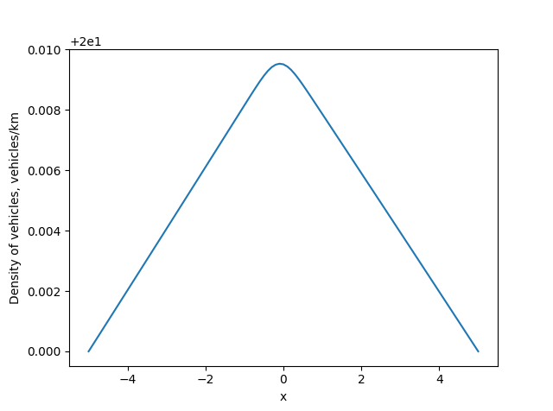
Lax-Friedrichs
Density of vehicles per meter

Slide 7
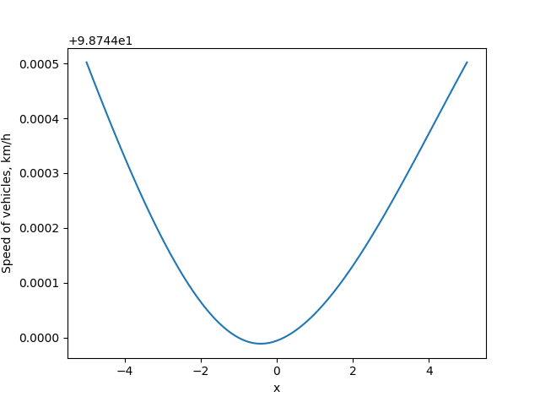
Lax-Friedrichs
Speed of vehicles

Slide 8
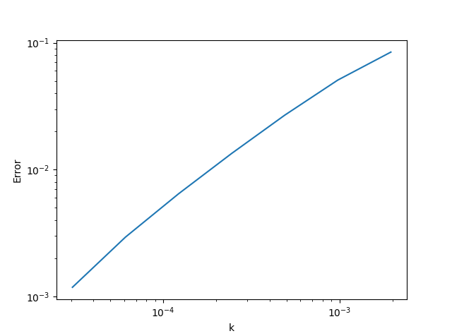
Lax-Friedrichs
Convergence in time

Slide 9
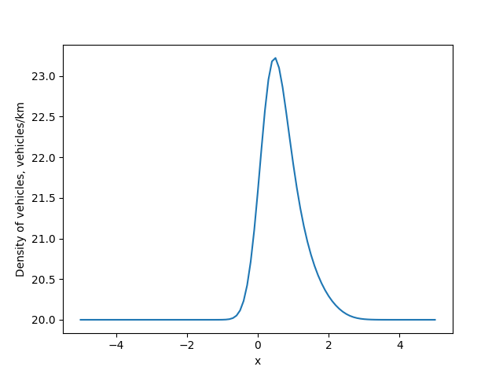
Lax-Wendroff
Density of vehicles per meter

Slide 10
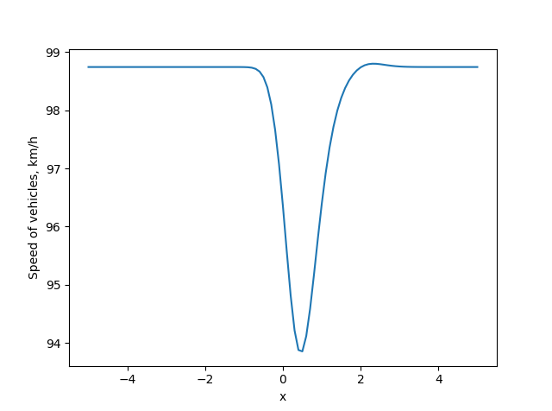
Lax-Wendroff
Speed of vehicles

Slide 11
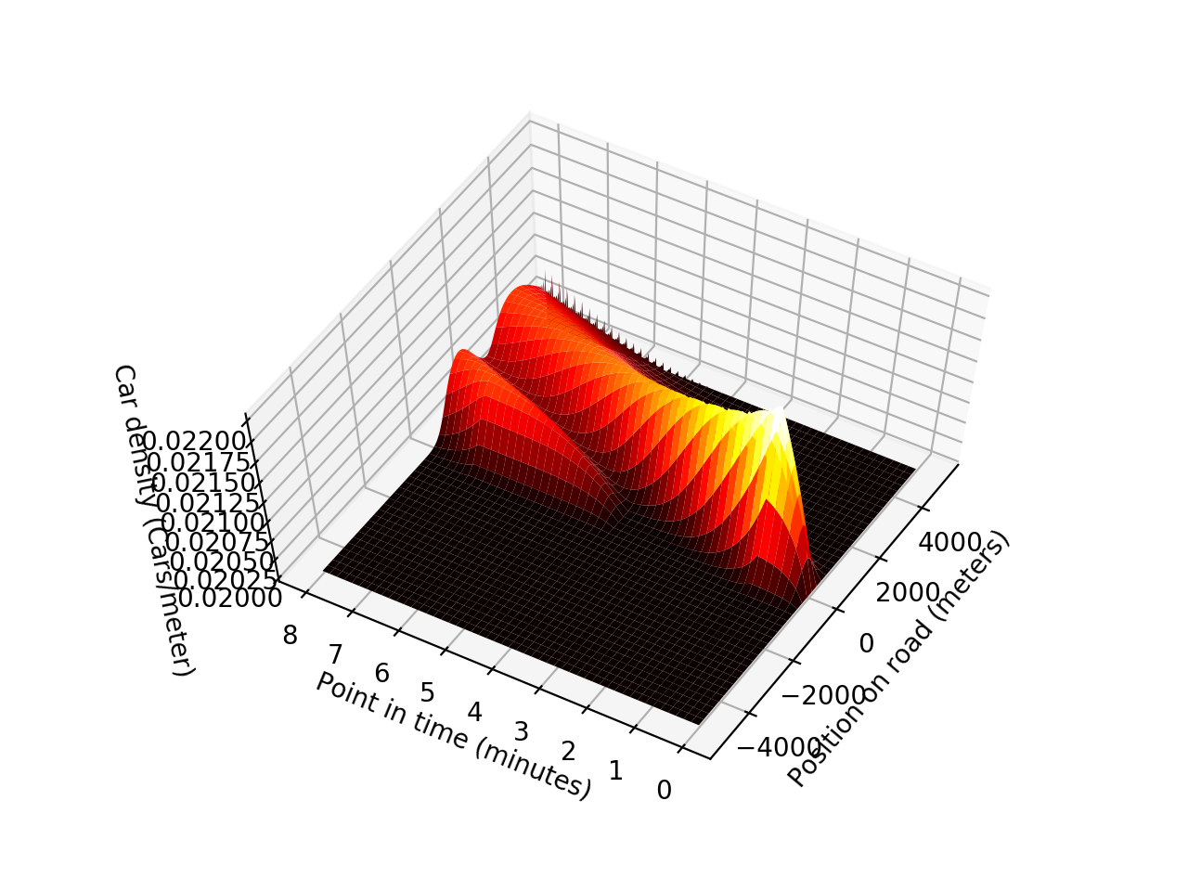
Lax-Wendroff
Density of vehicles in time and space

Slide 12
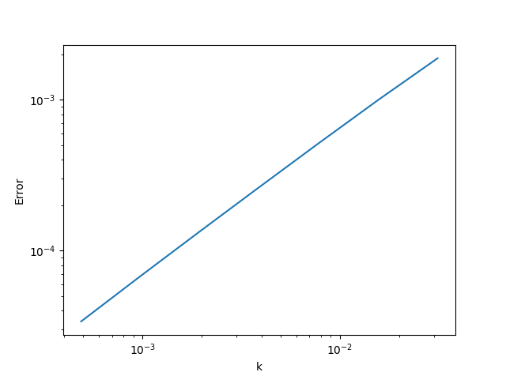
Lax-Wendroff
Convergence in time

Slide 13
Lax-Wendroff
Convergence in space

Slide 14
References
Lee, H.Y., Lee, H.-W. & Kim, D., (1999), Dynamic states of a continuum traffic equation with on-ramp, Physical Review, 59(5)
Helbing, H., Treiber M., (1999), Simulation of Macroscopic Traffic Equations, Institute of Theoretical Physics, University of Stuttgart

