Slide 1
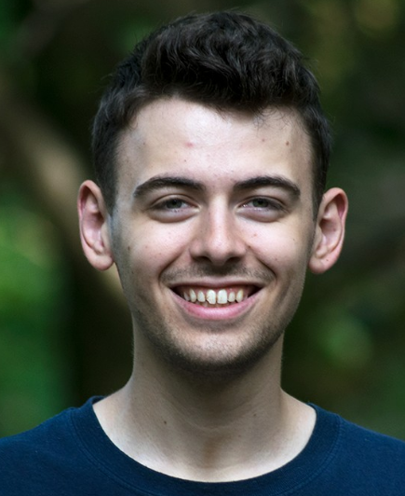
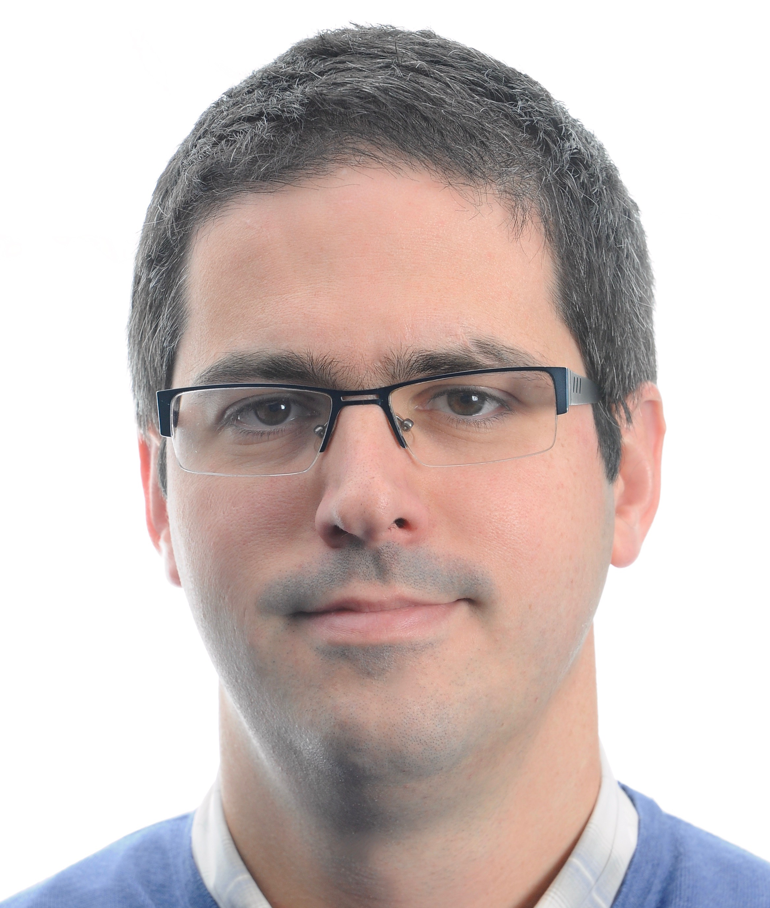
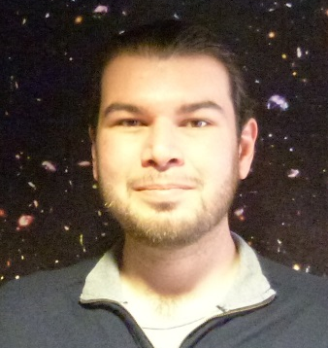
Christian Chapman-Bird: Physics and Astronomy undergraduate student (U. of Glasgow), he was involved in the development of the GWalarm during his summer project of 2019.
Dr. Borja Sorazu: Research Fellow at the Inst. for Gravitational Research (U. of Glasgow), involved with advanced laser interferometry, characterisation and commissioning of the Advanced LIGO and GEO gravitational wave detectors.
Dr. John Veitch: Lecturer at the Inst. for Gravitational Research (U. of Glasgow), involved with the analysis of gravitational waves from compact binaries.

