Slide 1
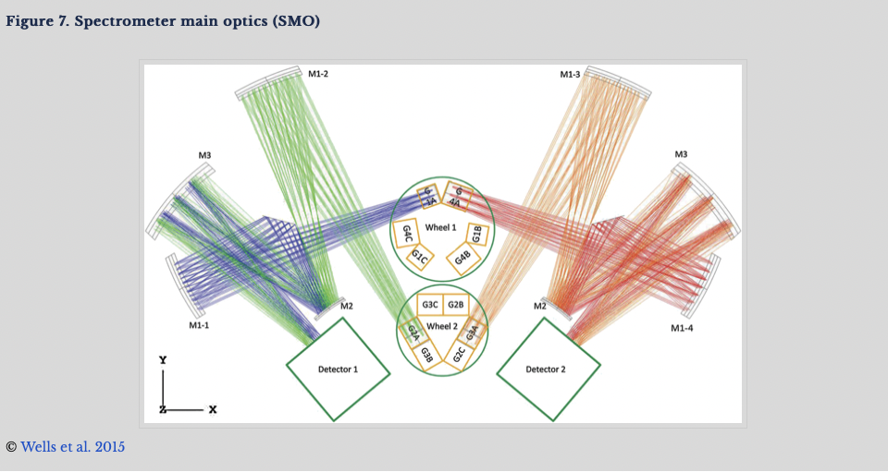
JWST Pipeline Processing of IFU Data
September 25

Slide 2
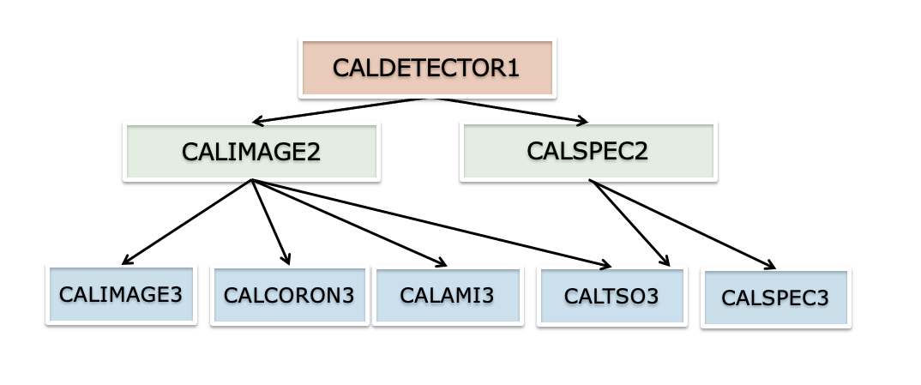
Overall Pipeline Architecture

Slide 3
Overall Pipeline Architecture
Stage 1: Detector-level corrections and ramp fitting for individual exposures
Stage 2: Individual exposures are further processed and calibrated for individual exposures
Stage 3: Combining data from multiple exposures

Slide 4
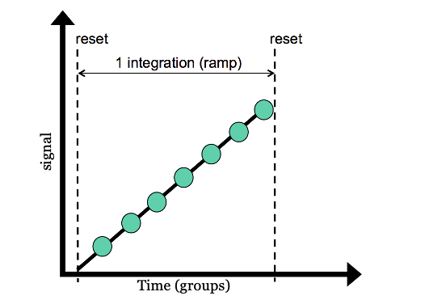
Stage 1: caLDetector 1
Convert raw data into a slope image (units DN/s).
Example steps:
Bad pixel flagging, bias, saturation, linearity, subract dark current, flagging cosmic rays, ramp fitting
NIR detectors have most steps in common.
MIRI has some specific corrections characteristic to SiAs IBC detectors.

Slide 5
Stage 2 for IFU: calspec2 pipeline
Assign WCS – spatial and spectral WCS set up using reference files – this allows us to convert pixel coordinates to sky and wavelength coordinates.
Background Subtraction – subtraction of dedicated background.
Imprint Subtraction – NIRSpec - subtraction of MSA imprint using a dedicated exposures with MSA shutters closed and IFU field-of-view-blocked (essentially a dark)
MSA Failed Open flagging – NIRSpec – Flag the pixels affected by failed open MSA shutters as being contaminated will have higher noise
Point vs Extended Decision- the user can provide point/extended in APT, unknown – extended for IFU. This affects how the path-loss correction and spectral extraction is done.
Straylight Removal – MIRI – subtracting straylight using inter-slice measured signal. Short-wavelength correction up to 2B. Intensity of the stray-light is about 1% of the peak flux for channel 1.
Fringe Flat – MIRI – divide spectral image by a fringe flat (removes fringes for uniform extended source).
Residual Fringe Correction - MIRI MRS additional fringe removal (current skipped by default)
Pathloss Correction – NIRSpec – correction for light loss – caused by beam being larger than the grating size and due to slit apertures (different correction for point source and extended – derived using instrument model)
Flux calibration – conversion to surface brightness. (For MIRI MRS time dependence apply the time-dependent throughput correction, using new reference data)

Slide 6
Stage 3 for IFU data- calspec3 pipeline
Associated data is defined in the ASN file – list members as “science” or “background”
Master Background Subtraction – master background is created using 1 or more 1D extracted background observations defined in ASN file and instrument model. The master 1-D spectrum determined with combine_1d step, this 1-D spectral is projected back to detector space.
Outlier Detection (for IFU data this step is really bad-pixel flagging)
IFU cube creation
Spectral Extraction (for MRS there is an option to subtract 1-D residual fringe correction)

Slide 7
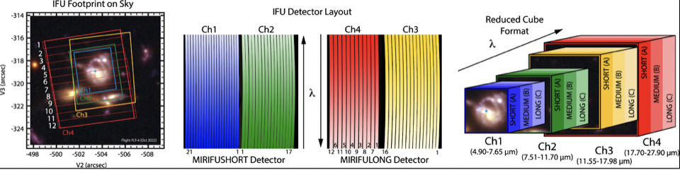
Schematic overview of MRS Cube Building

Slide 8
Spectroscopic Background Subtraction
1. Image-from-image subtraction can be performed by the background step during calwebb_spec2 processing. The background images can come from:
Observations of a dedicated background target
Nodded observations of a point-like science target
2. Subtraction of a “master” background spectrum in calwebb_spec3 where the master background spectrum can come from:
Observations of a dedicated background target
Nodded observations of a point-like science target
Dedicated background slitlets in a NIRSpec MOS exposure
A user-supplied spectrum
3. Local background subtraction for individual spectral can be performed by the extract_1d step when doing 1D spectral extraction.

Slide 9
Details of Each Pipeline step
https://jwst-pipeline.readthedocs.io/en/latest/index.html#
Details of optional parameters (that in general you should try) and options to tweak the pipeline to suit your data needs.

Slide 10
Installing the JWST Pipeline
Instructions https://jwst-pipeline.readthedocs.io/en/latest/
All the software package management for JWST happens via conda. If you do not have it already, install anaconda or miniconda. I recommend miniconda because it is much lighter.
Installing pipeline
For each installation create a fresh environment.
Activate environment
Install the jwst pipeline in the environment
conda create –n <env_name> python
conda activate <env_name>
Pip install jwst

Slide 11
Calibration References Data System (CRDs)
Contains the reference files to calibrate JWST
Assigns the best reference file based on the data
CRDS must be configured by setting two environment variables:
export CRDS_PATH=$HOME/crds_cache
export CRDS_SERVER_URL=https://jwst-crds.stsci.edu
Default reference files are in a database: https://jwst-crds.stsci.edu
First time running pipeline the reference files are downloaded to CRDS_PATH. The pipeline checks if the files are there to determine if it needs to download them or use the files on local machine.
Subscribing to notifications about new reference files: https://jwst-docs.stsci.edu/jwst-science-calibration-pipeline-overview/jwst-data-calibration-reference-files

Slide 12
Operational JWST Builds
The JWST calibration pipeline is used by MAST to calibration the JWST data. The operational pipeline is updated on a regular basis (about every 3 months).
Reference files in CRDS are updated as needed.
A good resource: JWST Calibration Pipeline Caveats https://jwst-docs.stsci.edu/jwst-calibration-pipeline-caveats

