Slide 1
Digest of ALMA Cycle 11 Proposer’s guide
EURECA meeting, Fengwu Sun
https://almascience.nrao.edu/documents-and-tools/cycle11/alma-proposers-guide

Slide 2
Important Timeline of ALMA Cycle-11
21 March 2024 | Release of Cycle 11 CfP, Observing Tool, and supporting documents, and opening of the Archive for proposal submission
25 April 2024 (15:00 UT; 8AM Tucson) | Proposal submission deadline for Cycle 11 proposals
5 June 2024 (15:00 UT; 8AM Tucson) | Deadline to submit reviews for the distributed peer review system
August 2024 | Announcement of the outcome of the proposal review process
1 October 2024 | Start of ALMA Cycle 11 science observations (anticipated)
30 September 2025 | End of ALMA Cycle 11

Slide 3
Cycle-11: Relevant New Capabilities
Band 1 on 12-m array with full polarization (previously only Stokes I);
Band-1: 35 – 50 GHz, high-z CO?
note that ALMA Band-1 sensitivity is not significantly better than JVLA in Ka band.
Band 1 on the 7-m array with Stokes I (previously no band 1);
High-frequency Long-baseline observations (Band 9 with C-10, Band 10 with C-9/C-10);
Long baselines (C9, C-10) are only offered once per two years
4x4-bit spectral model on 7-m (previously only on 12-m);
Slightly enhanced emission-line sensitivity with 7-m array

Slide 4
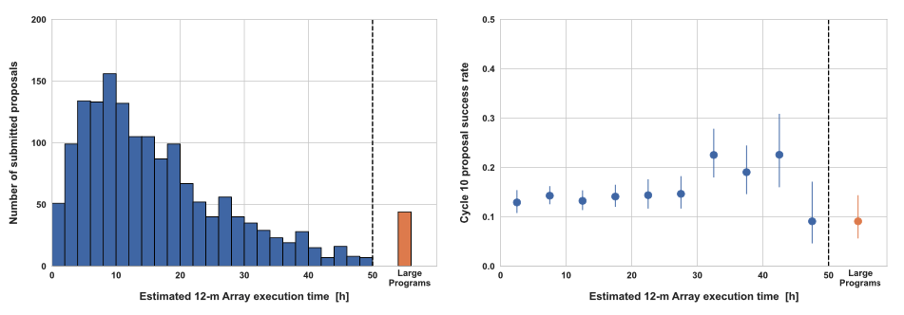
Proposal format & Category
Regular proposals (<50 hr with 12-m; <150-hr with 7-m);
If you PI one, you (or your co-I) will review 10 proposals -> ”distributed peer review”
No one is allowed to review more than 5 sets; I did 3-4 sets over the past two cycles;

Slide 5
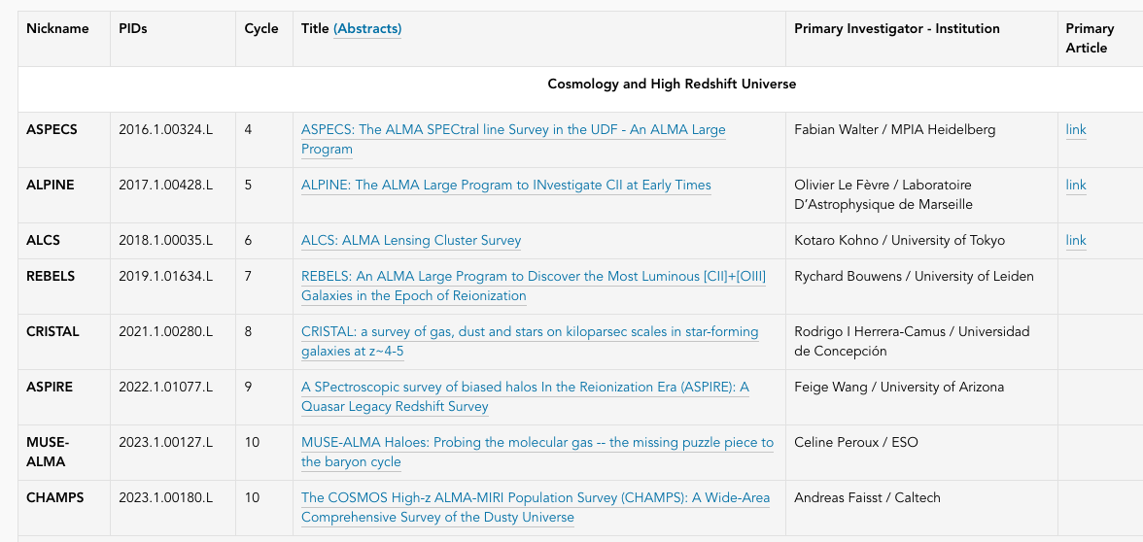
Proposal format & Category
Large Programs (≥50 hours with 12-m; ≥150 hours with 7-m)
Typically 1 acceptance per year;
7 pages SJ + Management plan (anonymous), plus an expertise statement; Justify scheduling feasibility

Slide 6
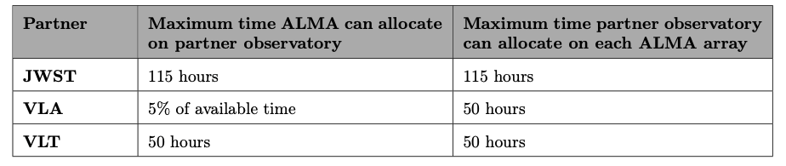
Proposal format & Category
For ALMA joint JWST, you will need to write:
Short JWST scientific justification in 4-page ALMA scientific justification pdf;
JWST technical justification to put in ALMA OT
JWST APT file & Extended Justification to submit to STScI (within 4 weeks from ALMA deadline);
I was on a Cycle-10 ALMA joint JWST (PI: Fujimoto) and it went through. The JWST scientific justification was short (7 lines) and reviewers didn’t attack much on that. However, there are existing JWST imaging / IFU data for the target, and the JWST request (very small) is clearly not the main focus of the proposal. Public JWST pdf: https://www.stsci.edu/jwst/phase2-public/4573.pdf

Slide 7
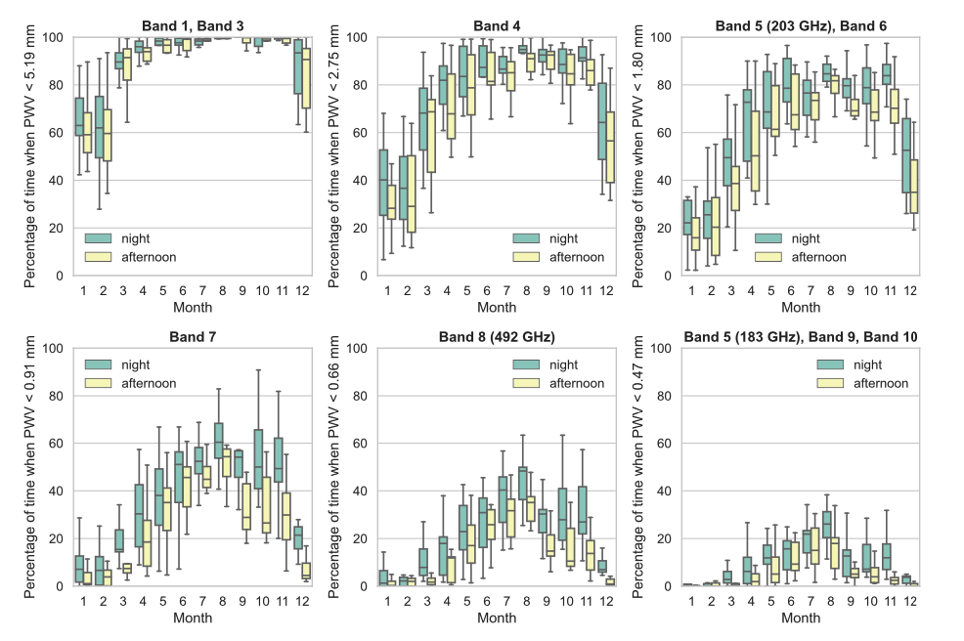
Observing Pressure
easier to observe at lower frequency
harder to observe at higher frequency

Slide 8
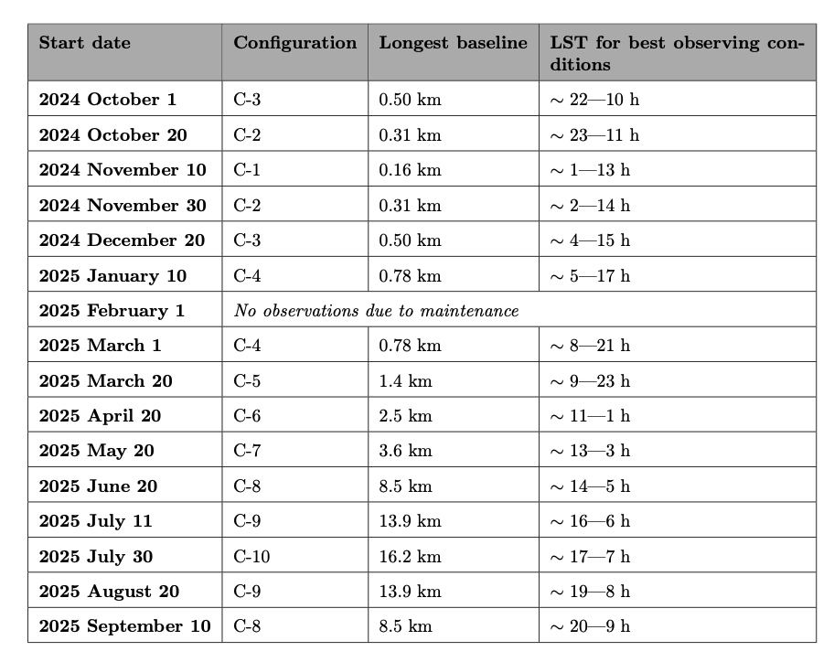
Observing Pressure
 | high-frequency | low frequency
high-resolution | bad | bad
low-resolution | bad | good
 | high-frequency | low frequency
high-resolution | good | good
low-resolution | bad | bad
Always bad for low-resolution high-frequency observation this cycle. Check Fig-5 in the proposer’s guide.

Slide 9
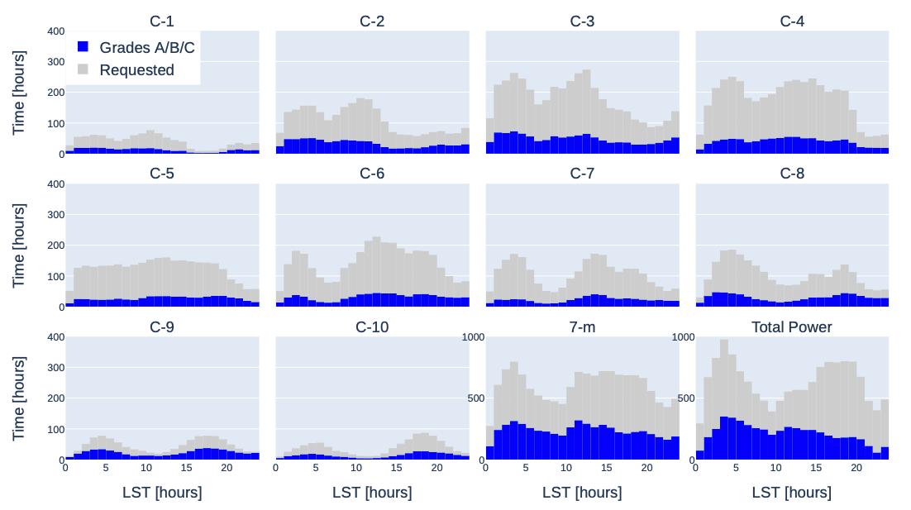
Observing Pressure
Cycle-9 Executed Time Summary (similar configuration schedule as Cycle-11)
UDS
CFDS
COSMOS
taurus
GC
Seems like C-9/10 time is not too over-subscribed?

Slide 10
ALMA Distributed Peer Review (DPR) and proposal preparation
EURECAA meeting edition, Fengwu Sun
Slide Deck From Proposal Handling Team (February 17, 2022)
Update from https://almascience.nrao.edu/proposing/alma-proposal-review
Check their webinars on May 9 – 14

Slide 11



Basics of distributed peer review
Every* proposal team nominates one person to be a reviewer
Proposal Handling Team (PHT) assigns 10 proposals to the reviewer
Reviewer ranks and write comments for each proposal
* Excluding Large Programs

Slide 12
Reviewer timeline for Cycle 11
April 25
Proposal deadline
Proposal PI designates the reviewer in Observing Tool (OT)
April 30
Expertise & conflicts
Reviewer specify scientific expertise in User Profile
Reviewer provide list of conflicts of interest in User Profile
May 4 - June 5
Stage 1
Declare any conflicts of interest in assigned proposals by May 15
Complete reviews by June 5 @ 15 UT (MANDATORY!)
June 6 – 20
Stage 2
Read reviews from other reviewers (optional)
Modify your ranks and comments as needed (optional)

Slide 13
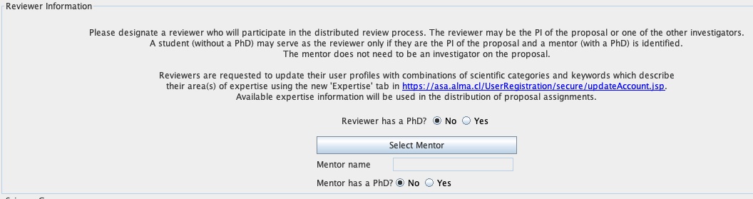

PI designates the reviewer
April 25
Proposal deadline
Proposal PI designates the reviewer in Observing Tool (OT)
Student PIs can be reviewers, but need to specify a mentor who will assist in the review.

Slide 14
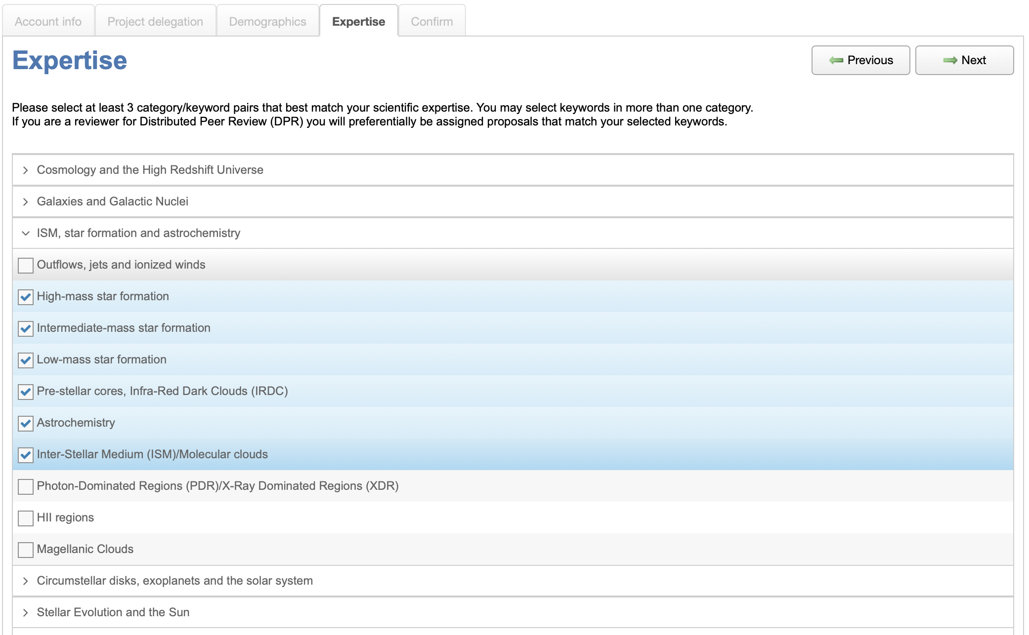
Reviewer expertise
April 30
Expertise & conflicts
Reviewer specify scientific expertise in User Profile
Reviewer provide list of conflicts of interest in User Profile
Log in to the ALMA Science Portal
Edit your User Profile
Go to the Expertise tab
Select keywords that match your scientific expertise
Go to the Confirm tab to save

Slide 15
How the PHT uses keywords to assign proposals
Priority #1
Assign proposals with the same keyword as the reviewer’s selected keywords.
Priority #2
Assign proposals in the same scientific category as the reviewer’s expertise.
Priority #3
Assign proposals in other scientific categories.
If a reviewer does not specify their expertise, the keywords of their proposal will be used.

Slide 16
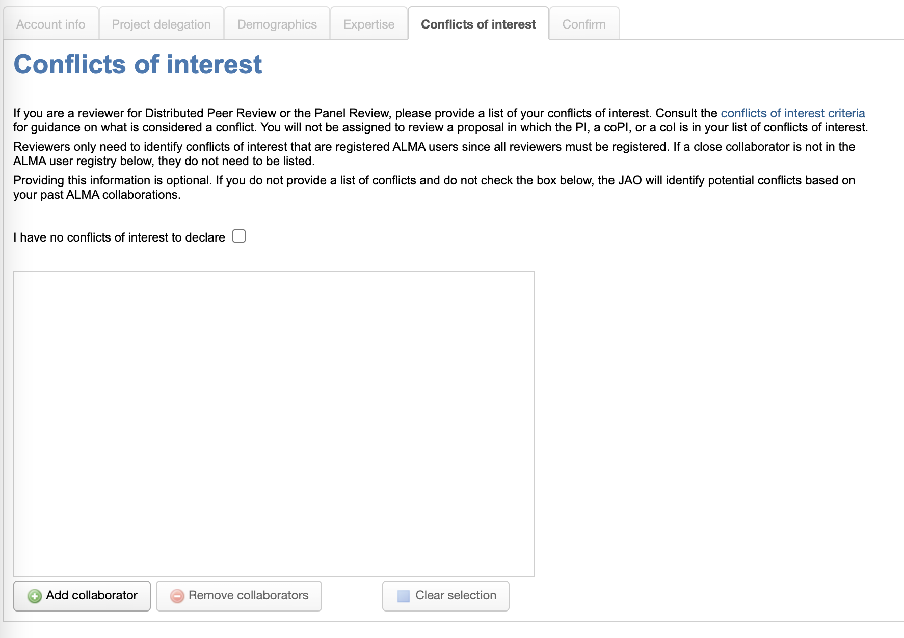
Reviewers can specify their conflicts of interest
April 30
Expertise & conflicts
Reviewer specify scientific expertise in User Profile
Reviewer provide list of conflicts of interest in User Profile
Log in to the ALMA Science Portal
Edit your User Profile
Go to the Conflicts of Interest tab
Identify ALMA users for which you have a conflict
Go to the Confirm tab to save

Slide 17
What is considered a conflict of interest?
In general, a reviewer has a major conflict of interest when their personal or work interests would benefit if the proposal under review is accepted or rejected.
Close collaborators, which are defined as a substantial collaboration on three or more papers within the past three years or an active, substantial collaboration on a current project. Co-membership in a large team on its own does not constitute a conflict of interest.
Students and postdocs under supervision of the reviewer within the past three years
A reviewer’s supervisor (for student and postdoc reviewers)
Close personal ties (e.g., family member, partner) that are ALMA users
Any other reason in which a reviewer believes a major conflict of interest exists
If a reviewer does not provide their conflicts, the PHT will determine conflicts based on the reviewer’s proposal history for the past three cycles.

Slide 18

How does the PHT use the conflicts of interest?
The PHT will not assign reviewers a proposal in which a PI, co-PI, or co-I is in their list of conflicts of interest.
Reviewers can also declare conflicts of interest when they receive their proposal assignments.

Slide 19

Stage 1: Review assigned proposals
May 4 - June 5
Stage 1
Declare any conflicts of interest in assigned proposals by May 15
Complete reviews by June 5 @ 15 UT (MANDATORY!)
Declare any additional conflicts in your assigned proposals
for example: observing the same object(s) with the same goals
If you identify a conflict after you submitted your conflicts, contact the PHT to be assigned another proposal.

Slide 20



Stage 1: Review assigned proposals
May 4 - June 5
Stage 1
Declare any conflicts of interest in assigned proposals by May 15
Complete reviews by June 5 @ 15 UT (MANDATORY!)
Rank the proposals from 1 (strongest) to 10 (weakest) based on scientific merit.
Write comments that summarize the strengths and weaknesses of the proposal
Comments will be sent to the PI verbatim.
Reviewer’s proposal will be canceled if the reviews are not submitted on time!
Extensions will not be granted since Stage 2 starts on June 5.
The reviewer can be changed after the proposal deadline in exceptional circumstances by having the proposal PI contact the PHT. The Stage 1 deadline though will remain the same.

Slide 21


Stage 2: Finalize the ranks and reviews
June 6 – 20
Stage 2
Read reviews from other reviewers (optional)
Modify your ranks and comments as needed (optional)
Read comments from the other reviewers to see if you overlooked any critical strengths or weaknesses.
Update your ranks and comments as needed.
Stage 2 is optional. If a reviewer does not complete Stage 2, the Stage 1 ranks/comments are considered final.

Slide 22
Reviewing proposals
Review criteria
Tips for reviewing proposals
Writing comments for PIs
Extensive guidance available on the ALMA Science Portal (Proposing => ALMA Proposal Review).

Slide 23


Proposal components
Abstract
Scientific Justification
Technical Justification
All three components are important and should be read by the reviewers.

Slide 24

Review criteria
Overall scientific merit
Does the proposal clearly indicate which important, outstanding questions will be addressed?
Will the proposed observations have a high scientific impact on this particular field and address the specific science goals of the proposal?
Does the proposal clearly describe how the data will be analyzed in order to achieve the science goals?
Suitability of the observations to achieve the scientific goals
Is the choice of target (or targets) clearly described and well justified?
Are the requested signal-to-noise ratio, angular resolution, largest angular scale, and spectral setup sufficient to achieve the science goals?
Does the proposal justify why new observations are needed to achieve the goals?

Slide 25


Technical Justification
ALMA Observing Tool
Observing Tool performs (most) technical validations
reviewers can assume requested sensitivity, angular resolution, largest angular scale, and correlator setup are valid and can be achieved technically.
Reviewers should evaluate if setup is sufficient to achieve science goals.
Sensitivity
Correlator setup
Largest angular scale
Angular resolution
The proposal is responsible for clearly justifying the setup with references as appropriate.

Slide 26
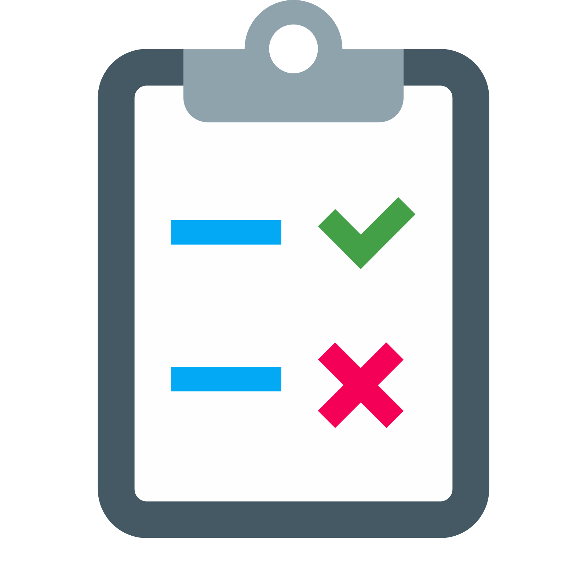

Best practices for writing reviews
Summarize both strengths and weaknesses
Take care to ensure strengths and weaknesses do not contradict each other
Avoid giving the impression a minor weakness was the cause of a poor ranking
A proposal review is NOT just a summary of the proposal
While the reviewer may include a BRIEF (~ 1 sentence) summary, the bulk of the contents need to discuss the strengths and weaknesses of the proposal

Slide 27


Best practices for writing reviews
Use complete sentences when writing the comments.
Be concise
It is not necessary to write a lengthy review, but avoid writing a single sentence

Slide 28


Best practices for writing reviews
Be specific as possible when writing reviews
Avoid generic statements that could apply to most proposals
Do not ask questions in your review
Questions usually indicate a proposal weakness - state the weakness directly

Slide 29


Best practices for writing reviews
Be professional and constructive
Do not use sarcasm or any insulting language
Critique the proposal and not the PI or the proposal team
Be aware of unconscious bias
Keep your review factual and objective as possible

Slide 30
Example review
Jets and outflows have been shown to be a common phenomenon during the protostellar phase, but details about the exact mechanism in the type of source proposed here are not fully known. The proposed target is very well justified and given its proximity, will provide excellent spatial resolution to study the structure of the outflow. The observations and analysis described will shed light on the physics of jet launching and accretion, leading to a better understanding of the evolution of this type of source.
However, the proposal did not adequately explain how the proposed observations will test whether the observed phenomenon is a result of the particular outflow launching mechanism or other scenarios discussed in the proposal. Also, the proposal did not adequately explain why the requested number of molecular transitions are needed for the proposed excitation analysis, compared with the pros and cons of instead observing fewer or different transitions.
Brief summary of proposal
Strengths specific to the proposal
Weaknesses specific to the proposal
Comments should indicate the strengths/weaknesses of the proposal, not the PI or the proposal team.

Slide 31
Everyone can write helpful reviews!
Students and young postdocs write just as helpful reviews as more experienced astronomers.

Slide 32
How many proposals set can I review?
The PHT recommends to review 3 Proposal Sets or less to keep workload manageable. PIs can delegate their review assignments to a coI in the Observing Tool.

Slide 33
How many proposals set can I review?
You should plan to spend about 1 working day to review one proposal set (= 10 proposals).

Slide 34
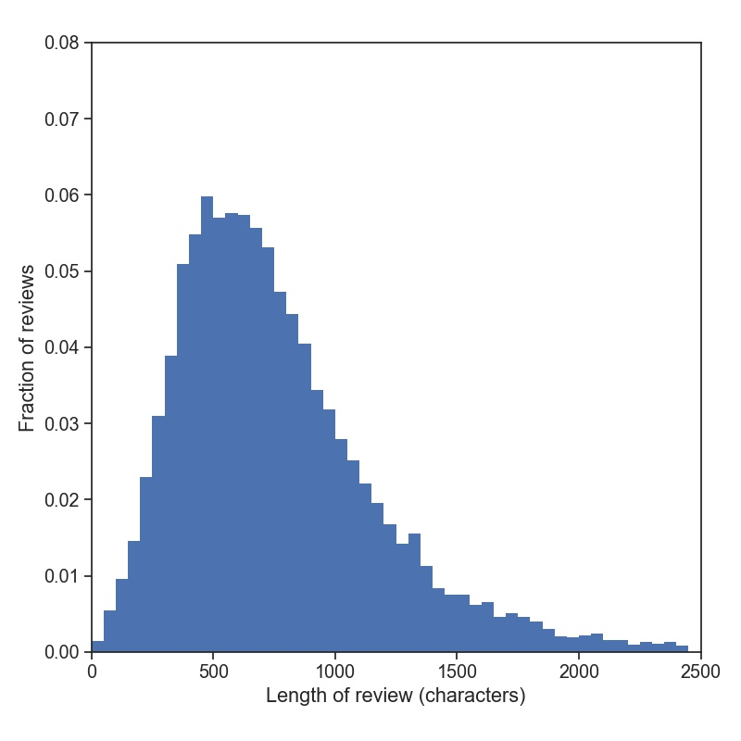
Length of review
Length of reviews in Cycle 8
Typical length of a review is ~700 characters, or about 6 sentences.
You should plan to spend about 1 working day to review one proposal set (= 10 proposals).

Slide 35
Summary
ALMA distributed peer review
Actions to take before and right after the proposal deadline:
Designate a reviewer
Reviewers update their profile information
Stage 1 --> Rank and write comments --> Mandatory
Stage 2 --> Update ranks and comments Optional
The work of the reviewer
Reviewers take into account all componentes of the proposal, looking the scientific merit and suitability of the observation
Lessons from Cycle 8
Everyone can write helpful reviews
Workload matters -->
Reviewer should expect to spend 1-2 work days per proposal set
No more than 3 Proposal Sets

Slide 36
Summary
More information
https://almascience.nrao.edu/proposing/alma-proposal-review
Dual-anonymous guidelines
Description of the distributed peer review
Detailed guidelines for the reviewers
FAQ

Slide 37

Questions?
Thank you!

Slide 38




Goal of presentation
What to expect from distributed peer review
Guidelines to reviewing proposals
Best practices for distributed peer review

