Slide 1
CSCE 313 Unix Threads MP7 DUE: FRI APR 21, 2017
Wei Zhang
Acknowledgment: Yi Cui, Wei Zhang, Prof. Tanzir Ahmed, CSCE-313

Slide 2
MP 6: Recap
Client creates 3 threads
Generate 3n DATA in the buffer, each thread generate one type of data.
Run concurrently
Feed the data to the buffer, handle race condition!
Then creates w worker threads
Each thread creates its own data channel
Run concurrently
Retrieve data form the buffer
Send the data to the server, handle race condition!

Slide 3
MP6: recap
Handle race condition
w worker threads retrieve and send
Data channel 1
3 threads
gen DATA
DATA
DATA
REP
Data channel 2
REP
Client
BUF
Data
Server
DATA
DATA
REP
Data channel w
REP
…
DATA
DATA
Handle race condition
REP
REP

Slide 4
MP 6 Limitations
Limitation #1: Fill the buffer first (with 3 threads), then drain the buffer (using w threads)
FIX: Can fill and drain happen simultaneously?
Data channel 1
drain
fill
DATA
DATA
REP
Data channel 2
REP
Client
BUF
Data
Server
DATA
DATA
REP
Data channel w
REP
…
DATA
DATA
REP
REP

Slide 5
MP 6 Limitations
Limitation #2: The buffer can be infinite in MP5
We have no idea how many data a user can generate
FIX: Can we limit the size of the buffer?
BUF

Slide 6
MP 6 Limitations
Limitation #3: Poor modularity for worker threads
Two distinct roles – (a) interact with server and (b) create stats.
FIX: Can we devise a scheme to separate these two roles?
BUF
WORKERS
STATISTAS

Slide 7
NET: What’s new in MP7 relative to MP6?
Request threads can now run concurrently with worker threads
Request Buffer is BOUNDED
Worker Threads record server responses in a BOUNDED Response Buffer
Statistics Threads run concurrently with Worker threads and compile frequency counts from entries in the Response Buffer

Slide 8
MP7 Structure
Requests from John, Jane, and Joe are mixed into one request buffer
Workers obtain responses from data server and send them to three separate buffers
Each person has a dedicated stats thread
Req thread john
Worker 1
Response john
Stats thread john
Req thread jane
Request buffer
…
Response jane
Stats thread jane
Req thread joe
Bounded buffer
Worker w
Response joe
Stats thread joe
Request threads
Worker threads
Bounded buffer
Stats threads

Slide 9
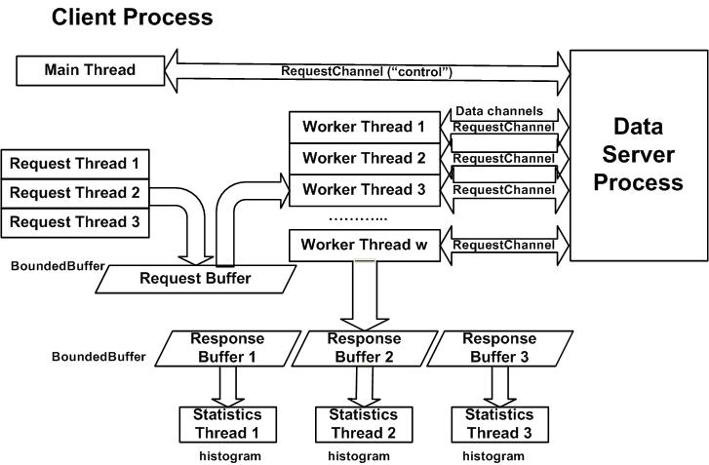
Another look at MP7 Structure

Slide 10
MP7 – Tangibles of the Assignment
dataserver.cpp, reqchannel.h, reqchannel.cpp, and makefile are already done for you
Your task
Implement bounded buffer, semaphore classes and client functions in accordance with the requirements published in the “Assignment” section of MP7_handout.pdf available here.
In addition, write a report with three key sections:
Performance Evaluation (especially relative to MP6)
Graph the runtime of your client program
execution time versus the number of worker threads (i.e. w)
execution time versus the size of request buffer (i.e. b)
Commentary on your client program performance in context of the system you ran it on

Slide 11
Key Reminders
Make sure to take note of the specific DON’T(s) mentioned on pp. 4 of MP7_handout.pdf available here.
Take note of the operations of Semaphore and Bounded Buffer classes mentioned on pp. 4-5 of MP7_handout.pdf available here.
Consider taking advantage of the BONUS points opportunity mentioned on pp. 5-6 of MP7_handout.pdf available here.
Read the rubrics carefully! They are listed on the last page pp. 7 of MP7_handout.pdf available here.

Slide 12
USEFUL BACKGROUND MATERIAL

Slide 13
Producer-Consumer
A classical yet powerful multi-thread programming framework
Three parts: producers, consumers, and a bounded buffer
Simple and efficient: producers and consumers don’t need to talk to each other, they both interact with the queue
producer
consumer
bounded buffer
FIFO queue
…
…
producer
consumer

Slide 14
Bounded Buffer
In MP4, we do not set any bounds on queue size, which may lead to two problems
Overflow: the queue size can grow to infinity (limited by RAM size)
Underflow: consumers may attempt to pop an empty queue
To solve the problems, we introduce bounded buffers
The queue size S is bounded by K. When S = K, producers must wait for consumers; when S = 0, consumers must wait for producers
Use semaphores to control the queue size

Slide 15
Semaphore
You can simply view a semaphore as a counter
When a thread calls sem.p()
Decrease the counter value C
If C >= 0, it can pass; otherwise, it is blocked, i.e., the maximum allowed number has been reached
When a thread calls sem.v()
Increase the counter value C
If C <= 0, release a blocked thread

Slide 16
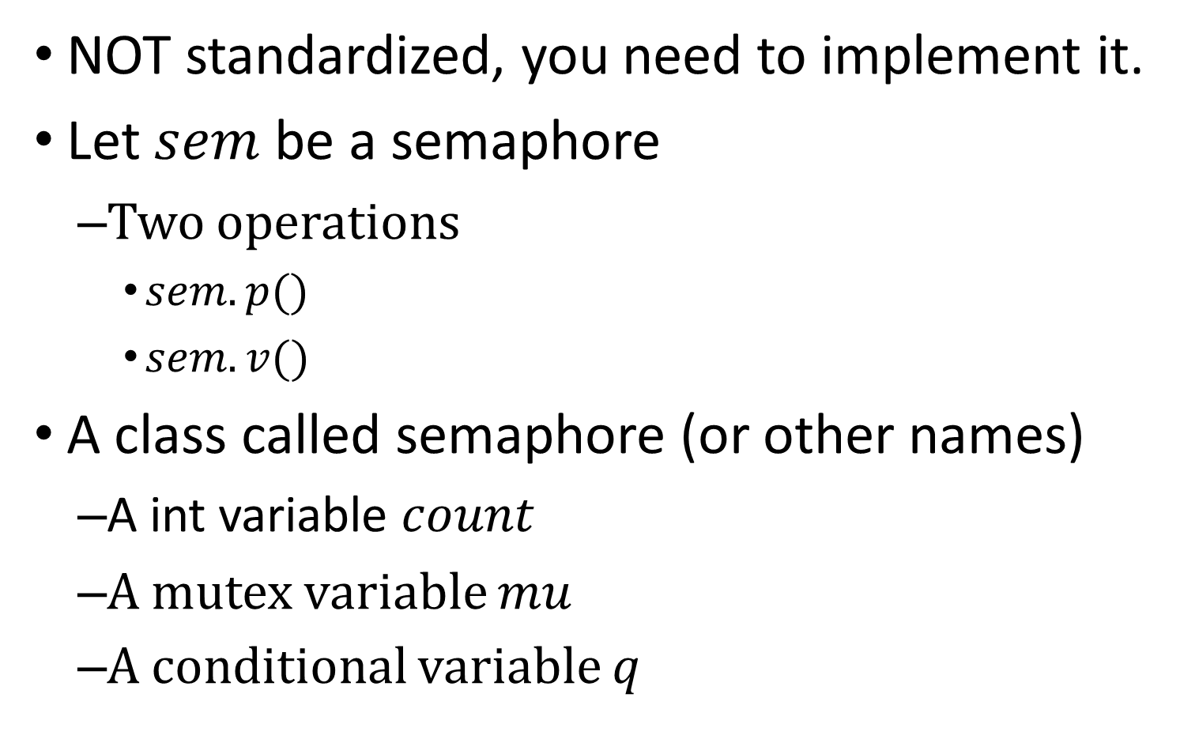
Semaphore - Example
NOT standardized, you need to implement it.
Let $sem$ be a semaphore
Two operations
$sem.p()$
$sem.v()$
A class called semaphore (or other names)
A int variable $count$
A mutex variable $mu$
A conditional variable $q$

Slide 17


$p()$ implementation - Example
$sem.p()$
$mu.lock()$
$count−−$
$mutex.unlock()$
sem.p()
{
mu.lock();
count--;
if (count<0) {
cond_wait(&q,&mu)
}
mu.unlock();
}

Slide 18

$v()$ implementation - Example
$sem.p()$
$mu.lock()$
$count−−$
$mutex.unlock()$
sem.v()
{
mu.lock();
count++;
if (count<=0) {//if Q is empty
cond_signal(&q);
}
mu.unlock();
}

Slide 19
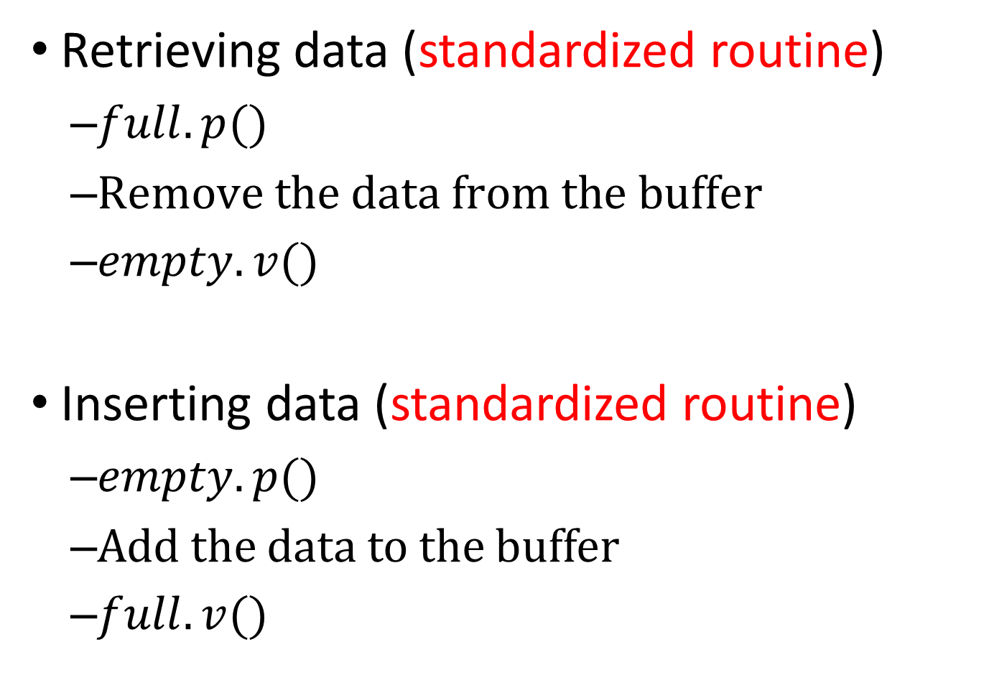
Use semaphore
Retrieving data (standardized routine)
$full.p()$
$\text{Remove} \text{the} \text{data} \text{from} \text{the} \text{buffer}$
$empty.v()$
Inserting data (standardized routine)
$empty.p()$
Add the data to the buffer
$full.v()$

Slide 20
Producer-Consumer Implementation
A standard approach
Two semaphores full and empty, which count the number of items and empty slots in the queue
empty initialized to buffer capacity, full initialized to 0
A mutex m to control concurrency on queue operations
Producer() {
while (true) {
// decrease the counter of empty slots
empty.p();
m.lock();
add one item to the queue
m.unlock();
// increase the counter of items
full.v();
}
}
Consumer() {
while (true) {
// decrease the counter of items
full.p();
m.lock();
pop one item from the queue
m.unlock();
// increase the counter of empty slots
empty.v();
}
}

Slide 21
Concurrency Control
In the consumers perspective, assume there are currently 3 items in the queue (semaphore full = 3)
Each consumer that reaches the queue must be able to find one item to consume
…
100 threads arrive
semaphore full = 3
3 threads pass semaphore
mutex
1 thread passes mutex and reach the queue
FIFO queue (S = 3)

Slide 22
Parting Reminder ☺
3 request threads
1 bounded buffer for requests
The w worker threads convey requests to the dataserver
Request threads = 3
w worker threads
Bounded buffer
Data
Server
Data
Server
…
…
Semaphore to sync

Slide 23
Parting Reminder ☺
3 statistics threads
Draw histogram
3 bounded buffers for response reception
The w worker threads put the corresponding responses to the right buffer
Statistics threads = 3
3 bounded buffers for response
w worker threads
get the response
Data
Server
Data
Server
…
…
Draw histogram
Semaphore to sync

